Slide 1
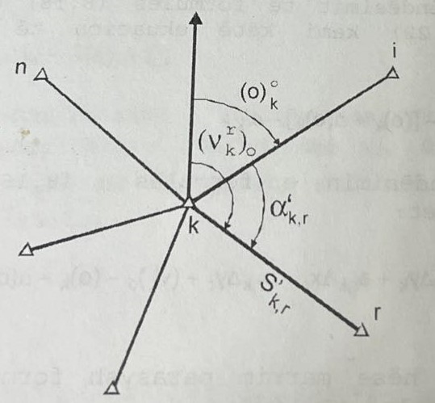
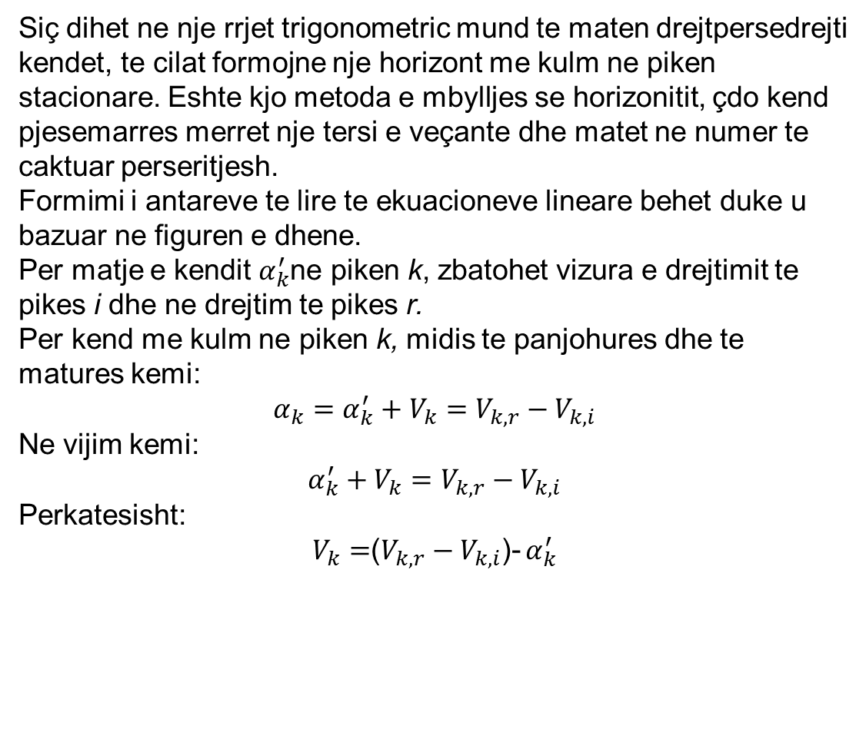
Formimi I ekuacioneve lineare dhe antareve te lire per kende
Siç dihet ne nje rrjet trigonometric mund te maten drejtpersedrejti kendet, te cilat formojne nje horizont me kulm ne piken stacionare. Eshte kjo metoda e mbylljes se horizonitit, çdo kend pjesemarres merret nje tersi e veçante dhe matet ne numer te caktuar perseritjesh.
Formimi i antareve te lire te ekuacioneve lineare behet duke u bazuar ne figuren e dhene.
Per matje e kendit $α_{k}^{′}$ne piken k, zbatohet vizura e drejtimit te pikes i dhe ne drejtim te pikes r.
Per kend me kulm ne piken k, midis te panjohures dhe te matures kemi:
$$α_{k}=α_{k}^{′}+V_{k}=V_{k,r}−V_{k,i}$$
Ne vijim kemi:
$α_{k}^{′}+V_{k}=V_{k,r}−V_{k,i}$
Perkatesisht:
$V_{k}=$($V_{k,r}−V_{k,i}$)- $α_{k}^{′}$

Slide 2
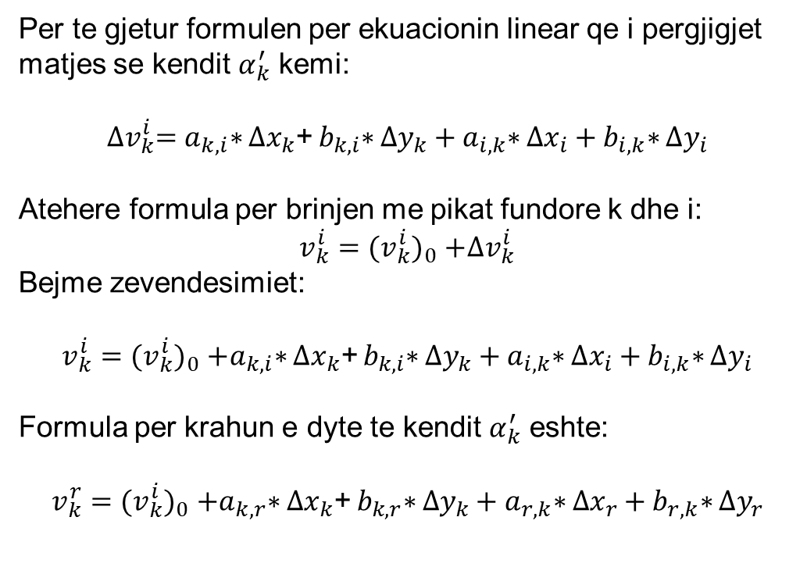
Formimi I ekuacioneve lineare dhe antareve te lire per kende
Per te gjetur formulen per ekuacionin linear qe i pergjigjet matjes se kendit $α_{k}^{′}$ kemi:
$${∆v}_{k}^{i}=a_{k,i}\text{∗} {∆x}_{k}\text{+} b_{k,i}\text{∗} {∆y}_{k}+a_{i,k}\text{∗} {∆x}_{i}+b_{i,k}\text{∗} {∆y}_{i}$$
Atehere formula per brinjen me pikat fundore k dhe i:
$$v_{k}^{i}{=(v_{k}^{i})}_{0}+{∆v}_{k}^{i}$$
Bejme zevendesimiet:
$$v_{k}^{i}{=(v_{k}^{i})}_{0}+a_{k,i}\text{∗} {∆x}_{k}\text{+} b_{k,i}\text{∗} {∆y}_{k}+a_{i,k}\text{∗} {∆x}_{i}+b_{i,k}\text{∗} {∆y}_{i}$$
Formula per krahun e dyte te kendit $α_{k}^{′}$ eshte:
$$v_{k}^{r}{=(v_{k}^{i})}_{0}+a_{k,r}\text{∗} {∆x}_{k}\text{+} b_{k,r}\text{∗} {∆y}_{k}+a_{r,k}\text{∗} {∆x}_{r}+b_{r,k}\text{∗} {∆y}_{r}$$

Slide 3
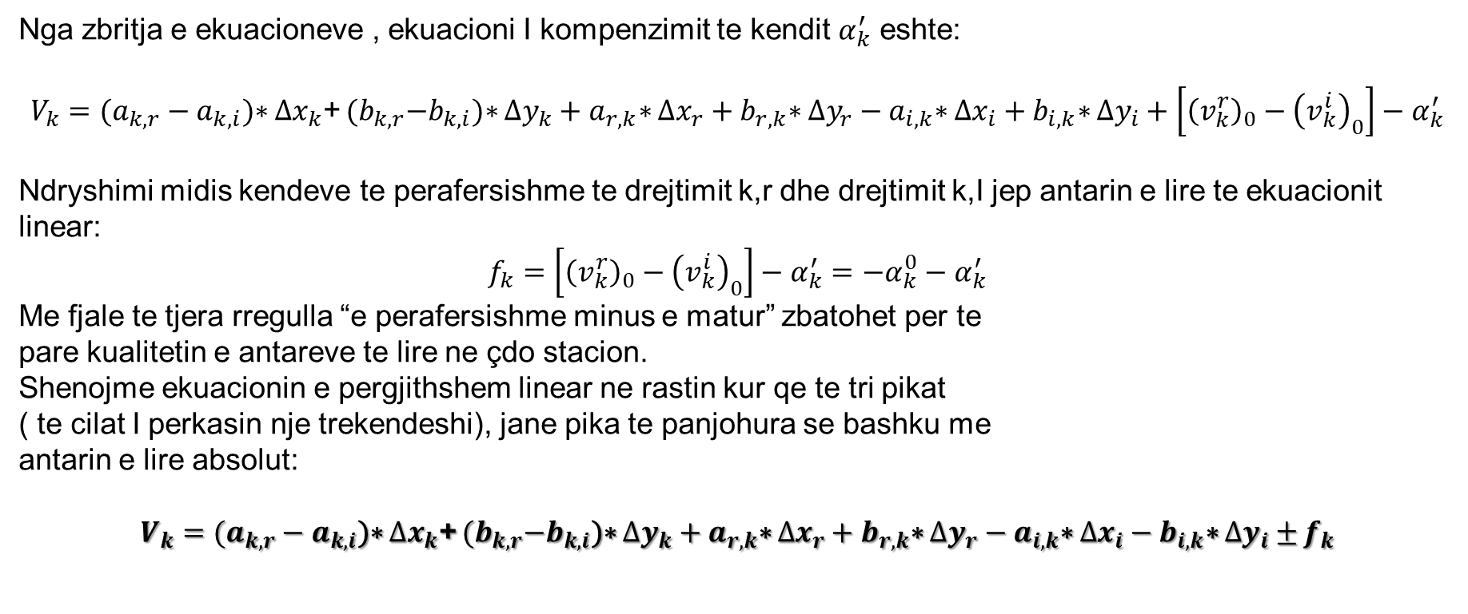
Formimi I ekuacioneve lineare dhe antareve te lire per kende
Nga zbritja e ekuacioneve , ekuacioni I kompenzimit te kendit $α_{k}^{′}$ eshte:
$$V_{k}=(a_{k,r}−a_{k,i}\text{)}\text{∗} {∆x}_{k}\text{+} {(b}_{k,r}−b_{k,i}\text{)}\text{∗} {∆y}_{k}+a_{r,k}\text{∗} {∆x}_{r}+b_{r,k}\text{∗} {∆y}_{r}−a_{i,k}\text{∗} {∆x}_{i}+b_{i,k}\text{∗} {∆y}_{i}+\left[{\left(v_{k}^{r}\right)}_{0}−{\left(v_{k}^{i}\right)}_{0}\right]−α_{k}^{′}$$
Ndryshimi midis kendeve te perafersishme te drejtimit k,r dhe drejtimit k,I jep antarin e lire te ekuacionit linear:
$$f_{k}=\left[{\left(v_{k}^{r}\right)}_{0}−{\left(v_{k}^{i}\right)}_{0}\right]−α_{k}^{′}=−α_{k}^{0}−α_{k}^{′}$$
Me fjale te tjera rregulla “e perafersishme minus e matur” zbatohet per te
pare kualitetin e antareve te lire ne çdo stacion.
Shenojme ekuacionin e pergjithshem linear ne rastin kur qe te tri pikat
( te cilat I perkasin nje trekendeshi), jane pika te panjohura se bashku me
antarin e lire absolut:
$V_{k}=(a_{k,r}−a_{k,i}\text{)}\text{∗} {∆x}_{k}\text{+} {(b}_{k,r}−b_{k,i}\text{)}\text{∗} {∆y}_{k}+a_{r,k}\text{∗} {∆x}_{r}+b_{r,k}\text{∗} {∆y}_{r}−a_{i,k}\text{∗} {∆x}_{i}−b_{i,k}\text{∗} {∆y}_{i}±$ $f_{k}$

Slide 4

Formimi I ekuacioneve lineare dhe antareve te lire per kende
Nese behen zevendesimet perkatese kur njera prej pikave eshte e dhene (dy caktohen me barazim) ose dy pika jane dhene dhe e treta caktohet me barazim.
P. sh. Kemi rastin kur per piken i jane dhene koordinatat definitive:
$${∆x}_{i}=0 dhe{ ∆y}_{i}=0$$
Ose kur pikat i dhe r jane dhene me vlera fikse te koordinatave e duhet caktuar koordintat e pikes k.
${∆x}_{i}={ ∆y}_{i}={∆x}_{r}={ ∆y}_{r}=0$ etj

Slide 5
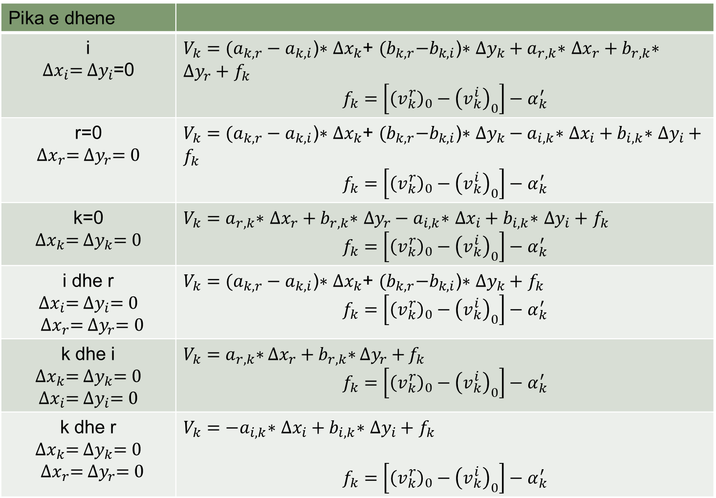
Ne vazhdim paraqesim tabelen e formimit te ekuacioneve lineare dhe te antareve te lire per te gjitha rastet e mundeshme:
Pika e dhene
i ${∆x}_{i}={ ∆y}_{i}$=0 | $V_{k}=(a_{k,r}−a_{k,i}\text{)}\text{∗} {∆x}_{k}\text{+ }{(b}_{k,r}−b_{k,i}\text{)}\text{∗} {∆y}_{k}+a_{r,k}\text{∗} {∆x}_{r}+b_{r,k}\text{∗} {∆y}_{r}+$ $f_{k}$ $$f_{k}=\left[{\left(v_{k}^{r}\right)}_{0}−{\left(v_{k}^{i}\right)}_{0}\right]−α_{k}^{′}$$
r=0 ${∆x}_{r}={ ∆y}_{r}=0$ | $V_{k}=(a_{k,r}−a_{k,i}\text{)}\text{∗} {∆x}_{k}\text{+ }{(b}_{k,r}−b_{k,i}\text{)}\text{∗} {∆y}_{k}−a_{i,k}\text{∗} {∆x}_{i}+b_{i,k}\text{∗} {∆y}_{i}+$ $f_{k}$ $$f_{k}=\left[{\left(v_{k}^{r}\right)}_{0}−{\left(v_{k}^{i}\right)}_{0}\right]−α_{k}^{′}$$
k=0 ${∆x}_{k}={ ∆y}_{k}=0$ | $V_{k}=a_{r,k}\text{∗} {∆x}_{r}+b_{r,k}\text{∗} {∆y}_{r}−a_{i,k}\text{∗} {∆x}_{i}+b_{i,k}\text{∗} {∆y}_{i}+$ $f_{k}$ $$f_{k}=\left[{\left(v_{k}^{r}\right)}_{0}−{\left(v_{k}^{i}\right)}_{0}\right]−α_{k}^{′}$$
i dhe r $${∆x}_{i}={ ∆y}_{i}=0$$ ${ ∆x}_{r}={ ∆y}_{r}=0$ | $V_{k}=(a_{k,r}−a_{k,i}\text{)}\text{∗} {∆x}_{k}\text{+ }{(b}_{k,r}−b_{k,i}\text{)}\text{∗} {∆y}_{k}+$ $f_{k}$ $$f_{k}=\left[{\left(v_{k}^{r}\right)}_{0}−{\left(v_{k}^{i}\right)}_{0}\right]−α_{k}^{′}$$
k dhe i $${∆x}_{k}={ ∆y}_{k}=0$$ $${∆x}_{i}={ ∆y}_{i}=0$$ | $V_{k}=a_{r,k}\text{∗} {∆x}_{r}+b_{r,k}\text{∗} {∆y}_{r}+$ $f_{k}$ $$f_{k}=\left[{\left(v_{k}^{r}\right)}_{0}−{\left(v_{k}^{i}\right)}_{0}\right]−α_{k}^{′}$$
k dhe r $${∆x}_{k}={ ∆y}_{k}=0$$ $${ ∆x}_{r}={ ∆y}_{r}=0$$ | $V_{k}=−a_{i,k}\text{∗} {∆x}_{i}+b_{i,k}\text{∗} {∆y}_{i}+$ $f_{k}$ $$f_{k}=\left[{\left(v_{k}^{r}\right)}_{0}−{\left(v_{k}^{i}\right)}_{0}\right]−α_{k}^{′}$$

Slide 6
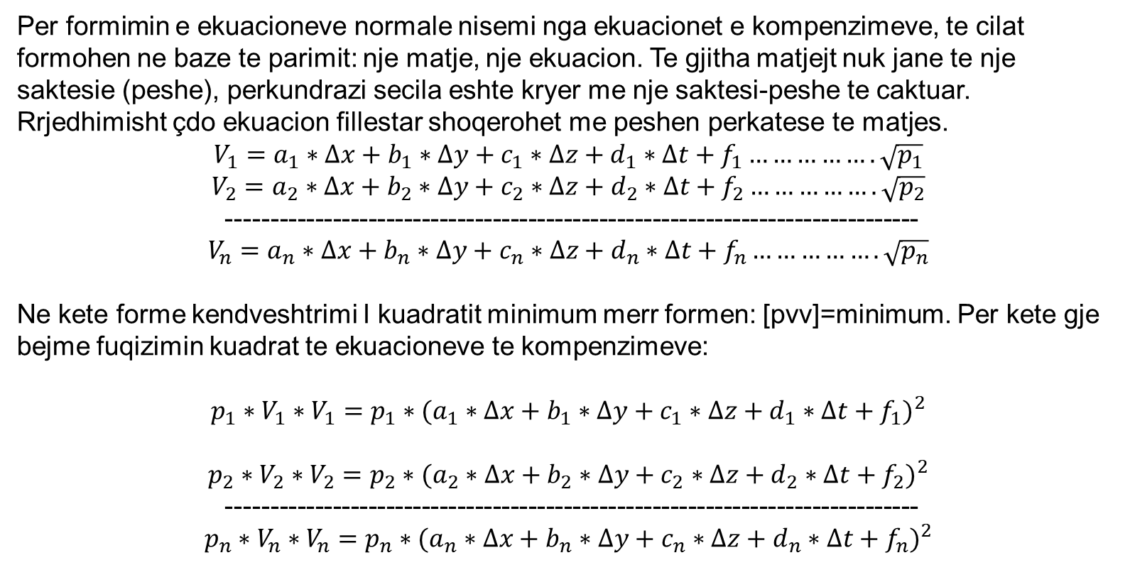
Formimi I ekuacioneve Normale
Per formimin e ekuacioneve normale nisemi nga ekuacionet e kompenzimeve, te cilat formohen ne baze te parimit: nje matje, nje ekuacion. Te gjitha matjejt nuk jane te nje saktesie (peshe), perkundrazi secila eshte kryer me nje saktesi-peshe te caktuar. Rrjedhimisht çdo ekuacion fillestar shoqerohet me peshen perkatese te matjes.
$$V_{1}=a_{1}∗∆x+b_{1}∗∆y+c_{1}∗∆z+d_{1}∗∆t+f_{1}…………….\sqrt{p_{1}}$$
$$V_{2}=a_{2}∗∆x+b_{2}∗∆y+c_{2}∗∆z+d_{2}∗∆t+f_{2}…………….\sqrt{p_{2}}$$
------------------------------------------------------------------------------
$$V_{n}=a_{n}∗∆x+b_{n}∗∆y+c_{n}∗∆z+d_{n}∗∆t+f_{n}…………….\sqrt{p_{n}}$$
Ne kete forme kendveshtrimi I kuadratit minimum merr formen: [pvv]=minimum. Per kete gje bejme fuqizimin kuadrat te ekuacioneve te kompenzimeve:
$$p_{1}∗V_{1}∗V_{1}=p_{1}∗{(a_{1}∗∆x+b_{1}∗∆y+c_{1}∗∆z+d_{1}∗∆t+f_{1})}^{2}$$
$$p_{2}∗V_{2}∗V_{2}=p_{2}∗{(a_{2}∗∆x+b_{2}∗∆y+c_{2}∗∆z+d_{2}∗∆t+f_{2})}^{2}$$
------------------------------------------------------------------------------
$$p_{n}∗V_{n}∗V_{n}=p_{n}∗{(a_{n}∗∆x+b_{n}∗∆y+c_{n}∗∆z+d_{n}∗∆t+f_{n})}^{2}$$

Slide 7
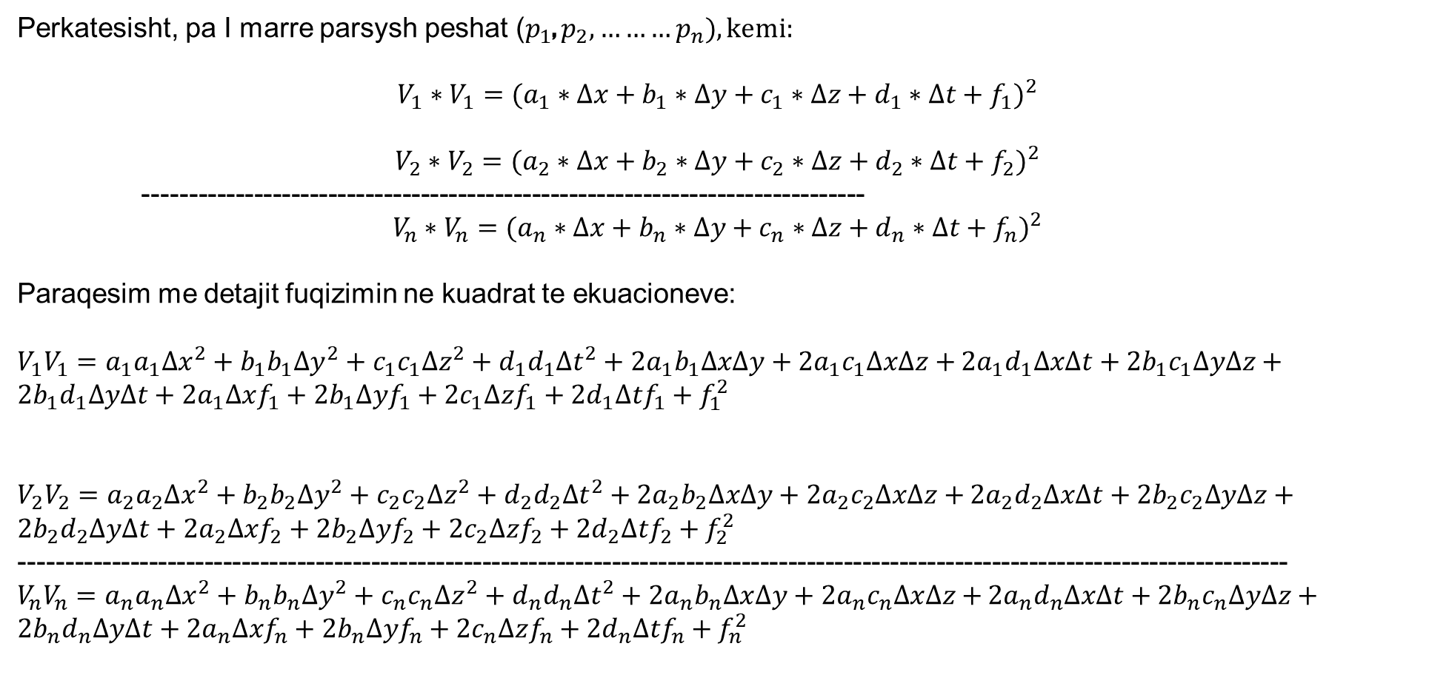
Perkatesisht, pa I marre parsysh peshat ($p_{1}$, $p_{2},………p_{n}), kemi:$
$$V_{1}∗V_{1}={(a_{1}∗∆x+b_{1}∗∆y+c_{1}∗∆z+d_{1}∗∆t+f_{1})}^{2}$$
$$V_{2}∗V_{2}={(a_{2}∗∆x+b_{2}∗∆y+c_{2}∗∆z+d_{2}∗∆t+f_{2})}^{2}$$
------------------------------------------------------------------------------
$$V_{n}∗V_{n}={(a_{n}∗∆x+b_{n}∗∆y+c_{n}∗∆z+d_{n}∗∆t+f_{n})}^{2}$$
Paraqesim me detajit fuqizimin ne kuadrat te ekuacioneve:
$V_{1}V_{1}=a_{1}a_{1}{∆x}^{2}+b_{1}b_{1}{∆y}^{2}+c_{1}c_{1}{∆z}^{2}+d_{1}d_{1}{∆t}^{2}+2a_{1}b_{1}∆x∆y+2a_{1}c_{1}∆x∆z+$ $2a_{1}d_{1}∆x∆t+2b_{1}c_{1}∆y∆z+2b_{1}d_{1}∆y∆t+2a_{1}∆xf_{1}+2b_{1}∆yf_{1}+2c_{1}∆zf_{1}+2d_{1}∆tf_{1}+f_{1}^{2}$
$V_{2}V_{2}=a_{2}a_{2}{∆x}^{2}+b_{2}b_{2}{∆y}^{2}+c_{2}c_{2}{∆z}^{2}+d_{2}d_{2}{∆t}^{2}+2a_{2}b_{2}∆x∆y+2a_{2}c_{2}∆x∆z+$ $2a_{2}d_{2}∆x∆t+2b_{2}c_{2}∆y∆z+2b_{2}d_{2}∆y∆t+2a_{2}∆xf_{2}+2b_{2}∆yf_{2}+2c_{2}∆zf_{2}+2d_{2}∆tf_{2}+f_{2}^{2}$
-----------------------------------------------------------------------------------------------------------------------------------------
$V_{n}V_{n}=a_{n}a_{n}{∆x}^{2}+b_{n}b_{n}{∆y}^{2}+c_{n}c_{n}{∆z}^{2}+d_{n}d_{n}{∆t}^{2}+2a_{n}b_{n}∆x∆y+2a_{n}c_{n}∆x∆z+$ $2a_{n}d_{n}∆x∆t+2b_{n}c_{n}∆y∆z+2b_{n}d_{n}∆y∆t+2a_{n}∆xf_{n}+2b_{n}∆yf_{n}+2c_{n}∆zf_{n}+2d_{n}∆tf_{n}+f_{n}^{2}$

Slide 8
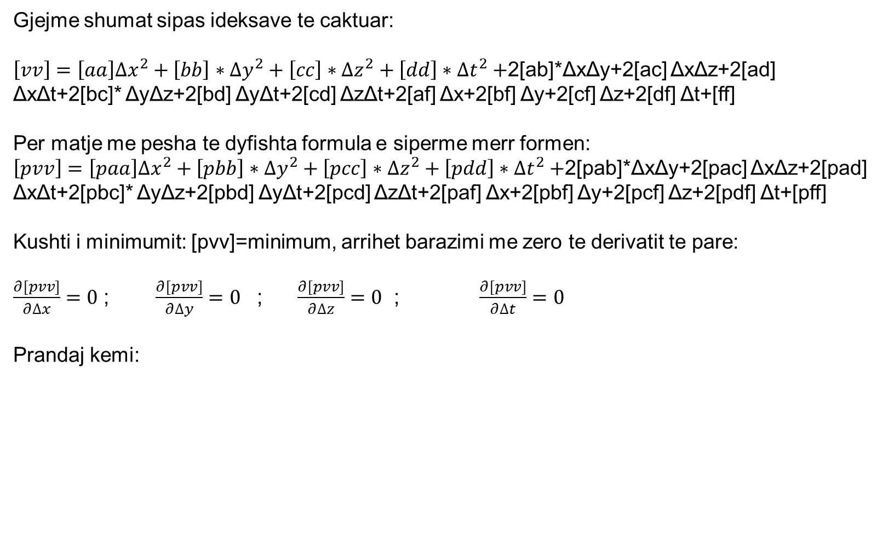
Gjejme shumat sipas ideksave te caktuar:
$\left[vv\right]=\left[aa\right]{∆x}^{2}+\left[bb\right]∗{∆y}^{2}+\left[cc\right]∗{∆z}^{2}+\left[dd\right]∗{∆t}^{2}+$2[ab]*ΔxΔy+2[ac] ΔxΔz+2[ad] ΔxΔt+2[bc]* ΔyΔz+2[bd] ΔyΔt+2[cd] ΔzΔt+2[af] Δx+2[bf] Δy+2[cf] Δz+2[df] Δt+[ff]
Per matje me pesha te dyfishta formula e siperme merr formen:
$\left[pvv\right]=\left[paa\right]{∆x}^{2}+\left[pbb\right]∗{∆y}^{2}+\left[pcc\right]∗{∆z}^{2}+\left[pdd\right]∗{∆t}^{2}+$2[pab]*ΔxΔy+2[pac] ΔxΔz+2[pad] ΔxΔt+2[pbc]* ΔyΔz+2[pbd] ΔyΔt+2[pcd] ΔzΔt+2[paf] Δx+2[pbf] Δy+2[pcf] Δz+2[pdf] Δt+[pff]
Kushti i minimumit: [pvv]=minimum, arrihet barazimi me zero te derivatit te pare:
$\frac{∂[pvv]}{∂∆x}=0$ ; $\frac{∂[pvv]}{∂∆y}=0$ ; $\frac{∂[pvv]}{∂∆z}=0$ ; $\frac{∂[pvv]}{∂∆t}=0$
Prandaj kemi:

Slide 9
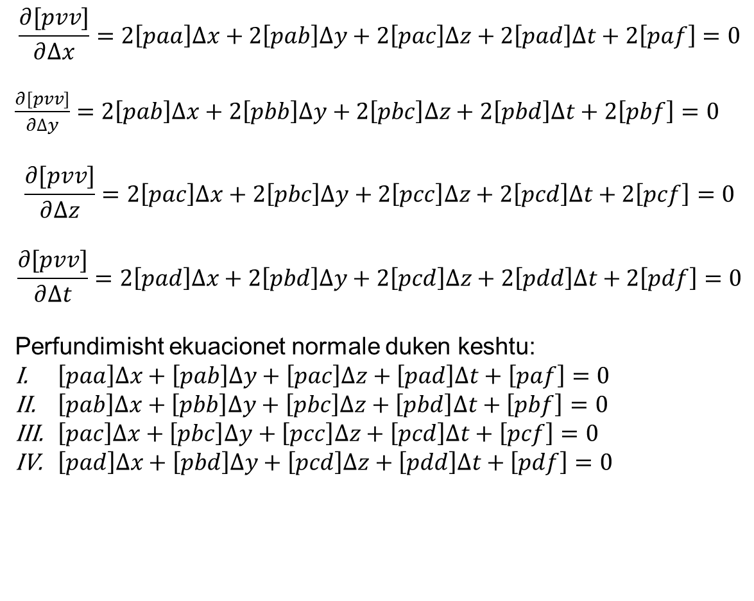
$$\frac{∂[pvv]}{∂∆x}=2\left[paa\right]∆x+2\left[pab\right]∆y+2\left[pac\right]∆z+2\left[pad\right]∆t+2\left[paf\right]=0$$
$\frac{∂[pvv]}{∂∆y}=2\left[pab\right]∆x+2\left[pbb\right]∆y+2\left[pbc\right]∆z+2\left[pbd\right]∆t+2\left[pbf\right]=0$
$$\frac{∂[pvv]}{∂∆z}=2\left[pac\right]∆x+2\left[pbc\right]∆y+2\left[pcc\right]∆z+2\left[pcd\right]∆t+2\left[pcf\right]=0$$
$$\frac{∂[pvv]}{∂∆t}=2\left[pad\right]∆x+2\left[pbd\right]∆y+2\left[pcd\right]∆z+2\left[pdd\right]∆t+2\left[pdf\right]=0$$
Perfundimisht ekuacionet normale duken keshtu:
$\left[paa\right]∆x+\left[pab\right]∆y+\left[pac\right]∆z+\left[pad\right]∆t+\left[paf\right]=0$
$\left[pab\right]∆x+\left[pbb\right]∆y+\left[pbc\right]∆z+\left[pbd\right]∆t+\left[pbf\right]=0$
$\left[pac\right]∆x+\left[pbc\right]∆y+\left[pcc\right]∆z+\left[pcd\right]∆t+\left[pcf\right]=0$
$\left[pad\right]∆x+\left[pbd\right]∆y+\left[pcd\right]∆z+\left[pdd\right]∆t+\left[pdf\right]=0$

Slide 10
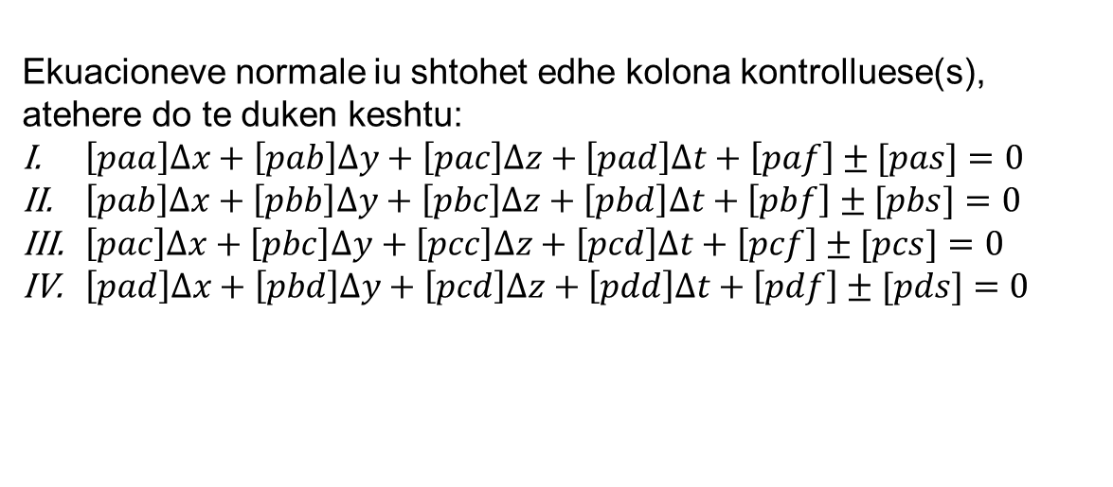
Ekuacioneve normale iu shtohet edhe kolona kontrolluese(s), atehere do te duken keshtu:
$\left[paa\right]∆x+\left[pab\right]∆y+\left[pac\right]∆z+\left[pad\right]∆t+\left[paf\right]±[pas]=0$
$\left[pab\right]∆x+\left[pbb\right]∆y+\left[pbc\right]∆z+\left[pbd\right]∆t+\left[pbf\right]±[pbs]=0$
$\left[pac\right]∆x+\left[pbc\right]∆y+\left[pcc\right]∆z+\left[pcd\right]∆t+\left[pcf\right]±[pcs]=0$
$\left[pad\right]∆x+\left[pbd\right]∆y+\left[pcd\right]∆z+\left[pdd\right]∆t+\left[pdf\right]±[pds]=0$

Slide 11
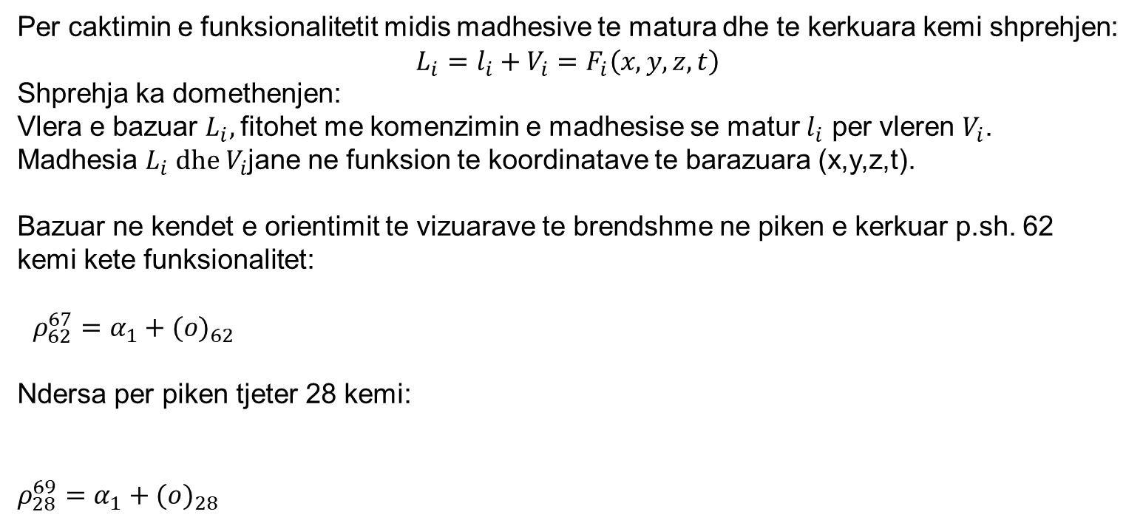
Definimi I funksionalitetit midis madhesive te matura dhe madhesive te kerkuara
Per caktimin e funksionalitetit midis madhesive te matura dhe te kerkuara kemi shprehjen:
$$L_{i}=l_{i}+V_{i}=F_{i}\left(x,y,z,t\right)$$
Shprehja ka domethenjen:
Vlera e bazuar $L_{i},$fitohet me komenzimin e madhesise se matur $l_{i}$ per vleren $V_{i}$.
Madhesia $L_{i} dhe{ V}_{i}$jane ne funksion te koordinatave te barazuara (x,y,z,t).
Bazuar ne kendet e orientimit te vizuarave te brendshme ne piken e kerkuar p.sh. 62 kemi kete funksionalitet:
$ρ_{62}^{67}=α_{1}+{(o)}_{62}$
Ndersa per piken tjeter 28 kemi:
$$ρ_{28}^{69}=α_{1}+{(o)}_{28}$$

Slide 12
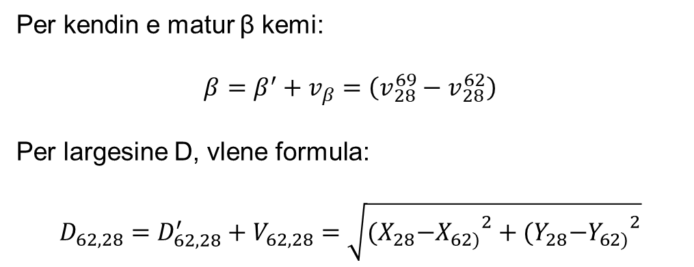
Per kendin e matur β kemi:
$$β=β^{′}+v_{β}=\left(v_{28}^{69}−v_{28}^{62}\right)$$
Per largesine D, vlene formula:
$$D_{62,28}=D_{62,28}^{′}+V_{62,28}=\sqrt{{{(X}_{28}−X_{62)}}^{2}+{{(Y}_{28}−Y_{62)}}^{2}}$$

Slide 13
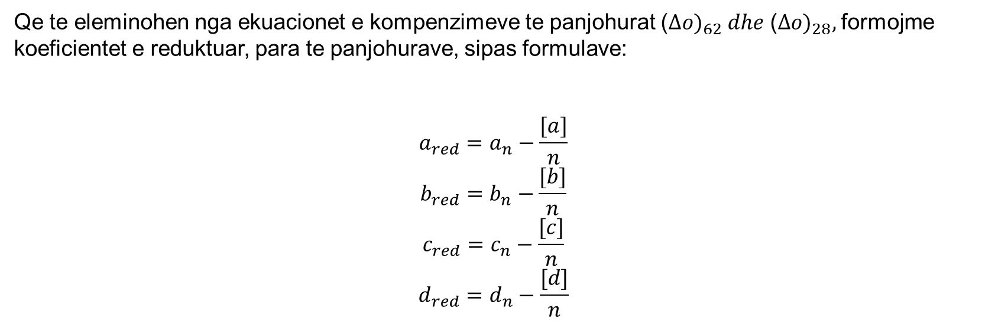
Reduktimi I koeficienteve
Qe te eleminohen nga ekuacionet e kompenzimeve te panjohurat ${\text{(}∆o)}_{62} dhe {\text{(}∆o)}_{28},$formojme koeficientet e reduktuar, para te panjohurave, sipas formulave:
$$a_{red}=a_{n}−\frac{[a]}{n}$$
$$b_{red}=b_{n}−\frac{[b]}{n}$$
$$c_{red}=c_{n}−\frac{[c]}{n}$$
$$d_{red}=d_{n}−\frac{[d]}{n}$$

Slide 14

Homogjenizimi I peshave
$${(p_{k})}_{1}={(p_{k})}_{2}=\frac{m_{0}^{2}}{m_{k}^{2}}=\frac{c}{m_{k}^{2}}, m_{0}^{2}=c=m_{α_{k}}^{2}$$
$${(p_{k})}_{1}={(p_{k})}_{2}=\frac{m_{0}^{2}}{m_{k}^{2}}=\frac{c}{m_{k}^{2}}=1$$
$$p_{β}=\frac{c}{m_{β}^{2}}$$
$$p_{D}=\frac{c}{m_{d}^{2}}$$

Slide 15
ESE- Vleresimi I saktesise se te panjohurave

