Slide 1
Barazimi I matjeve kushtore

Slide 2
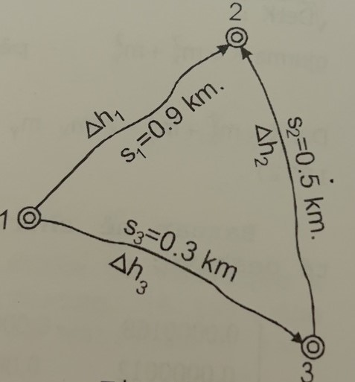
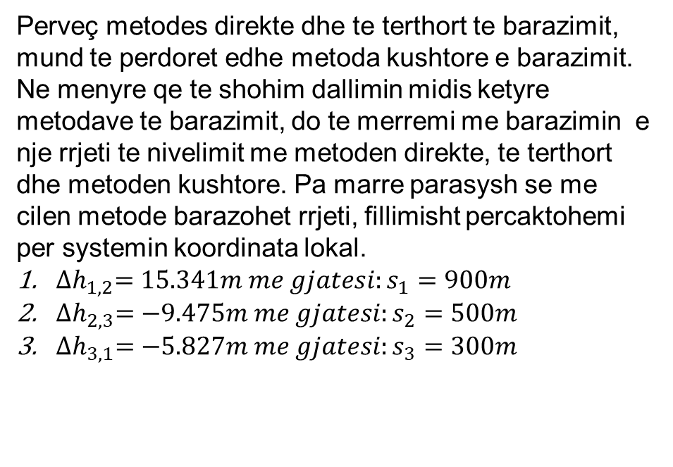
Barazimi I matjeve kushtore
Perveç metodes direkte dhe te terthort te barazimit, mund te perdoret edhe metoda kushtore e barazimit. Ne menyre qe te shohim dallimin midis ketyre metodave te barazimit, do te merremi me barazimin e nje rrjeti te nivelimit me metoden direkte, te terthort dhe metoden kushtore. Pa marre parasysh se me cilen metode barazohet rrjeti, fillimisht percaktohemi per systemin koordinata lokal.
${∆h}_{1,2}=15.341m me gjatesi:s_{1}=900m$
${∆h}_{2,3}=−9.475m me gjatesi:s_{2}=500m$
${∆h}_{3,1}=−5.827m me gjatesi:s_{3}=300m$

Slide 3
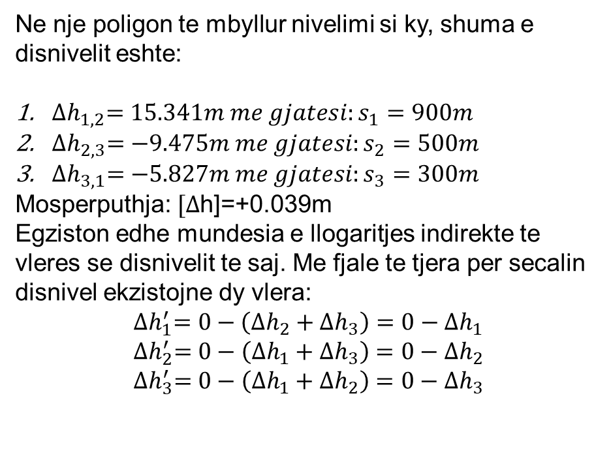
Barazimi I matjeve kushtore
Ne nje poligon te mbyllur nivelimi si ky, shuma e disnivelit eshte:
${∆h}_{1,2}=15.341m me gjatesi:s_{1}=900m$
${∆h}_{2,3}=−9.475m me gjatesi:s_{2}=500m$
${∆h}_{3,1}=−5.827m me gjatesi:s_{3}=300m$
Mosperputhja: $[∆$h]=+0.039m
Egziston edhe mundesia e llogaritjes indirekte te vleres se disnivelit te saj. Me fjale te tjera per secalin disnivel ekzistojne dy vlera:
$${∆h}_{1}^{′}=0−\left({∆h}_{2}+{∆h}_{3}\right)=0−{∆h}_{1}$$
$${∆h}_{2}^{′}=0−\left({∆h}_{1}+{∆h}_{3}\right)=0−{∆h}_{2}$$
$${∆h}_{3}^{′}=0−\left({∆h}_{1}+{∆h}_{2}\right)=0−{∆h}_{3}$$

Slide 4
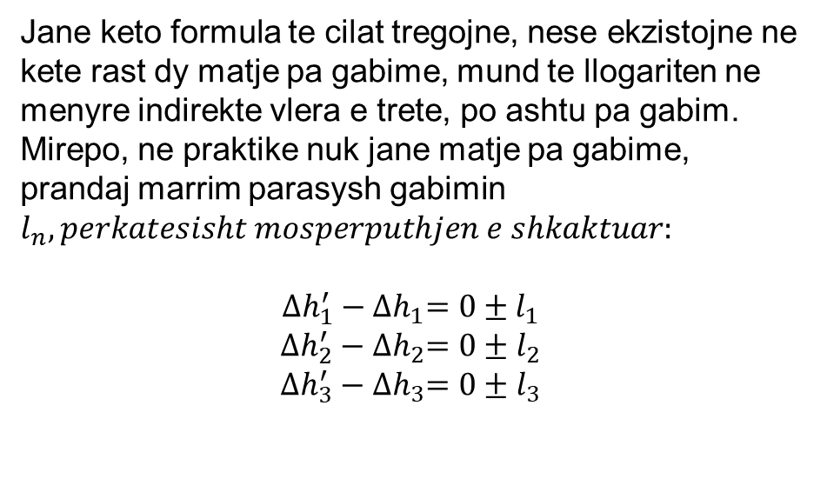
Barazimi I matjeve kushtore
Jane keto formula te cilat tregojne, nese ekzistojne ne kete rast dy matje pa gabime, mund te llogariten ne menyre indirekte vlera e trete, po ashtu pa gabim. Mirepo, ne praktike nuk jane matje pa gabime, prandaj marrim parasysh gabimin $l_{n}, perkatesisht mosperputhjen e shkaktuar:$
$${∆h}_{1}^{′}−{∆h}_{1}=0±l_{1}$$
$${∆h}_{2}^{′}−{∆h}_{2}=0±l_{2}$$
$${∆h}_{3}^{′}−{∆h}_{3}=0±l_{3}$$

Slide 5
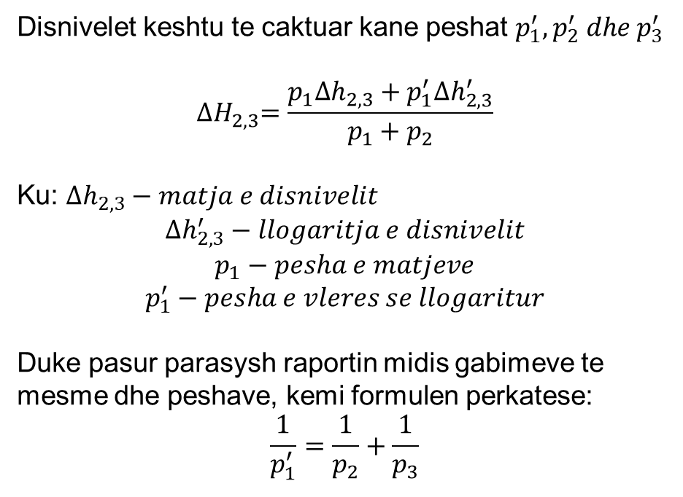
Barazimi I matjeve kushtore
Disnivelet keshtu te caktuar kane peshat $p_{1}^{′},p_{2}^{′} dhe p_{3}^{′}$
$${∆H}_{2,3}=\frac{p_{1}{∆h}_{2,3}+p_{1}^{′}{∆h}_{2,3}^{′}}{p_{1}+p_{2}}$$
Ku: ${∆h}_{2,3}−matja e disnivelit$
$${∆h}_{2,3}^{′}−llogaritja e disnivelit$$
$$p_{1}−pesha e matjeve$$
$$p_{1}^{′}−pesha e vleres se llogaritur$$
Duke pasur parasysh raportin midis gabimeve te mesme dhe peshave, kemi formulen perkatese:
$$\frac{1}{p_{1}^{′}}=\frac{1}{p_{2}}+\frac{1}{p_{3}}$$

Slide 6
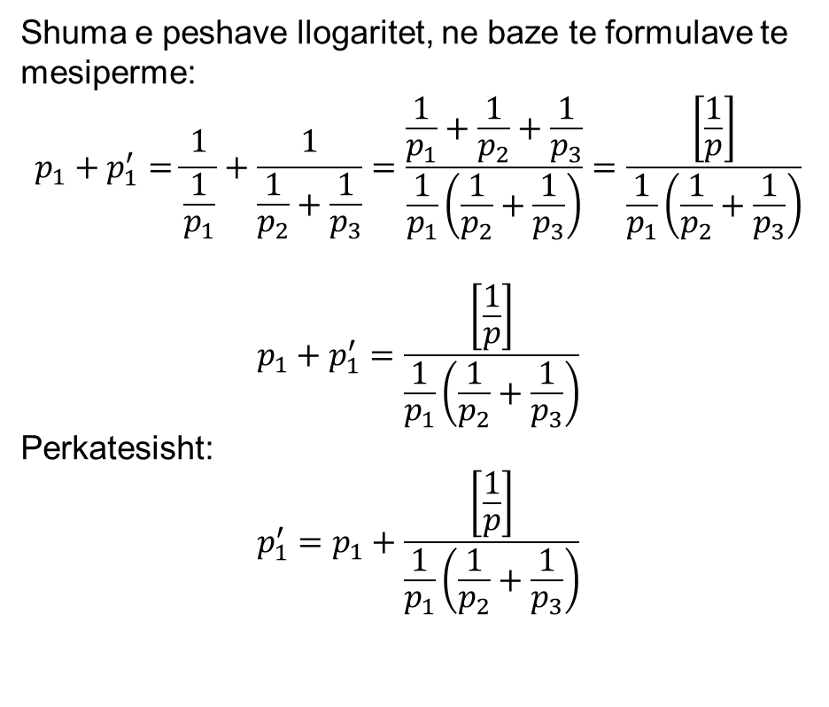
Barazimi I matjeve kushtore
Shuma e peshave llogaritet, ne baze te formulave te mesiperme:
$$p_{1}+p_{1}^{′}=\frac{1}{\frac{1}{p_{1}}}+\frac{1}{\frac{1}{p_{2}}+\frac{1}{p_{3}}}=\frac{\frac{1}{p_{1}}+\frac{1}{p_{2}}+\frac{1}{p_{3}}}{\frac{1}{p_{1}}\left(\frac{1}{p_{2}}+\frac{1}{p_{3}}\right)}=\frac{\left[\frac{1}{p}\right]}{\frac{1}{p_{1}}\left(\frac{1}{p_{2}}+\frac{1}{p_{3}}\right)}$$
$$p_{1}+p_{1}^{′}=\frac{\left[\frac{1}{p}\right]}{\frac{1}{p_{1}}\left(\frac{1}{p_{2}}+\frac{1}{p_{3}}\right)}$$
Perkatesisht:
$$p_{1}^{′}=p_{1}+\frac{\left[\frac{1}{p}\right]}{\frac{1}{p_{1}}\left(\frac{1}{p_{2}}+\frac{1}{p_{3}}\right)}$$

Slide 7
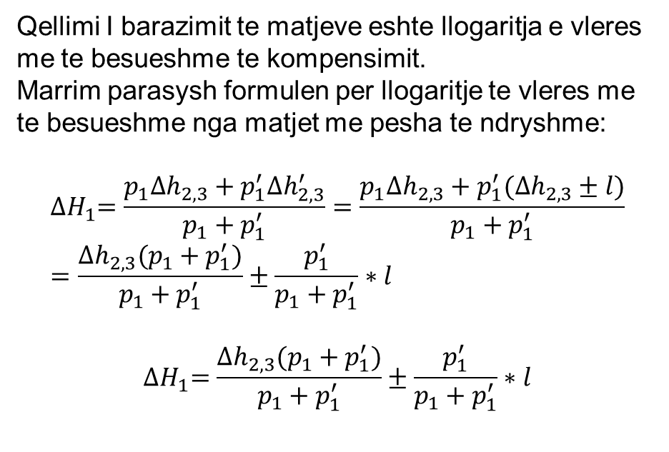
Barazimi I matjeve kushtore
Qellimi I barazimit te matjeve eshte llogaritja e vleres me te besueshme te kompensimit.
Marrim parasysh formulen per llogaritje te vleres me te besueshme nga matjet me pesha te ndryshme:
$${∆H}_{1}=\frac{p_{1}{∆h}_{2,3}+p_{1}^{′}{∆h}_{2,3}^{′}}{p_{1}+p_{1}^{′}}=\frac{p_{1}{∆h}_{2,3}+p_{1}^{′}({∆h}_{2,3}±l)}{p_{1}+p_{1}^{′}}=\frac{{∆h}_{2,3}(p_{1}+p_{1}^{′})}{p_{1}+p_{1}^{′}}±\frac{p_{1}^{′}}{p_{1}+p_{1}^{′}}∗l$$
$${∆H}_{1}=\frac{{∆h}_{2,3}(p_{1}+p_{1}^{′})}{p_{1}+p_{1}^{′}}±\frac{p_{1}^{′}}{p_{1}+p_{1}^{′}}∗l$$

Slide 8

Barazimi I matjeve kushtore
Prandaj perfundimisht kemi:
$${∆H}_{1,2}^{′}={∆H}_{1,2}±\frac{\frac{1}{p_{1}}}{\left[\frac{1}{p}\right]}∗l$$
Me shqyrtim te njejte fitohen:
$${∆H}_{2,3}^{′}={∆H}_{2,3}±\frac{\frac{1}{p_{2}}}{\left[\frac{1}{p}\right]}∗l$$
$${∆H}_{3,1}^{′}={∆H}_{3,1}±\frac{\frac{1}{p_{3}}}{\left[\frac{1}{p}\right]}∗l$$

Slide 9
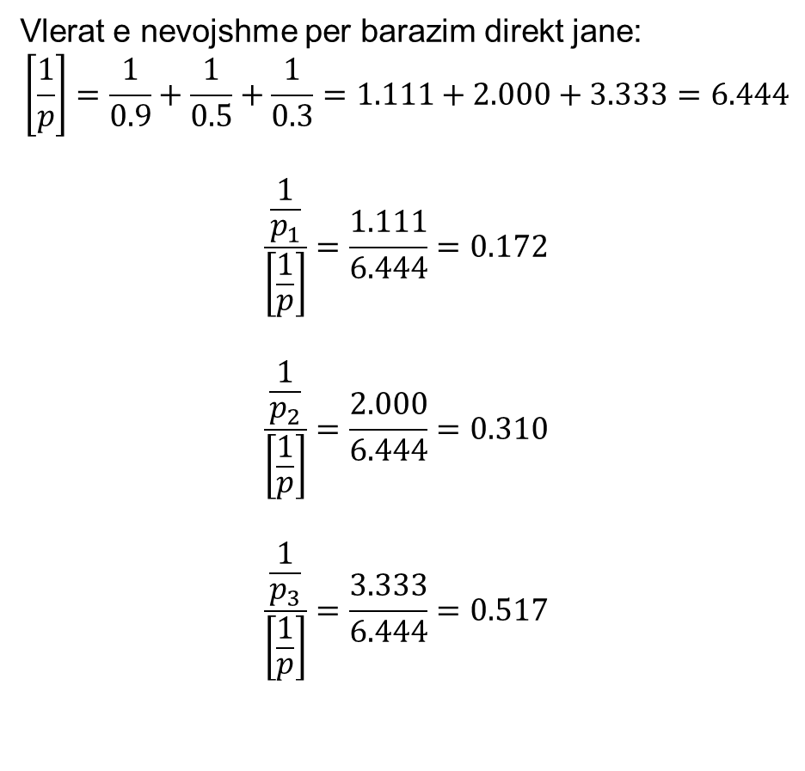
Barazimi I matjeve kushtore
Vlerat e nevojshme per barazim direkt jane:
$$\left[\frac{1}{p}\right]=\frac{1}{0.9}+\frac{1}{0.5}+\frac{1}{0.3}=1.111+2.000+3.333=6.444$$
$$\frac{\frac{1}{p_{1}}}{\left[\frac{1}{p}\right]}=\frac{1.111}{6.444}=0.172$$
$$\frac{\frac{1}{p_{2}}}{\left[\frac{1}{p}\right]}=\frac{2.000}{6.444}=0.310$$
$$\frac{\frac{1}{p_{3}}}{\left[\frac{1}{p}\right]}=\frac{3.333}{6.444}=0.517$$

Slide 10
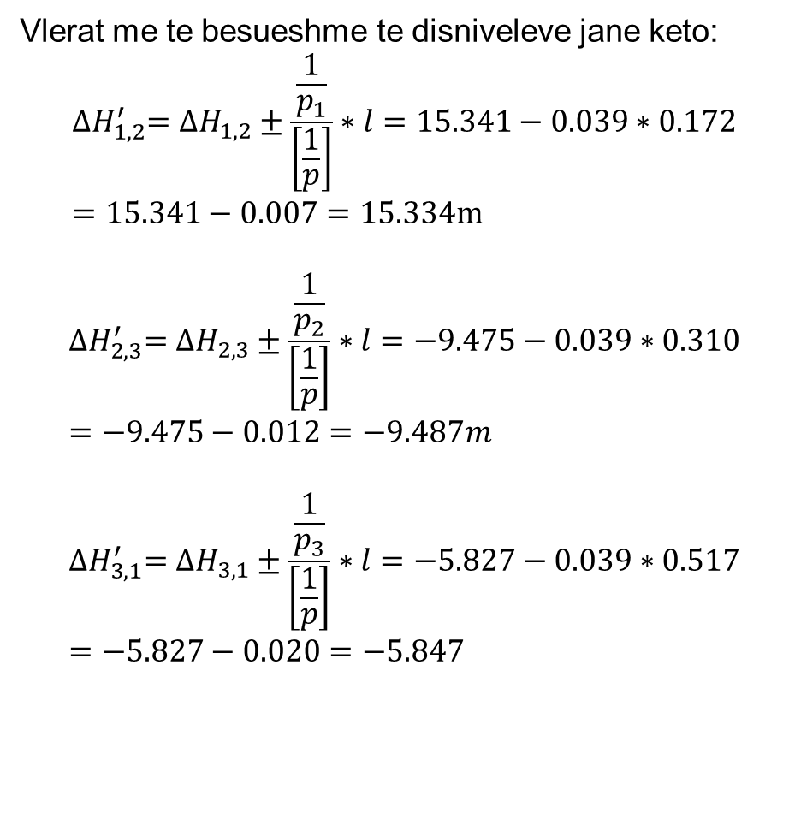
Barazimi I matjeve kushtore
Vlerat me te besueshme te disniveleve jane keto:
$${∆H}_{1,2}^{′}={∆H}_{1,2}±\frac{\frac{1}{p_{1}}}{\left[\frac{1}{p}\right]}∗l=15.341−0.039∗0.172=15.341−0.007=15.334m$$
$${∆H}_{2,3}^{′}={∆H}_{2,3}±\frac{\frac{1}{p_{2}}}{\left[\frac{1}{p}\right]}∗l=−9.475−0.039∗0.310=−9.475−0.012=−9.487m$$
$${∆H}_{3,1}^{′}={∆H}_{3,1}±\frac{\frac{1}{p_{3}}}{\left[\frac{1}{p}\right]}∗l=−5.827−0.039∗0.517=−5.827−0.020=−5.847$$

Slide 11
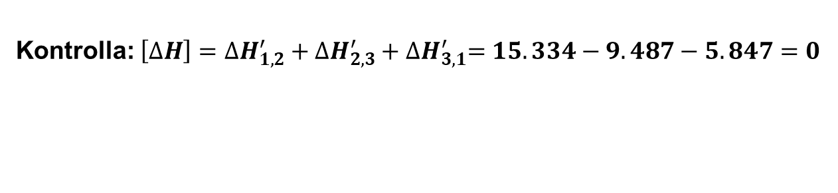
Barazimi I matjeve kushtore
Kontrolla: $\left[∆H\right]={∆H}_{1,2}^{′}+{∆H}_{2,3}^{′}+{∆H}_{3,1}^{′}=15.334−9.487−5.847=0$

Slide 12
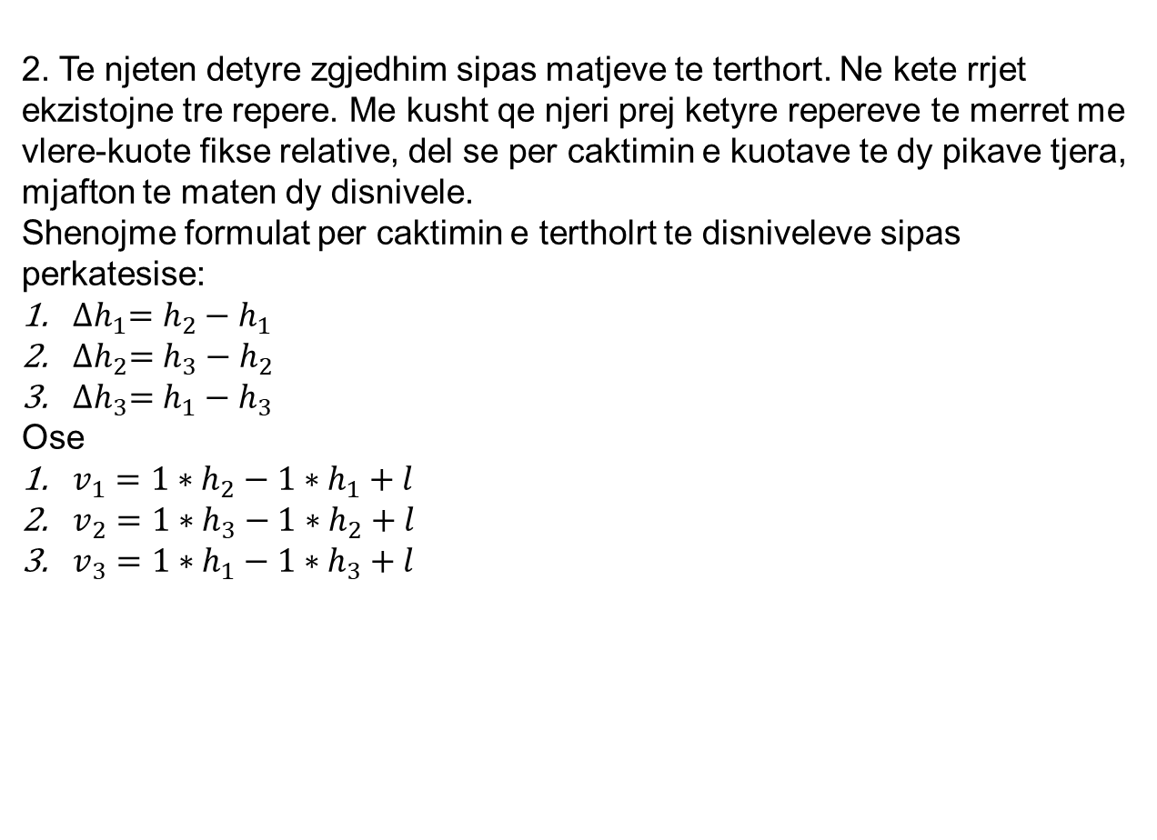
Barazimi I matjeve kushtore
2. Te njeten detyre zgjedhim sipas matjeve te terthort. Ne kete rrjet ekzistojne tre repere. Me kusht qe njeri prej ketyre repereve te merret me vlere-kuote fikse relative, del se per caktimin e kuotave te dy pikave tjera, mjafton te maten dy disnivele.
Shenojme formulat per caktimin e tertholrt te disniveleve sipas perkatesise:
${∆h}_{1}=h_{2}−h_{1}$
${∆h}_{2}=h_{3}−h_{2}$
${∆h}_{3}=h_{1}−h_{3}$
Ose
$v_{1}=1∗h_{2}−1∗h_{1}+l$
$v_{2}=1∗h_{3}−1∗h_{2}+l$
$v_{3}=1∗h_{1}−1∗h_{3}+l$

Slide 13
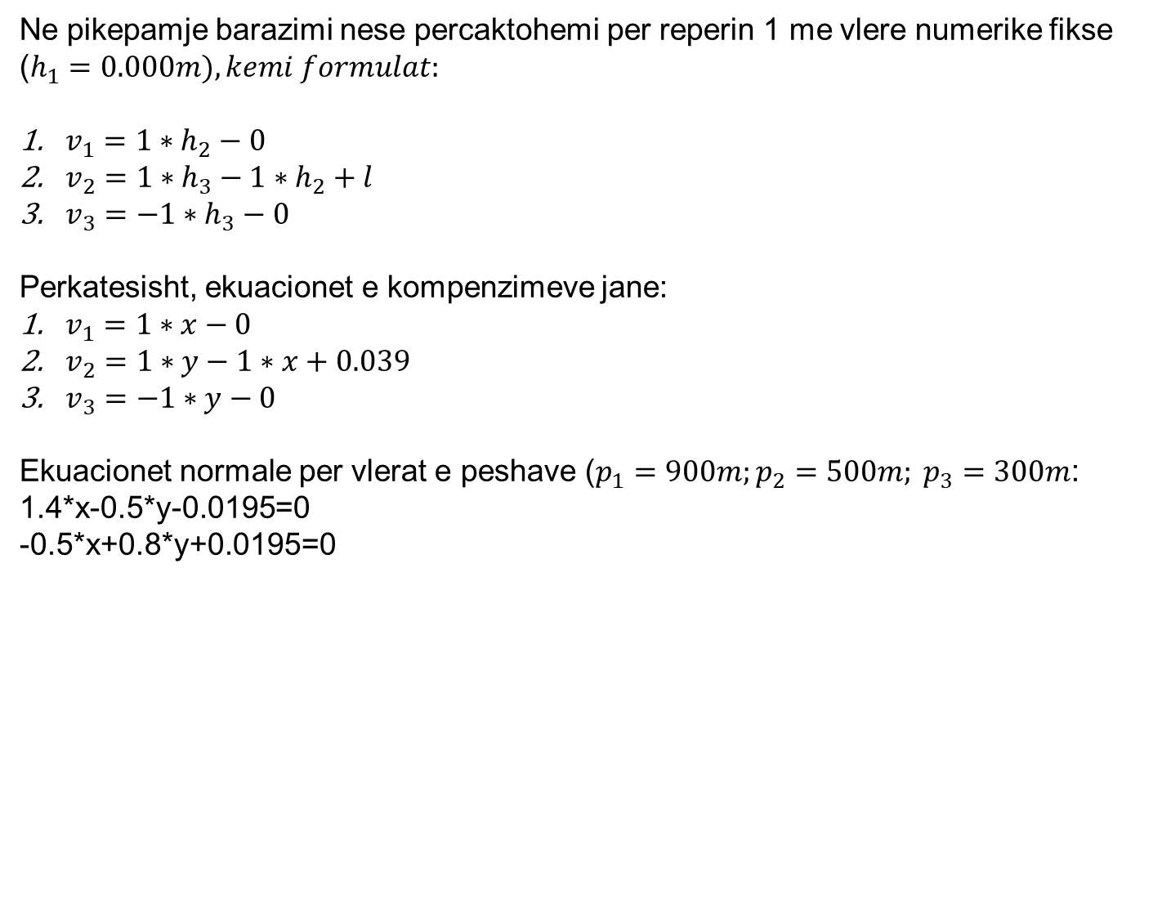
Barazimi I matjeve kushtore
Ne pikepamje barazimi nese percaktohemi per reperin 1 me vlere numerike fikse ($h_{1}=0.000m), kemi formulat:$
$v_{1}=1∗h_{2}−0$
$v_{2}=1∗h_{3}−1∗h_{2}+l$
$v_{3}=−1∗h_{3}−0$
Perkatesisht, ekuacionet e kompenzimeve jane:
$v_{1}=1∗x−0$
$v_{2}=1∗y−1∗x+0.039$
$v_{3}=−1∗y−0$
Ekuacionet normale per vlerat e peshave ($p_{1}=900m;p_{2}=500m; p_{3}=300m$:
1.4*x-0.5*y-0.0195=0
-0.5*x+0.8*y+0.0195=0

Slide 14
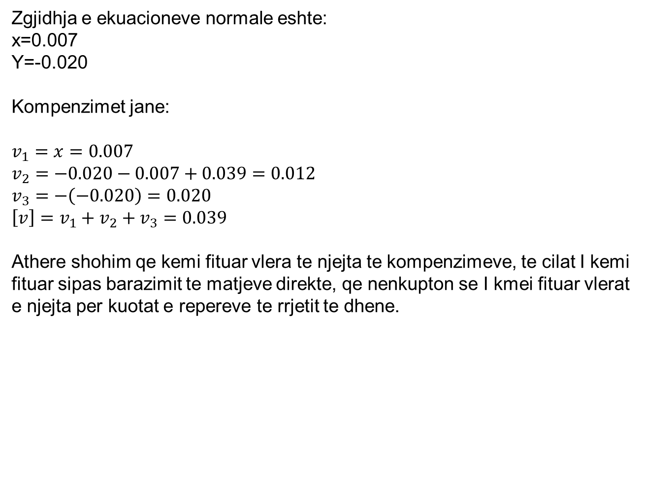
Barazimi I matjeve kushtore
Zgjidhja e ekuacioneve normale eshte:
x=0.007
Y=-0.020
Kompenzimet jane:
$$v_{1}=x=0.007$$
$$v_{2}=−0.020−0.007+0.039=0.012$$
$$v_{3}=−\left(−0.020\right)=0.020$$
$${\left[v\right]=v}_{1}+v_{2}+v_{3}=0.039$$
Athere shohim qe kemi fituar vlera te njejta te kompenzimeve, te cilat I kemi fituar sipas barazimit te matjeve direkte, qe nenkupton se I kmei fituar vlerat e njejta per kuotat e repereve te rrjetit te dhene.

Slide 15
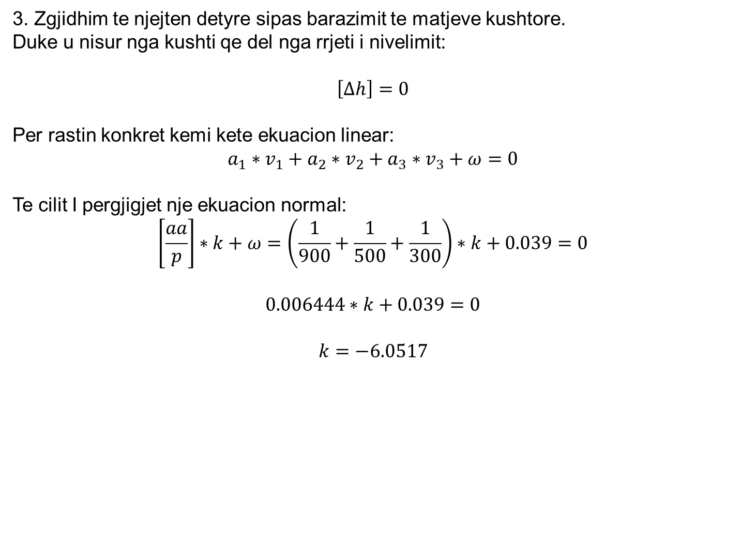
Barazimi I matjeve kushtore
3. Zgjidhim te njejten detyre sipas barazimit te matjeve kushtore.
Duke u nisur nga kushti qe del nga rrjeti i nivelimit:
$$\left[∆h\right]=0$$
Per rastin konkret kemi kete ekuacion linear:
$$a_{1}∗v_{1}+a_{2}∗v_{2}+a_{3}∗v_{3}+ω=0$$
Te cilit I pergjigjet nje ekuacion normal:
$$\left[\frac{aa}{p}\right]∗k+ω=\left(\frac{1}{900}+\frac{1}{500}+\frac{1}{300}\right)∗k+0.039=0$$
$$0.006444∗k+0.039=0$$
$$k=−6.0517$$

Slide 16
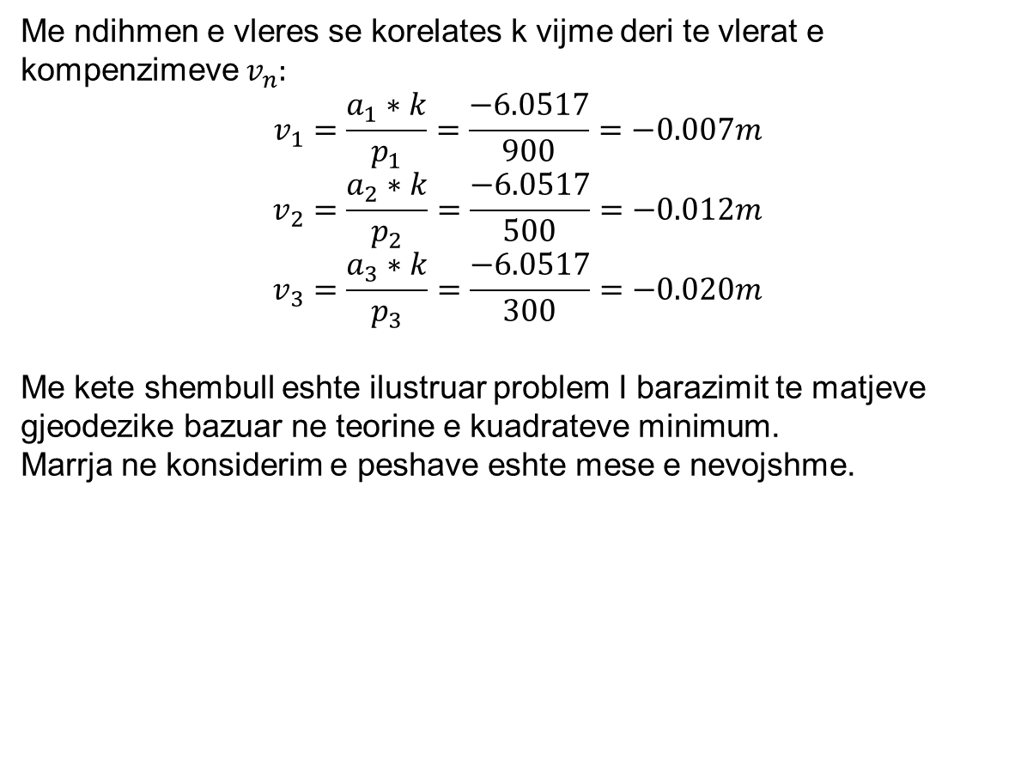
Barazimi I matjeve kushtore
Me ndihmen e vleres se korelates k vijme deri te vlerat e kompenzimeve $v_{n}:$
$$v_{1}=\frac{a_{1}∗k}{p_{1}}=\frac{−6.0517}{900}=−0.007m$$
$$v_{2}=\frac{a_{2}∗k}{p_{2}}=\frac{−6.0517}{500}=−0.012m$$
$$v_{3}=\frac{a_{3}∗k}{p_{3}}=\frac{−6.0517}{300}=−0.020m$$
Me kete shembull eshte ilustruar problem I barazimit te matjeve gjeodezike bazuar ne teorine e kuadrateve minimum.
Marrja ne konsiderim e peshave eshte mese e nevojshme.

Slide 17
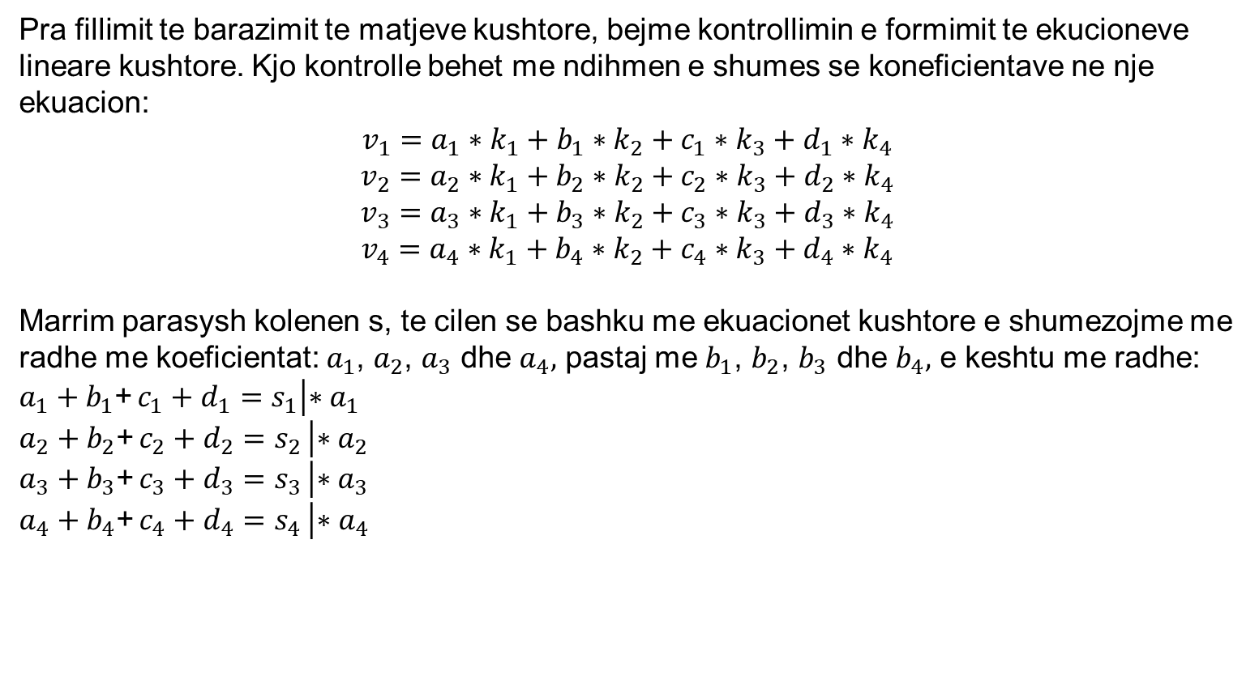
Kontrollimi I llogaritjeve me metoden kushtore
Pra fillimit te barazimit te matjeve kushtore, bejme kontrollimin e formimit te ekucioneve lineare kushtore. Kjo kontrolle behet me ndihmen e shumes se koneficientave ne nje ekuacion:
$$v_{1}=a_{1}∗k_{1}+b_{1}∗k_{2}+c_{1}∗k_{3}+d_{1}∗k_{4}$$
$$v_{2}=a_{2}∗k_{1}+b_{2}∗k_{2}+c_{2}∗k_{3}+d_{2}∗k_{4}$$
$$v_{3}=a_{3}∗k_{1}+b_{3}∗k_{2}+c_{3}∗k_{3}+d_{3}∗k_{4}$$
$$v_{4}=a_{4}∗k_{1}+b_{4}∗k_{2}+c_{4}∗k_{3}+d_{4}∗k_{4}$$
Marrim parasysh kolenen s, te cilen se bashku me ekuacionet kushtore e shumezojme me radhe me koeficientat: $a_{1}$, $a_{2}$, $a_{3}$ dhe $a_{4},$ pastaj me $b_{1}$, $b_{2}$, $b_{3}$ dhe $b_{4},$ e keshtu me radhe:
$a_{1}+b_{1}$+ $c_{1}+d_{1}=s_{1}\left|{∗a}_{1}\right.$
$a_{2}+b_{2}$+ $c_{2}+d_{2}=s_{2}$ $\left|∗a_{2}\right.$
$a_{3}+b_{3}$+ $c_{3}+d_{3}=s_{3}$ $\left|∗a_{3}\right.$
$a_{4}+b_{4}$+ $c_{4}+d_{4}=s_{4}$ $\left|{∗a}_{4}\right.$

Slide 18
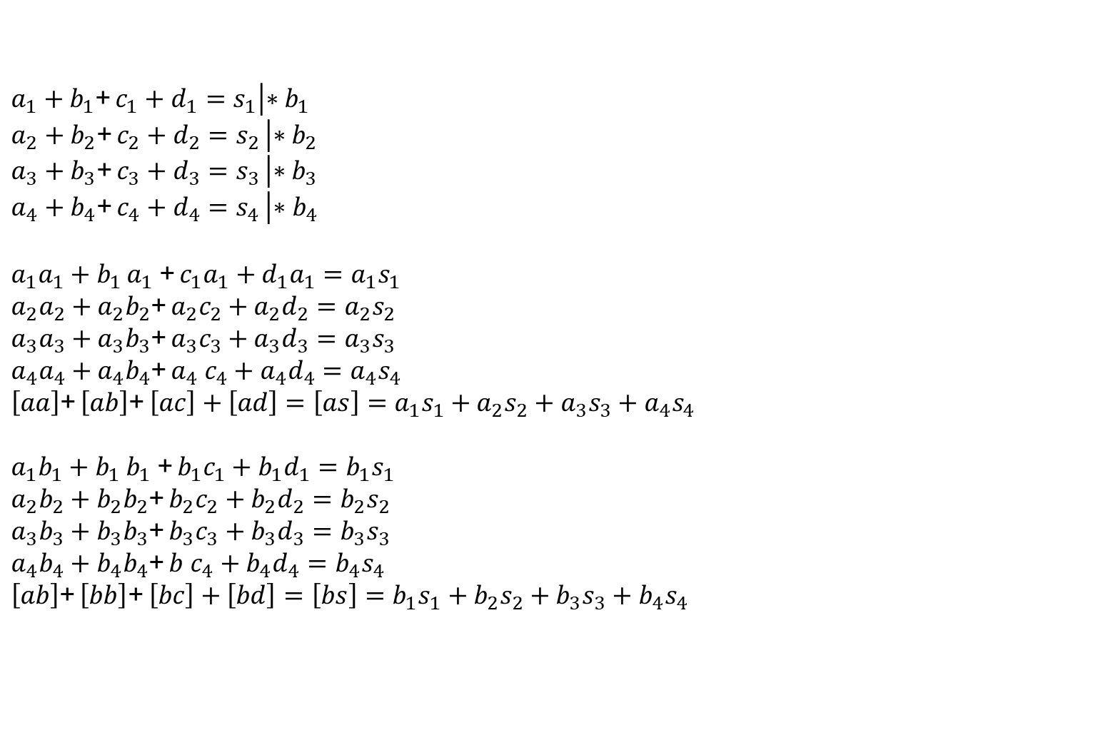
Kontrollimi I llogaritjeve me metoden kushtore
$a_{1}+b_{1}$+ $c_{1}+d_{1}=s_{1}\left|{∗b}_{1}\right.$
$a_{2}+b_{2}$+ $c_{2}+d_{2}=s_{2}$ $\left|∗b_{2}\right.$
$a_{3}+b_{3}$+ $c_{3}+d_{3}=s_{3}$ $\left|∗b_{3}\right.$
$a_{4}+b_{4}$+ $c_{4}+d_{4}=s_{4}$ $\left|{∗b}_{4}\right.$
$a_{1}a_{1}+b_{1}$ $a_{1}$+ $c_{1}a_{1}+d_{1}a_{1}={a_{1}s}_{1}$
$a_{2}a_{2}+{a_{2}b}_{2}$+ ${a_{2}c}_{2}+a_{2}d_{2}=a_{2}s_{2}$
${a_{3}a}_{3}+{a_{3}b}_{3}$+ ${a_{3}c}_{3}+a_{3}d_{3}={a_{3}s}_{3}$
${a_{4}a}_{4}+{a_{4}b}_{4}$+ $a_{4} c_{4}+{a_{4}d}_{4}=a_{4}s_{4}$
$\left[aa\right]$+ $\left[ab\right]$+ $\left[ac\right]+\left[ad\right]=\left[as\right]={a_{1}s}_{1}+{a_{2}s}_{2}+{a_{3}s}_{3}+{a_{4}s}_{4}$
$a_{1}b_{1}+b_{1}$ $b_{1}$+ $b_{1}c_{1}+b_{1}d_{1}={b_{1}s}_{1}$
$a_{2}b_{2}+{b_{2}b}_{2}$+ ${b_{2}c}_{2}+b_{2}d_{2}=b_{2}s_{2}$
${a_{3}b}_{3}+{b_{3}b}_{3}$+ ${b_{3}c}_{3}+b_{3}d_{3}={b_{3}s}_{3}$
${a_{4}b}_{4}+{b_{4}b}_{4}$+ $b c_{4}+{b_{4}d}_{4}=b_{4}s_{4}$
$\left[ab\right]$+ $\left[bb\right]$+ $\left[bc\right]+\left[bd\right]=\left[bs\right]={b_{1}s}_{1}+{b_{2}s}_{2}+{b_{3}s}_{3}+{b_{4}s}_{4}$

Slide 19
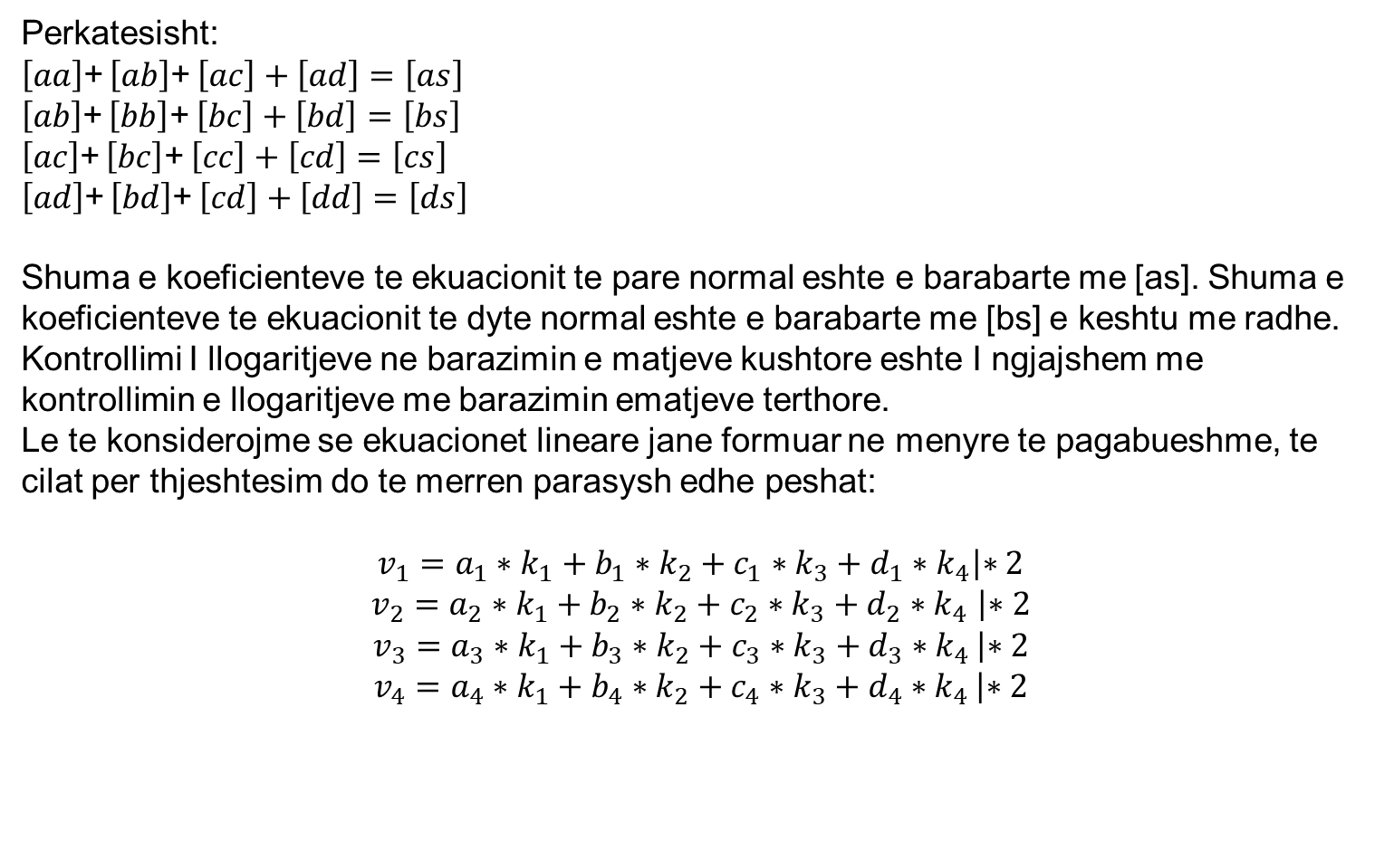
Kontrollimi I llogaritjeve me metoden kushtore
Perkatesisht:
$\left[aa\right]$+ $\left[ab\right]$+ $\left[ac\right]+\left[ad\right]=\left[as\right]$
$\left[ab\right]$+ $\left[bb\right]$+ $\left[bc\right]+\left[bd\right]=\left[bs\right]$
$\left[ac\right]$+ $\left[bc\right]$+ $\left[cc\right]+\left[cd\right]=\left[cs\right]$
$\left[ad\right]$+ $\left[bd\right]$+ $\left[cd\right]+\left[dd\right]=\left[ds\right]$
Shuma e koeficienteve te ekuacionit te pare normal eshte e barabarte me [as]. Shuma e koeficienteve te ekuacionit te dyte normal eshte e barabarte me [bs] e keshtu me radhe.
Kontrollimi I llogaritjeve ne barazimin e matjeve kushtore eshte I ngjajshem me kontrollimin e llogaritjeve me barazimin ematjeve terthore.
Le te konsiderojme se ekuacionet lineare jane formuar ne menyre te pagabueshme, te cilat per thjeshtesim do te merren parasysh edhe peshat:
$$v_{1}=a_{1}∗k_{1}+b_{1}∗k_{2}+c_{1}∗k_{3}+d_{1}∗k_{4}\left|∗2\right.$$
$v_{2}=a_{2}∗k_{1}+b_{2}∗k_{2}+c_{2}∗k_{3}+d_{2}∗k_{4}$ $\left|∗2\right.$
$v_{3}=a_{3}∗k_{1}+b_{3}∗k_{2}+c_{3}∗k_{3}+d_{3}∗k_{4}$ $\left|∗2\right.$
$v_{4}=a_{4}∗k_{1}+b_{4}∗k_{2}+c_{4}∗k_{3}+d_{4}∗k_{4}$ $\left|∗2\right.$

Slide 20
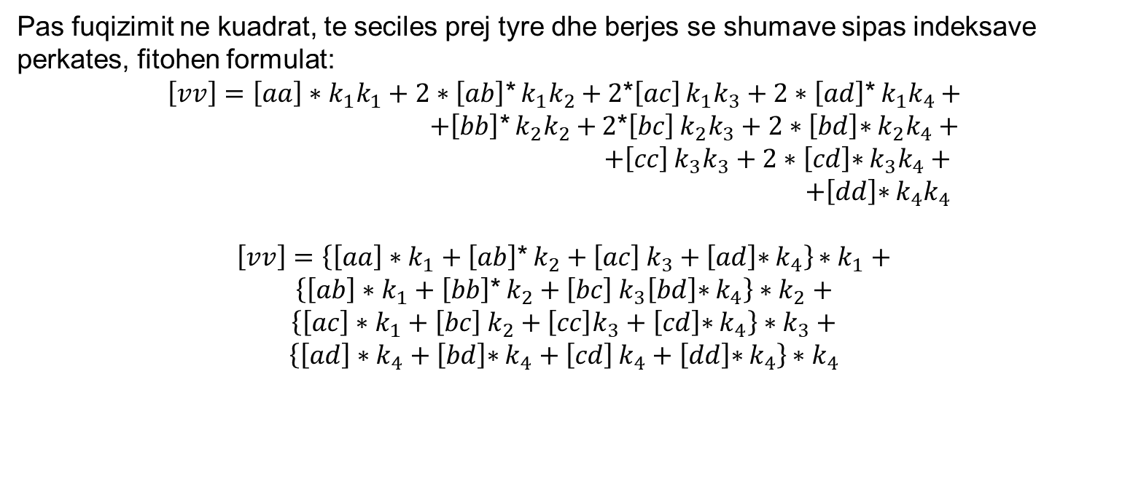
Kontrollimi I llogaritjeve me metoden kushtore
Pas fuqizimit ne kuadrat, te seciles prej tyre dhe berjes se shumave sipas indeksave perkates, fitohen formulat:
$\left[vv\right]=\left[aa\right]∗k_{1}k_{1}+2∗\left[ab\right]$* $k_{1}k_{2}+$ $2$*$\left[ac\right]$ $k_{1}k_{3}+2∗\left[ad\right]\text{∗} k_{1}k_{4}+$
$+\left[bb\right]$* $k_{2}k_{2}+$ $2$*$\left[bc\right]$ $k_{2}k_{3}+2∗\left[bd\right]\text{∗} k_{2}k_{4}+$
$+\left[cc\right]$ $k_{3}k_{3}+2∗\left[cd\right]\text{∗} k_{3}k_{4}+$
$+\left[dd\right]\text{∗} k_{4}k_{4}$
$\left[vv\right]=\left\{\left[aa\right]∗k_{1}+\left[ab\right]\text{∗} k_{2}+\left[ac\right] k_{3}+\left[ad\right]\text{∗} k_{4}\right\}$ $∗k_{1}+$
$\left\{\left[ab\right]∗k_{1}+\left[bb\right]\text{∗} k_{2}+\left[bc\right] k_{3}\left[bd\right]\text{∗} k_{4}\right\}∗k_{2}+$
$\left\{\left[ac\right]∗k_{1}+\left[bc\right] k_{2}+\left[cc\right]k_{3}+\left[cd\right]\text{∗} k_{4}\right\}∗k_{3}+$
$\left\{\left[ad\right]∗k_{4}+\left[bd\right]\text{∗} k_{4}+\left[cd\right] k_{4}+\left[dd\right]\text{∗} k_{4}\right\}$ $∗k_{4}$

Slide 21
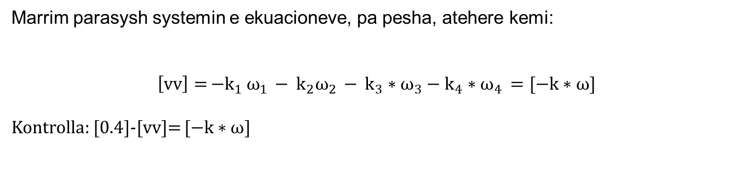
Kontrollimi I llogaritjeve me metoden kushtore
Marrim parasysh systemin e ekuacioneve, pa pesha, atehere kemi:
$\left[vv\right]=$ $−k_{1 }ω_{1 }− k_{2}ω_{2 }− k_{3}∗ω_{3}−k_{4}∗ω_{4 }=[−k∗ω$]
Kontrolla: [0.4]-[vv]= $[−k∗ω$]

Slide 22
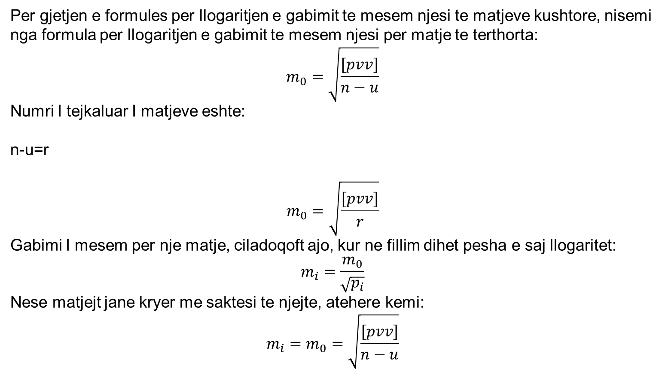
Gabimi I mesem njesi I matjeve
Per gjetjen e formules per llogaritjen e gabimit te mesem njesi te matjeve kushtore, nisemi nga formula per llogaritjen e gabimit te mesem njesi per matje te terthorta:
$$m_{0}=\sqrt{\frac{[pvv]}{n−u}}$$
Numri I tejkaluar I matjeve eshte:
n-u=r
$$m_{0}=\sqrt{\frac{[pvv]}{r}}$$
Gabimi I mesem per nje matje, ciladoqoft ajo, kur ne fillim dihet pesha e saj llogaritet:
$$m_{i}=\frac{m_{0}}{\sqrt{p_{i}}}$$
Nese matjejt jane kryer me saktesi te njejte, atehere kemi:
$$m_{i}=m_{0}=\sqrt{\frac{[pvv]}{n−u}}$$

Slide 23
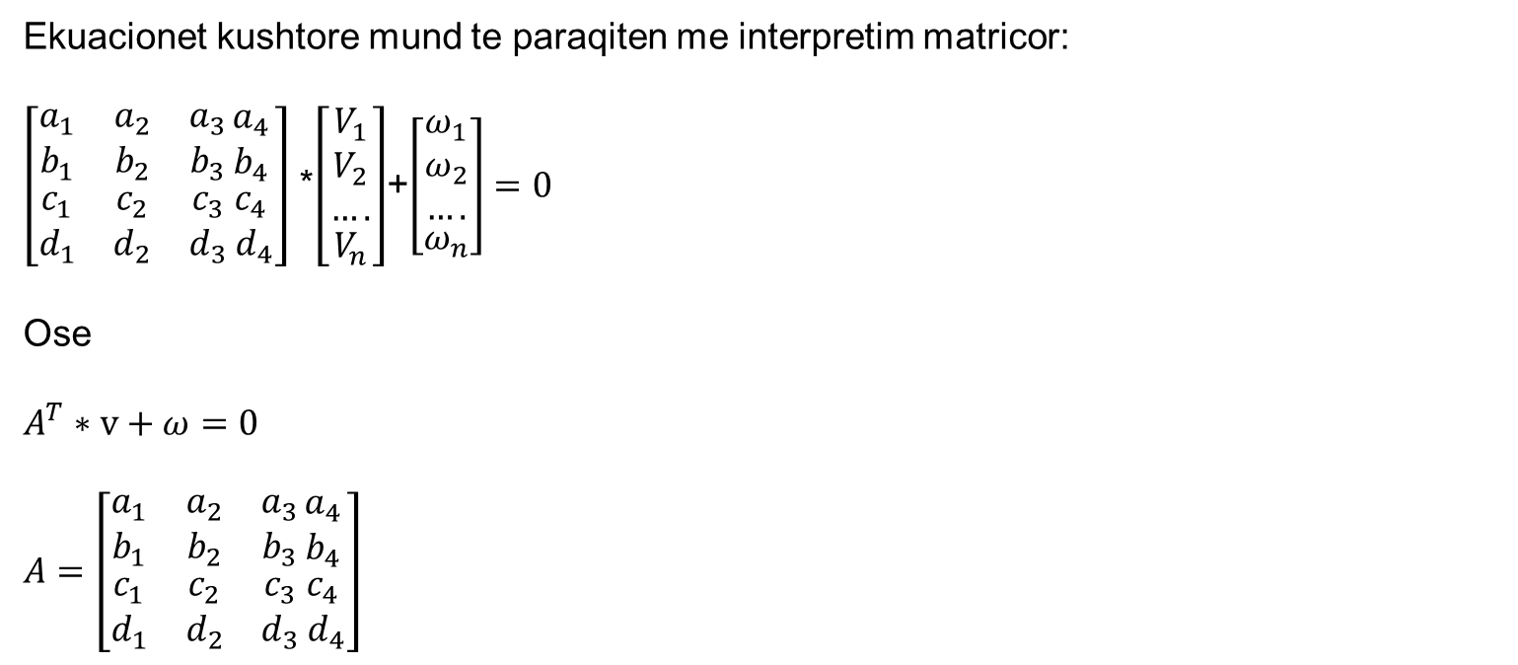
Interpretimi matricor I teorise se barazimit te matjeve kushtore
Ekuacionet kushtore mund te paraqiten me interpretim matricor:
$\left[\begin{matrix}a_{1} & a_{2} & a_{3} \\ b_{1} & b_{2} & b_{3} \\ \begin{aligned}c_{1} \\ d_{1}\end{aligned} & \begin{aligned}c_{2} \\ d_{2}\end{aligned} & \begin{aligned}c_{3} \\ d_{3}\end{aligned}\end{matrix}\begin{matrix}a_{4} \\ b_{4} \\ \begin{aligned}c_{4} \\ { d}_{4}\end{aligned}\end{matrix}\right]$ *$\left[\begin{aligned}\begin{matrix}V_{1} \\ V_{2} \\ ….\end{matrix} \\ V_{n}\end{aligned}\right]$+$\left[\begin{aligned}\begin{matrix}ω_{1} \\ ω_{2} \\ ….\end{matrix} \\ ω_{n}\end{aligned}\right]=0$
Ose
$$A^{T}∗v+ω=0$$
$$A=\left[\begin{matrix}a_{1} & a_{2} & a_{3} \\ b_{1} & b_{2} & b_{3} \\ \begin{aligned}c_{1} \\ d_{1}\end{aligned} & \begin{aligned}c_{2} \\ d_{2}\end{aligned} & \begin{aligned}c_{3} \\ d_{3}\end{aligned}\end{matrix}\begin{matrix}a_{4} \\ b_{4} \\ \begin{aligned}c_{4} \\ { d}_{4}\end{aligned}\end{matrix}\right]$$

Slide 24
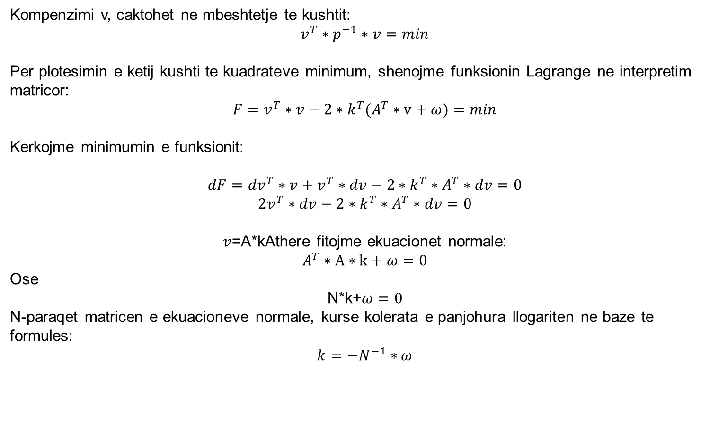
Interpretimi matricor I teorise se barazimit te matjeve kushtore
Kompenzimi v, caktohet ne mbeshtetje te kushtit:
$$v^{T}∗p^{−1}∗v=min$$
Per plotesimin e ketij kushti te kuadrateve minimum, shenojme funksionin Lagrange ne interpretim matricor:
$$F=v^{T}∗v−2∗k^{T}(A^{T}∗v+ω)=min$$
Kerkojme minimumin e funksionit:
$$dF={dv}^{T}∗v+v^{T}∗dv−2∗k^{T}∗A^{T}∗dv=0$$
$$2v^{T}∗dv−2∗k^{T}∗A^{T}∗dv=0$$
$v$=A*kAthere fitojme ekuacionet normale:
$$A^{T}∗A∗k+ω=0$$
Ose
N*k+$ω=0$
N-paraqet matricen e ekuacioneve normale, kurse kolerata e panjohura llogariten ne baze te formules:
${k=−N}^{−1}∗$ $ω$

