Slide 1
Zgjidhja e ekuacioneve normale-skema gauss
Ekuacionet normale kane formen:
[paa]*Δx+[pab]*Δy+[pac]*Δz+[pad]*Δt+[paf]±[pas]=0
[pbb]*Δy+[pbc]*Δz+[pbd]*Δt+[pbf]±[pbs]=0
[pcc]*Δz+[pcd]*Δt+[pcf]±[pcs]=0
[pdd]*Δt+[pdf]±[pds]=0

Slide 2
Zgjidhja e ekuacioneve normale-skema gauss
Skema Gauss-algoritmi Gauss?

Slide 3

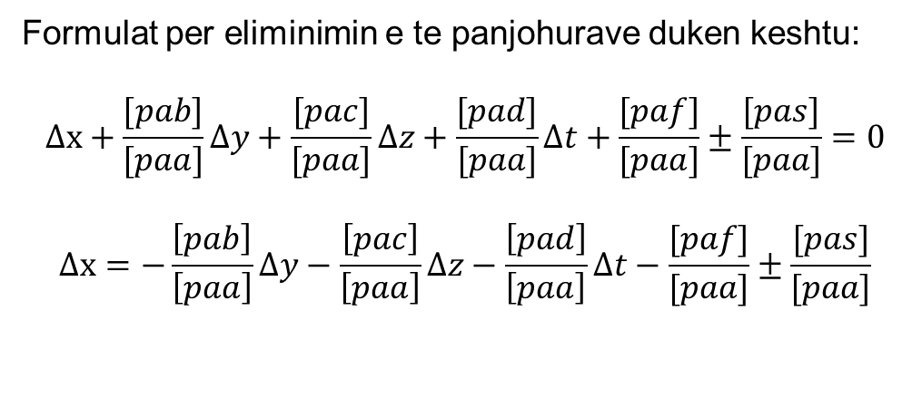
Zgjidhja e ekuacioneve normale-skema gauss
Skema Gauss-algoritmi Gauss bazohet ne eliminimin e te panjohurave nje nga nje, algoritem ky I sistemuar ne nje skeme perkatese.
Formulat per eliminimin e te panjohurave duken keshtu:
$$∆x+\frac{[pab]}{[paa]}∆y+\frac{[pac]}{[paa]}∆z+\frac{[pad]}{[paa]}∆t+\frac{[paf]}{[paa]}±\frac{[pas]}{[paa]}=0$$
$$∆x=−\frac{\left[pab\right]}{\left[paa\right]}∆y−\frac{\left[pac\right]}{\left[paa\right]}∆z−\frac{\left[pad\right]}{\left[paa\right]}∆t−\frac{[paf]}{[paa]}±\frac{[pas]}{[paa]}$$
Bejme zevendesimin e te panjohures $∆x$ ne ekuacionin e dyte, te trete dhe te katert. Me kete veprim te ekuacionet te dytin, te tretin dhe te katertin nuk figuron e panjohura e pare

Slide 4
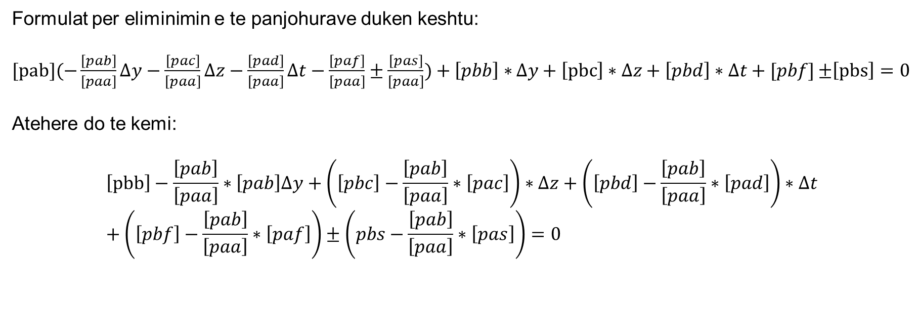
Zgjidhja e ekuacioneve normale-skema gauss
Formulat per eliminimin e te panjohurave duken keshtu:
$[pab](−\frac{\left[pab\right]}{\left[paa\right]}∆y−\frac{\left[pac\right]}{\left[paa\right]}∆z−\frac{\left[pad\right]}{\left[paa\right]}∆t−\frac{\left[paf\right]}{\left[paa\right]}±\frac{\left[pas\right]}{\left[paa\right]})+\left[pbb\right]∗$ $∆y+\left[pbc\right]∗∆z+\left[pbd\right]∗∆t+[pbf]$ $±\left[pbs\right]=0$
Atehere do te kemi:
$$\left[pbb\right]−\frac{\left[pab\right]}{\left[paa\right]}∗\left[pab\right]∆y+\left(\left[pbc\right]−\frac{\left[pab\right]}{\left[paa\right]}∗\left[pac\right]\right)∗∆z+\left(\left[pbd\right]−\frac{\left[pab\right]}{\left[paa\right]}∗\left[pad\right]\right)∗∆t+\left(\left[pbf\right]−\frac{\left[pab\right]}{\left[paa\right]}∗\left[paf\right]\right)±\left(pbs−\frac{\left[pab\right]}{\left[paa\right]}∗\left[pas\right]\right)=0$$

Slide 5

Zgjidhja e ekuacioneve normale-skema gauss
Bazuar ne simboliken matematikore te pervetesuar nga Gauss, ekuacioni I dyte pa te panjohuren e pare duket keshtu:
[pbb*1]* $∆y$+[pbc*1] $∆z+\left[pbd∗1\right]∗∆t+[pbf∗1]$ $±$[pbs*1]=0
Atehere kemi:
$$\left[pbb∗1\right]=\left[pbb\right]−\frac{\left[pab\right]}{\left[paa\right]}∗\left[pab\right]$$
$$\left[pbc∗1\right]=[pbc]−\frac{\left[pab\right]}{\left[paa\right]}∗\left[pac\right]$$
$$\left[pbd∗1\right]=[pbd]−\frac{\left[pab\right]}{\left[paa\right]}∗\left[pad\right]$$
$$\left[pbf∗1\right]=[pbf]−\frac{\left[pab\right]}{\left[paa\right]}∗\left[paf\right]$$
$$\left[pbs∗1\right]=±\left[pbs\right]− \frac{\left[pab\right]}{\left[paa\right]}∗\left[pas\right]$$

Slide 6
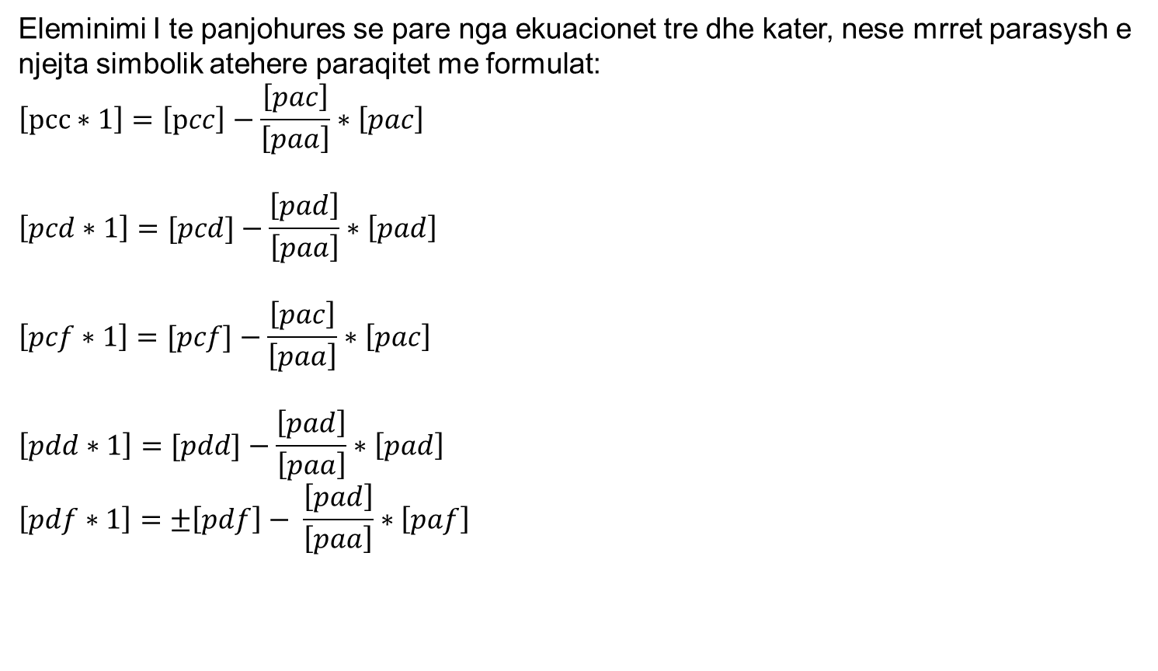
Zgjidhja e ekuacioneve normale-skema gauss
Eleminimi I te panjohures se pare nga ekuacionet tre dhe kater, nese mrret parasysh e njejta simbolik atehere paraqitet me formulat:
$$\left[pcc∗1\right]=\left[pcc\right]−\frac{\left[pac\right]}{\left[paa\right]}∗\left[pac\right]$$
$$\left[pcd∗1\right]=[pcd]−\frac{\left[pad\right]}{\left[paa\right]}∗\left[pad\right]$$
$$\left[pcf∗1\right]=[pcf]−\frac{\left[pac\right]}{\left[paa\right]}∗\left[pac\right]$$
$$\left[pdd∗1\right]=[pdd]−\frac{\left[pad\right]}{\left[paa\right]}∗\left[pad\right]$$
$$\left[pdf∗1\right]=±\left[pdf\right]− \frac{\left[pad\right]}{\left[paa\right]}∗\left[paf\right]$$

Slide 7
Zgjidhja e ekuacioneve normale-skema gauss
Pas eleminimit te panjohures se pare, forma e ekuacioneve dyte, te trete dhe te katert paraqitet me formulat e meposhtme:
[pbb*1]*Δy+[pbc*1]*Δz+[pbd*1]*Δt+[pbf*1]±[pbs*1]=0
[pbc*1]* Δy+ [pcc*1]*Δz+[pcd*1]*Δt+[pcf*1]±[pcs*1]=0
[pbd*1] Δy+[pcd*1] *Δz+[pdd*1]*Δt+[pdf*1]±[pds*1]=0
Keshtu kemi fituar tri ekuacione me tri te panjohura.

Slide 8
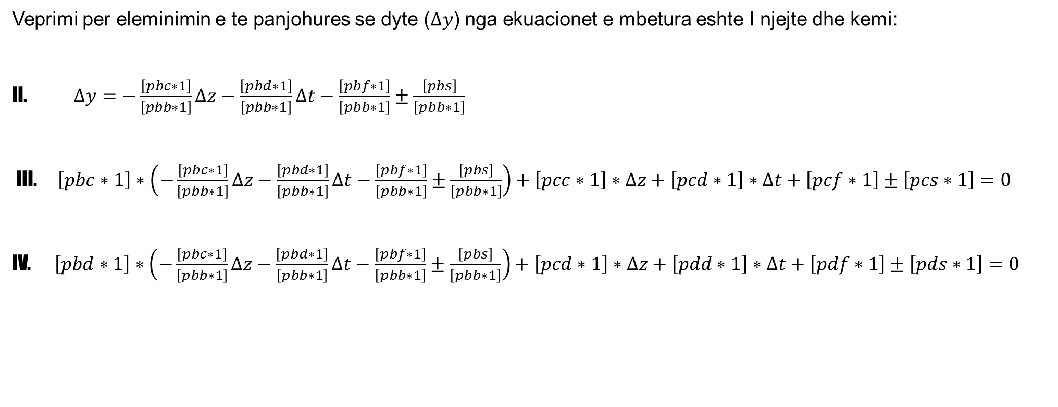
Zgjidhja e ekuacioneve normale-skema gauss
Veprimi per eleminimin e te panjohures se dyte ($∆y$) nga ekuacionet e mbetura eshte I njejte dhe kemi:
II. $∆y=−\frac{\left[pbc∗1\right]}{\left[pbb∗1\right]}∆z−\frac{\left[pbd∗1\right]}{\left[pbb∗1\right]}∆t−\frac{\left[pbf∗1\right]}{\left[pbb∗1\right]}±\frac{\left[pbs\right]}{\left[pbb∗1\right]}$
III. $\left[pbc∗1\right]∗\left(−\frac{\left[pbc∗1\right]}{\left[pbb∗1\right]}∆z−\frac{\left[pbd∗1\right]}{\left[pbb∗1\right]}∆t−\frac{\left[pbf∗1\right]}{\left[pbb∗1\right]}±\frac{\left[pbs\right]}{\left[pbb∗1\right]}\right)+\left[pcc∗1\right]∗∆z+\left[pcd∗1\right]∗∆t+\left[pcf∗1\right]±\left[pcs∗1\right]=0$
IV. $\left[pbd∗1\right]∗\left(−\frac{\left[pbc∗1\right]}{\left[pbb∗1\right]}∆z−\frac{\left[pbd∗1\right]}{\left[pbb∗1\right]}∆t−\frac{\left[pbf∗1\right]}{\left[pbb∗1\right]}±\frac{\left[pbs\right]}{\left[pbb∗1\right]}\right)+\left[pcd∗1\right]∗∆z+\left[pdd∗1\right]∗∆t+\left[pdf∗1\right]±\left[pds∗1\right]=0$

Slide 9
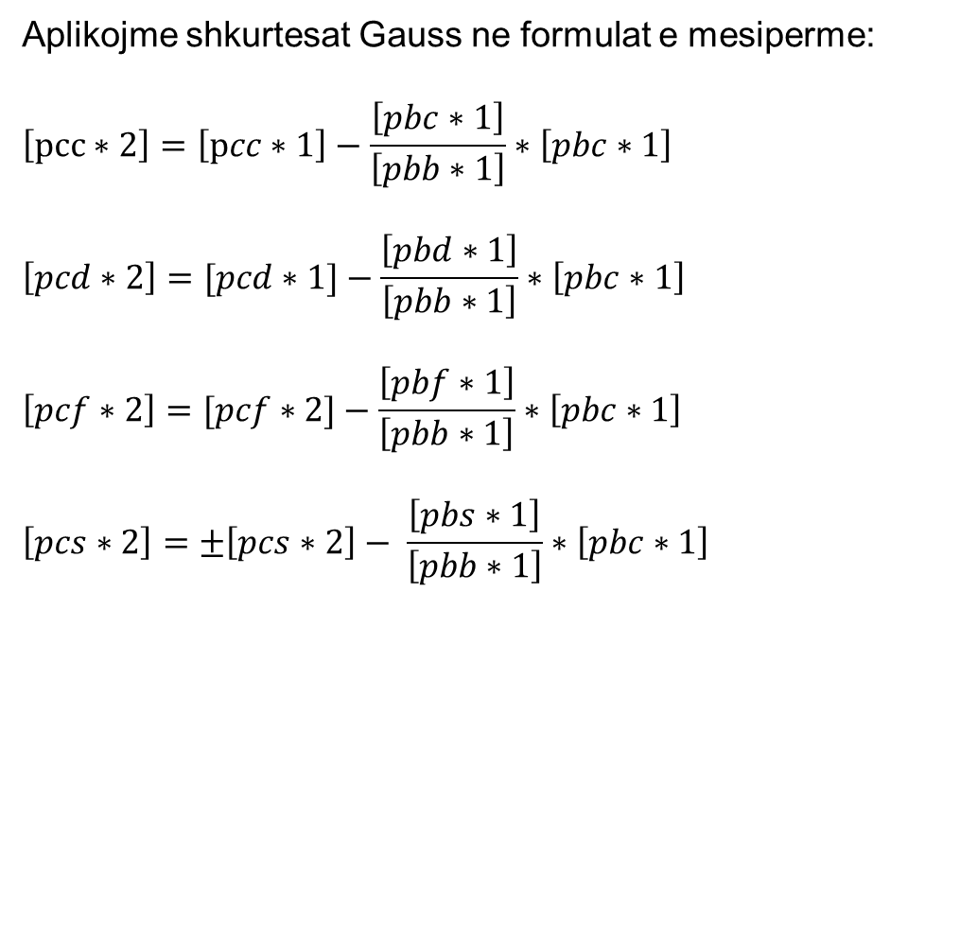
Zgjidhja e ekuacioneve normale-skema gauss
Aplikojme shkurtesat Gauss ne formulat e mesiperme:
$$\left[pcc∗2\right]=\left[pcc∗1\right]−\frac{\left[pbc∗1\right]}{\left[pbb∗1\right]}∗\left[pbc∗1\right]$$
$$\left[pcd∗2\right]=[pcd∗1]−\frac{\left[pbd∗1\right]}{\left[pbb∗1\right]}∗\left[pbc∗1\right]$$
$$\left[pcf∗2\right]=[pcf∗2]−\frac{\left[pbf∗1\right]}{\left[pbb∗1\right]}∗\left[pbc∗1\right]$$
$$\left[pcs∗2\right]=±\left[pcs∗2\right]− \frac{\left[pbs∗1\right]}{\left[pbb∗1\right]}∗\left[pbc∗1\right]$$

Slide 10
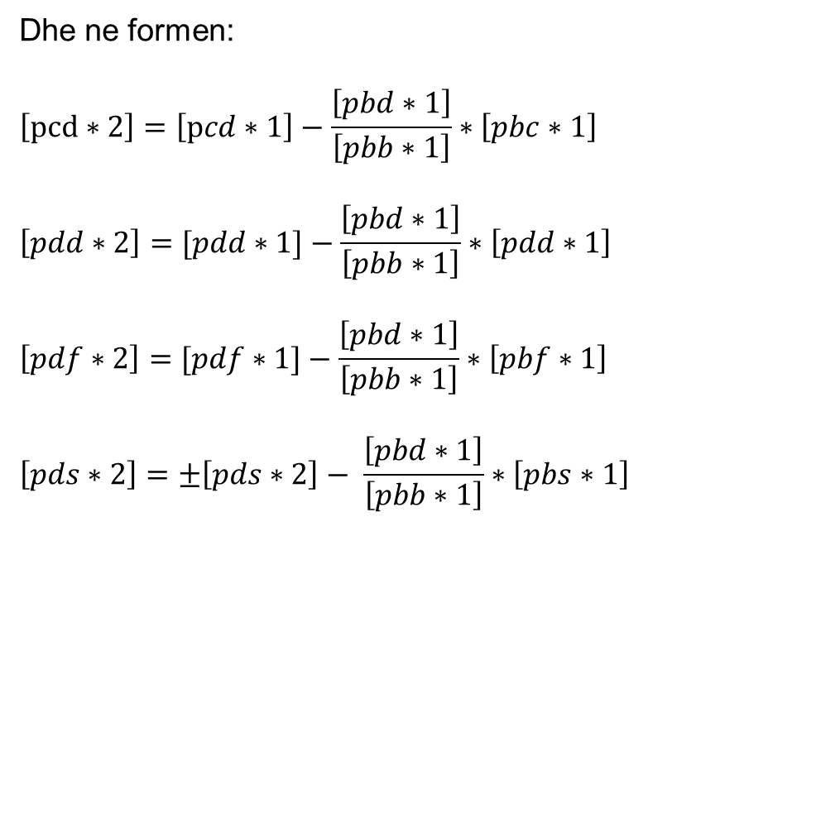
Zgjidhja e ekuacioneve normale-skema gauss
Dhe ne formen:
$$\left[pcd∗2\right]=\left[pcd∗1\right]−\frac{\left[pbd∗1\right]}{\left[pbb∗1\right]}∗\left[pbc∗1\right]$$
$$\left[pdd∗2\right]=[pdd∗1]−\frac{\left[pbd∗1\right]}{\left[pbb∗1\right]}∗\left[pdd∗1\right]$$
$$\left[pdf∗2\right]=[pdf∗1]−\frac{\left[pbd∗1\right]}{\left[pbb∗1\right]}∗\left[pbf∗1\right]$$
$$\left[pds∗2\right]=±\left[pds∗2\right]− \frac{\left[pbd∗1\right]}{\left[pbb∗1\right]}∗\left[pbs∗1\right]$$

Slide 11
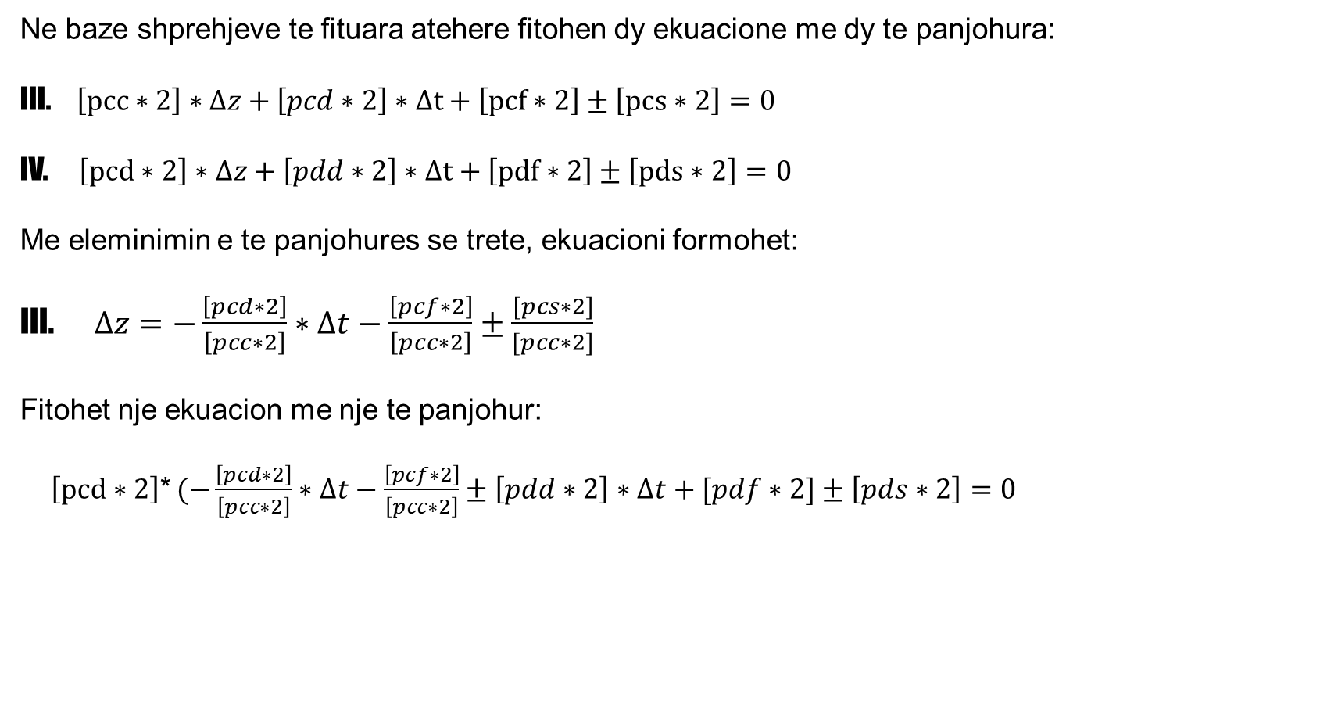
Zgjidhja e ekuacioneve normale-skema gauss
Ne baze shprehjeve te fituara atehere fitohen dy ekuacione me dy te panjohura:
III. $\left[pcc∗2\right]∗∆z+\left[pcd∗2\right]∗∆t+\left[pcf∗2\right]±\left[pcs∗2\right]=0$
IV. $\left[pcd∗2\right]∗∆z+\left[pdd∗2\right]∗∆t+\left[pdf∗2\right]±\left[pds∗2\right]=0$
Me eleminimin e te panjohures se trete, ekuacioni formohet:
III. $∆z=−\frac{\left[pcd∗2\right]}{\left[pcc∗2\right]}∗∆t−\frac{\left[pcf∗2\right]}{\left[pcc∗2\right]}±\frac{[pcs∗2]}{[pcc∗2]}$
Fitohet nje ekuacion me nje te panjohur:
$\left[pcd∗2\right]$* $(−\frac{\left[pcd∗2\right]}{\left[pcc∗2\right]}∗∆t−\frac{\left[pcf∗2\right]}{\left[pcc∗2\right]}±\left[pdd∗2\right]∗∆t+[pdf∗2]±\left[pds∗2\right]=0$

Slide 12

Zgjidhja e ekuacioneve normale-skema gauss
Perfundimisht kemi vleren e te panjohures se fundit $∆t$:
IV. $\left[pdd∗3\right]∗∆t+\left[pdf∗3\right]±\left[pds∗3\right]=0$
IV. $∆t=\frac{[pdf∗3]}{[pdd∗3]}±\frac{[pds∗3]}{[pdd∗3]}$
Ku eshte formuar:
$$\left[pdd∗3\right]=\left[pdd∗2\right]−\frac{\left[pcd∗2\right]}{\left[pcc∗2\right]}∗[pcd∗2]$$
$$\left[pdf∗3\right]=\left[pdf∗2\right]−\frac{\left[pcf∗2\right]}{\left[pcc∗2\right]}∗[pdf∗2]$$
$$\left[pds∗3\right]=\left[pds∗2\right]−\frac{\left[pcs∗2\right]}{\left[pcc∗2\right]}∗[pds∗2]$$

Slide 13

Zgjidhja e ekuacioneve normale-skema gauss
Kontrolla perfundimtare:
$$\left[pff∗4\right]=\left[pfs∗4\right]$$
[pff*4]=[pff]+[pff*1]+[pff*2]+[pff*3]
[pfs*4]=[pfs]+[pfs*1]+[pfs*2]+[pfs*3]

Slide 14
Zgjidhja e ekuacioneve normale-skema gauss
Janë dhënë ekuacionet normale. Të zgjidhet detyra sipas skemës së Gaussit
 | a] | b] | c] | d] | f] | s]
a] | -253.9031 | 352.2693 | -706.4093 | -420.8069 | 387.0109 | -641.8391
 | b] | 824.0969 | -263.8069 | -159.5906 | 246.0745 | 999.0432
 |  | c] | -381.9924 | -218.5053 | 643.1113 | -927.6026
 |  |  | d] | 687.0075 | -428.0706 | -539.9659
 |  |  |  | f] | 992.0166 | 1840.1427
 |  |  |  |  | s] | 729.7783

Slide 15
 | a] | b] | c] | d] | f] | s] | Kontrolla:
[a | -253.9031 | 352.2693 | -706.4093 | -420.8069 | 387.0109 | -641.8391
 | -1.00 | 1.3874 | -2.7822 | -1.6574 | 1.5242 | -2.5279 | -2.5279
 | [b | 824.0969 | -263.8069 | -159.5906 | 246.0745 | 999.0432
 |  | 488.7442 | -980.0838 | -583.8344 | 536.9452 | -890.4980
 |  | 1312.8411 | -1243.8907 | -743.4250 | 783.0197 | 108.5452
 |  | -1.00 | 0.9475 | 0.5663 | -0.5964 | -0.0827 | -0.0827
 |  | [c | -381.9924 | -218.5053 | 643.1113 | -927.6026
 |  |  | 1965.3722 | 1170.7691 | -1076.7419 | 1785.7250
 |  |  | 1583.3798 | 952.2638 | -433.6306 | 858.1224
 |  |  | -1178.5616 | -704.3803 | 741.8955 | 102.8444
 |  |  | 404.8183 | 247.8835 | 308.2650 | 960.9668
 |  |  | -1.00 | -0.6123 | -0.7615 | -2.3738 | -2.3738
 |  |  | [d | 687.0075 | -428.0706 | -539.9659
 |  |  |  | 697.4253 | -641.4134 | 1063.7535
 |  |  |  | 1384.4328 | -1069.4840 | 523.7876
 |  |  |  | -420.9806 | 443.4020 | 61.4661
 |  |  |  | 963.4522 | -626.0820 | 585.2537
 |  |  |  | -151.7872 | -188.7608 | -588.4315
 |  |  |  | 811.6649 | -814.8428 | -3.1778
 |  |  |  | -1.00 | 1.0039 | 0.0039 | 0.0039
 |  |  |  | [f | 992.0166 | 1840.1427
 |  |  |  |  | 589.9000 | -978.3210
 |  |  |  |  | 1581.9166 | 861.8217
 |  |  |  |  | -467.0176 | -64.7398
 |  |  |  |  | 1114.8990 | 797.0820
 |  |  |  |  | -234.7406 | -731.7664
 |  |  |  |  | 880.1583 | 65.3156
 |  |  |  |  | -818.0330 | -3.1903
 |  |  |  |  | 62.1253 | 62.1253

Slide 16
Llogaritja e X-ve
X1 | 1.8414
X2= | -1.3319
X3 | -1.3762
X4= | 1.0039

Slide 17
ESE-Ekuacionet?

