Slide 1
ekuacione normale

Slide 2
Zgjidhja e ekuacioneve normale sipas metodes cholesky
Metoda Guss zgjidhjen ekuacioneve normale bazen e kane reduktimin e ekuacioneve normale (bazuar ne metoden e zevendesimit), deri ne te panjohuren e fundit.
Metoda Cholesky bazohet ne zgjidhjet qe ka dhene Gauss me nje modifikim me qellim te thjeshtezimit te llogaritjeve dhe te zvogelimit te numrit te formulave per llogaritje.
Simbolet Cholesky jane te ngjajshme me simbolet Gauss. Sipas kesaj simbolike matematikore, kemi keto formula paraqitur ne forme permbledhese.

Slide 3
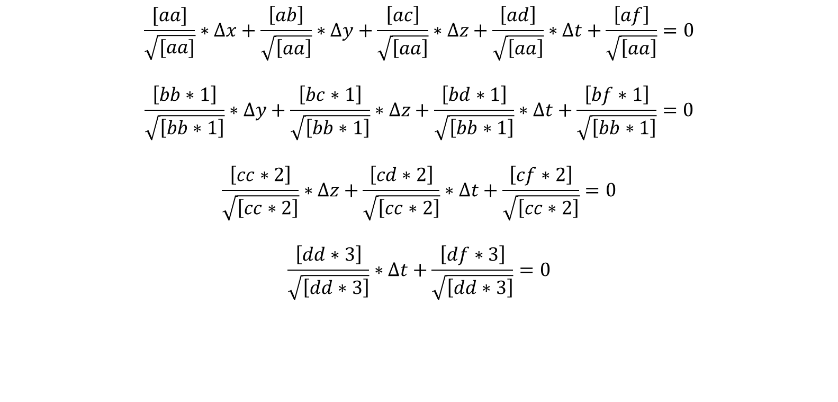
Zgjidhja e ekuacioneve normale sipas metodes cholesky
$$\frac{[aa]}{\sqrt{[aa]}}∗∆x+\frac{\left[ab\right]}{\sqrt{\left[aa\right]}}∗∆y+\frac{\left[ac\right]}{\sqrt{\left[aa\right]}}∗∆z+\frac{\left[ad\right]}{\sqrt{\left[aa\right]}}∗∆t+\frac{\left[af\right]}{\sqrt{\left[aa\right]}}=0$$
$$\frac{\left[bb∗1\right]}{\sqrt{\left[bb∗1\right]}}∗∆y+\frac{\left[bc∗1\right]}{\sqrt{\left[bb∗1\right]}}∗∆z+\frac{\left[bd∗1\right]}{\sqrt{\left[bb∗1\right]}}∗∆t+\frac{\left[bf∗1\right]}{\sqrt{\left[bb∗1\right]}}=0$$
$$\frac{\left[cc∗2\right]}{\sqrt{\left[cc∗2\right]}}∗∆z+\frac{\left[cd∗2\right]}{\sqrt{\left[cc∗2\right]}}∗∆t+\frac{\left[cf∗2\right]}{\sqrt{\left[cc∗2\right]}}=0$$
$$\frac{\left[dd∗3\right]}{\sqrt{\left[dd∗3\right]}}∗∆t+\frac{\left[df∗3\right]}{\sqrt{\left[dd∗3\right]}}=0$$

Slide 4
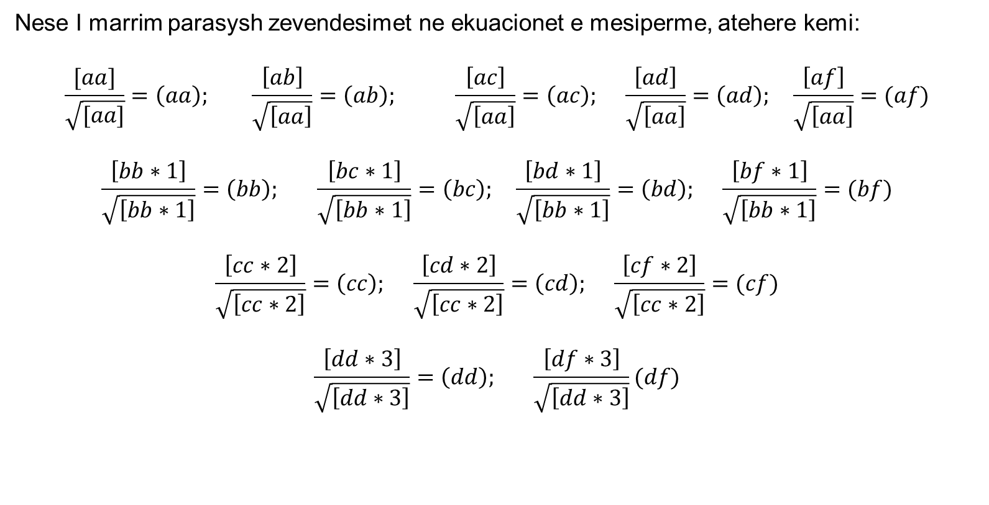
Zgjidhja e ekuacioneve normale sipas metodes cholesky
Nese I marrim parasysh zevendesimet ne ekuacionet e mesiperme, atehere kemi:
$$\frac{[aa]}{\sqrt{[aa]}}=\left(aa\right); \frac{\left[ab\right]}{\sqrt{\left[aa\right]}}=\left(ab\right); \frac{\left[ac\right]}{\sqrt{\left[aa\right]}}=\left(ac\right); \frac{\left[ad\right]}{\sqrt{\left[aa\right]}}=\left(ad\right); \frac{\left[af\right]}{\sqrt{\left[aa\right]}}=(af)$$
$$\frac{\left[bb∗1\right]}{\sqrt{\left[bb∗1\right]}}=\left(bb\right); \frac{\left[bc∗1\right]}{\sqrt{\left[bb∗1\right]}}=\left(bc\right); \frac{\left[bd∗1\right]}{\sqrt{\left[bb∗1\right]}}=\left(bd\right); \frac{\left[bf∗1\right]}{\sqrt{\left[bb∗1\right]}}=(bf)$$
$$\frac{\left[cc∗2\right]}{\sqrt{\left[cc∗2\right]}}=\left(cc\right); \frac{\left[cd∗2\right]}{\sqrt{\left[cc∗2\right]}}=\left(cd\right); \frac{\left[cf∗2\right]}{\sqrt{\left[cc∗2\right]}}=(cf)$$
$$\frac{\left[dd∗3\right]}{\sqrt{\left[dd∗3\right]}}=\left(dd\right); \frac{\left[df∗3\right]}{\sqrt{\left[dd∗3\right]}}(df)$$

Slide 5
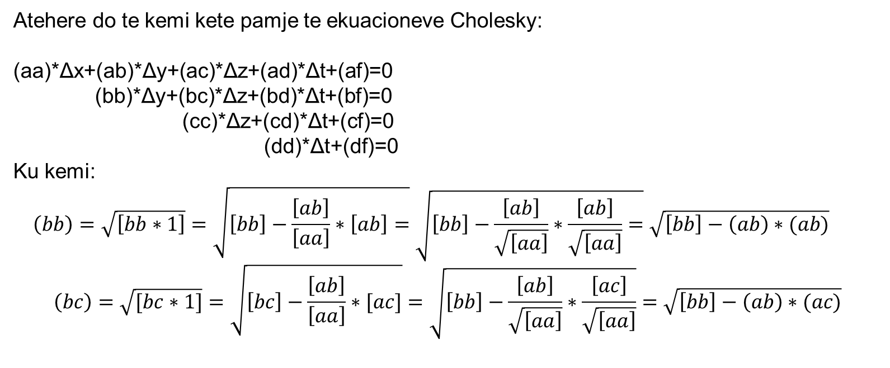
Zgjidhja e ekuacioneve normale sipas metodes cholesky
Atehere do te kemi kete pamje te ekuacioneve Cholesky:
(aa)*Δx+(ab)*Δy+(ac)*Δz+(ad)*Δt+(af)=0
(bb)*Δy+(bc)*Δz+(bd)*Δt+(bf)=0
(cc)*Δz+(cd)*Δt+(cf)=0
(dd)*Δt+(df)=0
Ku kemi:
$$\left(bb\right)=\sqrt{\left[bb∗1\right]}=\sqrt{\left[bb\right]−\frac{\left[ab\right]}{\left[aa\right]}∗\left[ab\right]=}\sqrt{\left[bb\right]−\frac{\left[ab\right]}{\sqrt{\left[aa\right]}}∗\frac{\left[ab\right]}{\sqrt{\left[aa\right]}}=}\sqrt{\left[bb\right]−\left(ab\right)∗(ab)}$$
$$\left(bc\right)=\sqrt{[bc∗1]}=\sqrt{\left[bc\right]−\frac{\left[ab\right]}{\left[aa\right]}∗[ac]}=\sqrt{\left[bb\right]−\frac{\left[ab\right]}{\sqrt{\left[aa\right]}}∗\frac{\left[ac\right]}{\sqrt{\left[aa\right]}}}=\sqrt{\left[bb\right]−\left(ab\right)∗(ac)}$$

Slide 6
Zgjidhja e ekuacioneve normale sipas metodes cholesky
Skema Cholesky:
(aa) | (ab) | (ac) | (ad) | (af) | (as)
 | (bb) | (bc) | (bd) | (bf) | (bs)
 |  | (cc) | (cd) | (cf) | (cs)
 |  |  | (dd) | (df) | (ds)
 |  |  |  | (ff) | (fs)

Slide 7
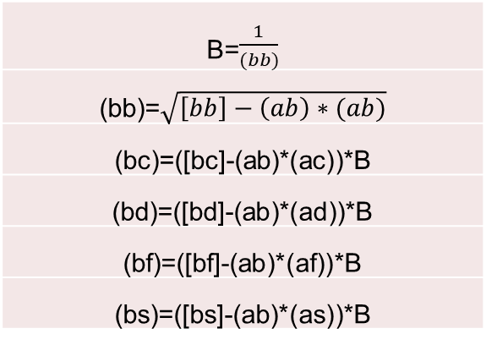
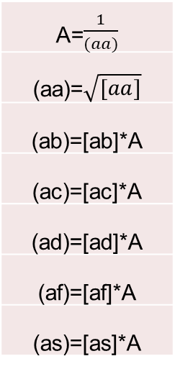
Zgjidhja e ekuacioneve normale sipas metodes cholesky
Sipas simbolikes se pervetesuar kemi keto llogaritje te reduktuara:
A=$\frac{1}{(aa)}$
(aa)=$\sqrt{[aa]}$
(ab)=[ab]*A
(ac)=[ac]*A
(ad)=[ad]*A
(af)=[af]*A
(as)=[as]*A
B=$\frac{1}{(bb)}$
(bb)=$\sqrt{\left[bb\right]−\left(ab\right)∗(ab)}$
(bc)=([bc]-(ab)*(ac))*B
(bd)=([bd]-(ab)*(ad))*B
(bf)=([bf]-(ab)*(af))*B
(bs)=([bs]-(ab)*(as))*B

Slide 8
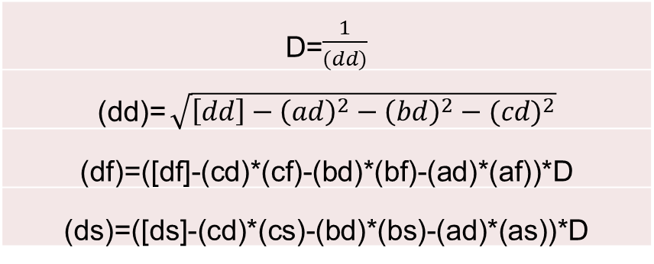
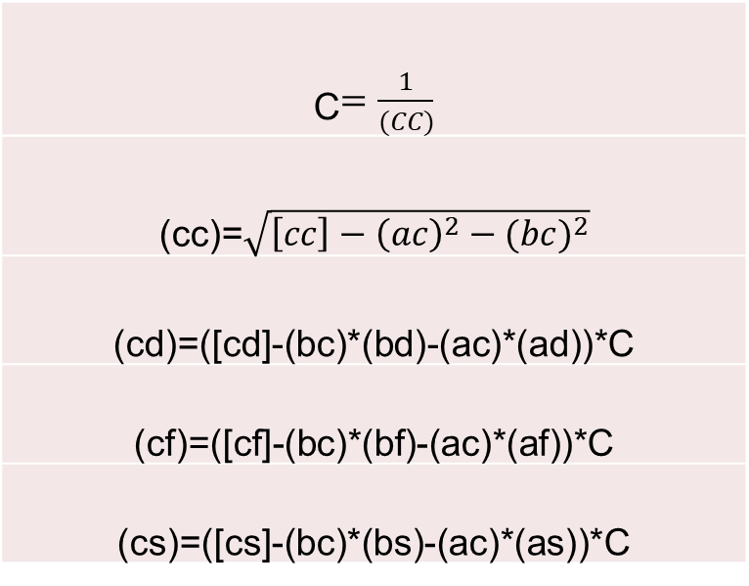
Zgjidhja e ekuacioneve normale sipas metodes cholesky
Sipas simbolikes se pervetesuar kemi keto llogaritje te reduktuara:
C$=\frac{1}{(CC)}$
(cc)=$\sqrt{\left[cc\right]−{\left(ac\right)}^{2}−{(bc)}^{2}}$
(cd)=([cd]-(bc)*(bd)-(ac)*(ad))*C
(cf)=([cf]-(bc)*(bf)-(ac)*(af))*C
(cs)=([cs]-(bc)*(bs)-(ac)*(as))*C
D=$\frac{1}{(dd)}$
(dd)= $\sqrt{\left[dd\right]−{\left(ad\right)}^{2}−{\left(bd\right)}^{2}−{(cd)}^{2}}$
(df)=([df]-(cd)*(cf)-(bd)*(bf)-(ad)*(af))*D
(ds)=([ds]-(cd)*(cs)-(bd)*(bs)-(ad)*(as))*D
(ff)=([ff]-(af)*(af)-(bf)*(bf)-(cf)*(cf)-(df)*(df))
(fs)=([fs]-(af)*(as)-(bf)*(bs)-(cf)*(cs)-(df)*(ds))

Slide 9
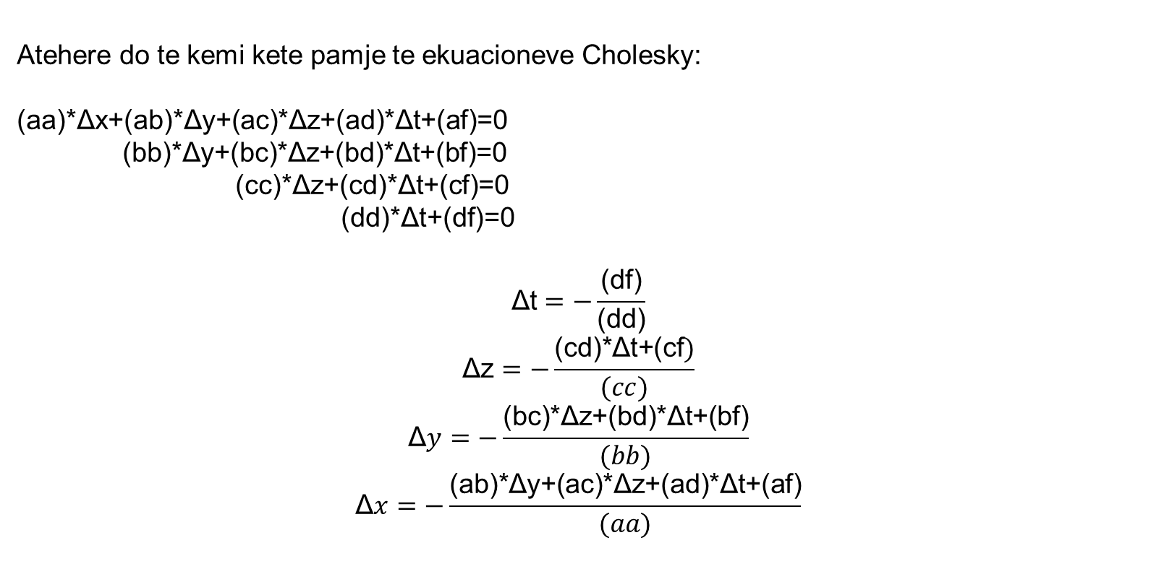
Zgjidhja e ekuacioneve normale sipas metodes cholesky
Atehere do te kemi kete pamje te ekuacioneve Cholesky:
(aa)*Δx+(ab)*Δy+(ac)*Δz+(ad)*Δt+(af)=0
(bb)*Δy+(bc)*Δz+(bd)*Δt+(bf)=0
(cc)*Δz+(cd)*Δt+(cf)=0
(dd)*Δt+(df)=0
$$\text{Δt}=−\frac{\text{(}\text{df}\text{)}}{\text{(}\text{dd}\text{)}}$$
$$\text{Δz}=−\frac{\text{(}\text{cd}\text{)∗}\text{Δt}\text{+(}\text{cf})}{(cc)}$$
$$\text{Δ}y=−\frac{\text{(}\text{bc}\text{)∗}\text{Δz}\text{+(}\text{bd}\text{)∗}\text{Δt}\text{+(}\text{bf}\text{)}}{(bb)}$$
$$\text{Δ}x=−\frac{\text{(}\text{ab}\text{)∗}\text{Δy}\text{+(}\text{ac}\text{)∗}\text{Δz}\text{+(}\text{ad}\text{)∗}\text{Δt}\text{+(}\text{af}\text{)}}{(aa)}$$

Slide 10
ESE- Ekuacionet Normale

