Slide 1
Vleresimi I saktesise se dy te panjohurave

Slide 2
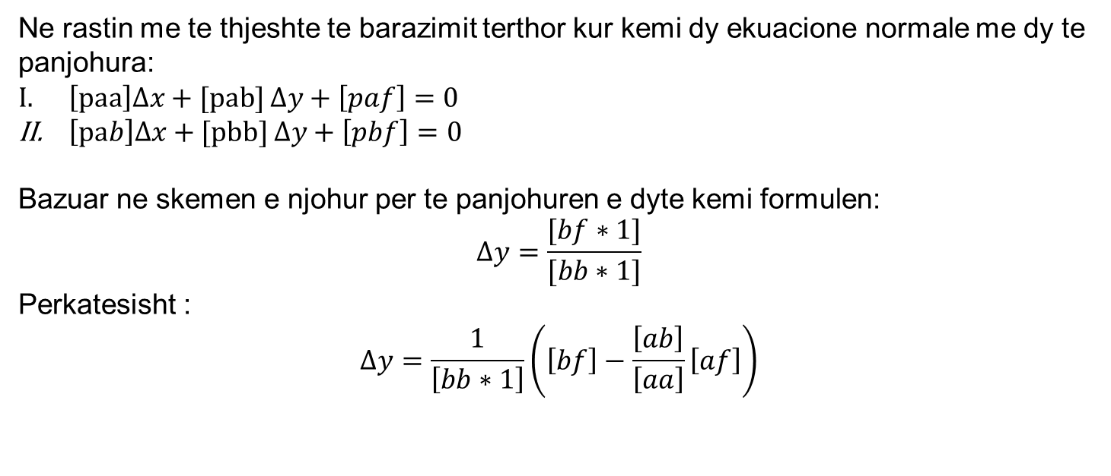
Vleresimi I saktesise se dy te panjohurave
Ne rastin me te thjeshte te barazimit terthor kur kemi dy ekuacione normale me dy te panjohura:
$\left[paa\right]∆x+[pab]$ $∆y+\left[paf\right]=0$
$\left[pab\right]∆x+[pbb]$ $∆y+\left[pbf\right]=0$
Bazuar ne skemen e njohur per te panjohuren e dyte kemi formulen:
$$∆y=\frac{[bf∗1]}{[bb∗1]}$$
Perkatesisht :
$$∆y=\frac{1}{\left[bb∗1\right]}\left(\left[bf\right]−\frac{\left[ab\right]}{\left[aa\right]}\left[af\right]\right)$$

Slide 3
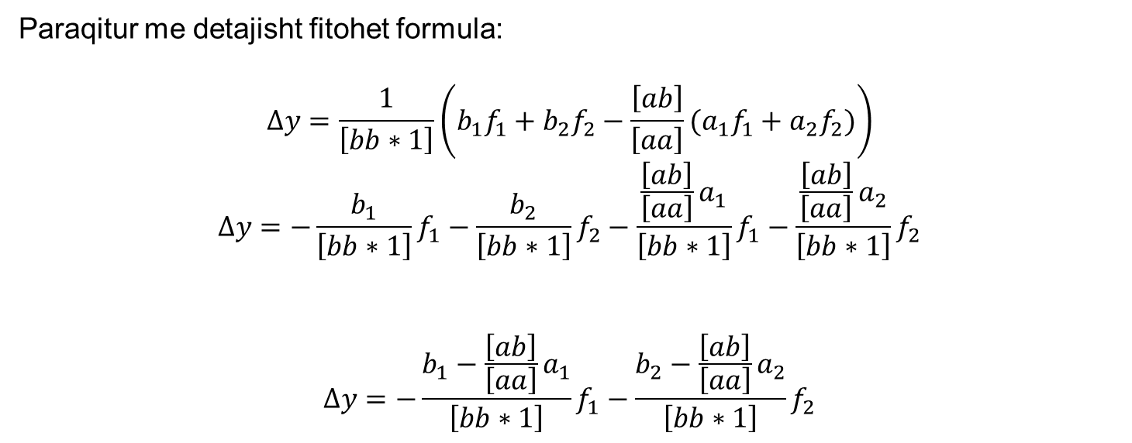
Vleresimi I saktesise se dy te panjohurave
Paraqitur me detajisht fitohet formula:
$$∆y=\frac{1}{\left[bb∗1\right]}\left(b_{1}f_{1}+b_{2}f_{2}−\frac{\left[ab\right]}{\left[aa\right]}{(a}_{1}f_{1}+a_{2}f_{2})\right)$$
$$∆y=−\frac{b_{1}}{\left[bb∗1\right]}f_{1}−\frac{b_{2}}{\left[bb∗1\right]}f_{2}−\frac{\frac{\left[ab\right]}{\left[aa\right]}a_{1}}{\left[bb∗1\right]}f_{1}−\frac{\frac{\left[ab\right]}{\left[aa\right]}a_{2}}{\left[bb∗1\right]}f_{2}$$
$$∆y=−\frac{b_{1}−\frac{\left[ab\right]}{\left[aa\right]}a_{1}}{\left[bb∗1\right]}f_{1}−\frac{b_{2}−\frac{\left[ab\right]}{\left[aa\right]}a_{2}}{\left[bb∗1\right]}f_{2}$$

Slide 4

Vleresimi I saktesise se dy te panjohurave
Me tej ne meyre te shkurtuar mund te shkruajme:
$$β_{1}=\frac{b_{1}−\frac{\left[ab\right]}{\left[aa\right]}a_{1}}{\left[bb∗1\right]}f_{1}$$
$β_{2}=$ $\frac{b_{2}−\frac{\left[ab\right]}{\left[aa\right]}a_{2}}{\left[bb∗1\right]}f_{2}$
$∆y=−$ $β_{1}∗f_{1}−β_{2}∗f_{2}$

Slide 5
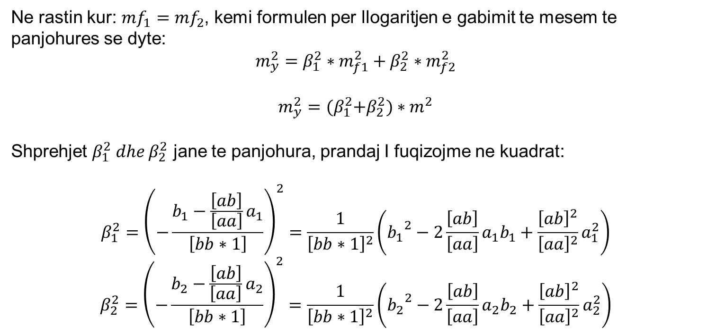
Vleresimi I saktesise se dy te panjohurave
Ne rastin kur: ${mf}_{1}={mf}_{2}$, kemi formulen per llogaritjen e gabimit te mesem te panjohures se dyte:
$$m_{y}^{2}=β_{1}^{2}∗m_{f1}^{2}+β_{2}^{2}∗m_{f2}^{2}$$
$$m_{y}^{2}={(β}_{1}^{2}+β_{2}^{2})∗m^{2}$$
Shprehjet $β_{1}^{2} dhe β_{2}^{2}$ jane te panjohura, prandaj I fuqizojme ne kuadrat:
$$β_{1}^{2}={\left(−\frac{b_{1}−\frac{\left[ab\right]}{\left[aa\right]}a_{1}}{\left[bb∗1\right]}\right)}^{2}=\frac{1}{{\left[bb∗1\right]}^{2}}\left({b_{1}}^{2}−2\frac{\left[ab\right]}{\left[aa\right]}a_{1}b_{1}+\frac{{\left[ab\right]}^{2}}{{\left[aa\right]}^{2}}a_{1}^{2}\right)$$
$$β_{2}^{2}={\left(−\frac{b_{2}−\frac{\left[ab\right]}{\left[aa\right]}a_{2}}{\left[bb∗1\right]}\right)}^{2}=\frac{1}{{\left[bb∗1\right]}^{2}}\left({b_{2}}^{2}−2\frac{\left[ab\right]}{\left[aa\right]}a_{2}b_{2}+\frac{{\left[ab\right]}^{2}}{{\left[aa\right]}^{2}}a_{2}^{2}\right)$$

Slide 6
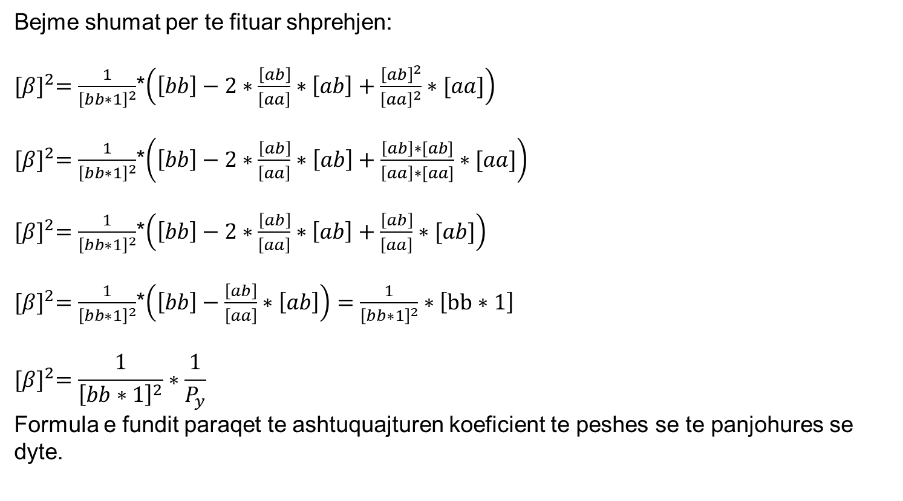
Vleresimi I saktesise se dy te panjohurave
Bejme shumat per te fituar shprehjen:
${[β]}^{2}=\frac{1}{{\left[bb∗1\right]}^{2}}$*$\left(\left[bb\right]−2∗\frac{\left[ab\right]}{\left[aa\right]}∗\left[ab\right]+\frac{{\left[ab\right]}^{2}}{{\left[aa\right]}^{2}}∗[aa]\right)$
${[β]}^{2}=\frac{1}{{\left[bb∗1\right]}^{2}}$*$\left(\left[bb\right]−2∗\frac{\left[ab\right]}{\left[aa\right]}∗\left[ab\right]+\frac{\left[ab\right]∗[ab]}{\left[aa\right]∗[aa]}∗[aa]\right)$
${[β]}^{2}=\frac{1}{{\left[bb∗1\right]}^{2}}$*$\left(\left[bb\right]−2∗\frac{\left[ab\right]}{\left[aa\right]}∗\left[ab\right]+\frac{\left[ab\right]}{\left[aa\right]}∗[ab]\right)$
${[β]}^{2}=\frac{1}{{\left[bb∗1\right]}^{2}}$*$\left(\left[bb\right]−\frac{\left[ab\right]}{\left[aa\right]}∗\left[ab\right]\right)=\frac{1}{{\left[bb∗1\right]}^{2}}∗\left[bb∗1\right]$
$${[β]}^{2}=\frac{1}{{\left[bb∗1\right]}^{2}}∗\frac{1}{P_{y}}$$
Formula e fundit paraqet te ashtuquajturen koeficient te peshes se te panjohures se dyte.

Slide 7
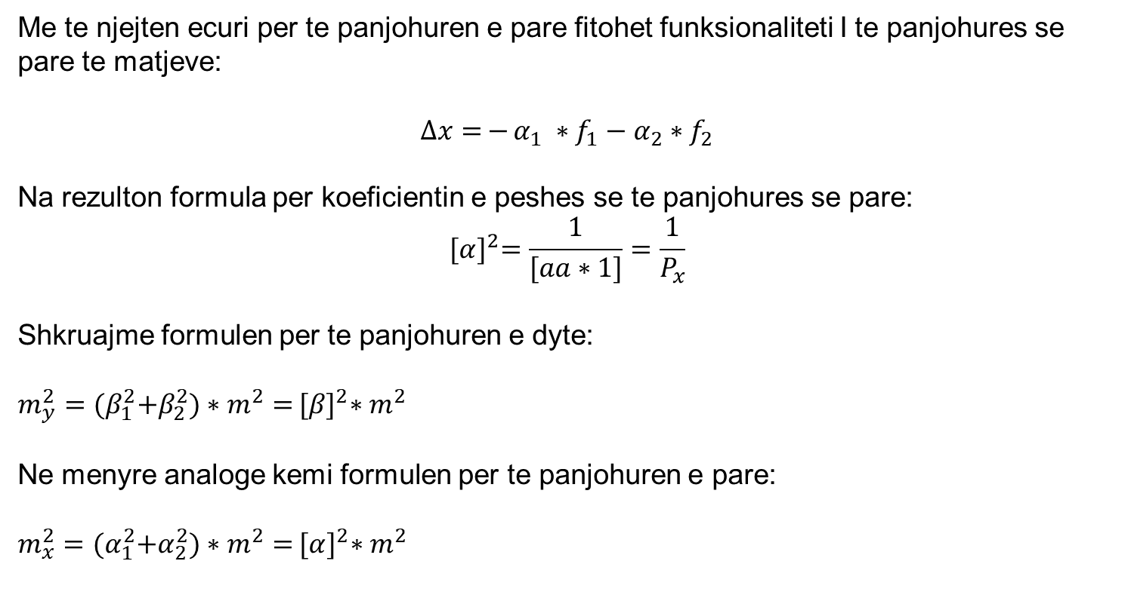
Vleresimi I saktesise se dy te panjohurave
Me te njejten ecuri per te panjohuren e pare fitohet funksionaliteti I te panjohures se pare te matjeve:
$∆x=$ $−$ $α_{1} ∗f_{1}−α_{2}∗f_{2}$
Na rezulton formula per koeficientin e peshes se te panjohures se pare:
$${[α]}^{2}=\frac{1}{[aa∗1]}=\frac{1}{P_{x}}$$
Shkruajme formulen per te panjohuren e dyte:
$m_{y}^{2}={(β}_{1}^{2}+β_{2}^{2})∗m^{2}=$ ${[β]}^{2}∗m^{2}$
Ne menyre analoge kemi formulen per te panjohuren e pare:
$m_{x}^{2}={(α}_{1}^{2}+α_{2}^{2})∗m^{2}=$ ${[α]}^{2}∗m^{2}$

Slide 8
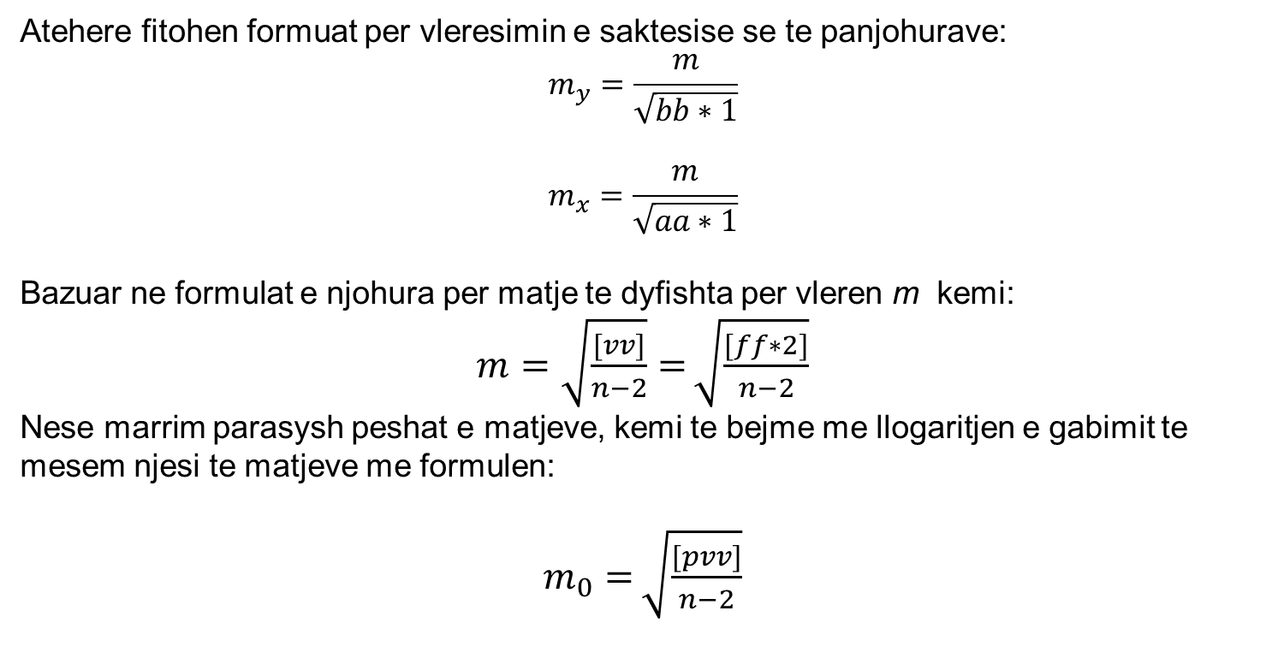
Vleresimi I saktesise se dy te panjohurave
Atehere fitohen formuat per vleresimin e saktesise se te panjohurave:
$$m_{y}=\frac{m}{\sqrt{bb∗1}}$$
$$m_{x}=\frac{m}{\sqrt{aa∗1}}$$
Bazuar ne formulat e njohura per matje te dyfishta per vleren m kemi:
$m=\sqrt{\frac{[vv]}{n−2}}=$ $\sqrt{\frac{[ff∗2]}{n−2}}$
Nese marrim parasysh peshat e matjeve, kemi te bejme me llogaritjen e gabimit te mesem njesi te matjeve me formulen:
$m_{0}=$ $\sqrt{\frac{[pvv]}{n−2}}$

Slide 9
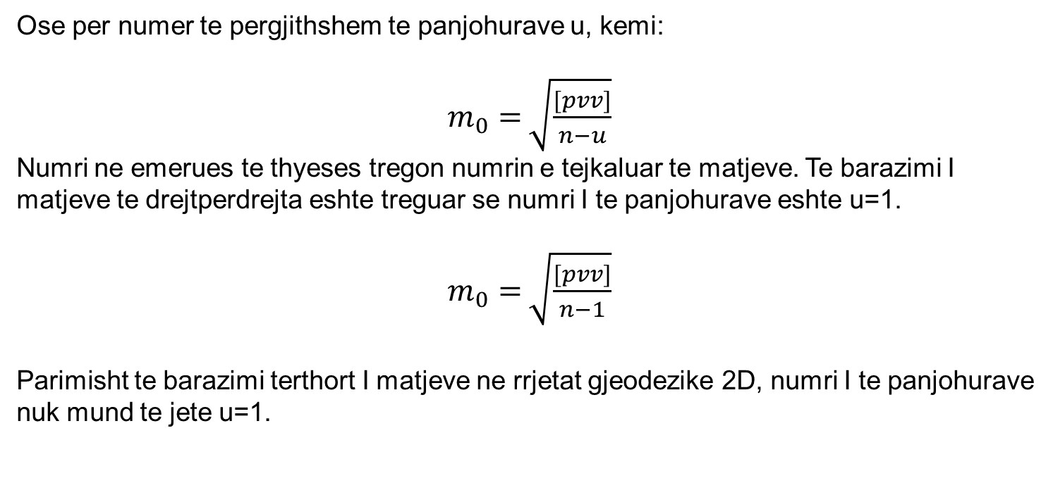
Vleresimi I saktesise se dy te panjohurave
Ose per numer te pergjithshem te panjohurave u, kemi:
$m_{0}=$ $\sqrt{\frac{[pvv]}{n−u}}$
Numri ne emerues te thyeses tregon numrin e tejkaluar te matjeve. Te barazimi I matjeve te drejtperdrejta eshte treguar se numri I te panjohurave eshte u=1.
$m_{0}=$ $\sqrt{\frac{[pvv]}{n−1}}$
Parimisht te barazimi terthort I matjeve ne rrjetat gjeodezike 2D, numri I te panjohurave nuk mund te jete u=1.

Slide 10
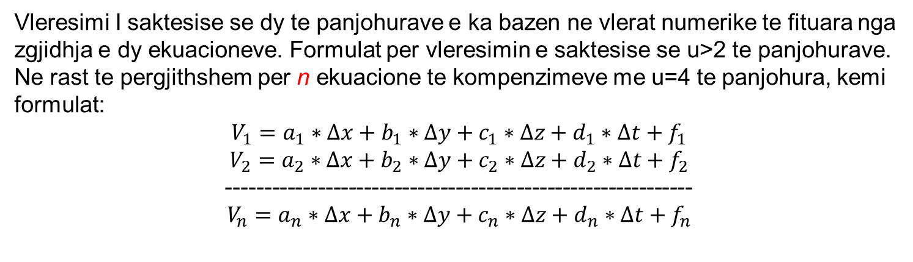
Vleresimi I saktesise se u-te panjohurave
Vleresimi I saktesise se dy te panjohurave e ka bazen ne vlerat numerike te fituara nga zgjidhja e dy ekuacioneve. Formulat per vleresimin e saktesise se u>2 te panjohurave.
Ne rast te pergjithshem per n ekuacione te kompenzimeve me u=4 te panjohura, kemi formulat:
$$V_{1}=a_{1}∗∆x+b_{1}∗∆y+c_{1}∗∆z+d_{1}∗∆t+f_{1}$$
$$V_{2}=a_{2}∗∆x+b_{2}∗∆y+c_{2}∗∆z+d_{2}∗∆t+f_{2}$$
-------------------------------------------------------------
$$V_{n}=a_{n}∗∆x+b_{n}∗∆y+c_{n}∗∆z+d_{n}∗∆t+f_{n}$$

Slide 11
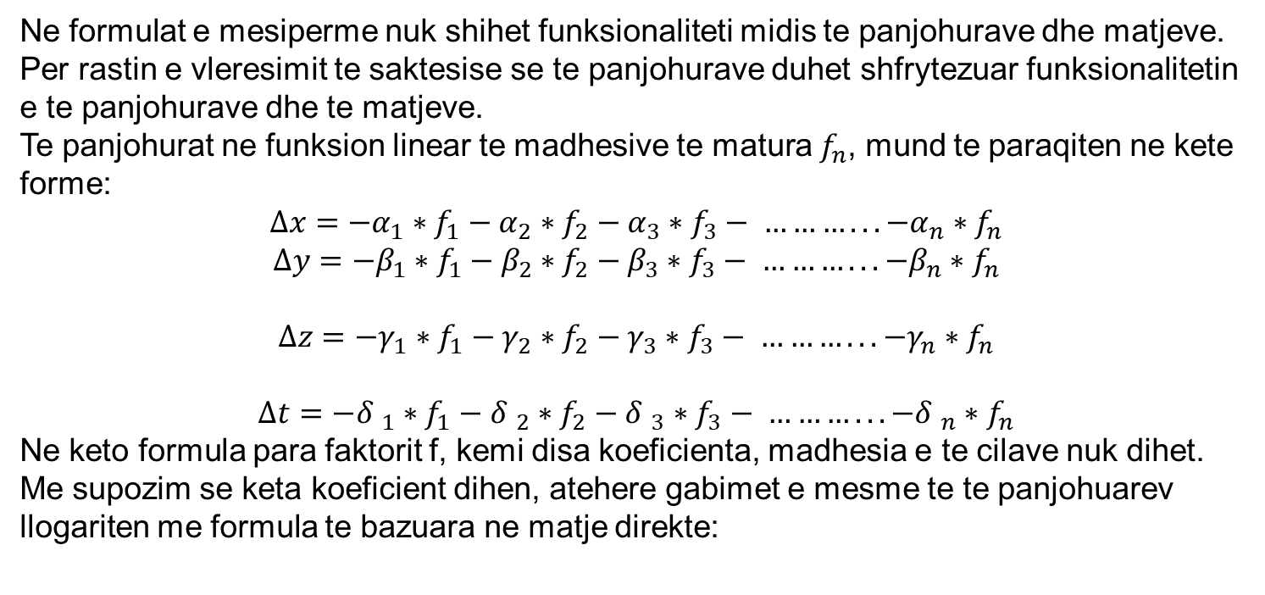
Vleresimi I saktesise se u-te panjohurave
Ne formulat e mesiperme nuk shihet funksionaliteti midis te panjohurave dhe matjeve. Per rastin e vleresimit te saktesise se te panjohurave duhet shfrytezuar funksionalitetin e te panjohurave dhe te matjeve.
Te panjohurat ne funksion linear te madhesive te matura $f_{n}$, mund te paraqiten ne kete forme:
$$∆x=−α_{1}∗f_{1}−α_{2}∗f_{2}−α_{3}∗f_{3}− ………...−α_{n}∗f_{n}$$
$$∆y=−β_{1}∗f_{1}−β_{2}∗f_{2}−β_{3}∗f_{3}− ………...−β_{n}∗f_{n}$$
$$∆z=−γ_{1}∗f_{1}−γ_{2}∗f_{2}−γ_{3}∗f_{3}− ………...−γ_{n}∗f_{n}$$
$$∆t=−{δ }_{1}∗f_{1}−{δ }_{2}∗f_{2}−{δ }_{3}∗f_{3}− ………...−{δ }_{n}∗f_{n}$$
Ne keto formula para faktorit f, kemi disa koeficienta, madhesia e te cilave nuk dihet. Me supozim se keta koeficient dihen, atehere gabimet e mesme te te panjohuarev llogariten me formula te bazuara ne matje direkte:

Slide 12
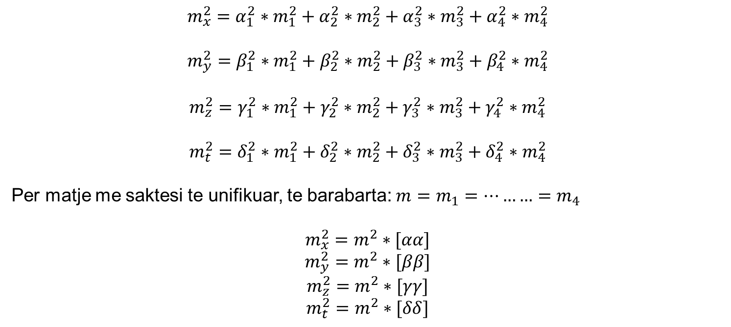
Vleresimi I saktesise se u-te panjohurave
$$m_{x}^{2}=α_{1}^{2}∗m_{1}^{2}+α_{2}^{2}∗m_{2}^{2}+α_{3}^{2}∗m_{3}^{2}+α_{4}^{2}∗m_{4}^{2}$$
$$m_{y}^{2}=β_{1}^{2}∗m_{1}^{2}+β_{2}^{2}∗m_{2}^{2}+β_{3}^{2}∗m_{3}^{2}+β_{4}^{2}∗m_{4}^{2}$$
$$m_{z}^{2}=γ_{1}^{2}∗m_{1}^{2}+γ_{2}^{2}∗m_{2}^{2}+γ_{3}^{2}∗m_{3}^{2}+γ_{4}^{2}∗m_{4}^{2}$$
$$m_{t}^{2}=δ_{1}^{2}∗m_{1}^{2}+δ_{2}^{2}∗m_{2}^{2}+δ_{3}^{2}∗m_{3}^{2}+δ_{4}^{2}∗m_{4}^{2}$$
Per matje me saktesi te unifikuar, te barabarta: ${m=m}_{1}=………=m_{4}$
$$m_{x}^{2}=m^{2}∗[αα]$$
$$m_{y}^{2}=m^{2}∗[ββ]$$
$$m_{z}^{2}=m^{2}∗[γγ]$$
$$m_{t}^{2}=m^{2}∗[δδ]$$

Slide 13
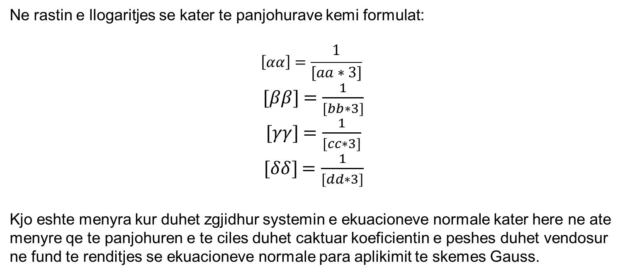
Vleresimi I saktesise se u-te panjohurave
Ne rastin e llogaritjes se kater te panjohurave kemi formulat:
$$\left[αα\right]=\frac{1}{[aa∗3]}$$
$[ββ]$ $=\frac{1}{[bb∗3]}$
$[γγ]$ $=\frac{1}{[cc∗3]}$
$[δδ]$ $=\frac{1}{[dd∗3]}$
Kjo eshte menyra kur duhet zgjidhur systemin e ekuacioneve normale kater here ne ate menyre qe te panjohuren e te ciles duhet caktuar koeficientin e peshes duhet vendosur ne fund te renditjes se ekuacioneve normale para aplikimit te skemes Gauss.

Slide 14
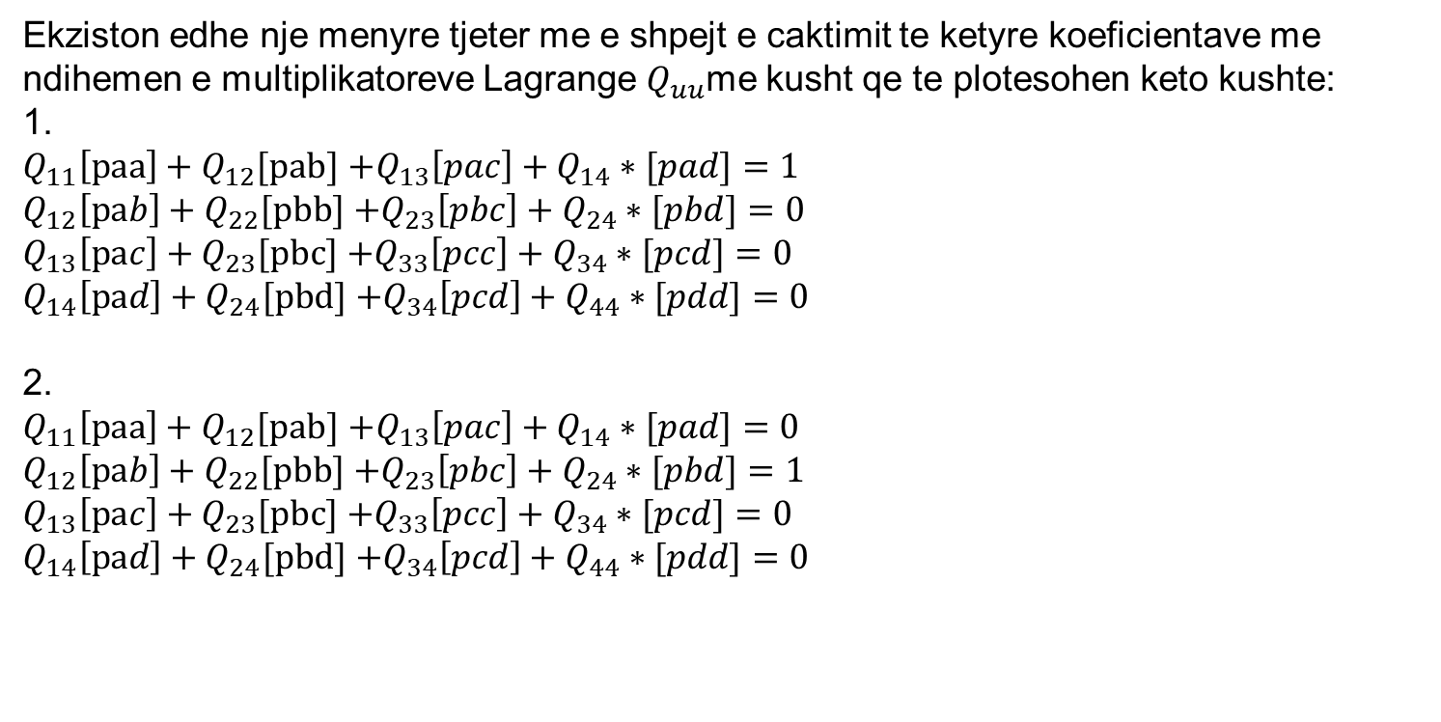
Vleresimi I saktesise se u-te panjohurave
Ekziston edhe nje menyre tjeter me e shpejt e caktimit te ketyre koeficientave me ndihemen e multiplikatoreve Lagrange $Q_{uu}$me kusht qe te plotesohen keto kushte:
1.
$Q_{11}\left[paa\right]+Q_{12}[pab]$ $+Q_{13}\left[pac\right]+Q_{14}∗[pad]=1$
$Q_{12}\left[pab\right]+Q_{22}[pbb]$ $+Q_{23}\left[pbc\right]+Q_{24}∗[pbd]=0$
$Q_{13}\left[pac\right]+Q_{23}[pbc]$ $+Q_{33}\left[pcc\right]+Q_{34}∗[pcd]=0$
$Q_{14}\left[pad\right]+Q_{24}[pbd]$ $+Q_{34}\left[pcd\right]+Q_{44}∗[pdd]=0$
2.
$Q_{11}\left[paa\right]+Q_{12}[pab]$ $+Q_{13}\left[pac\right]+Q_{14}∗[pad]=0$
$Q_{12}\left[pab\right]+Q_{22}[pbb]$ $+Q_{23}\left[pbc\right]+Q_{24}∗[pbd]=1$
$Q_{13}\left[pac\right]+Q_{23}[pbc]$ $+Q_{33}\left[pcc\right]+Q_{34}∗[pcd]=0$
$Q_{14}\left[pad\right]+Q_{24}[pbd]$ $+Q_{34}\left[pcd\right]+Q_{44}∗[pdd]=0$

Slide 15
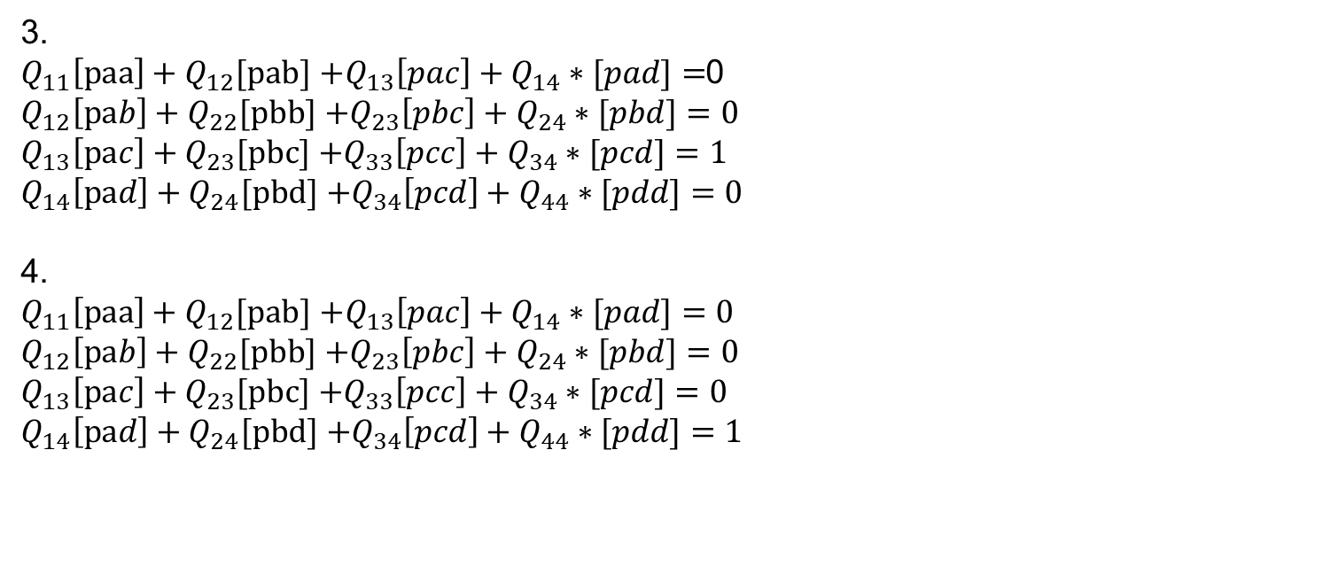
Vleresimi I saktesise se u-te panjohurave
3.
$Q_{11}\left[paa\right]+Q_{12}[pab]$ $+Q_{13}\left[pac\right]+Q_{14}∗[pad]=$0
$Q_{12}\left[pab\right]+Q_{22}[pbb]$ $+Q_{23}\left[pbc\right]+Q_{24}∗[pbd]=0$
$Q_{13}\left[pac\right]+Q_{23}[pbc]$ $+Q_{33}\left[pcc\right]+Q_{34}∗[pcd]=1$
$Q_{14}\left[pad\right]+Q_{24}[pbd]$ $+Q_{34}\left[pcd\right]+Q_{44}∗[pdd]=0$
4.
$Q_{11}\left[paa\right]+Q_{12}[pab]$ $+Q_{13}\left[pac\right]+Q_{14}∗[pad]=0$
$Q_{12}\left[pab\right]+Q_{22}[pbb]$ $+Q_{23}\left[pbc\right]+Q_{24}∗[pbd]=0$
$Q_{13}\left[pac\right]+Q_{23}[pbc]$ $+Q_{33}\left[pcc\right]+Q_{34}∗[pcd]=0$
$Q_{14}\left[pad\right]+Q_{24}[pbd]$ $+Q_{34}\left[pcd\right]+Q_{44}∗[pdd]=1$

Slide 16
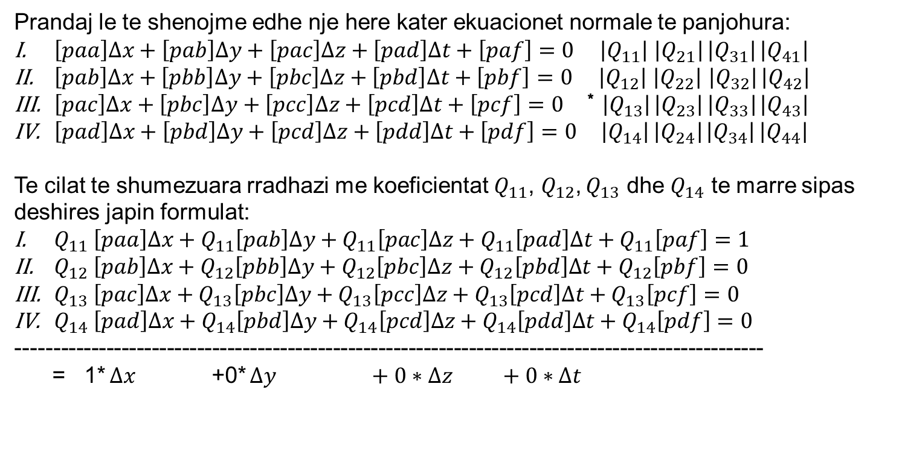
Vleresimi I saktesise se u-te panjohurave
Prandaj le te shenojme edhe nje here kater ekuacionet normale te panjohura:
$\left[paa\right]∆x+\left[pab\right]∆y+\left[pac\right]∆z+\left[pad\right]∆t+\left[paf\right]=0$ $\left|Q_{11}\right|$ $\left|Q_{21}\right|$ $\left|Q_{31}\right|$ $\left|Q_{41}\right|$
$\left[pab\right]∆x+\left[pbb\right]∆y+\left[pbc\right]∆z+\left[pbd\right]∆t+\left[pbf\right]=0$ $\left|Q_{12}\right|$ $\left|Q_{22}\right|$ $\left|Q_{32}\right|$ $\left|Q_{42}\right|$
$\left[pac\right]∆x+\left[pbc\right]∆y+\left[pcc\right]∆z+\left[pcd\right]∆t+\left[pcf\right]=0$ * $\left|Q_{13}\right|$ $\left|Q_{23}\right|$ $\left|Q_{33}\right|$ $\left|Q_{43}\right|$
$\left[pad\right]∆x+\left[pbd\right]∆y+\left[pcd\right]∆z+\left[pdd\right]∆t+\left[pdf\right]=0$ $\left|Q_{14}\right|$ $\left|Q_{24}\right|$ $\left|Q_{34}\right|$ $\left|Q_{44}\right|$
Te cilat te shumezuara rradhazi me koeficientat $Q_{11}$, $Q_{12}$, $Q_{13}$ dhe $Q_{14}$ te marre sipas deshires japin formulat:
$Q_{11} \left[paa\right]∆x+Q_{11}\left[pab\right]∆y+Q_{11}\left[pac\right]∆z+Q_{11}\left[pad\right]∆t+Q_{11}\left[paf\right]=1$
$Q_{12} \left[pab\right]∆x+Q_{12}\left[pbb\right]∆y+Q_{12}\left[pbc\right]∆z+Q_{12}\left[pbd\right]∆t+Q_{12}\left[pbf\right]=0$
$Q_{13} \left[pac\right]∆x+Q_{13}\left[pbc\right]∆y+Q_{13}\left[pcc\right]∆z+Q_{13}\left[pcd\right]∆t+Q_{13}\left[pcf\right]=0$
$Q_{14} \left[pad\right]∆x+Q_{14}\left[pbd\right]∆y+Q_{14}\left[pcd\right]∆z+Q_{14}\left[pdd\right]∆t+Q_{14}\left[pdf\right]=0$
---------------------------------------------------------------------------------------------------
= 1* $∆x$ +0* $∆y +0∗∆z +0∗∆t$

Slide 17
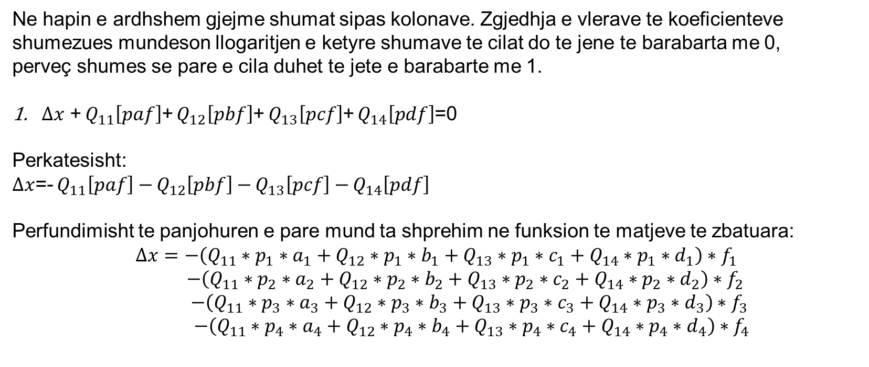
Vleresimi I saktesise se u-te panjohurave
Ne hapin e ardhshem gjejme shumat sipas kolonave. Zgjedhja e vlerave te koeficienteve shumezues mundeson llogaritjen e ketyre shumave te cilat do te jene te barabarta me 0,
perveç shumes se pare e cila duhet te jete e barabarte me 1.
$∆x$ + $Q_{11}\left[paf\right]$+ $Q_{12}\left[pbf\right]$+ $Q_{13}\left[pcf\right]$+ $Q_{14}\left[pdf\right]$=0
Perkatesisht:
$∆x$=- $Q_{11}\left[paf\right]−$ $Q_{12}\left[pbf\right]−$ $Q_{13}\left[pcf\right]−$ $Q_{14}\left[pdf\right]$
Perfundimisht te panjohuren e pare mund ta shprehim ne funksion te matjeve te zbatuara:
$$∆x=−\left(Q_{11}∗p_{1}∗a_{1}+Q_{12}∗p_{1}∗b_{1}+Q_{13}∗p_{1}∗c_{1}+Q_{14}∗p_{1}∗d_{1}\right)∗f_{1}$$
$−\left(Q_{11}∗p_{2}∗a_{2}+Q_{12}∗p_{2}∗b_{2}+Q_{13}∗p_{2}∗c_{2}+Q_{14}∗p_{2}∗d_{2}\right)∗f_{2}$
$$−\left(Q_{11}∗p_{3}∗a_{3}+Q_{12}∗p_{3}∗b_{3}+Q_{13}∗p_{3}∗c_{3}+Q_{14}∗p_{3}∗d_{3}\right)∗f_{3}$$
$$−\left(Q_{11}∗p_{4}∗a_{4}+Q_{12}∗p_{4}∗b_{4}+Q_{13}∗p_{4}∗c_{4}+Q_{14}∗p_{4}∗d_{4}\right)∗f_{4}$$

Slide 18
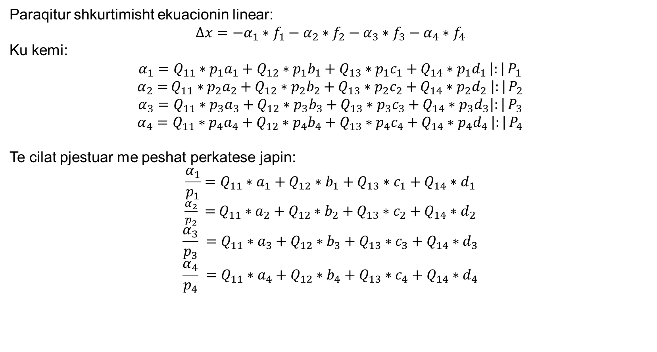
Vleresimi I saktesise se u-te panjohurave
Paraqitur shkurtimisht ekuacionin linear:
$$∆x=−α_{1}∗f_{1}−α_{2}∗f_{2}−α_{3}∗f_{3}−α_{4}∗f_{4}$$
Ku kemi:
$α_{1}=Q_{11}∗p_{1}a_{1}+Q_{12}∗p_{1}b_{1}+Q_{13}∗p_{1}c_{1}+Q_{14}∗p_{1}d_{1}$ $\left|:\right|$ $P_{1}$
$α_{2}=$ $Q_{11}∗p_{2}a_{2}+Q_{12}∗p_{2}b_{2}+Q_{13}∗p_{2}c_{2}+Q_{14}∗p_{2}d_{2} \left|:\right|$ $P_{2}$
$α_{3}=Q_{11}∗p_{3}a_{3}+Q_{12}∗p_{3}b_{3}+Q_{13}∗p_{3}c_{3}+Q_{14}∗p_{3}d_{3}\left|:\right|$ $P_{3}$
$α_{4}=Q_{11}∗p_{4}a_{4}+Q_{12}∗p_{4}b_{4}+Q_{13}∗p_{4}c_{4}+Q_{14}∗p_{4}d_{4}$ $\left|:\right|$ $P_{4}$
Te cilat pjestuar me peshat perkatese japin:
$$\frac{α_{1}}{p_{1}}=Q_{11}∗a_{1}+Q_{12}∗b_{1}+Q_{13}∗c_{1}+Q_{14}∗d_{1}$$
$\frac{α_{2}}{p_{2}} =$ $Q_{11}∗a_{2}+Q_{12}∗b_{2}+Q_{13}∗c_{2}+Q_{14}∗d_{2}$
$$\frac{α_{3}}{p_{3}} =Q_{11}∗a_{3}+Q_{12}∗b_{3}+Q_{13}∗c_{3}+Q_{14}∗d_{3}$$
$$\frac{α_{4}}{p_{4}} =Q_{11}∗a_{4}+Q_{12}∗b_{4}+Q_{13}∗c_{4}+Q_{14}∗d_{4}$$

Slide 19
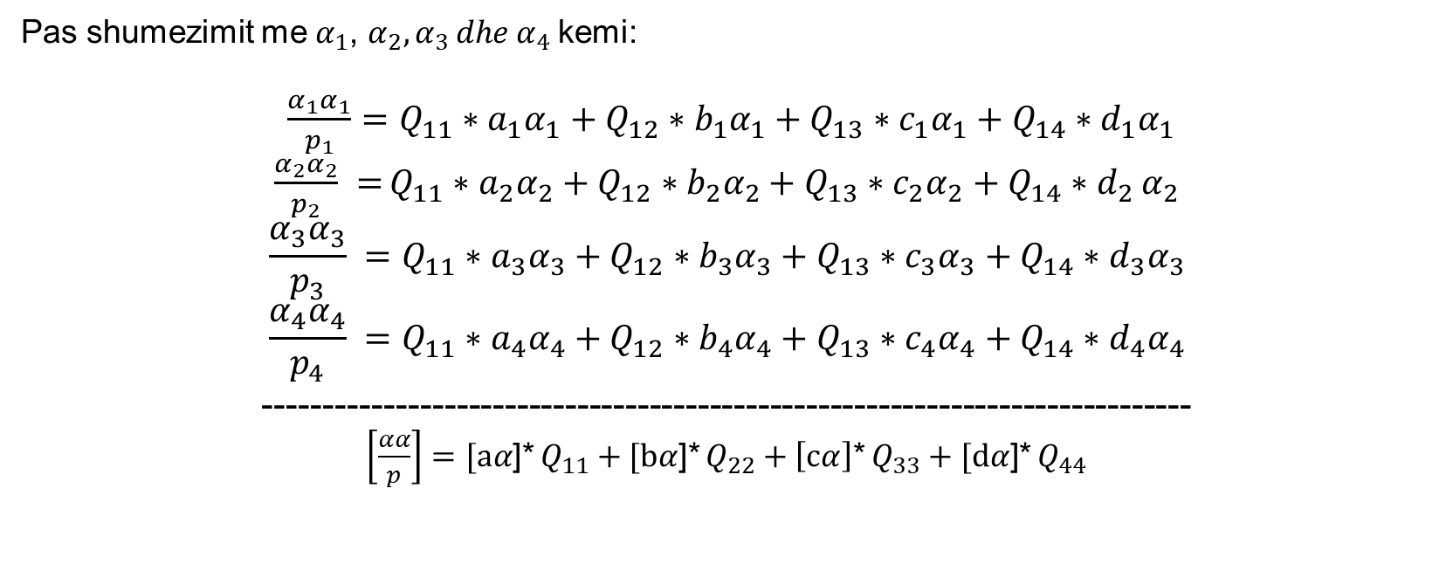
Vleresimi I saktesise se u-te panjohurave
Pas shumezimit me $α_{1}$, $α_{2},α_{3 }dhe{ α}_{4}$kemi:
$\frac{α_{1}α_{1}}{p_{1}}=Q_{11}∗a_{1}α_{1}+Q_{12}∗b_{1}α_{1}+Q_{13}∗c_{1}α_{1}+Q_{14}∗d_{1}α_{1}$
$\frac{α_{2}α_{2}}{p_{2}} =$ $Q_{11}∗a_{2}α_{2}+Q_{12}∗b_{2}α_{2}+Q_{13}∗c_{2}α_{2}+Q_{14}∗d_{2}$ $α_{2}$
$$\frac{α_{3}α_{3}}{p_{3}} =Q_{11}∗a_{3}α_{3}+Q_{12}∗b_{3}α_{3}+Q_{13}∗c_{3}α_{3}+Q_{14}∗d_{3}α_{3}$$
$$\frac{α_{4}α_{4}}{p_{4}} =Q_{11}∗a_{4}α_{4}+Q_{12}∗b_{4}α_{4}+Q_{13}∗c_{4}α_{4}+Q_{14}∗d_{4}α_{4}$$
-----------------------------------------------------------------------------
$\left[\frac{αα}{p}\right]=[aα$]* $Q_{11}+[bα$]* $Q_{22}+\left[cα\right]\text{∗} Q_{33}+[dα\text{]∗} Q_{44}$

Slide 20
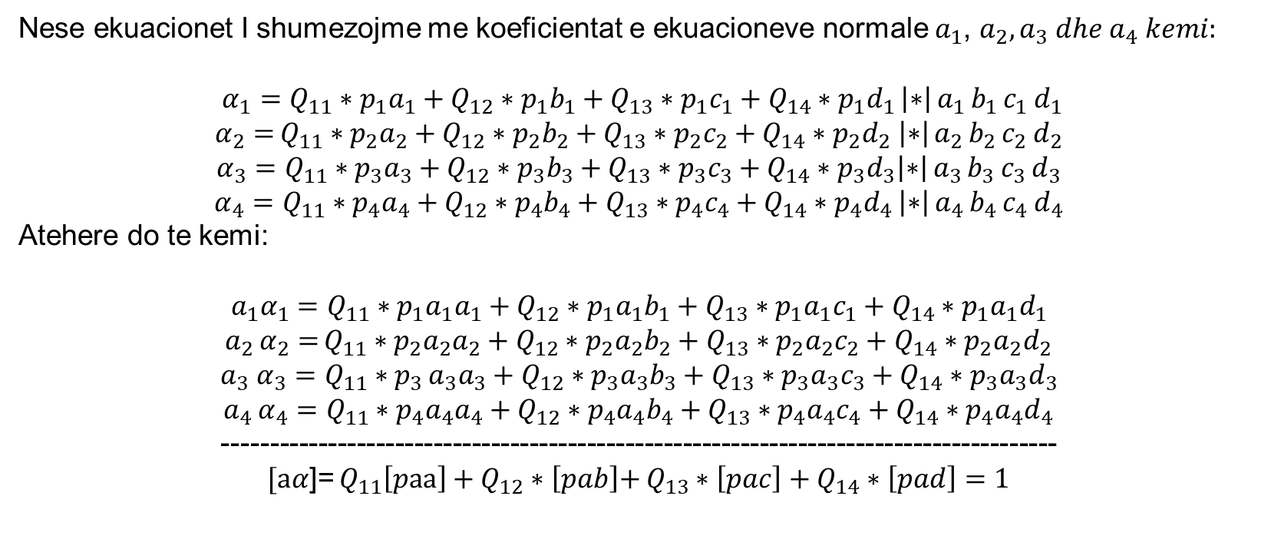
Vleresimi I saktesise se u-te panjohurave
Nese ekuacionet I shumezojme me koeficientat e ekuacioneve normale $a_{1}$, $a_{2},a_{3} dhe a_{4} kemi:$
$α_{1}=Q_{11}∗p_{1}a_{1}+Q_{12}∗p_{1}b_{1}+Q_{13}∗p_{1}c_{1}+Q_{14}∗p_{1}d_{1}$ $\left|∗\right|$ $a_{1}$ $b_{1}$ $c_{1}$ $d_{1}$
$α_{2}=$ $Q_{11}∗p_{2}a_{2}+Q_{12}∗p_{2}b_{2}+Q_{13}∗p_{2}c_{2}+Q_{14}∗p_{2}d_{2} \left|∗\right|$ $a_{2}$ $b_{2}$ $c_{2}$ $d_{2}$
$α_{3}=Q_{11}∗p_{3}a_{3}+Q_{12}∗p_{3}b_{3}+Q_{13}∗p_{3}c_{3}+Q_{14}∗p_{3}d_{3}\left|∗\right|$ $a_{3}$ $b_{3}$ $c_{3}$ $d_{3}$
$α_{4}=Q_{11}∗p_{4}a_{4}+Q_{12}∗p_{4}b_{4}+Q_{13}∗p_{4}c_{4}+Q_{14}∗p_{4}d_{4}$ $\left|∗\right|$ $a_{4}$ $b_{4}$ $c_{4}$ $d_{4}$
Atehere do te kemi:
$${a_{1}α}_{1}=Q_{11}∗p_{1}a_{1}a_{1}+Q_{12}∗p_{1}{a_{1}b}_{1}+Q_{13}∗p_{1}{a_{1}c}_{1}+Q_{14}∗p_{1}{a_{1}d}_{1}$$
$a_{2}$ $α_{2}=$ $Q_{11}∗p_{2}a_{2}a_{2}+Q_{12}∗p_{2}{a_{2}b}_{2}+Q_{13}∗p_{2}a_{2}c_{2}+Q_{14}∗p_{2}a_{2}d_{2}$
$$a_{3} α_{3}=Q_{11}∗p_{3 }a_{3}a_{3}+Q_{12}∗p_{3}a_{3}b_{3}+Q_{13}∗p_{3}a_{3}c_{3}+Q_{14}∗p_{3}a_{3}d_{3}$$
$a_{4}$ $α_{4}=Q_{11}∗p_{4}{a_{4}a}_{4}+Q_{12}∗p_{4}{a_{4}b}_{4}+Q_{13}∗p_{4}a_{4}c_{4}+Q_{14}∗p_{4}{a_{4}d}_{4}$
---------------------------------------------------------------------------------------
$[aα$]= $Q_{11}\left[paa\right]+Q_{12}∗\left[pab\right]\text{+} Q_{13}∗\left[pac\right]+Q_{14}∗\left[pad\right]=1$

Slide 21

Vleresimi I saktesise se u-te panjohurave
N$ese kete ecuri e zbatojme ne ate menyre qe formulat te shumezohen radhazi me b_{1}$, $b_{2},b_{3} dhe b_{4} pastaj me{ c}_{1}\text{, }c_{2},c_{3} dhe c_{4}, si dhe me d_{1}\text{, }d_{2},d_{3} dhe d_{4}, atehere do te kemi:$
$[aα$]=1
$[bα$]=0
$[cα$]=0
$[dα$]=0
Prandaj:
$$\left[\frac{αα}{p}\right]=Q_{11}$$
Rrjedhimisht:
$$m_{x}^{2}=m^{2}∗\left[αα\right]=m^{2}∗Q_{11}$$
$$\left[αα\right]=Q_{11}=\frac{m_{x}^{2}}{m^{2}}$$

Slide 22

Vleresimi I saktesise se u-te panjohurave
Per peshen kemi formulen:
$$p_{x}=\frac{m^{2}}{m_{x}^{2}}$$
$$\left[αα\right]=Q_{11}=\frac{1}{p_{x}}$$
Formulat mund te vertetohen nese aplikohet ligji per percjelljen e gabimeve:
$∆x=−α_{1}∗f_{1}−α_{2}∗f_{2}−α_{3}∗f_{3}−α_{4}∗f_{4}$
$$m_{∆x}^{2}=α_{1}^{2}∗m_{1}^{2}+α_{2}^{2}∗m_{2}^{2}+α_{3}^{2}∗m_{3}^{2}+α_{4}^{2}∗m_{4}^{2}$$
$$m_{∆x}^{2}=\left[αα∗m^{2}\right]=\left[\frac{αα}{p}\right]$$

Slide 23
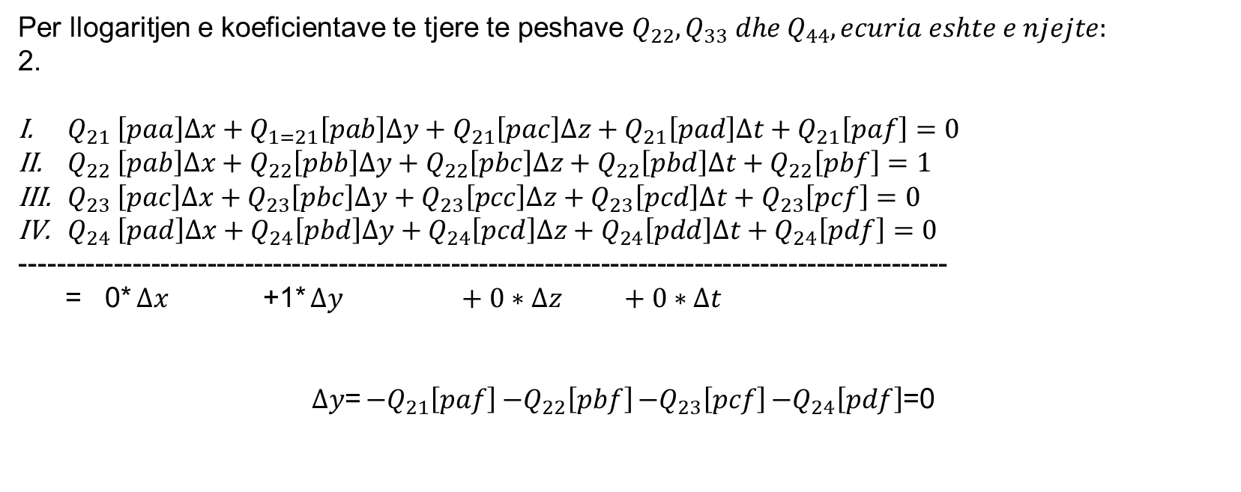
Vleresimi I saktesise se u-te panjohurave
Per llogaritjen e koeficientave te tjere te peshave $Q_{22},Q_{33} dhe{ Q}_{44}, ecuria eshte e njejte:$
2.
$Q_{21} \left[paa\right]∆x+Q_{1=21}\left[pab\right]∆y+Q_{21}\left[pac\right]∆z+Q_{21}\left[pad\right]∆t+Q_{21}\left[paf\right]=0$
$Q_{22} \left[pab\right]∆x+Q_{22}\left[pbb\right]∆y+Q_{22}\left[pbc\right]∆z+Q_{22}\left[pbd\right]∆t+Q_{22}\left[pbf\right]=1$
$Q_{23} \left[pac\right]∆x+Q_{23}\left[pbc\right]∆y+Q_{23}\left[pcc\right]∆z+Q_{23}\left[pcd\right]∆t+Q_{23}\left[pcf\right]=0$
$Q_{24} \left[pad\right]∆x+Q_{24}\left[pbd\right]∆y+Q_{24}\left[pcd\right]∆z+Q_{24}\left[pdd\right]∆t+Q_{24}\left[pdf\right]=0$
---------------------------------------------------------------------------------------------------
= 0* $∆x$ +1* $∆y +0∗∆z +0∗∆t$
$∆y$= ${−Q}_{21}\left[paf\right]$ $−Q_{22}\left[pbf\right]$ ${−Q}_{23}\left[pcf\right]$ $−Q_{24}\left[pdf\right]$=0

Slide 24
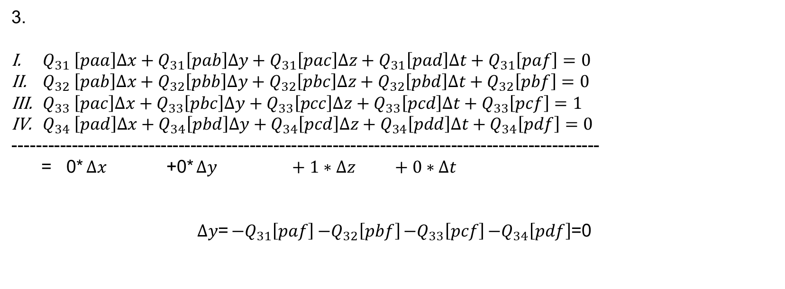
Vleresimi I saktesise se u-te panjohurave
3.
$Q_{31} \left[paa\right]∆x+Q_{31}\left[pab\right]∆y+Q_{31}\left[pac\right]∆z+Q_{31}\left[pad\right]∆t+Q_{31}\left[paf\right]=0$
$Q_{32} \left[pab\right]∆x+Q_{32}\left[pbb\right]∆y+Q_{32}\left[pbc\right]∆z+Q_{32}\left[pbd\right]∆t+Q_{32}\left[pbf\right]=0$
$Q_{33} \left[pac\right]∆x+Q_{33}\left[pbc\right]∆y+Q_{33}\left[pcc\right]∆z+Q_{33}\left[pcd\right]∆t+Q_{33}\left[pcf\right]=1$
$Q_{34} \left[pad\right]∆x+Q_{34}\left[pbd\right]∆y+Q_{34}\left[pcd\right]∆z+Q_{34}\left[pdd\right]∆t+Q_{34}\left[pdf\right]=0$
---------------------------------------------------------------------------------------------------
= 0* $∆x$ +0* $∆y +1∗∆z +0∗∆t$
$∆y$= ${−Q}_{31}\left[paf\right]$ $−Q_{32}\left[pbf\right]$ ${−Q}_{33}\left[pcf\right]$ $−Q_{34}\left[pdf\right]$=0

Slide 25
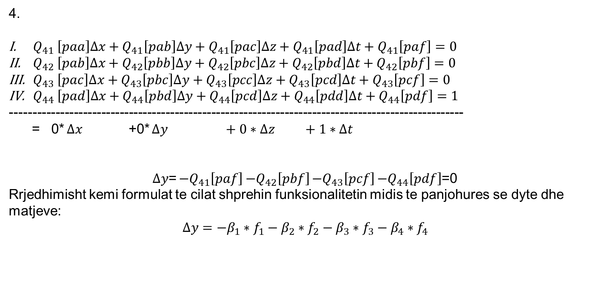
Vleresimi I saktesise se u-te panjohurave
4.
$Q_{41} \left[paa\right]∆x+Q_{41}\left[pab\right]∆y+Q_{41}\left[pac\right]∆z+Q_{41}\left[pad\right]∆t+Q_{41}\left[paf\right]=0$
$Q_{42} \left[pab\right]∆x+Q_{42}\left[pbb\right]∆y+Q_{42}\left[pbc\right]∆z+Q_{42}\left[pbd\right]∆t+Q_{42}\left[pbf\right]=0$
$Q_{43} \left[pac\right]∆x+Q_{43}\left[pbc\right]∆y+Q_{43}\left[pcc\right]∆z+Q_{43}\left[pcd\right]∆t+Q_{43}\left[pcf\right]=0$
$Q_{44} \left[pad\right]∆x+Q_{44}\left[pbd\right]∆y+Q_{44}\left[pcd\right]∆z+Q_{44}\left[pdd\right]∆t+Q_{44}\left[pdf\right]=1$
---------------------------------------------------------------------------------------------------
= 0* $∆x$ +0* $∆y +0∗∆z +1∗∆t$
$∆y$= ${−Q}_{41}\left[paf\right]$ $−Q_{42}\left[pbf\right]$ ${−Q}_{43}\left[pcf\right]$ $−Q_{44}\left[pdf\right]$=0
Rrjedhimisht kemi formulat te cilat shprehin funksionalitetin midis te panjohures se dyte dhe matjeve:
$$∆y=−β_{1}∗f_{1}−β_{2}∗f_{2}−β_{3}∗f_{3}−β_{4}∗f_{4}$$

Slide 26

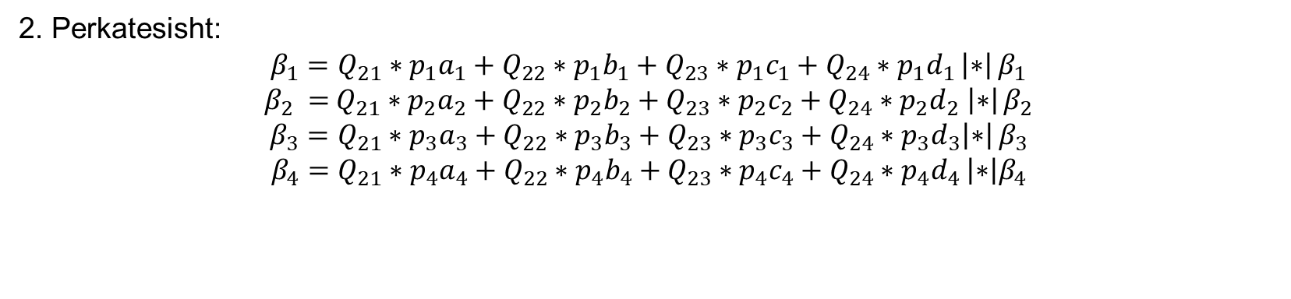
Vleresimi I saktesise se u-te panjohurave
2. Perkatesisht:
$β_{1}=Q_{21}∗p_{1}a_{1}+Q_{22}∗p_{1}b_{1}+Q_{23}∗p_{1}c_{1}+Q_{24}∗p_{1}d_{1}$ $\left|∗\right|$ $β_{1}$
$β_{2} =$ $Q_{21}∗p_{2}a_{2}+Q_{22}∗p_{2}b_{2}+Q_{23}∗p_{2}c_{2}+Q_{24}∗p_{2}d_{2} \left|∗\right|$ $β_{2}$
$β_{3}=Q_{21}∗p_{3}a_{3}+Q_{22}∗p_{3}b_{3}+Q_{23}∗p_{3}c_{3}+Q_{24}∗p_{3}d_{3}\left|∗\right|$ $β_{3}$
$β_{4}=Q_{21}∗p_{4}a_{4}+Q_{22}∗p_{4}b_{4}+Q_{23}∗p_{4}c_{4}+Q_{24}∗p_{4}d_{4}$ $\left|∗\right|β_{4}$
$[aβ$]=0
$[bβ$]=1
$[cβ$]=0
$[d$ $β$]=0
Prandaj:
$$\left[\frac{ββ}{p}\right]=Q_{22}=\frac{1}{p_{y}}$$
Dhe keshtu me radhe:

Slide 27

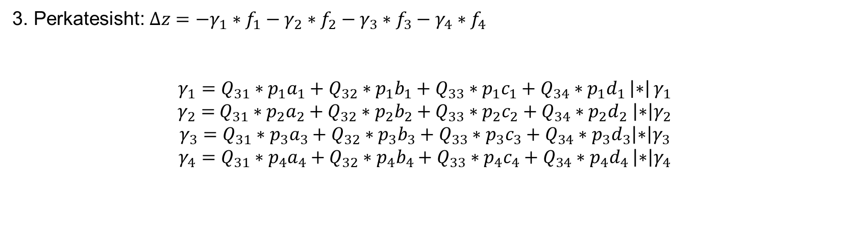
Vleresimi I saktesise se u-te panjohurave
3. Perkatesisht: $∆z=−γ_{1}∗f_{1}−γ_{2}∗f_{2}−γ_{3}∗f_{3}−γ_{4}∗f_{4}$
$γ_{1}=Q_{31}∗p_{1}a_{1}+Q_{32}∗p_{1}b_{1}+Q_{33}∗p_{1}c_{1}+Q_{34}∗p_{1}d_{1}$ $\left|∗\right|$ $γ_{1}$
$γ_{2}=$ $Q_{31}∗p_{2}a_{2}+Q_{32}∗p_{2}b_{2}+Q_{33}∗p_{2}c_{2}+Q_{34}∗p_{2}d_{2} \left|∗\right|γ_{2}$
$$γ_{3}=Q_{31}∗p_{3}a_{3}+Q_{32}∗p_{3}b_{3}+Q_{33}∗p_{3}c_{3}+Q_{34}∗p_{3}d_{3}\left|∗\right|γ_{3}$$
$γ_{4}=Q_{31}∗p_{4}a_{4}+Q_{32}∗p_{4}b_{4}+Q_{33}∗p_{4}c_{4}+Q_{34}∗p_{4}d_{4}$ $\left|∗\right|γ_{4}$
$[aγ$]=0
$[bγ$]=0
$[cγ$]=1
$[d$ $γ$]=0
Prandaj:
$$\left[\frac{γγ}{p}\right]=Q_{22}=\frac{1}{p_{z}}$$
Dhe se fundi:

Slide 28

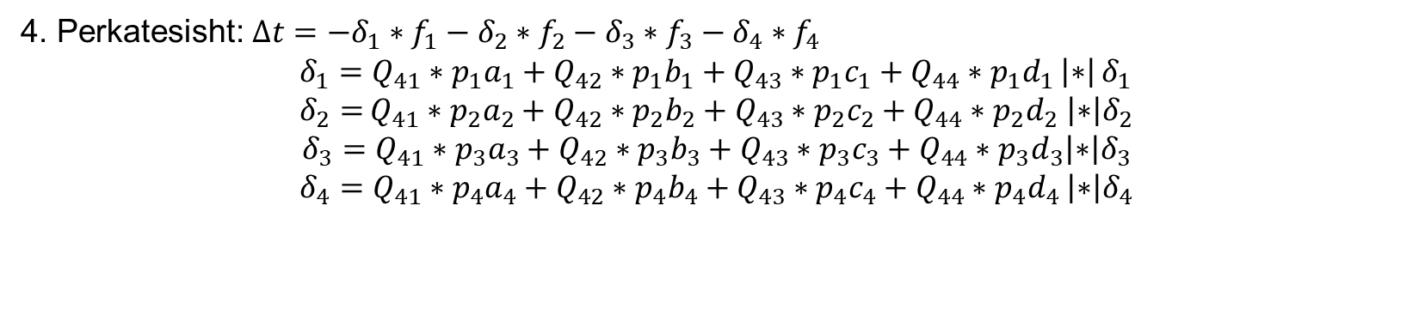
Vleresimi I saktesise se u-te panjohurave
4. Perkatesisht: $∆t=−δ_{1}∗f_{1}−δ_{2}∗f_{2}−δ_{3}∗f_{3}−δ_{4}∗f_{4}$
$δ_{1}=Q_{41}∗p_{1}a_{1}+Q_{42}∗p_{1}b_{1}+Q_{43}∗p_{1}c_{1}+Q_{44}∗p_{1}d_{1}$ $\left|∗\right|$ $δ_{1}$
$δ_{2}=$ $Q_{41}∗p_{2}a_{2}+Q_{42}∗p_{2}b_{2}+Q_{43}∗p_{2}c_{2}+Q_{44}∗p_{2}d_{2} \left|∗\right|δ_{2}$
$$δ_{3}=Q_{41}∗p_{3}a_{3}+Q_{42}∗p_{3}b_{3}+Q_{43}∗p_{3}c_{3}+Q_{44}∗p_{3}d_{3}\left|∗\right|δ_{3}$$
$δ_{4}=Q_{41}∗p_{4}a_{4}+Q_{42}∗p_{4}b_{4}+Q_{43}∗p_{4}c_{4}+Q_{44}∗p_{4}d_{4}$ $\left|∗\right|δ_{4}$
$[aδ$]=0
$[bδ$]=0
$[cδ$]=0
$[d$ $δ$]=1
Prandaj:
$$\left[\frac{δδ}{p}\right]=Q_{22}=\frac{1}{p_{t}}$$

Slide 29
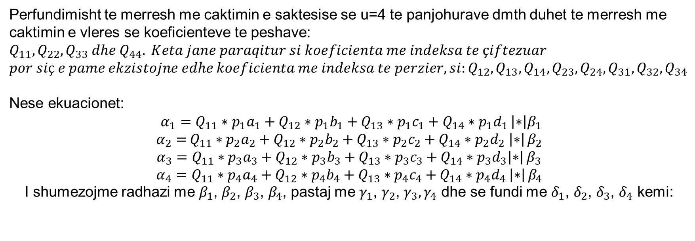
Vleresimi I saktesise se u-te panjohurave
Perfundimisht te merresh me caktimin e saktesise se u=4 te panjohurave dmth duhet te merresh me caktimin e vleres se koeficienteve te peshave: $Q_{11},Q_{22},Q_{33} dhe{ Q}_{44}. Keta jane paraqitur si koeficienta me indeksa te çiftezuar$
$$por siç e pame ekzistojne edhe koeficienta me indeksa te perzier, si:Q_{12},Q_{13},Q_{14},Q_{23},Q_{24},Q_{31},Q_{32},Q_{34}$$
Nese ekuacionet:
$α_{1}=Q_{11}∗p_{1}a_{1}+Q_{12}∗p_{1}b_{1}+Q_{13}∗p_{1}c_{1}+Q_{14}∗p_{1}d_{1}$ $\left|∗\right|β_{1}$
$α_{2}=$ $Q_{11}∗p_{2}a_{2}+Q_{12}∗p_{2}b_{2}+Q_{13}∗p_{2}c_{2}+Q_{14}∗p_{2}d_{2} \left|∗\right|$ $β_{2}$
$α_{3}=Q_{11}∗p_{3}a_{3}+Q_{12}∗p_{3}b_{3}+Q_{13}∗p_{3}c_{3}+Q_{14}∗p_{3}d_{3}\left|∗\right|$ $β_{3}$
$α_{4}=Q_{11}∗p_{4}a_{4}+Q_{12}∗p_{4}b_{4}+Q_{13}∗p_{4}c_{4}+Q_{14}∗p_{4}d_{4}$ $\left|∗\right|$ $β_{4}$
I shumezojme radhazi me $β_{1}$, $β_{2}$, $β_{3}$, $β_{4}$, pastaj me $γ_{1}$, $γ_{2}$, $γ_{3},γ_{4}$ dhe se fundi me $δ_{1}$, $δ_{2}$, $δ_{3}$, $δ_{4}$ kemi:

Slide 30
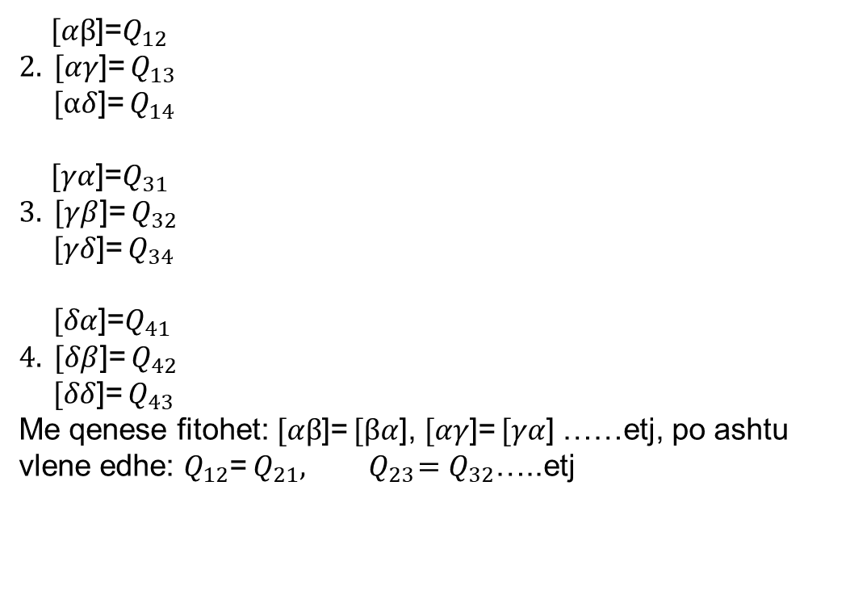
Vleresimi I saktesise se u-te panjohurave
$[αβ$]=$Q_{12}$
$2. [αγ$]= $Q_{13}$
$[αδ$]= $Q_{14}$
$[γα$]=$Q_{31}$
$3. [γβ$]= $Q_{32}$
$[γδ$]= $Q_{34}$
$[δα$]=$Q_{41}$
$4. [δβ$]= $Q_{42}$
$[δδ$]= $Q_{43}$
Me qenese fitohet: $[αβ$]= $[βα$], $[αγ$]= $[γα$] ……etj, po ashtu vlene edhe: $Q_{12}$= $Q_{21},{ Q}_{23}=Q_{32}$…..etj

Slide 31
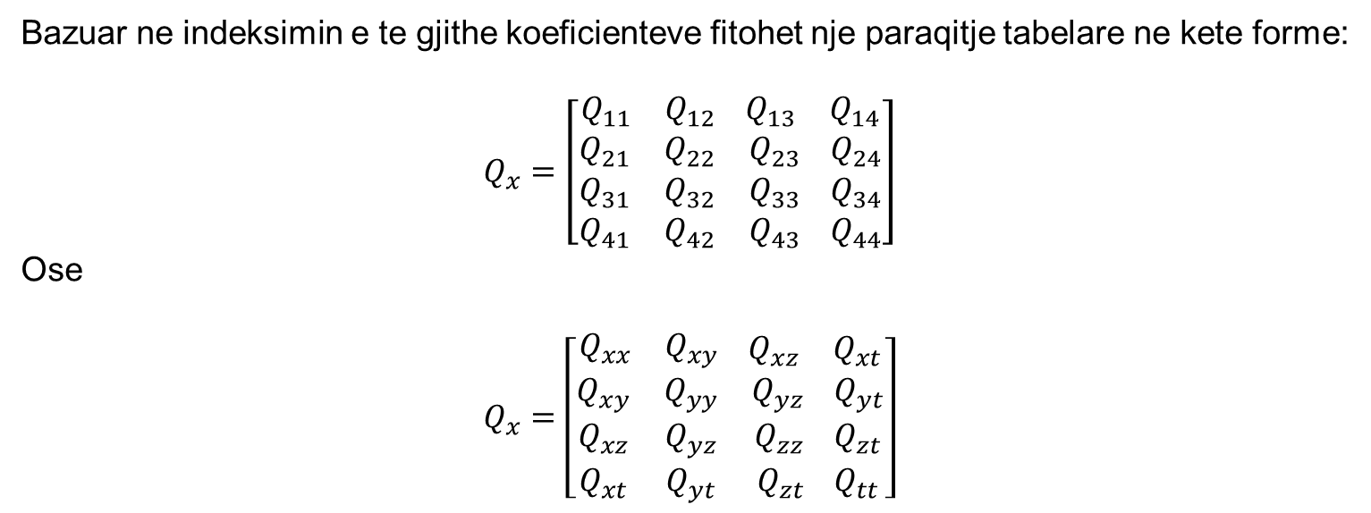
Vleresimi I saktesise se u-te panjohurave
Bazuar ne indeksimin e te gjithe koeficienteve fitohet nje paraqitje tabelare ne kete forme:
$$Q_{x}=\left[\begin{aligned}\begin{matrix}Q_{11} & Q_{12}\end{matrix}\begin{matrix}{ Q}_{13} & Q_{14}\end{matrix} \\ \begin{matrix}Q_{21} & Q_{22} & Q_{23}{ Q}_{24} \\ Q_{31} & Q_{32} & Q_{33}{ Q}_{34} \\ Q_{41} & Q_{42} & Q_{43}{ Q}_{44}\end{matrix}\end{aligned}\right]$$
Ose
$$Q_{x}=\left[\begin{aligned}\begin{matrix}Q_{xx} & Q_{xy}\end{matrix}\begin{matrix}{ Q}_{xz} & Q_{xt}\end{matrix} \\ \begin{matrix}Q_{xy} & Q_{yy} & Q_{yz}{ Q}_{yt} \\ Q_{xz} & Q_{yz} & Q_{zz}{ Q}_{zt} \\ Q_{xt} & Q_{yt} & Q_{zt}{ Q}_{tt}\end{matrix}\end{aligned}\right]$$

Slide 32
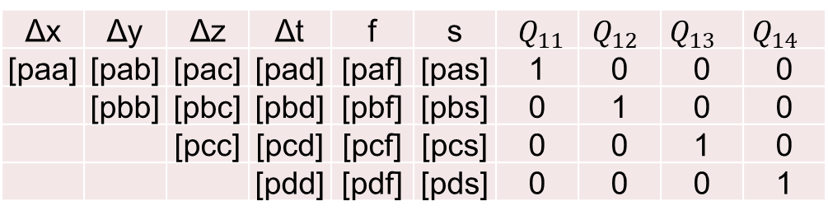
Vleresimi I saktesise se u-te panjohurave
Per llogaritjen e te panjohurave duhet zgjedhur njehere sistemin e ekuacioneve normale, kurse per llogaritjen e koeficienteve Lagrange duhet zgjedhur kater here systemin e ekuacioneve normale.
Ne menyre qe te reduktohet puna ne kete rast te dy keto dy detyra gjeodezike bashkohen ne nje (llogaritja e te panjohurave dhe koeficientave Lagrange).
Δx | Δy | Δz | Δt | f | s | $Q_{11}$ | $Q_{12}$ | $Q_{13}$ | $Q_{14}$
[paa] | [pab] | [pac] | [pad] | [paf] | [pas] | 1 | 0 | 0 | 0
 | [pbb] | [pbc] | [pbd] | [pbf] | [pbs] | 0 | 1 | 0 | 0
 |  | [pcc] | [pcd] | [pcf] | [pcs] | 0 | 0 | 1 | 0
 |  |  | [pdd] | [pdf] | [pds] | 0 | 0 | 0 | 1

Slide 33

Vleresimi I saktesise se u-te panjohurave
Ne gjeodezi ekzistojne raste kur ne ekuacionet normale te formuara njehere nderrojne vetem antaret e lire:
$$∆x=−Q_{11}∗\left[paf\right]−Q_{12}∗\left[pbf\right]−Q_{13}∗\left[pcf\right]−Q_{14}∗\left[pdf\right]$$
$$∆y=−Q_{12}∗\left[paf\right]−Q_{22}∗\left[pbf\right]−Q_{23}∗\left[pcf\right]−Q_{24}∗\left[pdf\right]$$
$$∆z=−Q_{13}∗\left[paf\right]−Q_{23}∗\left[pbf\right]−Q_{33}∗\left[pcf\right]−Q_{34}∗\left[pdf\right]$$
$$∆t=−Q_{14}∗\left[paf\right]−Q_{24}∗\left[pbf\right]−Q_{34}∗\left[pcf\right]−Q_{44}∗\left[pdf\right]$$

Slide 34
ESE-Teoria e Lagrange

