Slide 1
Interpretimi matricor I barazimit terthor

Slide 2
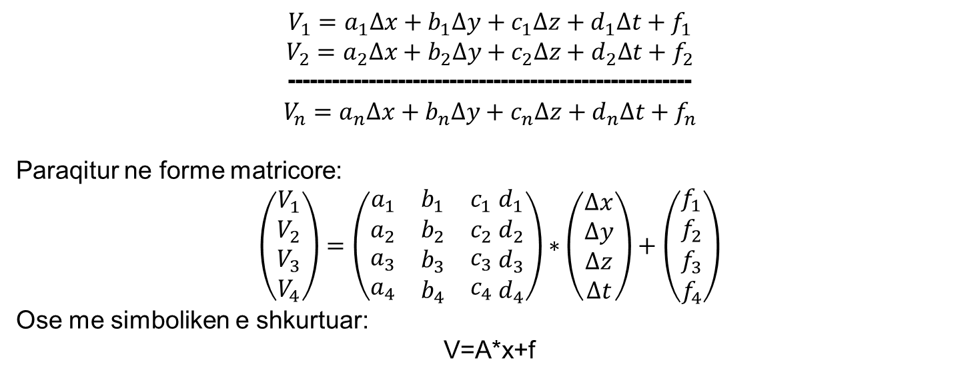
Interpretimi matricor I barazimit terthor
$$V_{1}=a_{1}∆x+b_{1}∆y+c_{1}∆z+d_{1}∆t+f_{1}$$
$$V_{2}=a_{2}∆x+b_{2}∆y+c_{2}∆z+d_{2}∆t+f_{2}$$
-------------------------------------------------------
$$V_{n}=a_{n}∆x+b_{n}∆y+c_{n}∆z+d_{n}∆t+f_{n}$$
Paraqitur ne forme matricore:
$$\left(\begin{aligned}\begin{matrix}V_{1} \\ V_{2} \\ V_{3}\end{matrix} \\ V_{4}\end{aligned}\right)=\left(\begin{matrix}a_{1} & b_{1} & c_{1} \\ a_{2} & b_{2} & c_{2} \\ \begin{aligned}a_{3} \\ a_{4}\end{aligned} & \begin{aligned}b_{3} \\ b_{4}\end{aligned} & \begin{aligned}c_{3} \\ c_{4}\end{aligned}\end{matrix}\begin{matrix}{ d}_{1} \\ { d}_{2} \\ \begin{aligned}{ d}_{3} \\ { d}_{4}\end{aligned}\end{matrix}\right)∗\left(\begin{matrix}∆x \\ ∆y \\ \begin{aligned}∆z \\ ∆t\end{aligned}\end{matrix}\right)+\left(\begin{matrix}f_{1} \\ f_{2} \\ \begin{aligned}f_{3} \\ f_{4}\end{aligned}\end{matrix}\right)$$
Ose me simboliken e shkurtuar:
V=A*x+f

Slide 3
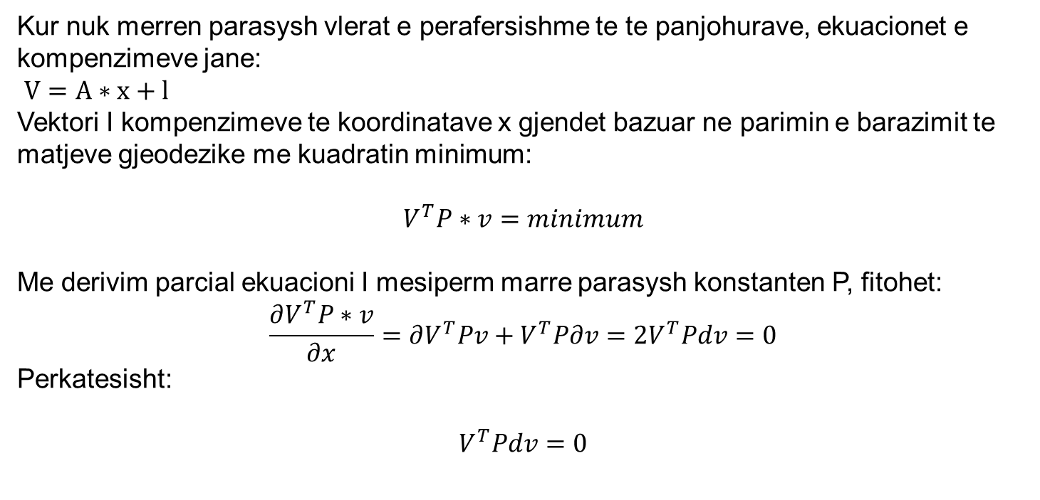
Interpretimi matricor I barazimit terthor
Kur nuk merren parasysh vlerat e perafersishme te te panjohurave, ekuacionet e kompenzimeve jane:
$V=A∗x+l$
Vektori I kompenzimeve te koordinatave x gjendet bazuar ne parimin e barazimit te matjeve gjeodezike me kuadratin minimum:
$$V^{T}P∗v=minimum$$
Me derivim parcial ekuacioni I mesiperm marre parasysh konstanten P, fitohet:
$$\frac{∂V^{T}P∗v}{∂x}=∂V^{T}Pv+V^{T}P∂v=2V^{T}Pdv=0$$
Perkatesisht:
$$V^{T}Pdv=0$$

Slide 4
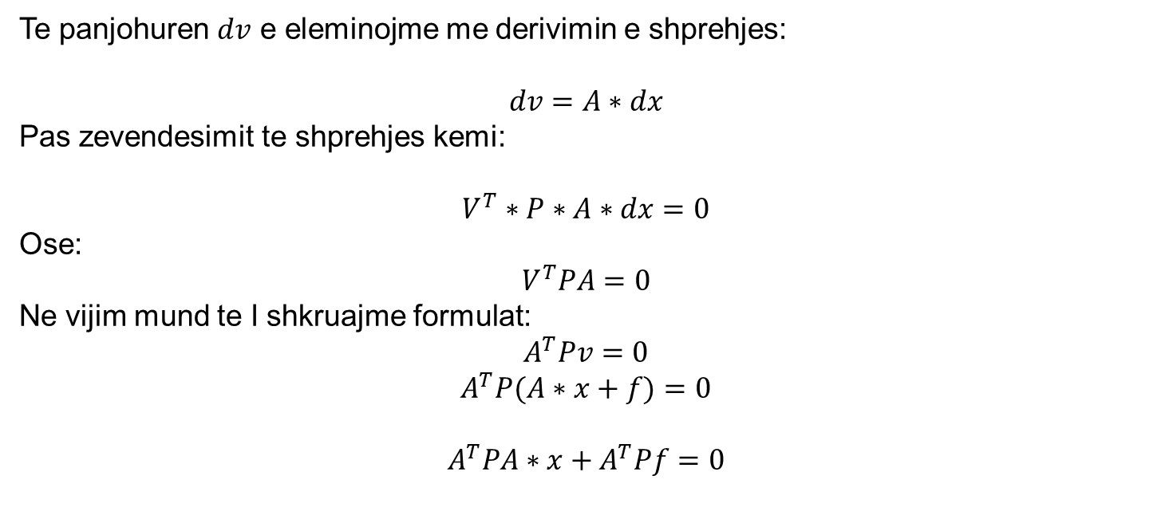
Interpretimi matricor I barazimit terthor
Te panjohuren $dv$ e eleminojme me derivimin e shprehjes:
$$dv=A∗dx$$
Pas zevendesimit te shprehjes kemi:
$$V^{T}∗P∗A∗dx=0$$
Ose:
$$V^{T}PA=0$$
Ne vijim mund te I shkruajme formulat:
$$A^{T}Pv=0$$
$$A^{T}P(A∗x+f)=0$$
$$A^{T}PA∗x+A^{T}Pf=0$$

Slide 5
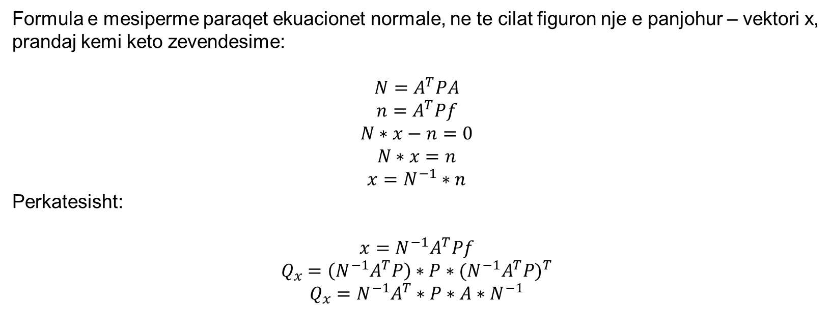
Interpretimi matricor I barazimit terthor
Formula e mesiperme paraqet ekuacionet normale, ne te cilat figuron nje e panjohur – vektori x, prandaj kemi keto zevendesime:
$${N=A}^{T}PA$$
$${n=A}^{T}Pf$$
$$N∗x−n=0$$
$$N∗x=n$$
$$x=N^{−1}∗n$$
Perkatesisht:
$$x=N^{−1}A^{T}Pf$$
$$Q_{x}=\left(N^{−1}A^{T}P\right)∗P∗{(N^{−1}A^{T}P)}^{T}$$
$$Q_{x}=N^{−1}A^{T}∗P∗A∗N^{−1}$$

Slide 6
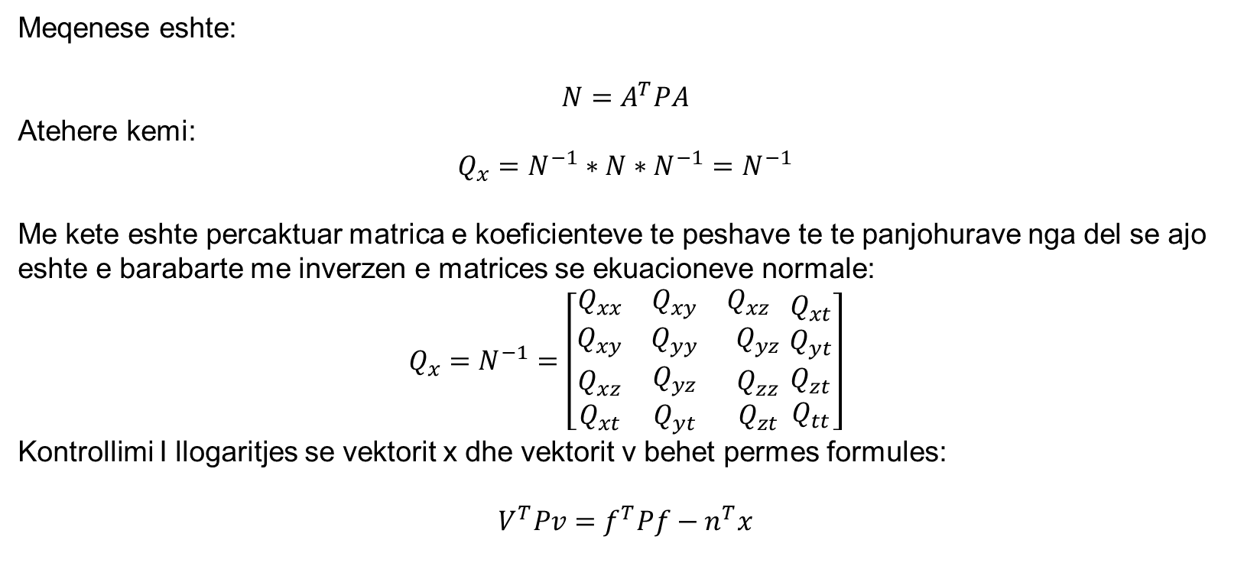
Interpretimi matricor I barazimit terthor
Meqenese eshte:
$${N=A}^{T}PA$$
Atehere kemi:
$$Q_{x}=N^{−1}∗N∗N^{−1}=N^{−1}$$
Me kete eshte percaktuar matrica e koeficienteve te peshave te te panjohurave nga del se ajo eshte e barabarte me inverzen e matrices se ekuacioneve normale:
$$Q_{x}=N^{−1}=\left[\begin{matrix}Q_{xx} & Q_{xy} & Q_{xz} \\ Q_{xy} & Q_{yy} & Q_{yz} \\ \begin{aligned}Q_{xz} \\ Q_{xt}\end{aligned} & \begin{aligned}Q_{yz} \\ Q_{yt}\end{aligned} & \begin{aligned}Q_{zz} \\ Q_{zt}\end{aligned}\end{matrix}\begin{matrix}Q_{xt} \\ Q_{yt} \\ \begin{aligned}Q_{zt} \\ Q_{tt}\end{aligned}\end{matrix}\right]$$
Kontrollimi I llogaritjes se vektorit x dhe vektorit v behet permes formules:
$$V^{T}Pv=f^{T}Pf−n^{T}x$$

Slide 7
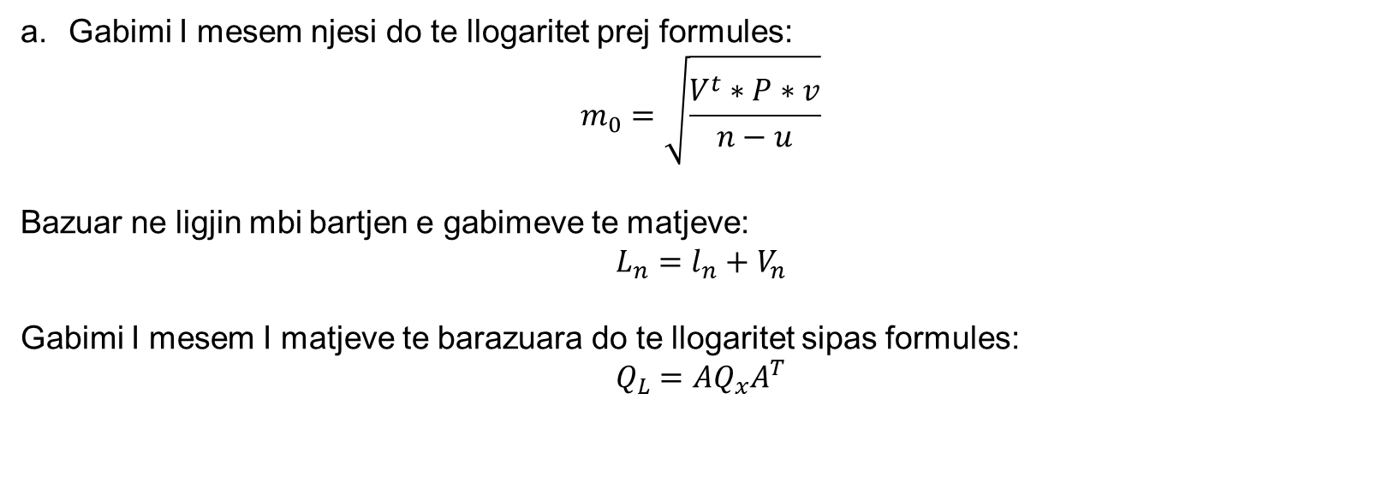
Vleresimi I saktesise
Gabimi I mesem njesi do te llogaritet prej formules:
$$m_{0}=\sqrt{\frac{V^{t}∗P∗v}{n−u}}$$
Bazuar ne ligjin mbi bartjen e gabimeve te matjeve:
$$L_{n}=l_{n}+V_{n}$$
Gabimi I mesem I matjeve te barazuara do te llogaritet sipas formules:
$$Q_{L}=AQ_{x}A^{T}$$

Slide 8
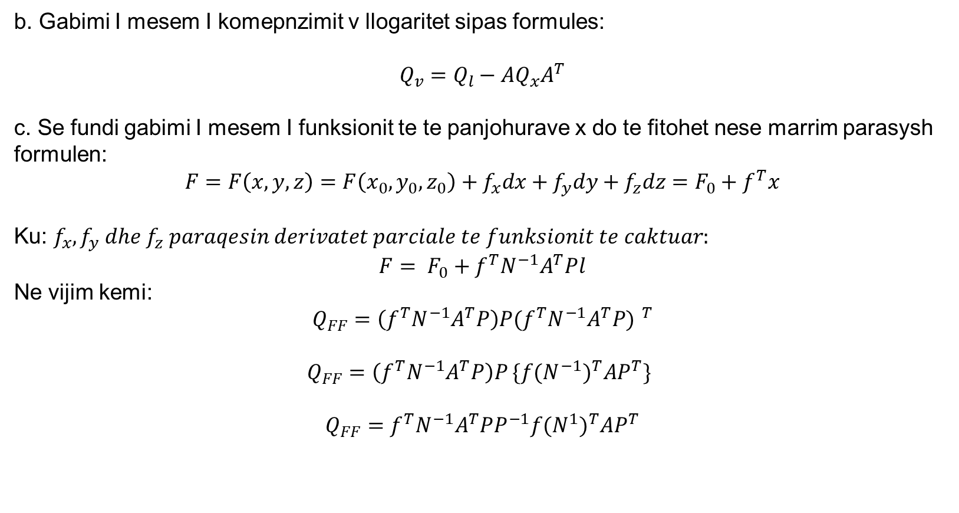
Vleresimi I saktesise
b. Gabimi I mesem I komepnzimit v llogaritet sipas formules:
$$Q_{v}=Q_{l}−AQ_{x}A^{T}$$
c. Se fundi gabimi I mesem I funksionit te te panjohurave x do te fitohet nese marrim parasysh formulen:
$$F=F\left(x,y,z\right)=F\left(x_{0},y_{0},z_{0}\right)+f_{x}dx+f_{y}dy+f_{z}dz=F_{0}+f^{T}x$$
Ku: $f_{x},f_{y} dhe f_{z} paraqesin derivatet parciale te funksionit te caktuar:$
$$F= F_{0}+f^{T}{N^{−1}A}^{T}Pl$$
Ne vijim kemi:
$$Q_{FF}=\left(f^{T}{N^{−1}A}^{T}P\right)P{(f^{T}{N^{−1}A}^{T}P) }^{T}$$
$Q_{FF}=\left(f^{T}{N^{−1}A}^{T}P\right)P$ $\{f{(N^{−1})}^{T}{AP}^{T}\}$
$$Q_{FF}=f^{T}N^{−1}A^{T}PP^{−1}f{(N^{1})}^{T}AP^{T}$$

Slide 9
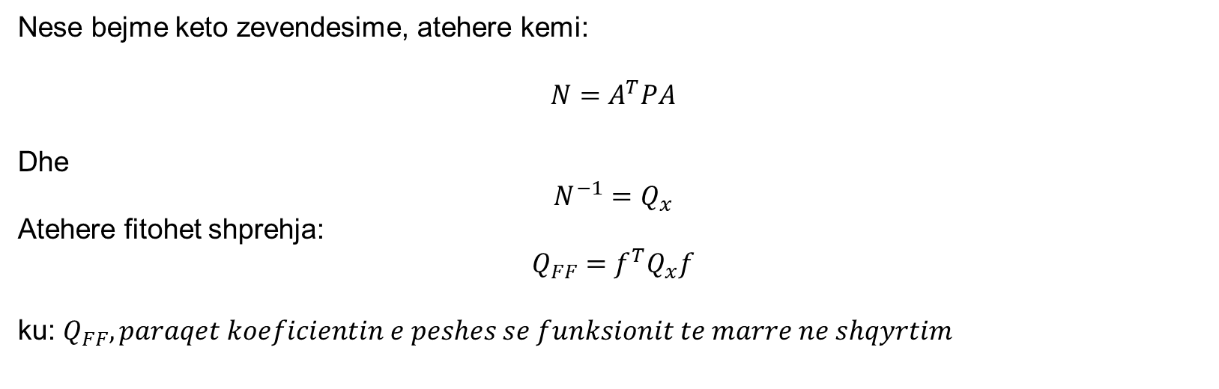
Vleresimi I saktesise
Nese bejme keto zevendesime, atehere kemi:
$$N=A^{T}PA$$
Dhe
$$N^{−1}=Q_{x}$$
Atehere fitohet shprehja:
$$Q_{FF}=f^{T}Q_{x}f$$
ku: $Q_{FF}, paraqet koeficientin e peshes se funksionit te marre ne shqyrtim$

Slide 10
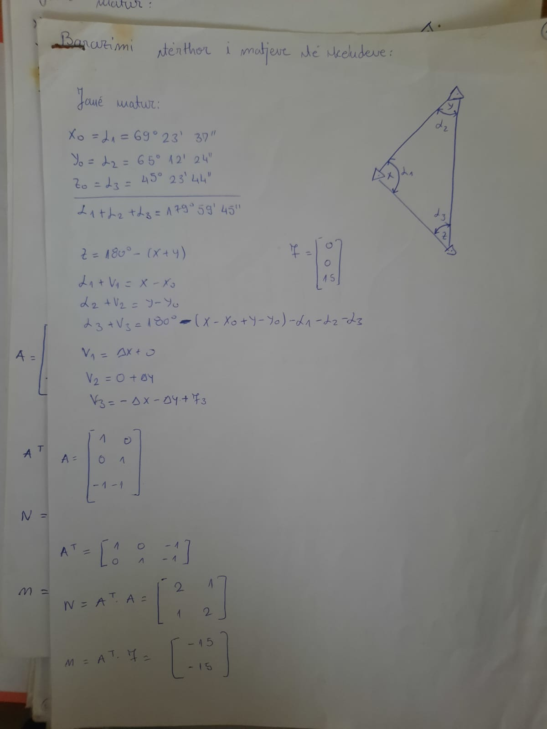
Ushtrim numerik

Slide 11
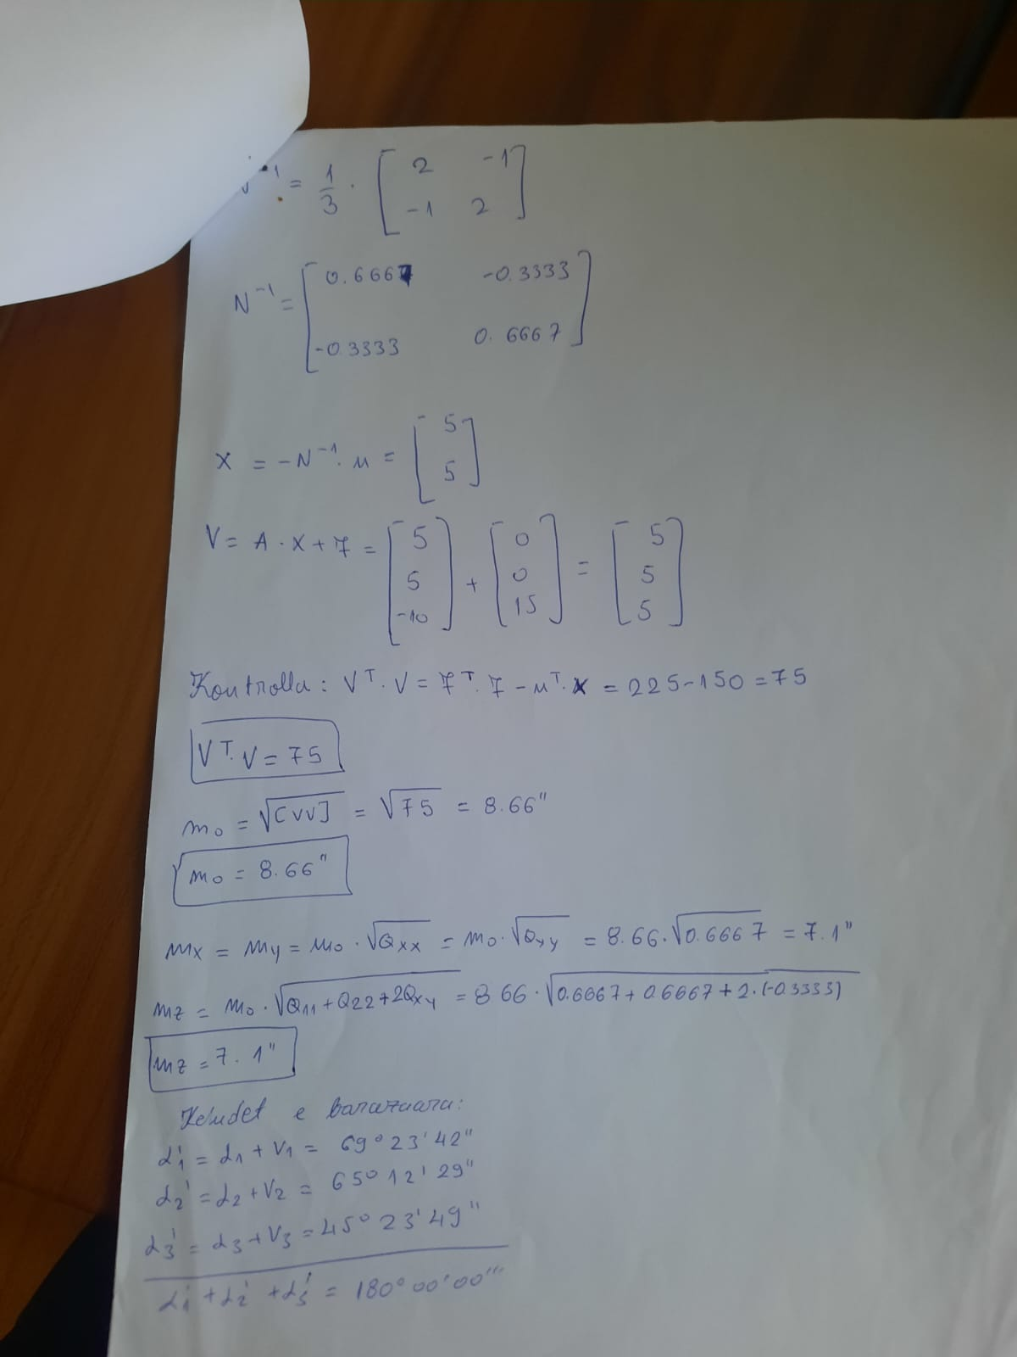
Ushtrim numerik

Slide 12
ESE-BAZRAZIMI TERTHOR I MATJEVE

