Slide 1
Barazimi terhor I matjeve te kendeve

Slide 2
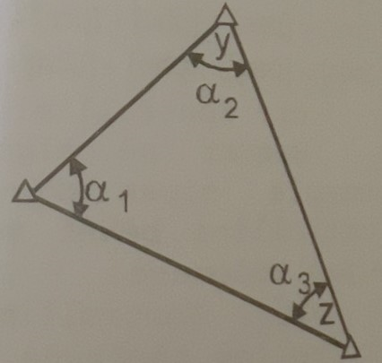
Barazimi terhor I matjeve te kendeve
Barazimi I rrjetave trigonometrike mund te marrin pjese edhe kendet edhe drejtimet ne menyre te kombinuar.
Forma me e thjeshte e rrjetit trigonometric eshte kur ai perbehet prej tri pikave te cilat formojne nje trekendesh trigonometric.
Percaktimi I gjeometriese se ketij trekendeshi bazohet ne barazimin e matjeve te ketij trekendeshi bazohet ne barazimin e matjeve te kendeve dhe te drejtimeve.
Per kete qellim ne kete trekendesh duhet matur 3 kende dhe gjashte drejtime.

Slide 3
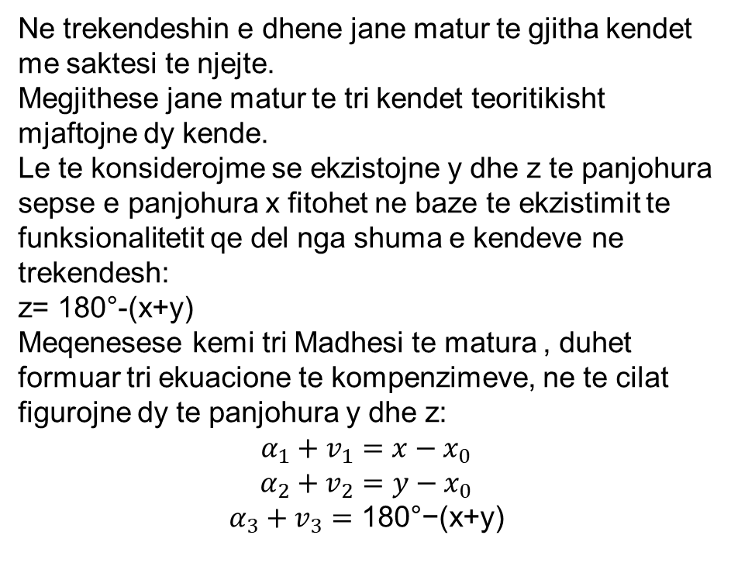
Barazimi terhor I matjeve te kendeve
Ne trekendeshin e dhene jane matur te gjitha kendet me saktesi te njejte.
Megjithese jane matur te tri kendet teoritikisht mjaftojne dy kende.
Le te konsiderojme se ekzistojne y dhe z te panjohura sepse e panjohura x fitohet ne baze te ekzistimit te funksionalitetit qe del nga shuma e kendeve ne trekendesh:
z= 180°-(x+y)
Meqenesese kemi tri Madhesi te matura , duhet formuar tri ekuacione te kompenzimeve, ne te cilat figurojne dy te panjohura y dhe z:
$$α_{1}+v_{1}=x−x_{0}$$
$$α_{2}+v_{2}=y−x_{0}$$
$$α_{3}+v_{3}=\text{180°−(}\text{x}\text{+}\text{y}\text{)}$$

Slide 4
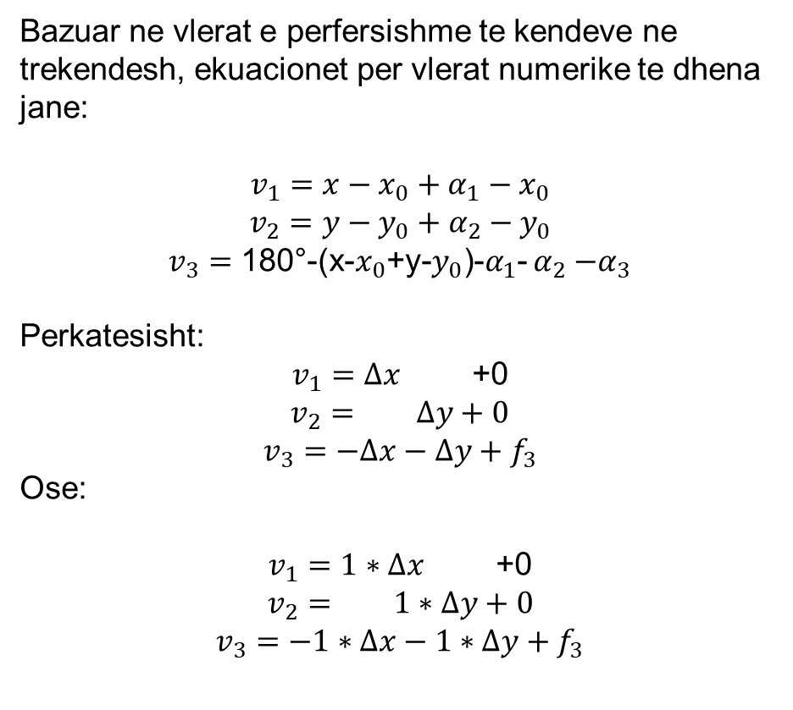
Barazimi terhor I matjeve te kendeve
Bazuar ne vlerat e perfersishme te kendeve ne trekendesh, ekuacionet per vlerat numerike te dhena jane:
$$v_{1}=x−x_{0}+α_{1}−x_{0}$$
$$v_{2}=y−y_{0}+α_{2}−y_{0}$$
$v_{3}=\text{180°−(}\text{x}\text{−}x_{0}\text{+}\text{y}\text{−}y_{0}\text{)}\text{−}α_{1}$- $α_{2}{−α}_{3}$
Perkatesisht:
$v_{1}=Δx$ +0
$v_{2}=$ $Δy+0$
$v_{3}=$ $−Δx−Δy+f_{3}$
Ose:
$v_{1}=1∗Δx$ +0
$v_{2}=$ $1∗Δy+0$
$v_{3}=$ $−1∗Δx−1∗Δy+f_{3}$

Slide 5
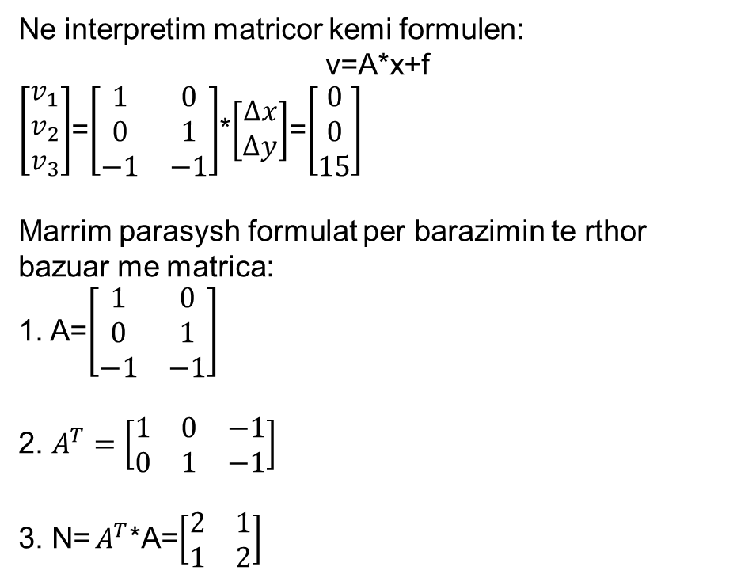
Barazimi terhor I matjeve te kendeve
Ne interpretim matricor kemi formulen:
v=A*x+f
$\left[\begin{matrix}v_{1} \\ v_{2} \\ v_{3}\end{matrix}\right]$=$\left[\begin{matrix}1 & 0 \\ 0 & 1 \\ −1 & −1\end{matrix}\right]$*$\left[\begin{matrix}Δx \\ Δy\end{matrix}\right]$=$\left[\begin{matrix}0 \\ 0 \\ 15\end{matrix}\right]$
Marrim parasysh formulat per barazimin te rthor bazuar me matrica:
1. A=$\left[\begin{matrix}1 & 0 \\ 0 & 1 \\ −1 & −1\end{matrix}\right]$
2. $A^{T}=\left[\begin{matrix}1 & 0 & −1 \\ 0 & 1 & −1\end{matrix}\right]$
3. N= $A^{T}$*A=$\left[\begin{matrix}2 & 1 \\ 1 & 2\end{matrix}\right]$

Slide 6
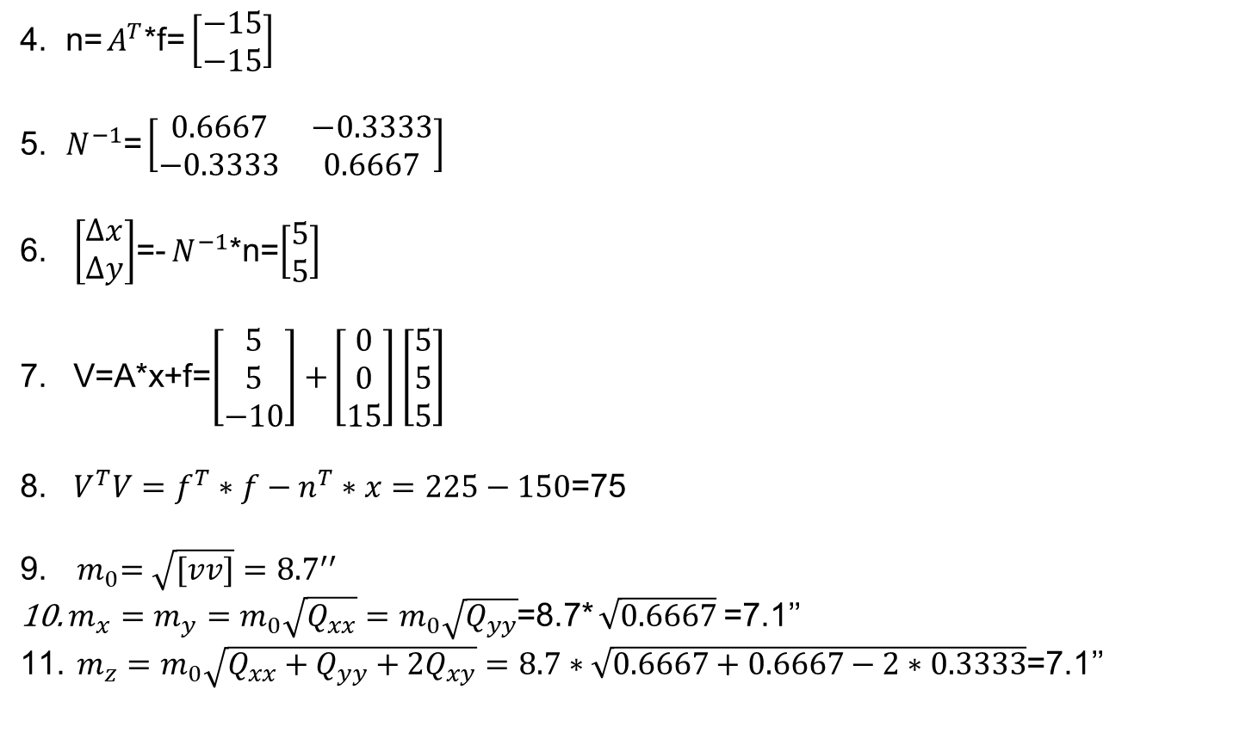
Barazimi terhor I matjeve te kendeve
4. n= $A^{T}$*f= $\left[\begin{matrix}−15 \\ −15\end{matrix}\right]$
5. $N^{−1}$= $\left[\begin{matrix}0.6667 & −0.3333 \\ −0.3333 & 0.6667\end{matrix}\right]$
6. $\left[\begin{matrix}∆x \\ ∆y\end{matrix}\right]$=- $N^{−1}$*n=$\left[\begin{matrix}5 \\ 5\end{matrix}\right]$
7. V=A*x+f=$\left[\begin{matrix}5 \\ 5 \\ −10\end{matrix}\right]+$ $\left[\begin{matrix}0 \\ 0 \\ 15\end{matrix}\right]$ $\left[\begin{matrix}5 \\ 5 \\ 5\end{matrix}\right]$
8. $V^{T}V=f^{T}∗f−n^{T}∗x=225−150$=75
9.${ m}_{0}=\sqrt{[vv]}={8.7}^{′′}$
$m_{x}=m_{y}=m_{0}\sqrt{Q_{xx}}=m_{0}\sqrt{Q_{yy}}$=8.7* $\sqrt{0.6667}$=7.1’’
$m_{z}=m_{0}\sqrt{Q_{xx}+Q_{yy}+{2Q}_{xy}}=8.7∗\sqrt{0.6667+0.6667−2∗0.3333}$=7.1’’

Slide 7
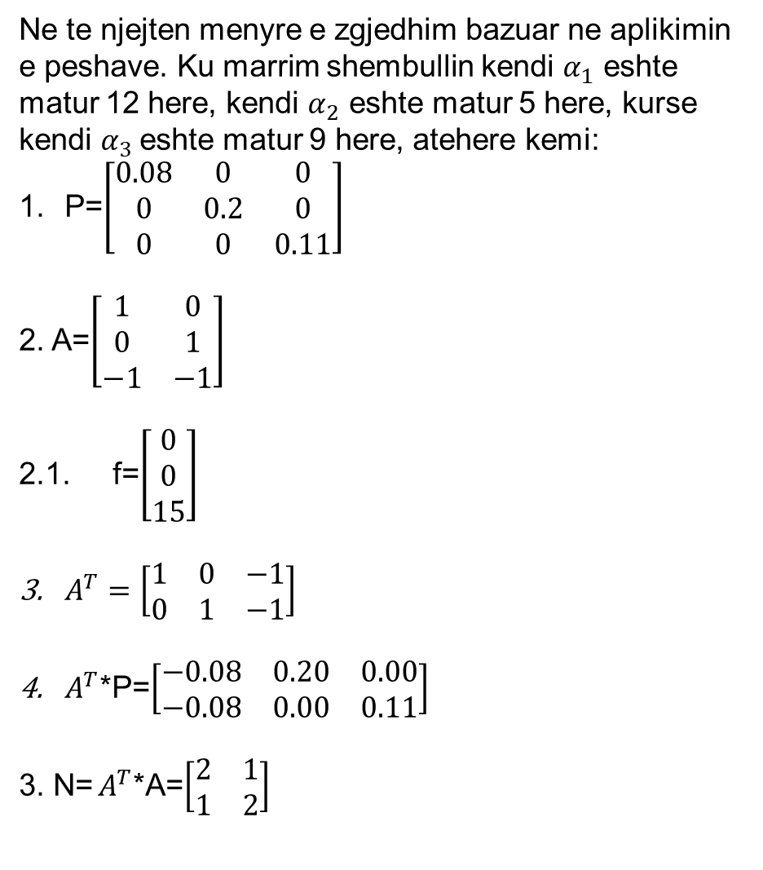
Barazimi terhor I matjeve te kendeve
Ne te njejten menyre e zgjedhim bazuar ne aplikimin e peshave. Ku marrim shembullin kendi $α_{1}$ eshte matur 12 here, kendi $α_{2}$ eshte matur 5 here, kurse kendi $α_{3}$eshte matur 9 here, atehere kemi:
P=$\left[\begin{matrix}0.08 & 0 & 0 \\ 0 & 0.2 & 0 \\ 0 & 0 & 0.11\end{matrix}\right]$
2. A=$\left[\begin{matrix}1 & 0 \\ 0 & 1 \\ −1 & −1\end{matrix}\right]$
2.1. f=$\left[\begin{matrix}0 \\ 0 \\ 15\end{matrix}\right]$
$A^{T}=\left[\begin{matrix}1 & 0 & −1 \\ 0 & 1 & −1\end{matrix}\right]$
$A^{T}$*P=$\left[\begin{matrix}−0.08 & 0.20 & 0.00 \\ −0.08 & 0.00 & 0.11\end{matrix}\right]$
3. N= $A^{T}$*A=$\left[\begin{matrix}2 & 1 \\ 1 & 2\end{matrix}\right]$

Slide 8

Barazimi terhor I matjeve te kendeve
5. N= $A^{T}$*p*A=$\left[\begin{matrix}0.28 & 0.08 \\ 0.08 & 0.19\end{matrix}\right]$
$6. N^{−1}$= $\left[\begin{matrix}4.0385 & −1.7308 \\ −1.7308 & 5.8846\end{matrix}\right]$
7. n= $A^{T}$*p*f= $\left[\begin{matrix}−1.25 \\ −1.25\end{matrix}\right]$
8. $\left[\begin{matrix}x_{1} \\ x_{2}\end{matrix}\right]$=- $N^{−1}$*n=$\left[\begin{matrix}5.19 \\ 2.88\end{matrix}\right]$
9. V=A*x+f=$\left[\begin{matrix}2.88 \\ 5.19 \\ −8.08\end{matrix}\right]+$ $\left[\begin{matrix}0 \\ 0 \\ 15\end{matrix}\right]$ $\left[\begin{matrix}2.88 \\ 5.19 \\ 6.92\end{matrix}\right]$
8. $V^{T}∗p∗V=f^{T}∗p∗f−n^{T}∗x=18.75−10.10=8.65$

Slide 9
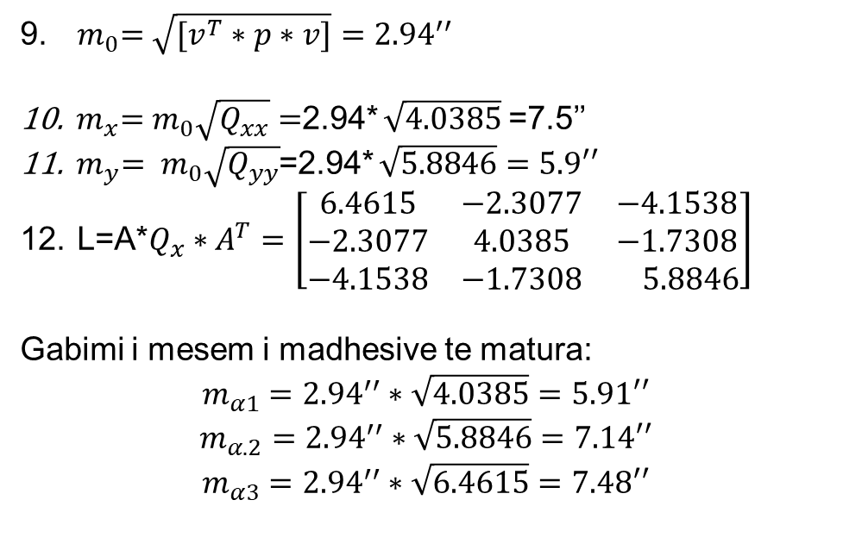
Barazimi terhor I matjeve te kendeve
9.${ m}_{0}=\sqrt{[v^{T}∗p∗v]}={2.94}^{′′}$
${ m}_{x}=m_{0}\sqrt{Q_{xx}}=$2.94* $\sqrt{4.0385}$=7.5’’
${ m}_{y}= m_{0}\sqrt{Q_{yy}}$=2.94* $\sqrt{5.8846}=5.9′′$
L=A*$Q_{x}∗A^{T}=\left[\begin{matrix}6.4615 & −2.3077 & −4.1538 \\ −2.3077 & 4.0385 & −1.7308 \\ −4.1538 & −1.7308 & 5.8846\end{matrix}\right]$
Gabimi i mesem i madhesive te matura:
$$m_{α1}={2.94}^{′′}∗\sqrt{4.0385}=5.91′′$$
$$m_{α.2}={2.94}^{′′}∗\sqrt{5.8846}=7.14′′$$
$$m_{α3}={2.94}^{′′}∗\sqrt{6.4615}=7.48′′$$

Slide 10
Barazimi terhor I matjeve te kendeve
9.${ m}_{0}=\sqrt{[v^{T}∗p∗v]}={2.94}^{′′}$
${ m}_{x}=m_{0}\sqrt{Q_{xx}}=$2.94* $\sqrt{4.0385}$=7.5’’
${ m}_{y}= m_{0}\sqrt{Q_{yy}}$=2.94* $\sqrt{5.8846}=5.9′′$
L=A*$Q_{x}∗A^{T}=\left[\begin{matrix}6.4615 & −2.3077 & −4.1538 \\ −2.3077 & 4.0385 & −1.7308 \\ −4.1538 & −1.7308 & 5.8846\end{matrix}\right]$
Gabimi i mesem i madhesive te matura:
$$m_{α1}={2.94}^{′′}∗\sqrt{4.0385}=5.91′′$$
$$m_{α.2}={2.94}^{′′}∗\sqrt{5.8846}=7.14′′$$
$$m_{α3}={2.94}^{′′}∗\sqrt{6.4615}=7.48′′$$

Slide 11
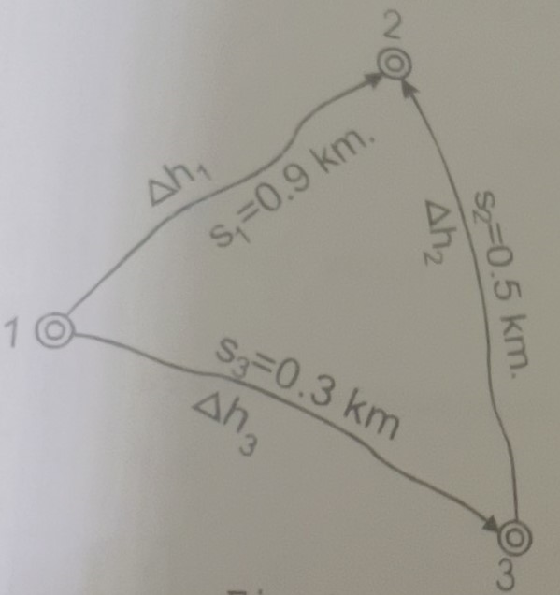
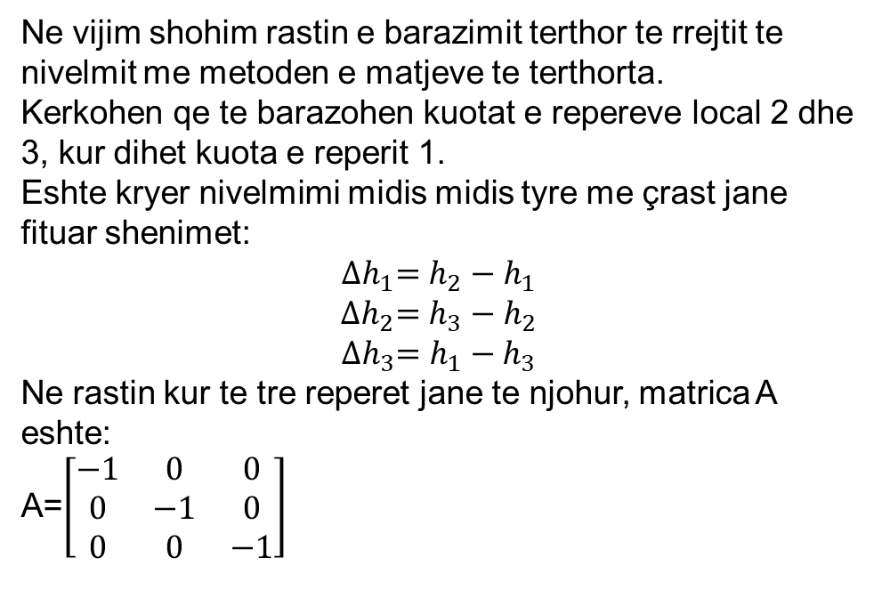
Aplikimi I Barazimit terhor ne rrjetat e nivelimit
Ne vijim shohim rastin e barazimit terthor te rrejtit te nivelmit me metoden e matjeve te terthorta.
Kerkohen qe te barazohen kuotat e repereve local 2 dhe 3, kur dihet kuota e reperit 1.
Eshte kryer nivelmimi midis midis tyre me çrast jane fituar shenimet:
$${∆h}_{1}=h_{2}−h_{1}$$
$${∆h}_{2}=h_{3}−h_{2}$$
$${∆h}_{3}=h_{1}−h_{3}$$
Ne rastin kur te tre reperet jane te njohur, matrica A eshte:
A=$\left[\begin{matrix}−1 & 0 & 0 \\ 0 & −1 & 0 \\ 0 & 0 & −1\end{matrix}\right]$

Slide 12
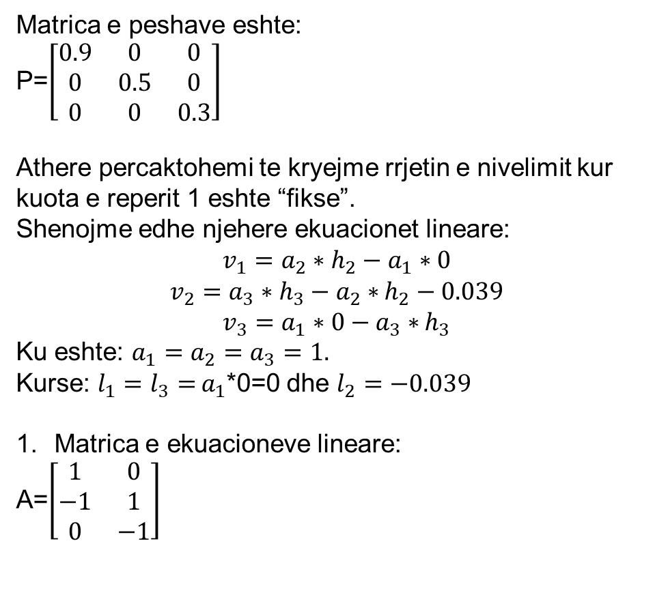
Aplikimi I Barazimit terhor ne rrjetat e nivelimit
Matrica e peshave eshte:
P=$\left[\begin{matrix}0.9 & 0 & 0 \\ 0 & 0.5 & 0 \\ 0 & 0 & 0.3\end{matrix}\right]$
Athere percaktohemi te kryejme rrjetin e nivelimit kur kuota e reperit 1 eshte “fikse”.
Shenojme edhe njehere ekuacionet lineare:
$$v_{1}=a_{2}∗h_{2}−a_{1}∗0$$
$v_{2}=a_{3}∗h_{3}−a_{2}∗$ $h_{2}−0.039$
$v_{3}=a_{1}∗0−a_{3}∗$ $h_{3}$
Ku eshte: $a_{1}=a_{2}=a_{3}=1.$
Kurse: $l_{1}=l_{3}=$ $a_{1}$*0=0 dhe $l_{2}=−0.039$
Matrica e ekuacioneve lineare:
A=$\left[\begin{matrix}1 & 0 \\ −1 & 1 \\ 0 & −1\end{matrix}\right]$

Slide 13
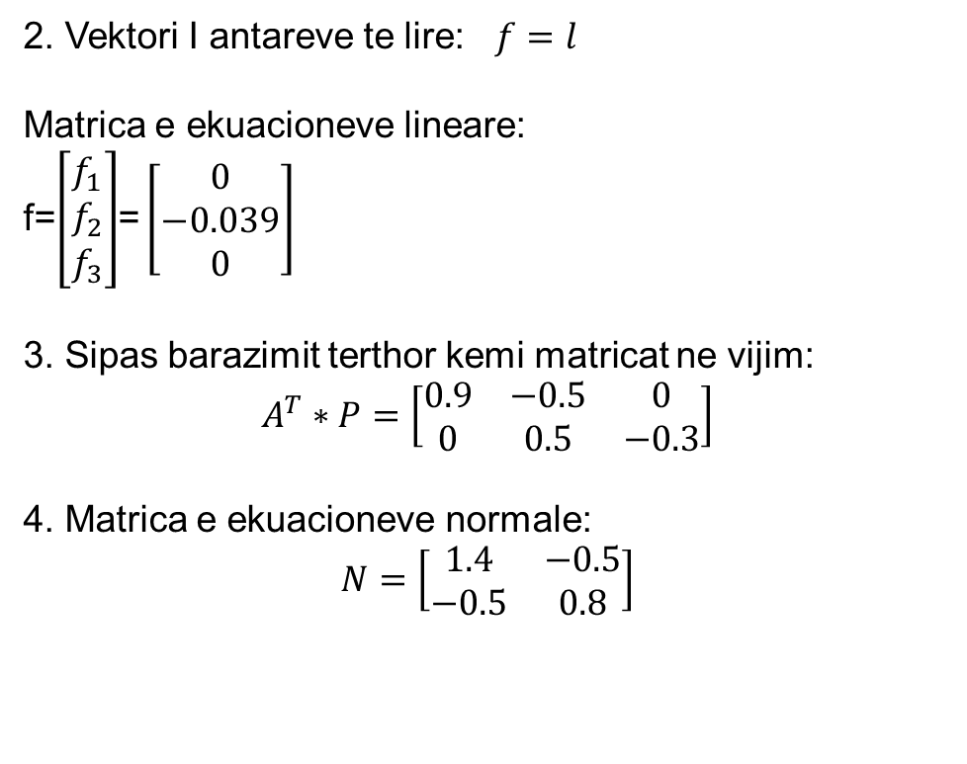
Aplikimi I Barazimit terhor ne rrjetat e nivelimit
2. Vektori I antareve te lire: $f=l$
Matrica e ekuacioneve lineare:
f=$\left[\begin{matrix}f_{1} \\ f_{2} \\ f_{3}\end{matrix}\right]$= $\left[\begin{matrix}0 \\ −0.039 \\ 0\end{matrix}\right]$
3. Sipas barazimit terthor kemi matricat ne vijim:
$$A^{T}∗P=\left[\begin{matrix}0.9 & −0.5 & 0 \\ 0 & 0.5 & −0.3\end{matrix}\right]$$
4. Matrica e ekuacioneve normale:
$$N=\left[\begin{matrix}1.4 & −0.5 \\ −0.5 & 0.8\end{matrix}\right]$$

Slide 14
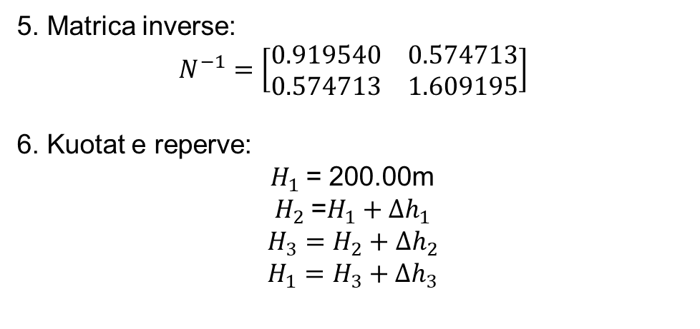
Aplikimi I Barazimit terhor ne rrjetat e nivelimit
5. Matrica inverse:
$$N^{−1}=\left[\begin{matrix}0.919540 & 0.574713 \\ 0.574713 & 1.609195\end{matrix}\right]$$
6. Kuotat e reperve:
$H_{1}$= 200.00m
$H_{2}$=${H_{1}+∆h}_{1}$
$$H_{3}={H_{2}+∆h}_{2}$$
$$H_{1}={H_{3}+∆h}_{3}$$

Slide 15
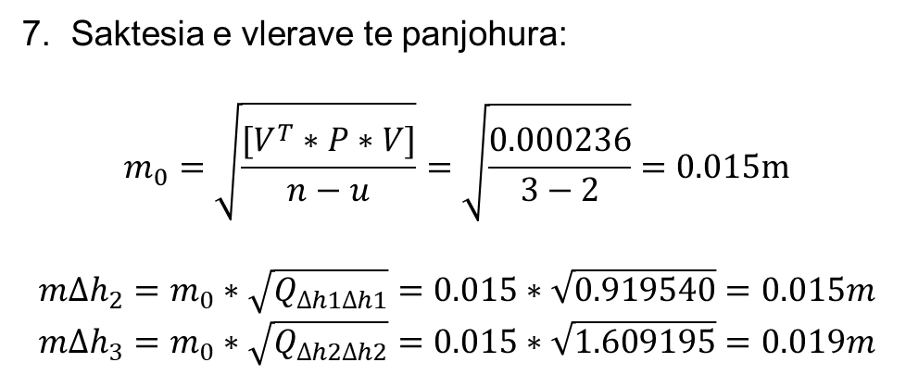
Aplikimi I Barazimit terhor ne rrjetat e nivelimit
7. Saktesia e vlerave te panjohura:
$$m_{0}=\sqrt{\frac{[V^{T}∗P∗V]}{n−u}}=\sqrt{\frac{0.000236}{3−2}}=0.015m$$
$${m∆h}_{2}=m_{0}∗\sqrt{Q_{∆h1∆h1}}=0.015∗\sqrt{0.919540}=0.015m$$
$${m∆h}_{3}=m_{0}∗\sqrt{Q_{∆h2∆h2}}=0.015∗\sqrt{1.609195}=0.019m$$

Slide 16
ESE-kontrollimi I llogaritjeve me metoden kushtore

