Slide 1
Teoria e barazimt te matjeve terthore
Llojet e matjeve?

Slide 2
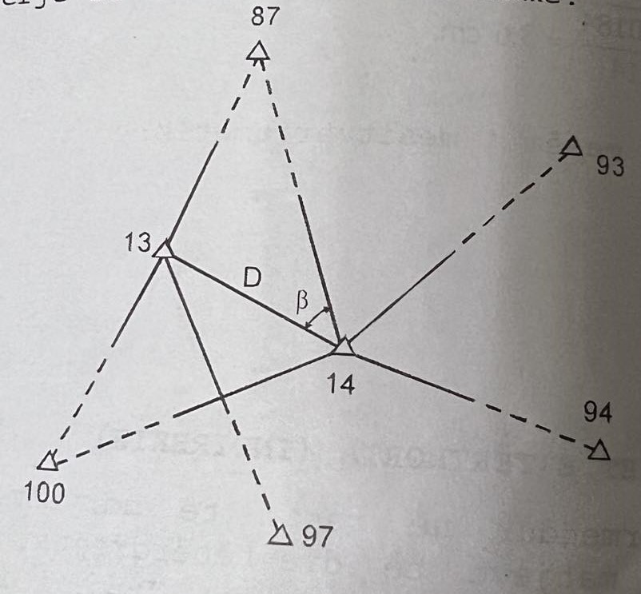
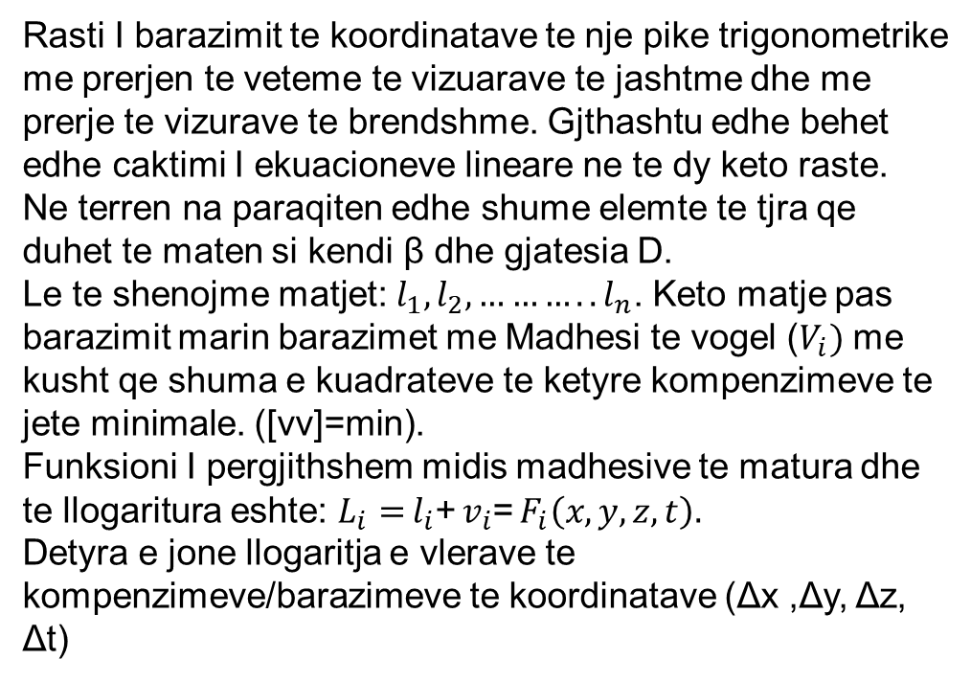
Teoria e barazimt te matjeve terthore
Rasti I barazimit te koordinatave te nje pike trigonometrike me prerjen te veteme te vizuarave te jashtme dhe me prerje te vizurave te brendshme. Gjthashtu edhe behet edhe caktimi I ekuacioneve lineare ne te dy keto raste.
Ne terren na paraqiten edhe shume elemte te tjra qe duhet te maten si kendi β dhe gjatesia D.
Le te shenojme matjet: $l_{1},l_{2},………..l_{n}$. Keto matje pas barazimit marin barazimet me Madhesi te vogel ($V_{i})$ me kusht qe shuma e kuadrateve te ketyre kompenzimeve te jete minimale. ([vv]=min).
Funksioni I pergjithshem midis madhesive te matura dhe te llogaritura eshte: $L_{i}=$ $l_{i}$+ $v_{i}$= $F_{i}\left(x,y,z,t\right).$
Detyra e jone llogaritja e vlerave te kompenzimeve/barazimeve te koordinatave (Δx ,Δy, Δz, Δt)

Slide 3
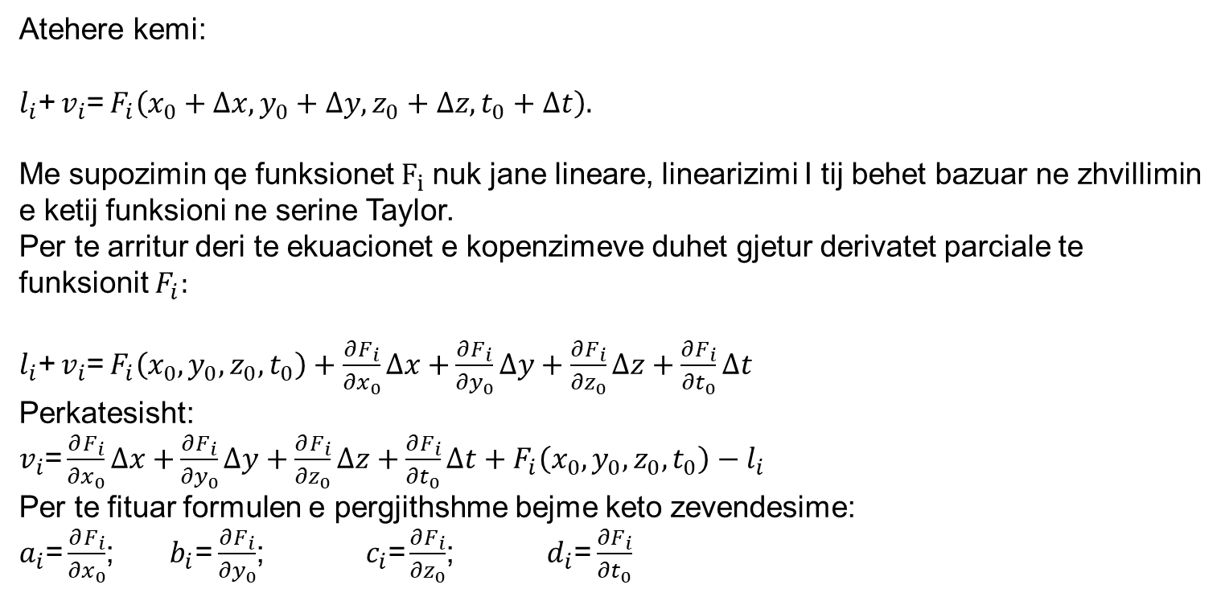
Teoria e barazimt te matjeve terthore
Atehere kemi:
$l_{i}$+ $v_{i}$= $F_{i}\left(x_{0}+∆x,y_{0}+∆y,z_{0}+∆z,t_{0}+∆t\right).$
Me supozimin qe funksionet $F_{i}$nuk jane lineare, linearizimi I tij behet bazuar ne zhvillimin e ketij funksioni ne serine Taylor.
Per te arritur deri te ekuacionet e kopenzimeve duhet gjetur derivatet parciale te funksionit $F_{i}:$
$l_{i}$+ $v_{i}$= $F_{i}\left(x_{0},y_{0},z_{0},t_{0}\right)+\frac{∂F_{i}}{{∂x}_{0}}∆x+$ $\frac{∂F_{i}}{{∂y}_{0}}∆y+\frac{∂F_{i}}{{∂z}_{0}}∆z+\frac{∂F_{i}}{{∂t}_{0}}∆t$
Perkatesisht:
$v_{i}$= $\frac{∂F_{i}}{{∂x}_{0}}∆x+$ $\frac{∂F_{i}}{{∂y}_{0}}∆y+\frac{∂F_{i}}{{∂z}_{0}}∆z+\frac{∂F_{i}}{{∂t}_{0}}∆t+F_{i}\left(x_{0},y_{0},z_{0},t_{0}\right)−l_{i}$
Per te fituar formulen e pergjithshme bejme keto zevendesime:
$a_{i}$= $\frac{∂F_{i}}{{∂x}_{0}}$; ${ b}_{i}$= $\frac{∂F_{i}}{{∂y}_{0}}$; $c_{i}$= $\frac{∂F_{i}}{{∂z}_{0}}$; $d_{i}$= $\frac{∂F_{i}}{{∂t}_{0}}$

Slide 4
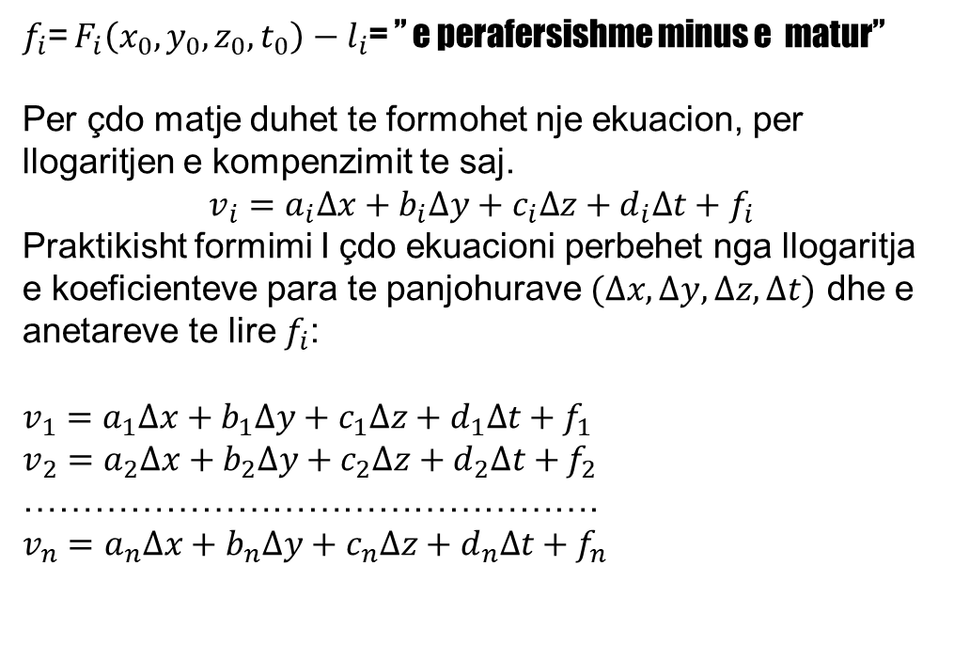
Teoria e barazimt te matjeve terthore
$f_{i}$= $F_{i}\left(x_{0},y_{0},z_{0},t_{0}\right)−l_{i}$= ” e perafersishme minus e matur”
Per çdo matje duhet te formohet nje ekuacion, per llogaritjen e kompenzimit te saj.
$$v_{i}=a_{i}∆x+b_{i}∆y+c_{i}∆z+d_{i}∆t+f_{i}$$
Praktikisht formimi I çdo ekuacioni perbehet nga llogaritja e koeficienteve para te panjohurave $(∆x, ∆y,∆z, ∆t)$ dhe e anetareve te lire $f_{i}$:
$v_{1}=a_{1}∆x+b_{1}∆y+c_{1}∆z+d_{1}∆t+$ $f_{1}$
$v_{2}=a_{2}∆x+b_{2}∆y+c_{2}∆z+d_{2}∆t+$ $f_{2}$
………………………………………….
$v_{n}=a_{n}∆x+b_{n}∆y+c_{n}∆z+d_{n}∆t+$ $f_{n}$

Slide 5
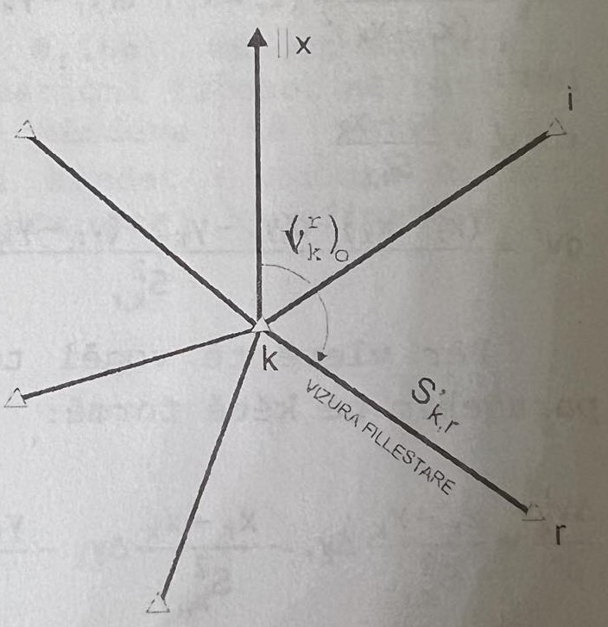
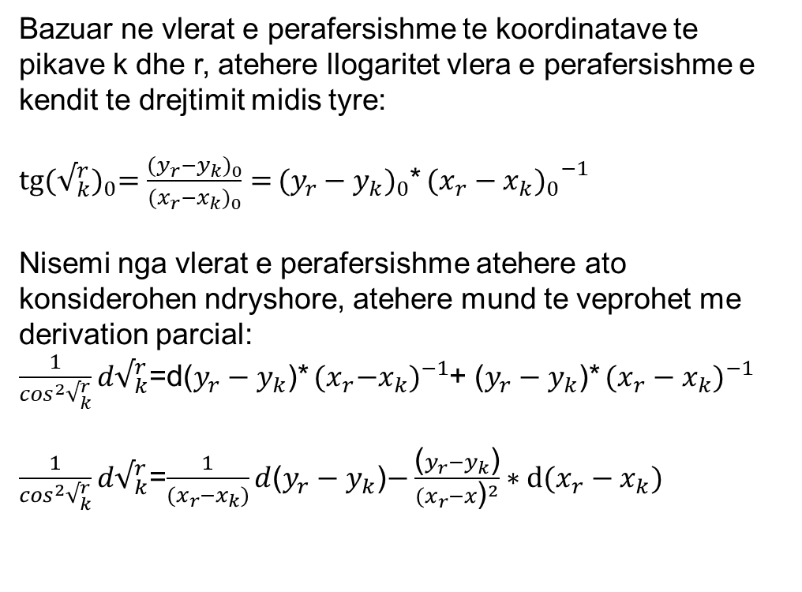

Formimi I ekuacioneve te kompenzimeve per vizura (drejtime)
Bazuar ne vlerat e perafersishme te koordinatave te pikave k dhe r, atehere llogaritet vlera e perafersishme e kendit te drejtimit midis tyre:
$tg{(√_{k}^{r})}_{0}=\frac{{(y_{r}−y_{k})}_{0}}{{(x_{r}−x_{k})}_{0}}=$ ${(y_{r}−y_{k})}_{0}$* ${{(x_{r}−x_{k})}_{0}}^{−1}$
Nisemi nga vlerat e perafersishme atehere ato konsiderohen ndryshore, atehere mund te veprohet me derivation parcial:
$\frac{1}{\cos^{2}√_{k}^{r}}d√_{k}^{r}$=d($y_{r}−y_{k}$)* ${{(x}_{r}−x_{k})}^{−1}$+ ($y_{r}−y_{k}$)* ${(x_{r}−x_{k})}^{−1}$
$\frac{1}{\cos^{2}√_{k}^{r}}d√_{k}^{r}$=$\frac{1}{{(x}_{r}−x_{k})}d$($y_{r}−y_{k}$)$−\frac{\text{(}y_{r}−y_{k}\text{)}}{{(x_{r}−x\text{)}}^{2}}∗d(x_{r}−x_{k})$
$$⁡$$

Slide 6
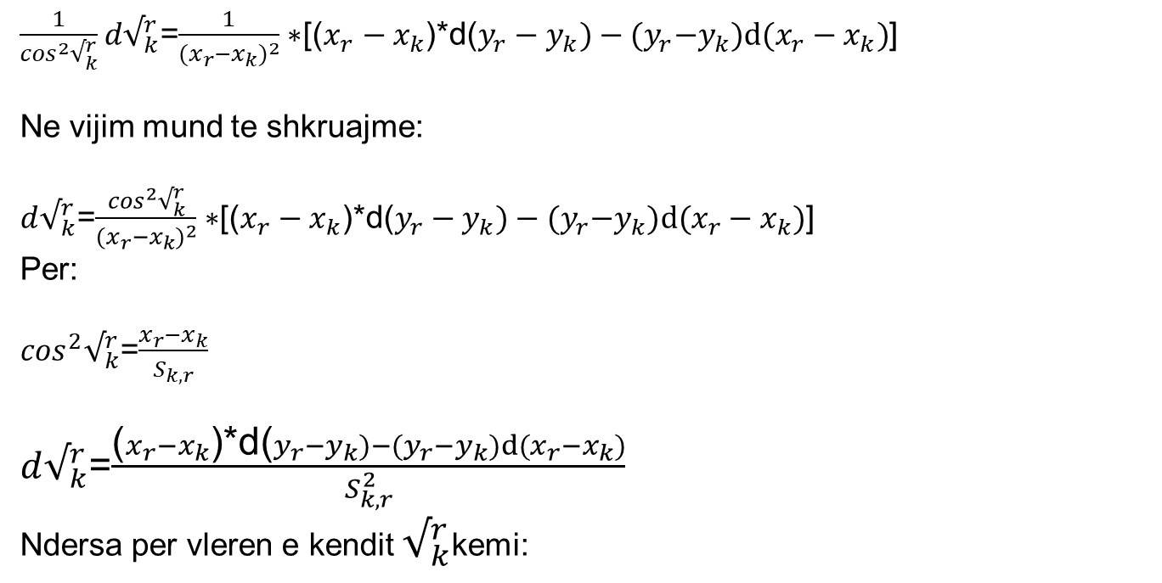
Teoria e barazimt te matjeve terthore
$\frac{1}{\cos^{2}√_{k}^{r}}d√_{k}^{r}$=$\frac{1}{{{(x}_{r}−x_{k})}^{2}}∗$[($x_{r}−x_{k}$)*d($y_{r}−y_{k})−{(y}_{r}−y_{k})d(x_{r}−x_{k})$]
Ne vijim mund te shkruajme:
$d√_{k}^{r}$=$\frac{\cos^{2}√_{k}^{r}}{{{(x}_{r}−x_{k})}^{2}}∗$[($x_{r}−x_{k}$)*d($y_{r}−y_{k})−{(y}_{r}−y_{k})d(x_{r}−x_{k})$]
Per:
$\cos^{2}√_{k}^{r}$=$\frac{x_{r}−x_{k}}{S_{k,r}}$
$d√_{k}^{r}$=$\frac{\text{(}x_{r}−x_{k}\text{)∗}\text{d}\text{(}y_{r}−y_{k})−{(y}_{r}−y_{k})d(x_{r}−x_{k})}{S_{k,r}^{2}}$
Ndersa per vleren e kendit $√_{k}^{r}$kemi:

Slide 7

Teoria e barazimt te matjeve terthore
$\frac{∆√_{k}^{r}}{ρ′′}=\frac{x_{r}−x_{k}}{S_{k,r}^{2}}∗{∆y}_{r}−\frac{x_{r}−x_{k}}{S_{k,r}^{2}}∗{∆y}_{k}−\frac{y_{r}−y_{k}}{S_{k,r}^{2}}∗{∆x}_{r}+$ $\frac{y_{r}−y_{k}}{S_{k,r}^{2}}$ ${∆x}_{r}$
$\frac{∆√_{k}^{r}}{ρ′′}=\frac{y_{r}−y_{k}}{S_{k,r}^{2}}∗{∆x}_{k}−\frac{x_{r}−x_{k}}{S_{k,r}^{2}}∗{∆y}_{k}−\frac{y_{r}−y_{k}}{S_{k,r}^{2}}∗{∆x}_{r}+$ $\frac{x_{r}−x_{k}}{S_{k,r}^{2}}$ ${∆y}_{r}$
Marrim parasysh formulat:
$\frac{y_{r}−y_{k}}{S_{k,r}^{2}}∗$ $ρ′′$=$a_{k,r}$
$$−\frac{x_{r}−x_{k}}{S_{k,r}^{2}}∗ ρ′′\text{=}b_{k,r}$$
$a_{k,r}$=- $a_{k,r}$
$b_{k,r}$=- $b_{k,r}$ $∆√_{k}^{r}$= $a_{k,r}$* ${∆x}_{k}$+ $b_{k,r}$* ${∆y}_{k}−a_{k,r}\text{∗} {∆x}_{r}−b_{k,r}\text{∗} {∆y}_{r}$

Slide 8
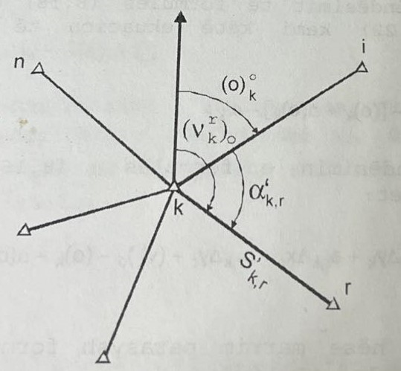
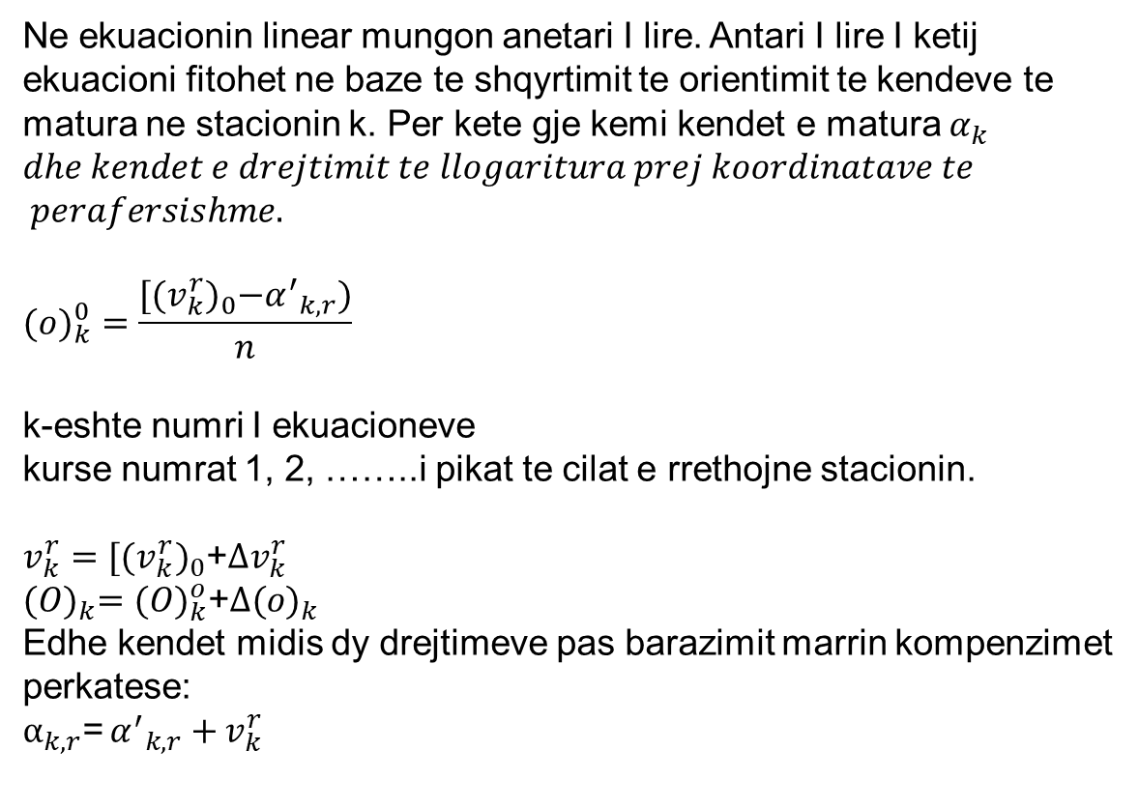
Formimi I antareve te lire
Ne ekuacionin linear mungon anetari I lire. Antari I lire I ketij ekuacioni fitohet ne baze te shqyrtimit te orientimit te kendeve te matura ne stacionin k. Per kete gje kemi kendet e matura $α_{k}$ $dhe kendet e drejtimit te llogaritura prej koordinatave te$
$$perafersishme.$$
$$({o)}_{k}^{0}=\frac{{[(v_{k}^{r})}_{0}−{α^{′}}_{k,r})}{n}$$
k-eshte numri I ekuacioneve
kurse numrat 1, 2, ……..i pikat te cilat e rrethojne stacionin.
${v_{k}^{r}=[(v_{k}^{r})}_{0}$+${∆v}_{k}^{r}$
$${(O)}_{k}={(O)}_{k}^{o}\text{+}∆{(o)}_{k}$$
Edhe kendet midis dy drejtimeve pas barazimit marrin kompenzimet perkatese:
$α_{k,r}$= ${α^{′}}_{k,r}+$ $v_{k}^{r}$

Slide 9

Formimi I antareve te lire
$α_{k,r}$= ${α^{′}}_{k,r}+$ $v_{k}^{r}$ = $v_{k}^{r}$- ${(O)}_{k}$
${α^{′}}_{k,r}+$ $v_{k}^{r}$ = $v_{k}^{r}$- ${(O)}_{k}$
Ose
$v_{k}^{r}$ = $v_{k}^{r}$- ${(O)}_{k}$- ${α^{′}}_{k,r}$
Atehere kemi ekuacionin e pergjithshem linear:
$v_{k}^{r}$ = ${(v_{k}^{r})}_{0}$+${∆v}_{k}^{r}$-[${(O)}_{k}^{o}\text{+}∆{(o)}_{k}$]- ${α^{′}}_{k,r}$
$V_{k,r}$= $a_{k,r}\text{∗} {∆x}_{k}\text{+} b_{k,r}\text{∗} {∆y}_{k}−a_{r,k}\text{∗} {∆x}_{r}−b_{r,k}\text{∗} {∆y}_{r}+{ \left(v_{k}^{r}\right)}_{0}−{\left(o\right)}_{k}−∆{\left(o\right)}_{k}$- ${α^{′}}_{k,r}$

Slide 10
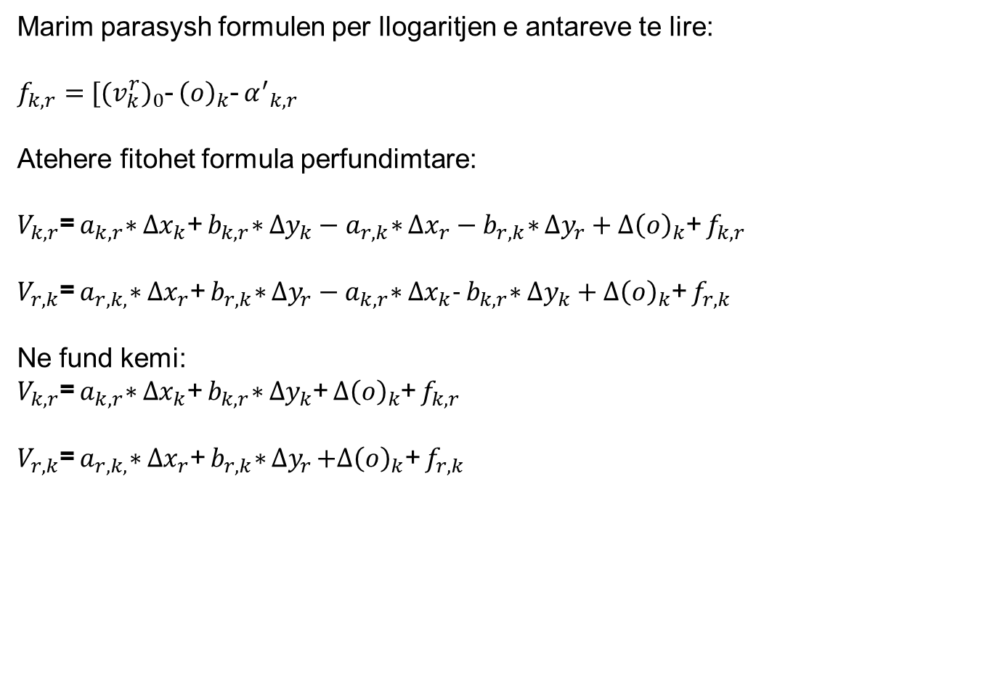
Formimi I antareve te lire
Marim parasysh formulen per llogaritjen e antareve te lire:
$f_{k,r}={ [(v_{k}^{r})}_{0}$- ${\left(o\right)}_{k}$- ${α^{′}}_{k,r}$
Atehere fitohet formula perfundimtare:
$V_{k,r}$= $a_{k,r}\text{∗} {∆x}_{k}\text{+} b_{k,r}\text{∗} {∆y}_{k}−a_{r,k}\text{∗} {∆x}_{r}−b_{r,k}\text{∗} {∆y}_{r}+∆{\left(o\right)}_{k}$+ $f_{k,r}$
$V_{r,k}$= $a_{r,k,}\text{∗} {∆x}_{r}\text{+} b_{r,k}\text{∗} {∆y}_{r}−a_{k,r}\text{∗} {∆x}_{k}\text{−} b_{k,r}\text{∗} {∆y}_{k}+∆{\left(o\right)}_{k}$+ $f_{r,k}$
Ne fund kemi:
$V_{k,r}$= $a_{k,r}\text{∗} {∆x}_{k}\text{+} b_{k,r}\text{∗} {∆y}_{k}$+ $∆{\left(o\right)}_{k}$+ $f_{k,r}$
$V_{r,k}$= $a_{r,k,}\text{∗} {∆x}_{r}\text{+} b_{r,k}\text{∗} {∆y}_{r}$ $+∆{\left(o\right)}_{k}$+ $f_{r,k}$

Slide 11
ESE- Matjet e dyfishta ne rrjetin e nivelimit

