Slide 1
Mechatronics -
Hands-on Approach
Session 5
Prof Ka C Cheok
Electrical & Computer Engineering Dept
Oakland University, Rochester, MI, USA
Prof Arbnor Pajaziti
Mechanical Engineering
University of Prishtina, Prishtina, Kosovo

Slide 2
Scope of this Course
Tell me and I will forget;
show me and I will remember;
but involve me and I will understand.
Overview of Mechatronics
Microcontrollers – Intro to Arduino & hands-on assignments
Microcomputers & Microcontrollers – Matlab + Arduino combo
Feedback Control System – Simple closed-loop examples
Matlab Video Processing & Simulink Computer Vision – Examples & demos
Auto-Target Tracking Servo-System – Matlab + Arduino experiment
Modeling, Simulation & Visualization of Mechatronics - Matlab Simscape (time permitting)
Other Aspects of Mechatronics

Slide 3
Today’s Goal
A) Your Eyes & Brain
  Millions of years of evolution
B) Computer Vision
  Cameras + Computers
  Math, algorithms,
  Selfie, Color tracking
C) Picking & Tracking a Color using Matlab
  Image Acquisition & Processing

Slide 4
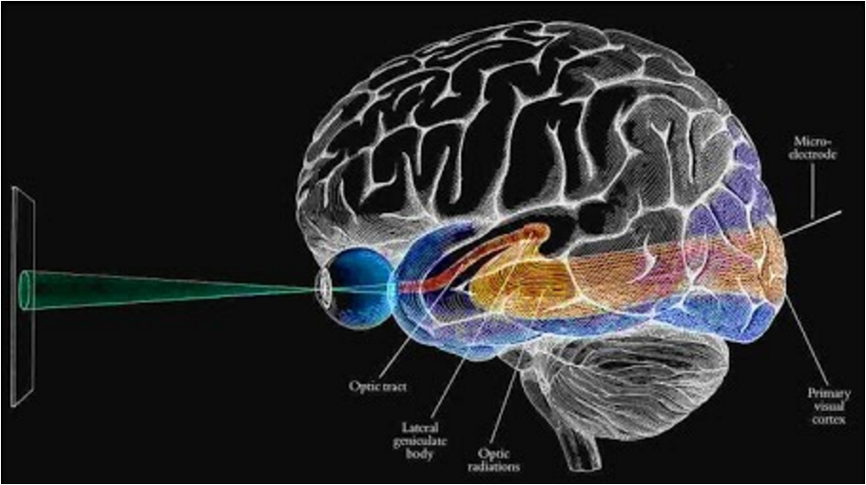

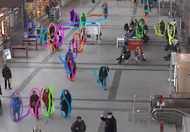
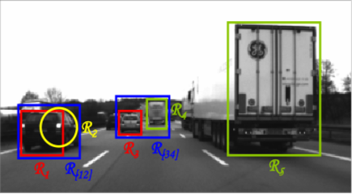
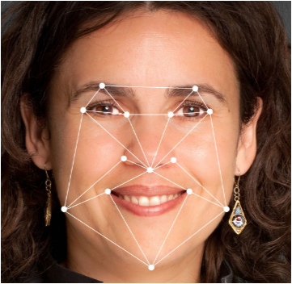

A) Your Eyes & Brain
Your eye retinas are attached directly to your brain!
Joke: The next time you look closely into someone’s eyes, you could say, “Oh my, your brain is so beautiful!”
Your eyes and brain have evolved over millions of years!
It learns, adapts and interprets the world.
Blue = Yellow
https://www.youtube.com/watch?v=JHT-VHOFDFY
Don’t believe your eyes
https://www.youtube.com/watch?v=YPlB20a0CQw
Eyes & Brain (very old & proven) versus Computer Vision (very young but full of potential)

Slide 5
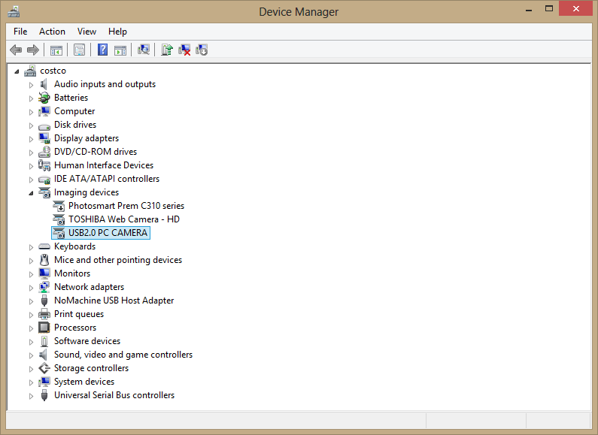
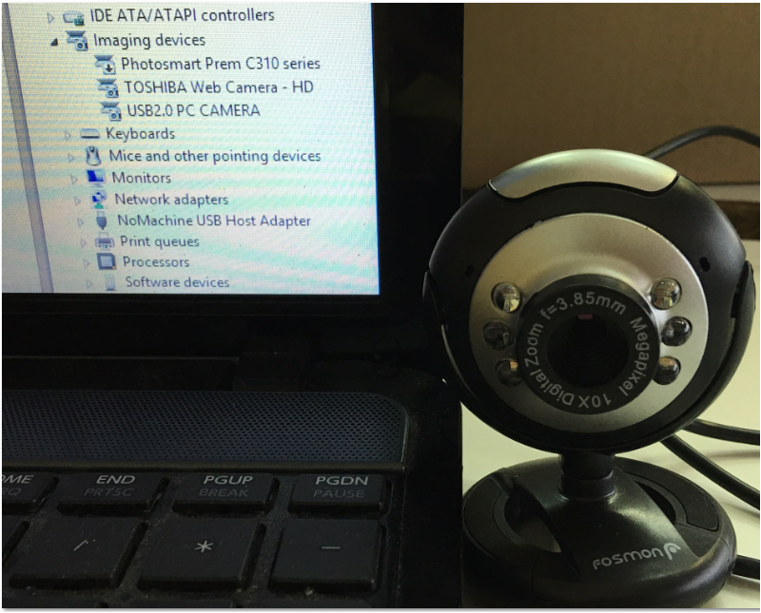
B) Computer Vision
  New, exciting & great potential
  Math, algorithms, sciences, engineering
  Plug & play ?
USB PC Camera
  Plug & play ?
Plug the camera into the USB port.
Open in the Control Panel.
Open the Device Manager.
Windows should detect the presence of the camera

Slide 6
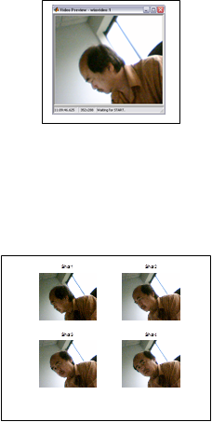
Camera + Matlab
  Selfie
%% Program name: VIP1_VidAcqDispStore.m Rev 2016-07-09
% Prof KaC Cheok – PISU
% Example of acquiring, displaying and storing images
%% Start with a clean slate
clear all; close all; clc; closepreview;
%% Inquire what type of camera is attached
Image_Acq_Info = imaqhwinfo
Image_Acq_Info.InstalledAdaptors
%% Access the installed camera and preview what it sees
Video_Obj = videoinput('winvideo', 1);
preview(Video_Obj)
pause(1.5)
%% Acquire and display a snapshop or single image frame:
Snapshot = getsnapshot(Video_Obj);
figure(2); set(gcf,'pos',[20 100 600 500]);
image(Snapshot); title('Display using image(...)');
%% Acquiring and displaying multiple images
figure(4); set(gcf,'pos',[60 60 600 500]);
[d1,d2,d3] = size(Snapshot); 4
MyClip = uint8(zeros(d1,d2,d3,4));
for i = 1:4
MyClip(:,:,:,i) = getsnapshot(Video_Obj);
subplot(2,2,i); imshow(MyClip(:,:,:,i));
title(strcat('Shot ',num2str(i)));
pause(0.5);
end
%% Example of how to save Snapshot to image6.mat file
save image6 Snapshot MyClip
%% Clean up
% Release the camera from this program so other application may access it
delete(Video_Obj)
clear Video_Obj

Slide 7
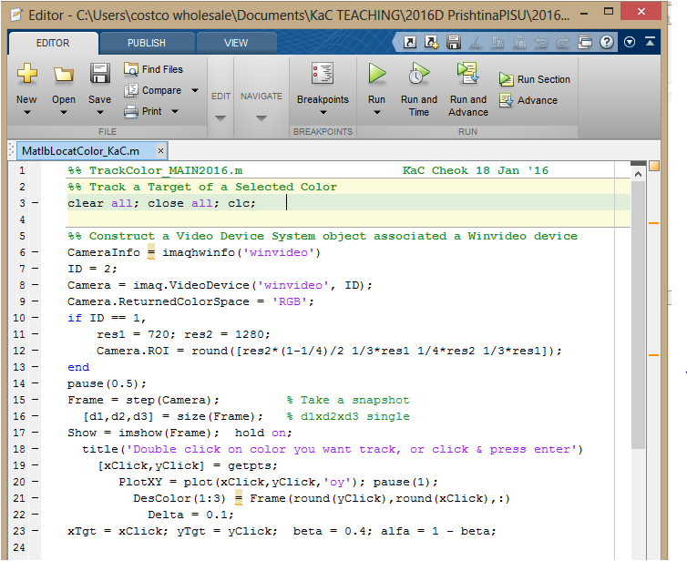
C) Picking & Tracking a
Color using Matlab
  Examples of Image Acquisition & Processing

Slide 8
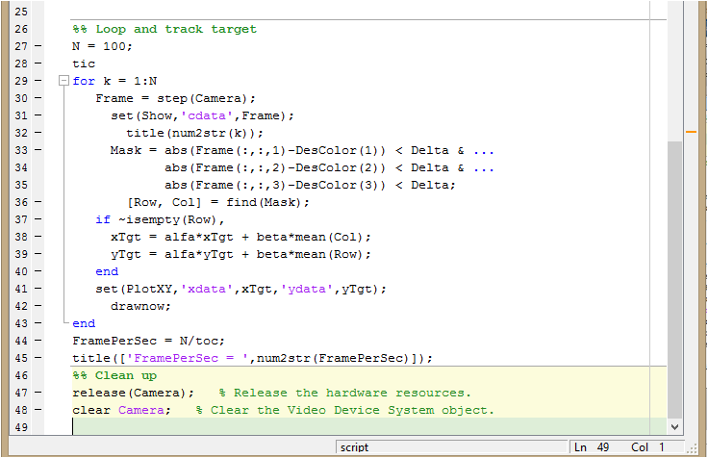
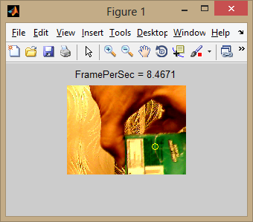

Slide 9
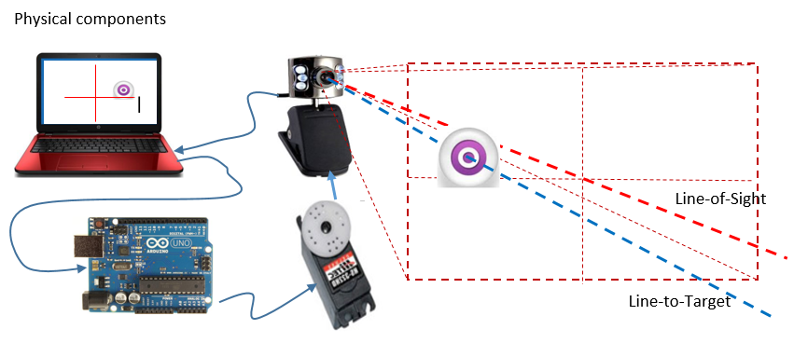
D) Auto-Target Tracking using Matlab
  Matlab: Camera, processing, control + Arduino: Servomotor

