Slide 1
Mechatronics -
Hands-on Approach
Session 3
Prof Ka C Cheok
Electrical & Computer Engineering Dept
Oakland University, Rochester, MI, USA
Prof Arbnor Pajaziti
Mechanical Engineering
University of Prishtina, Prishtina, Kosovo

Slide 2
Scope of this Course
Tell me and I will forget;
show me and I will remember;
but involve me and I will understand.
Overview of Mechatronics
Microcontrollers – Intro to Arduino & hands-on assignments
Microcomputers & Microcontrollers – Matlab + Arduino combo
Feedback Control System – Simple closed-loop examples
Matlab Video Processing & Simulink Computer Vision – Examples & demos
Auto-Target Tracking Servo-System – Matlab + Arduino experiment
Modeling, Simulation & Visualization of Mechatronics - Matlab Simscape (time permitting)
Other Aspects of Mechatronics

Slide 3
Today’s Goal
A) Lesson 11 Light Tracker … to complete SunFounder version
  Explanation of principle, hardware, software
B) Light Tracker … modify and write own Arduino version
  Explanation of Arduino serial communication program & code
  Serial comm viewer in SKETCH
C) Light Tracker … write own Arduino + Matlab version
  Intro to Matlab
  Matlab commands for serial communication, parsing a string, plotting
  Arduino → Matlab program

Slide 4
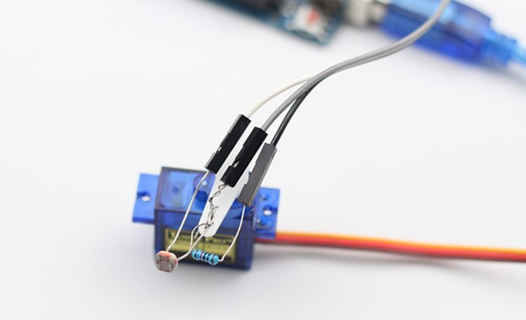
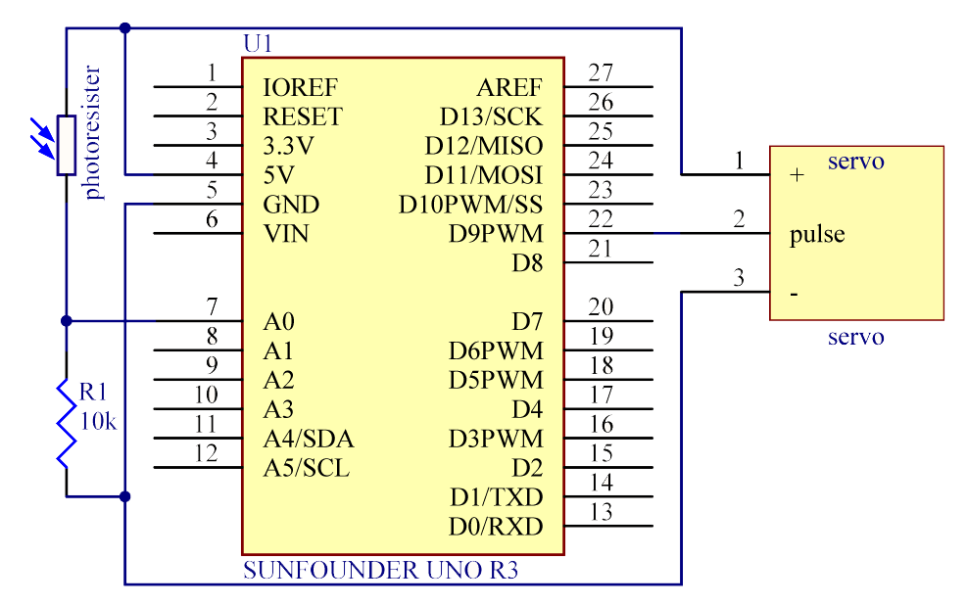
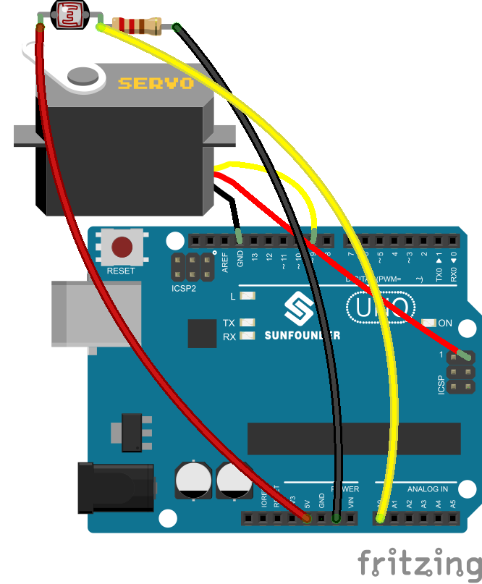
A) Lesson 11 Light Tracking … complete SunFounder version
The servo motor and the photoresistor scan and look for light source in 180 degree and record the location of light source. After finishing scanning, the servo motor and the photoresistor stop at the direction of light source.

Slide 5
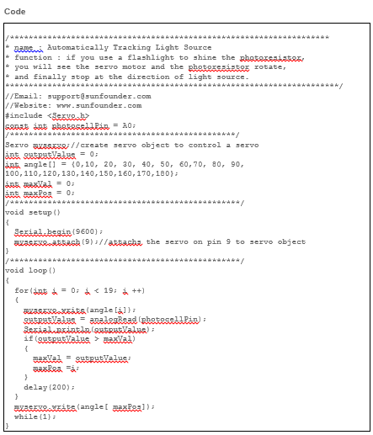
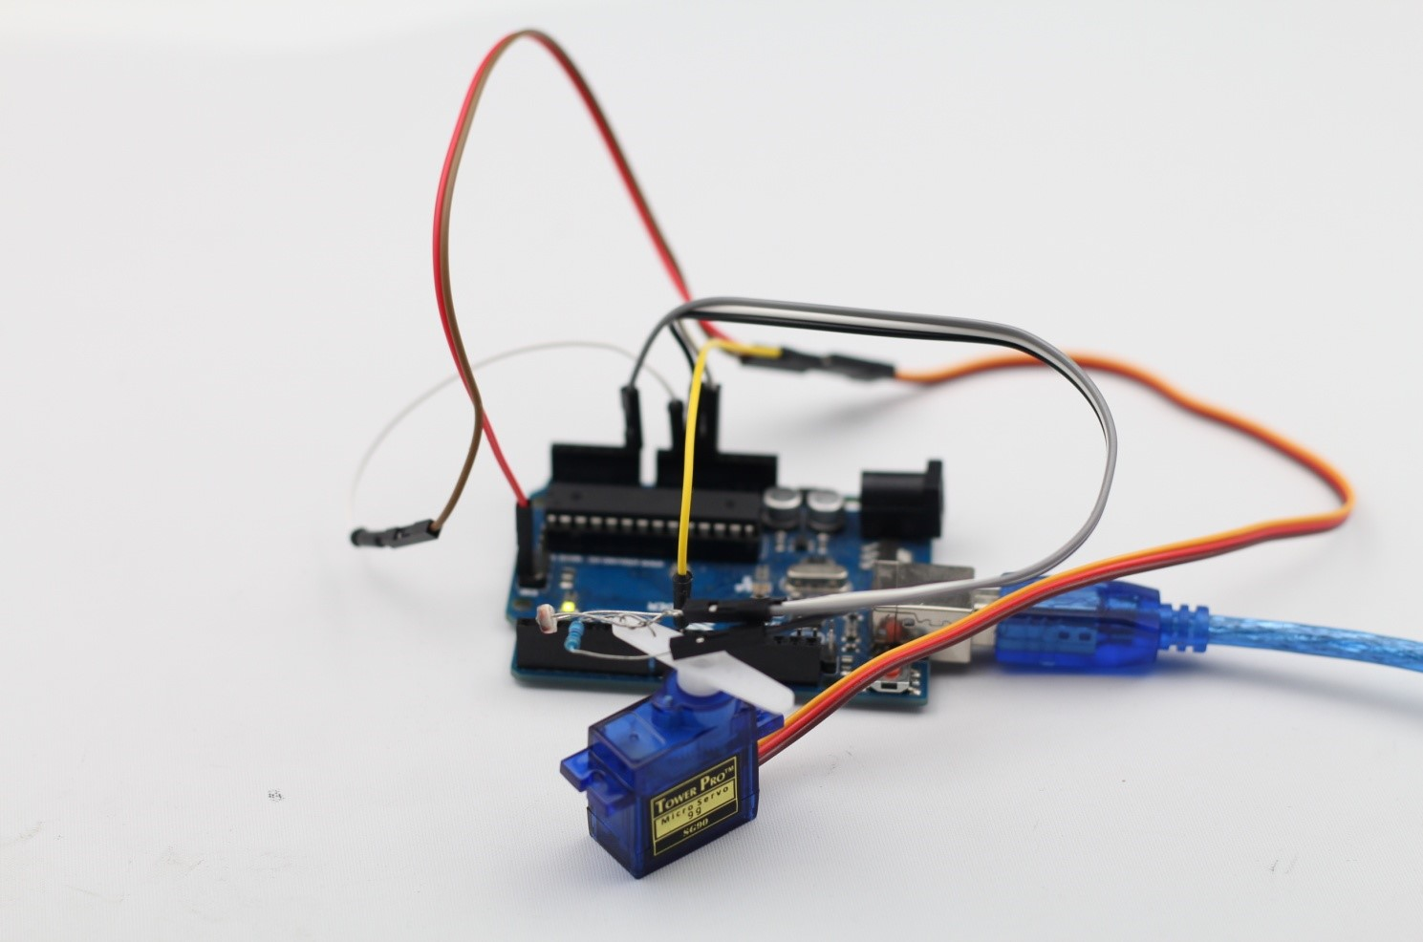
Lesson 11 Servo … contd

Slide 6
B) Light Tracker … modify and write own Arduino version
/********************************************************************
* name : Automatically Tracking Light Source
* function : if you use a flashlight to shine the photoresistor,
* you will see the servo motor and the photoresistor rotate,
* and finally stop at the direction of light source.
***********************************************************************/
//Email: support@sunfounder.com //Website: www.sunfounder.com
// KaC’s version July 2016 … write your name here
#include <Servo.h>
const int photocellPin = A0;
/************************************************/
Servo myservo;//create servo object to control a servo
int outputValue = 0;
int angle[] = {0,10, 20, 30, 40, 50, 60,70, 80, 90, 100,110,120,130,140,150,160,170,180};
int maxVal = 0;
int maxPos = 0;
char End = 'r';
/*************************************************/
void setup()
{
Serial.begin(9600);
myservo.attach(9);//attachs the servo on pin 9 to servo object
myservo.write(angle[0]); delay(500);
Serial.print(" Angle Value"); Serial.println();
}
/*************************************************/
void loop()
{
for(int i = 0; i < 19; i ++)
{
myservo.write(angle[i]);//write the angle to servo
outputValue = analogRead(photocellPin);//read the value of A0
Serial.print("$");
Serial.print(i);
Serial.print(",\t");
Serial.print(angle[i]);
Serial.print(",\t");
Serial.print(outputValue);
Serial.println(',');
if(outputValue > maxVal)//if the current value of A0 is greater than previous
{
maxVal = outputValue;//write down the value
maxPos =i;//
}
delay(100);
}
myservo.write(angle[maxPos]);//write the angle to servo which A0 has greatest value
Serial.println();
Serial.print("$Max");
Serial.print(",\t");
Serial.print(angle[maxPos]);
Serial.print(",\t");
Serial.print(maxVal);
Serial.println(',');
while(1);
}

Slide 7
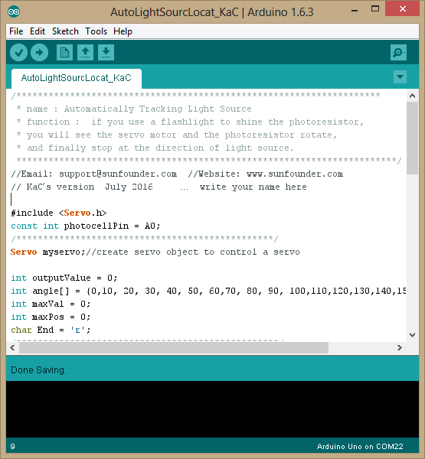
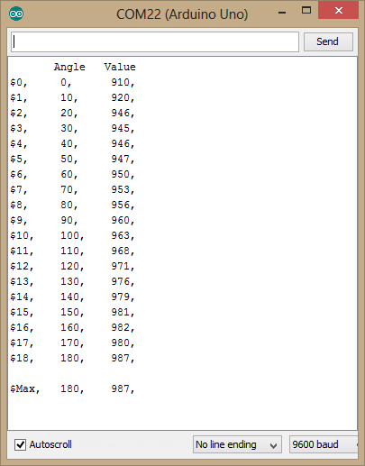
  Serial communication viewer in SKETCH

Slide 8
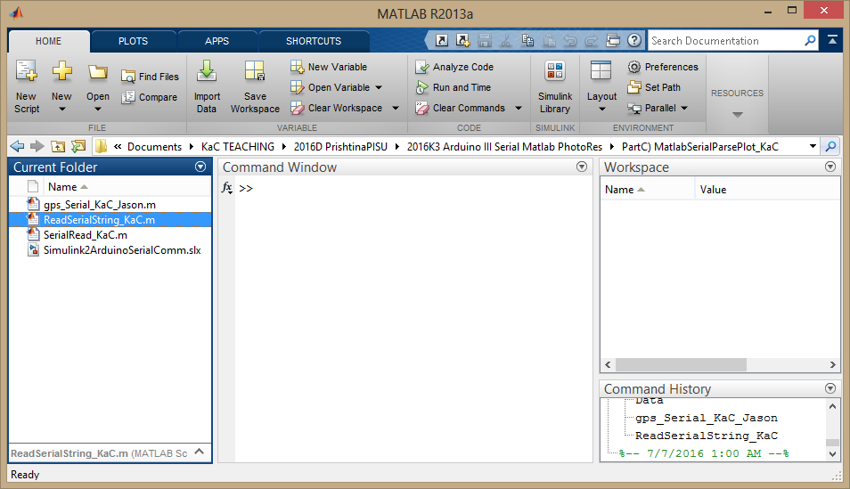
C) Light Tracker … write own Arduino + Matlab version

Slide 9
Matlab commands for serial communication, parsing a string, plotting
Data='';
while isempty(strmatch('$Max',Data)) %
Data = fscanf(obj1, '%c'); %the terminator was missing, that's why the data buffer was full
end
[header_string,Data] = strtok(Data,',');
[angle_string,Data] = strtok(Data,',');
[value_string,Data] = strtok(Data,',');
maxAngle = str2double(angle_string);
maxValue = str2double(value_string);
SecPerSample = toc/N'
close(figure(1)); figure(1);
plot(Angles,Values,'.-b'); hold on;
title(['Second per Sample = ', num2str(SecPerSample)]);
ylabel('Intensity value'); xlabel('Angles [deg]');
plot(maxAngle*[1 1],[min(Values) maxValue],'-r');
plot(maxAngle,maxValue,'*r');
text(maxAngle,maxValue,'Maximum Intensity');
%% Free the serial port so other program can use the port
fclose(obj1);
delete(obj1);
%% ReadSerialString_KaC.m by KaC Cheok 06Jul'16
%% Create a serial port object, read a string, separate values
% obj1 = instrfind('Type', 'serial', 'Port', 'COM8', 'Tag', '');
clc
FindObjects = instrfind;
fclose(FindObjects);
FindAgain = instrfind
%% Connect to instrument object, obj1.
%% MUST CLOSE OTHER CPNNECTION TO COM22
obj1 = serial('COM22');
obj1.BaudRate = 9600;
fopen(obj1);
%% We only want the strings with $GPGGA
N = 19; Angles = zeros(1,N); Values = zeros(1,N);
tic
for k = 1:N
Data='';
while isempty(strmatch('$',Data)) %
Data = fscanf(obj1, '%c'); % Read till LINE RETURN. See sscanf help
end
[header_string,Data] = strtok(Data,',');
[angle_string,Data] = strtok(Data,',');
[value_string,Data] = strtok(Data,',');
Angles(k) = str2double(angle_string);
Values(k) = str2double(value_string);
end

Slide 10
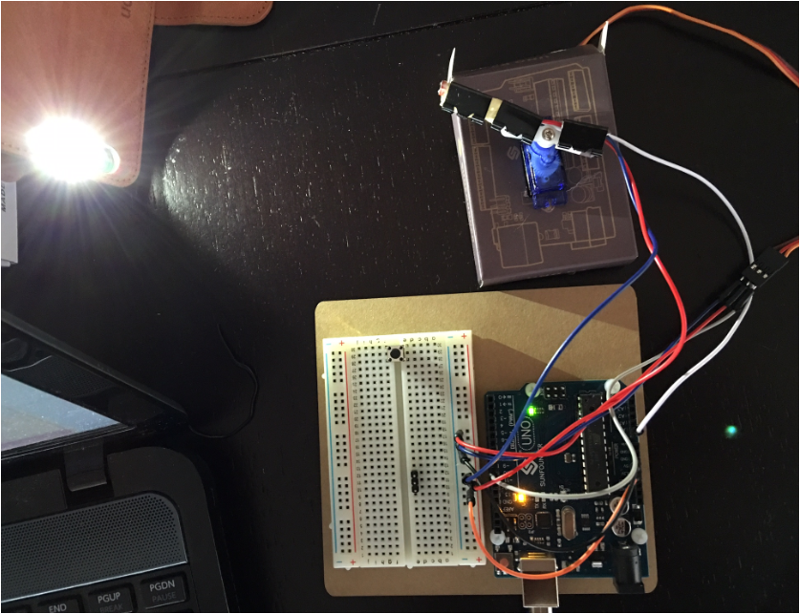
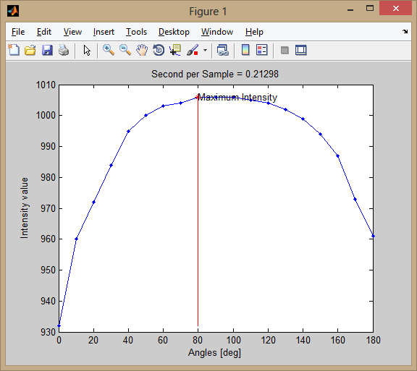

Slide 11
