Slide 1
Mechatronics -
Hands-on Approach
Prof Ka C Cheok
Electrical & Computer Engineering Dept
Oakland University, Rochester, MI, USA
Prof Arbnor Pajaziti
Mechanical Engineering
University of Prishtina, Prishtina, Kosovo

Slide 2
Scope of this Course
Tell me and I will forget;
show me and I will remember;
but involve me and I will understand.
Overview of Mechatronics
Microcontrollers – Intro to Arduino & hands-on assignments
Microcomputers & Microcontrollers – Matlab + Arduino combo
Feedback Control System – Simple closed-loop examples
Matlab Video Processing & Simulink Computer Vision – Examples & demos
Auto-Target Tracking Servo-System – Matlab + Arduino experiment
Modeling, Simulation & Visualization of Mechatronics - Matlab Simscape
Other Aspects of Mechatronics

Slide 3
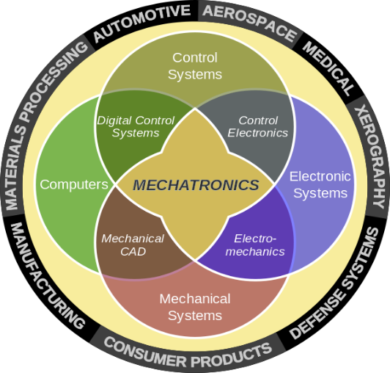
Mechatronics
General Background
Existing & New Engineering Knowledge
Existing & New Technologies
Capability to Adapt
Creativeness
Experience
Teamwork
Funding
Passion
Wide & multi-disciplinary
Specialization
Technologies is advance at a tremendous pace.
It’s difficult to keep up with all the trends. Time & money.
We would have a purpose and choose a trend.
Keep learning, adapting, applying & anticipating!

Slide 4
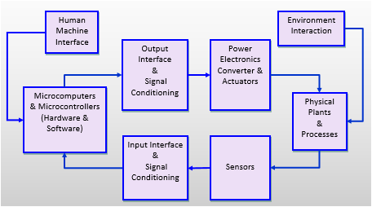
System of Functions
System of Systems
Human Machine Interface
Environment
Interaction
Output
Interface
&
Signal Conditioning
Power Electronics Converter & Actuators
Microcomputers
& Microcontrollers
(Hardware & Software)
Physical Plants
&
Processes
Input Interface
&
Signal Conditioning
Sensors
Simple systems: New technologies, solid foundation, concepts
Complex systems: Automobile, aircraft, robot
Challenges: New applications, smart systems
Challenges: Smarter, communications
Prishtina International Summer University
7/2/2016
4

Slide 5
Microcontroller
Human Machine Interface
Environment
Interaction
Output
Interface
&
Signal Conditioning
Power Electronics Converter & Actuators
There are hundreds of different microcontrollers introduced in the market over the years.
One that is hugely accepted by enthusiasts and practitioners alike is the family of Arduinos.
Arduinos
Is simple to learn and use, and affordable
Has open-source online tutorials that include codes and videos
Has capability to incorporates latest technologies
However, Arduinos is yet to be used in rigorous critical operations.
Microcomputers
& Microcontrollers
(Hardware & Software)
Physical Plants
&
Processes
Input Interface
&
Signal Conditioning
Sensors
Arduinos
http://www.arduinos.cc
https://www.adafruit.com/
http://www.digikey.com/
http://www.amazon.com/
http://www.sparkfun.com

Slide 6
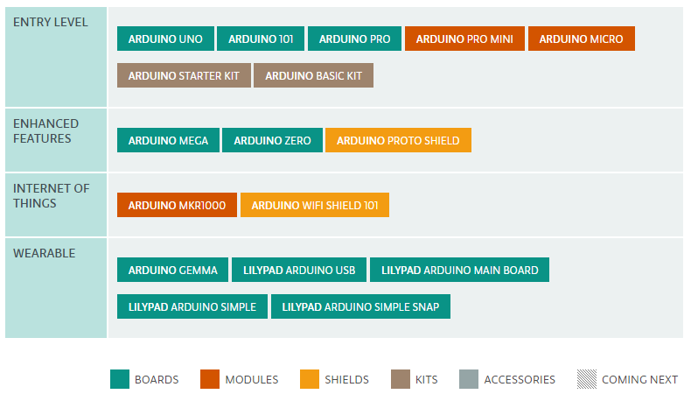
Types of Arduinos
https://www.arduino.cc/en/Main/Products

Slide 7

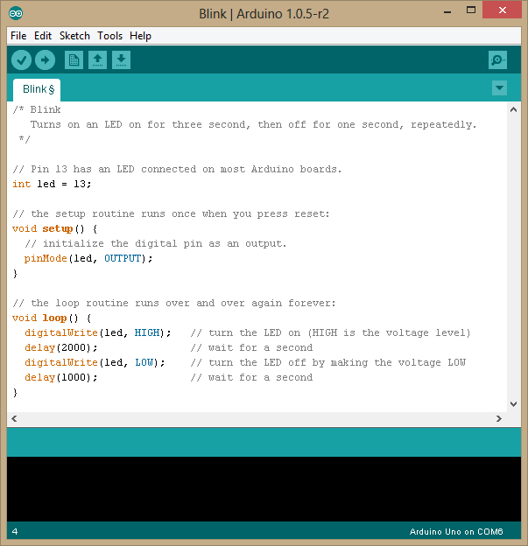
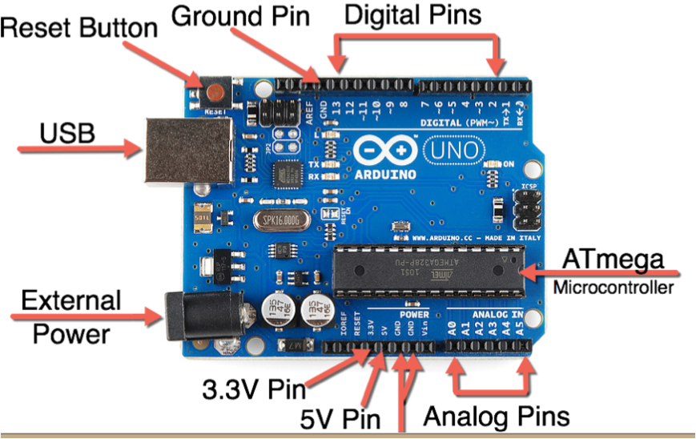
Hardware & Software Sides of Arduinos
Application interface
Serial Rx/Tx
USB
Application interface

Slide 8
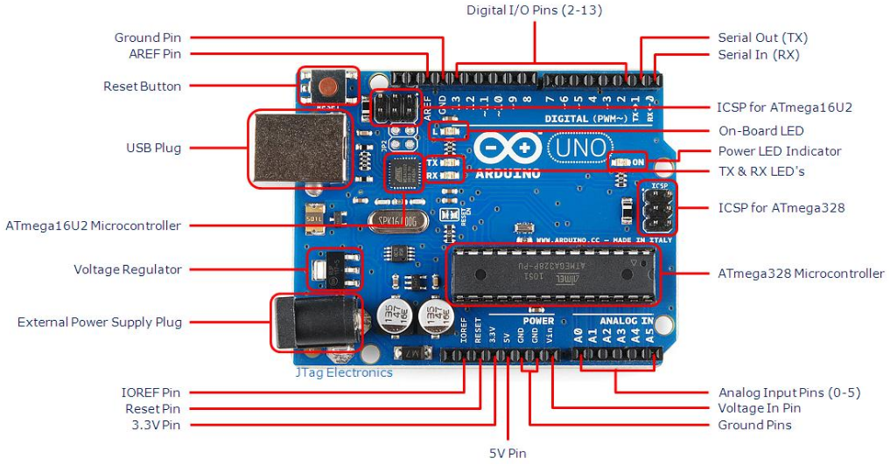
Hardware Side
Arduino Uno R3 Board
Application interface
Application interface
A detail description of the pins & functions can be found at http://www.jtagelectronics.com/?p=75

Slide 9
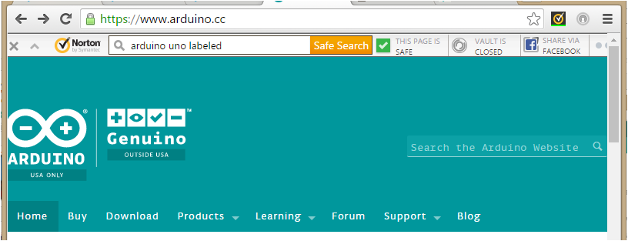
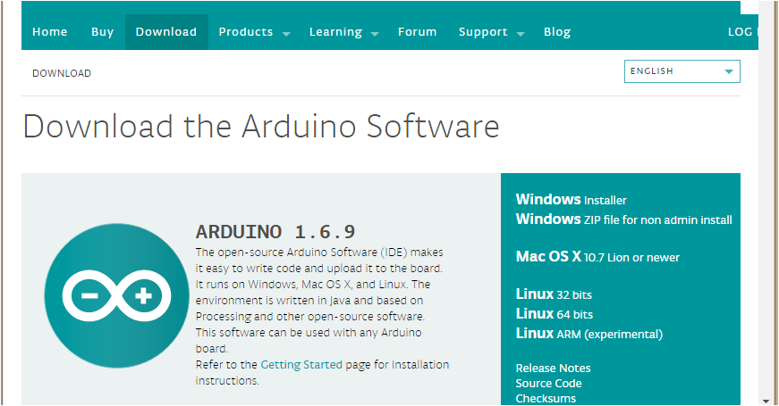
Software Side
Install Arduino Integrated Development Environment called SKETCH

Slide 10
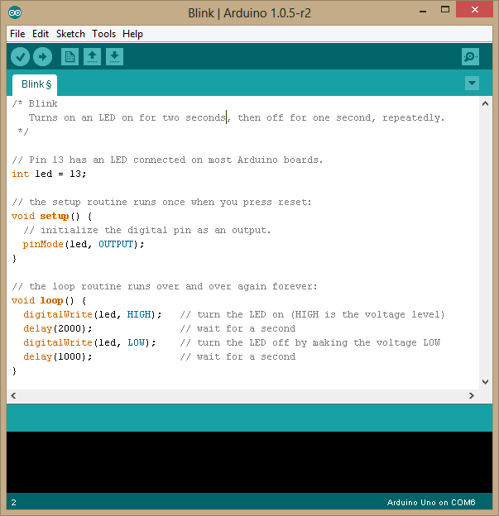

DOWNLOAD
  www.Arduino.cc
  Download
  Windows
  Zip file download
  (several mins)
EXTRACT
  Extract all
  Specify a directory
  (several mins)
START UP ARDUINO
  Open up (execute) Arduino
  File → Save → SpecifyFileName
  Compose program shown →
  .
  .
  .
  Save
  Upload

Slide 11
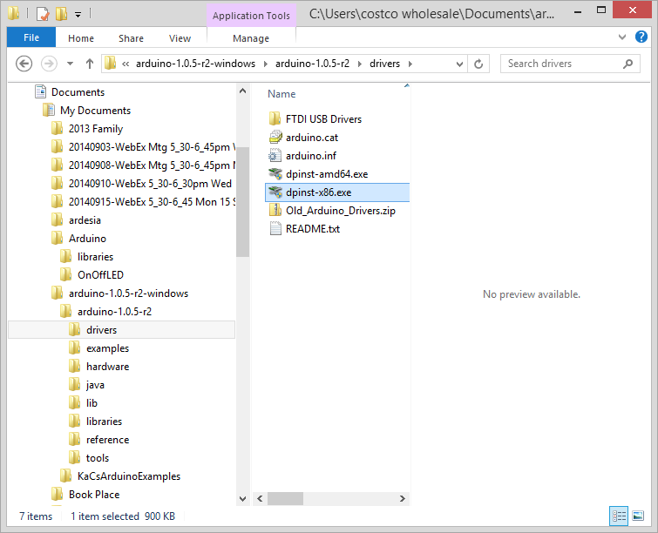
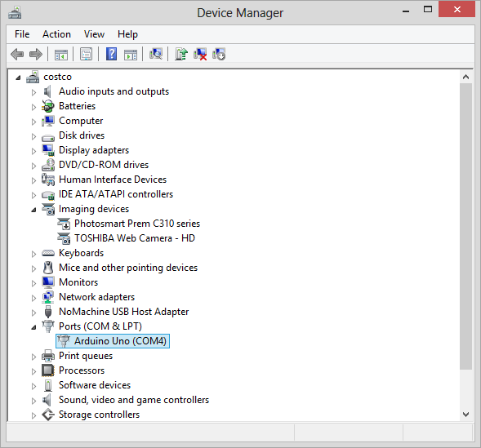
May or may not need to update the driver for the Uno

Slide 12
Software Side
Definition
Labels
Basic Required Sections of an Arduino Sketch (program)
Initialization
Looping statements

Slide 13
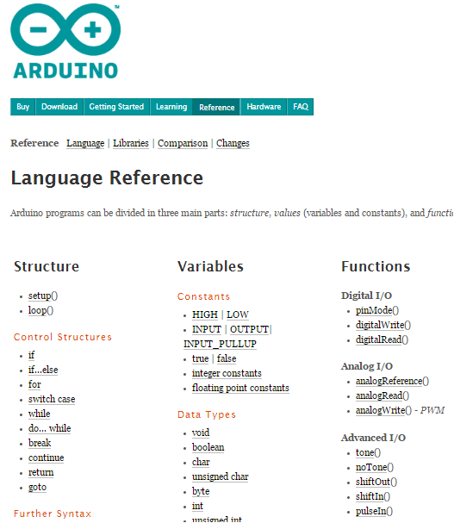
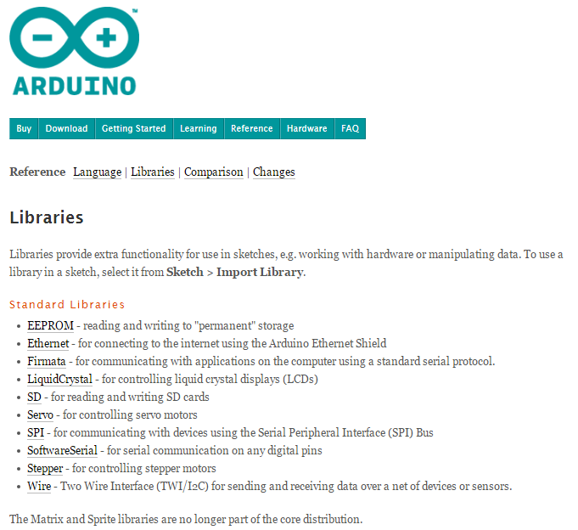
Click on Help in the Sketch Menu

Slide 14
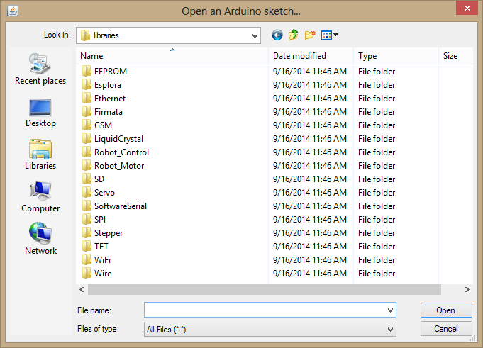
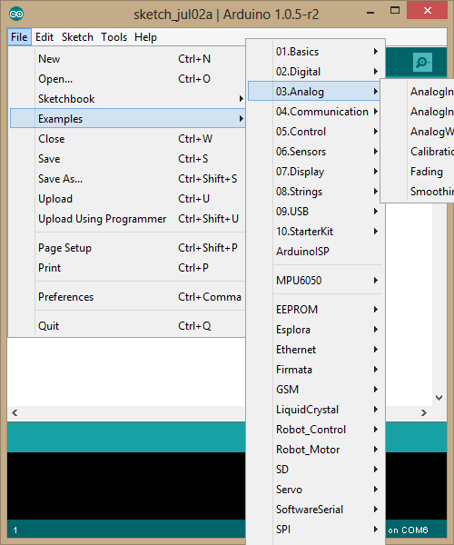
Explore Learning from Examples, Tutorials, Videos

Slide 15
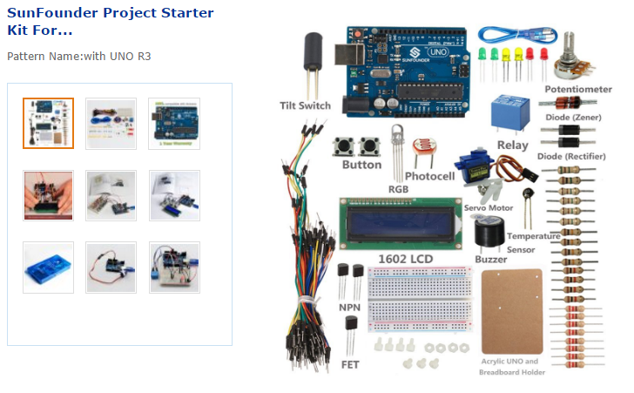
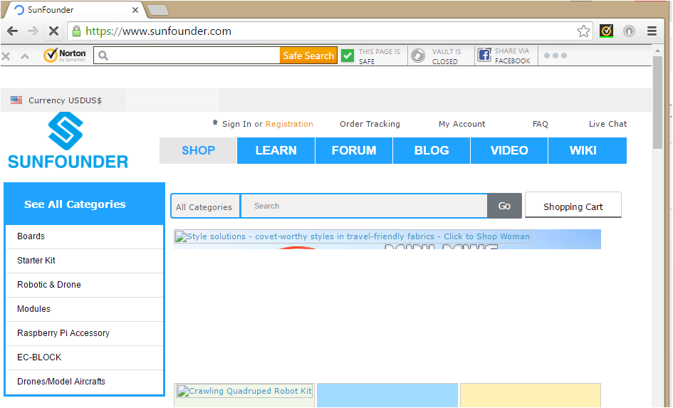
“If you want to learn to swim, jump into the water.”
Arduinos – Getting Started
SunFounder Project 1602 LCD Starter Kit For Arduino UNO R3 US$43

Slide 16
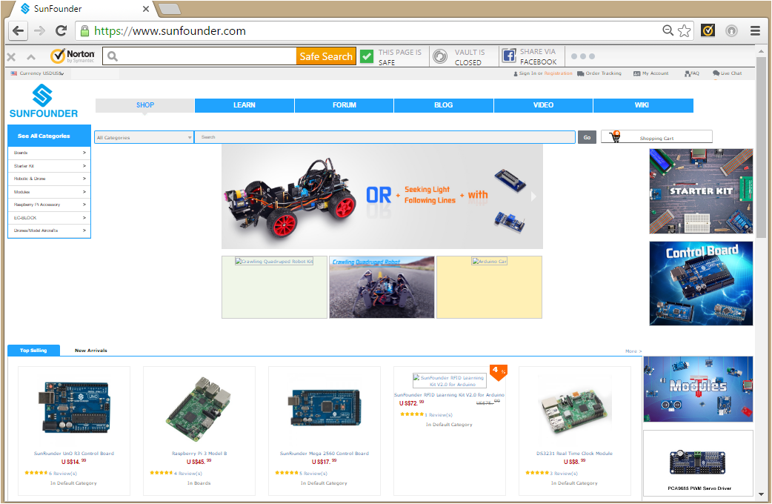
www.sunfounder.com

Slide 17
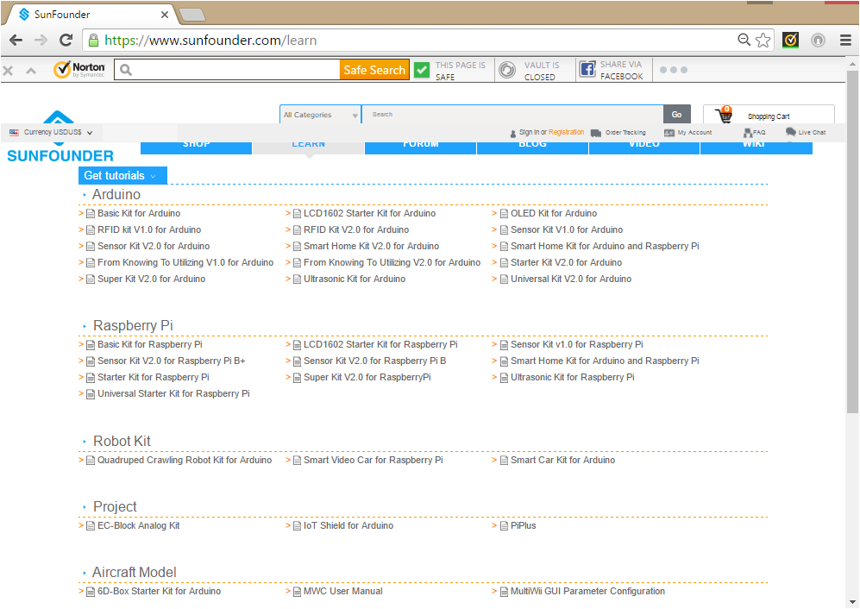

Slide 18
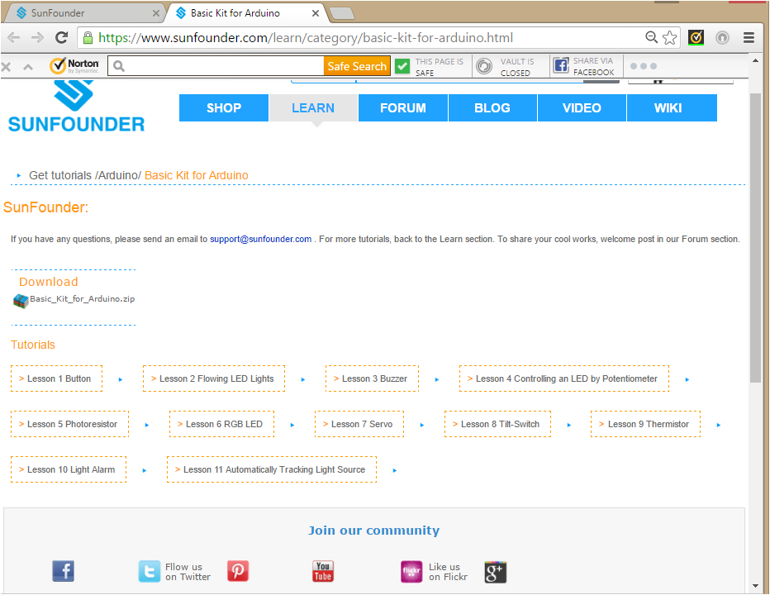

Slide 19
www.sunfounder.com
Select Learn ➔ Get Tutorial Get tutorials and watch videos
Select Basic Kit for Arduino Get to Lessons for the Basic Kit
 | Software | Hardware
Lesson 1 Button | pinMode, digitalRead, digitalWrite | Pin D12, Pin D13
Lesson 2 Flowing LED Lights
Lesson 3 Buzzer
Lesson 4 Photoresistor
Lesson 5 RGB LED
Lesson 6 Relay
Lesson 7 Tilt-Switch
Lesson 8 Servo
Lesson 9 LCD1602
Lesson 10 Thermister
Lesson 11Voltmeter
Lesson 12 Automatic Tracking Light Source

Slide 20
There are many websites for Arduino tutorials. For example,
Book by Exploring Arduino by Jeremy Blum
http://www.youtube.com/watch?annotation_id=channel%3A51e09272-0-2908-8e47-47d7b3a8cc4&feature=iv&src_vid=_LCCGFSMOr4&v=dcyy6fHLkhg
Tutorial 1 Getting acquainted with Arduino http://www.youtube.com/watch?v=fCxzA9_kg6s
Tutorial 2 Buttons, PWM and Function http://www.youtube.com/watch?v=_LCCGFSMOr4
Tutorial 3 Electrical Engineering Basics http://www.youtube.com/watch?v=abWCy_aOSwY
Tutorial 4 Analog Inputs http://www.youtube.com/watch?v=js4TK0U848I
Tutorial 5 Motors and Transistors http://www.youtube.com/watch?v=TtZEZYQG0xk
Tutorial 6 Serial Communication & Processing http://www.youtube.com/watch?v=g0pSfyXOXj8
Tutorial 7 I2C Communication & Processing http://www.youtube.com/watch?v=GJX0BRUagCg
Tutorial 8 SPI Interfaces http://www.youtube.com/watch?v=1nO2SSExEnQ
Tutorial 9 Wireless Communication http://www.youtube.com/watch?v=vKVNmA8C6m8
Tutorial 10 Interrupts &HW Debouncing http://www.youtube.com/watch?v=CRJUdf5TTQQ
Tutorial 11 SD Card & Datalogging http://www.youtube.com/watch?v=5v5A3j7Rrco
Tutorial 12 RFID http://www.youtube.com/watch?v=gIlSLwcbeTU
Tutorial 13 LCD http://www.youtube.com/watch?v=oIiDseJO4dM
Tutorial 14 Holiday Lights and Sound http://www.youtube.com/watch?v=CoG_Czyr7z0
Tutorial 15 GPS Tracking http://www.youtube.com/watch?v=TtZEZYQG0xk

