Slide 1
Mechatronics -
Hands-on Approach
Session 6
Prof Ka C Cheok
Electrical & Computer Engineering Dept
Oakland University, Rochester, MI, USA
Prof Arbnor Pajaziti
Mechanical Engineering
University of Prishtina, Prishtina, Kosovo

Slide 2
Scope of this Course
Tell me and I will forget;
show me and I will remember;
but involve me and I will understand.
Overview of Mechatronics
Microcontrollers – Intro to Arduino & hands-on assignments
Microcomputers & Microcontrollers – Matlab + Arduino combo
Feedback Control System – Simple closed-loop examples
Matlab Video Processing & Simulink Computer Vision – Examples & demos
Auto-Target Tracking Servo-System – Matlab + Arduino experiment
Modeling, Simulation & Visualization of Mechatronics - Matlab Simscape (time permitting)
Other Aspects of Mechatronics

Slide 3
Today’s Goal
Auto-Target Tracking using Matlab
  Control concept, scheme
  Hardware, software components
  Servomotor + Camera mount
  Matlab: Image acquisition
  Image processing
  Feedback control
  Serial communication
  Arduino: Serial communication
  Servomotor

Slide 4
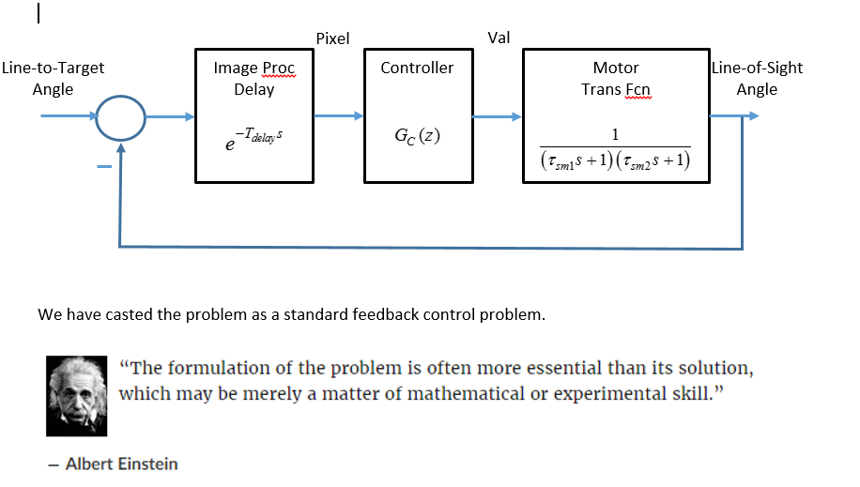
  Control Scheme
  Control Block Diagram
  P-Controller, PI Controller, PID Controller

Slide 5
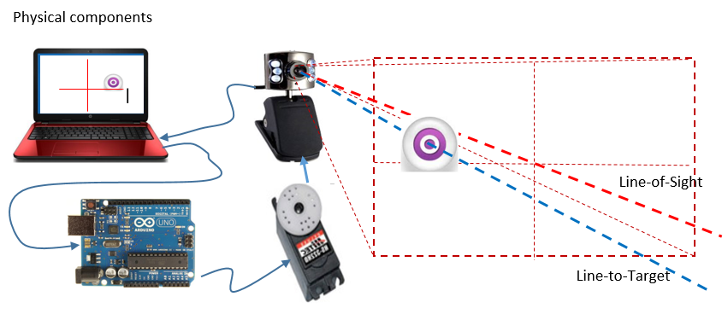
  Hardware
  Camera → PC → Serial → Arduino → Servomotor
  Software
  Matlab: Pick and track color → Control → Serial
  Arduino: Serial → Servo

Slide 6
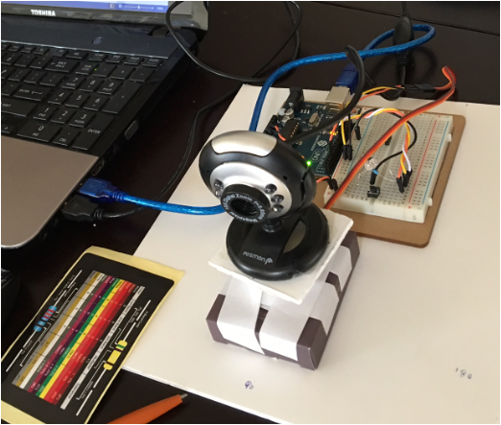
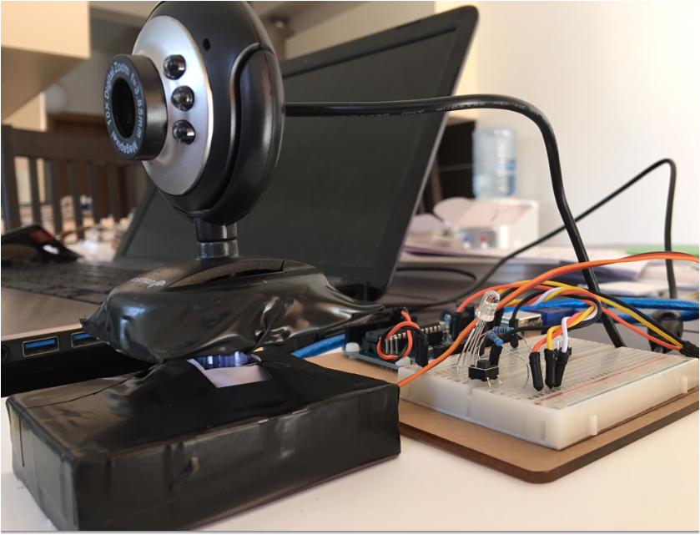

Slide 7
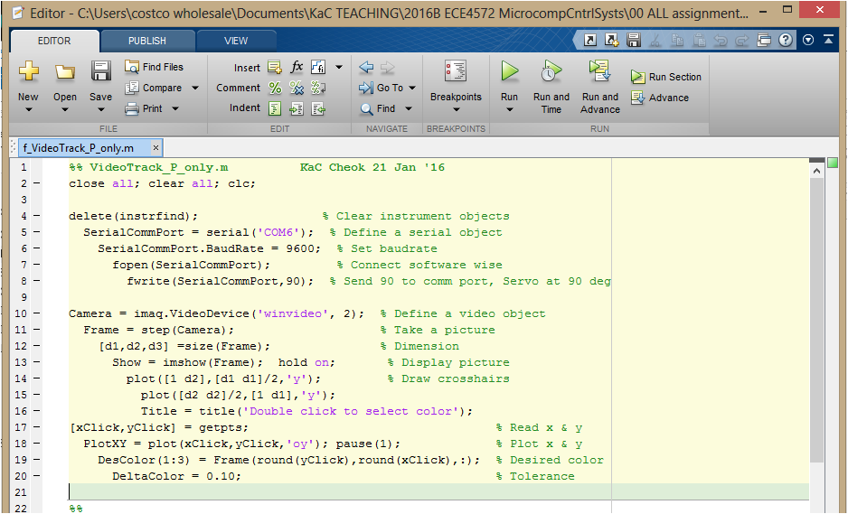
  Matlab Program
  Camera → PC → Acquisition → Processing → Control -- > Tx Serial

Slide 8
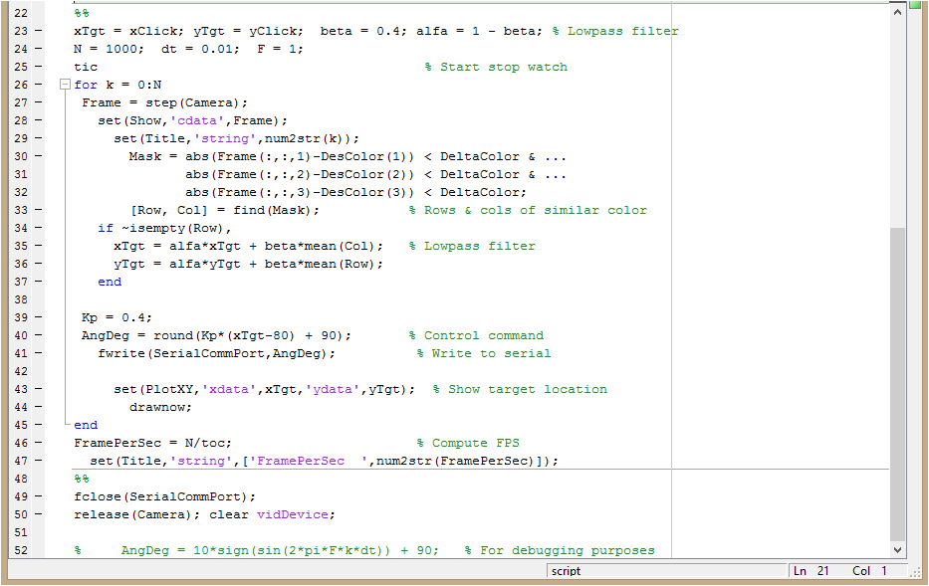

Slide 9
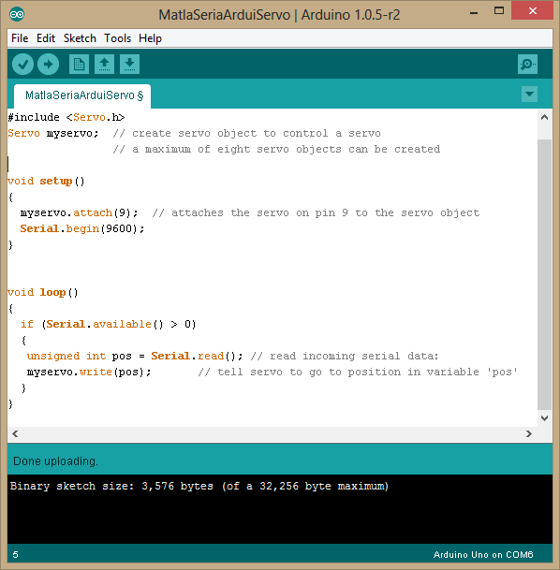
  Arduino Program
  Arduino: Rx Serial → Servo

Slide 10
  Live demo

