Slide 1
Mechatronics -
Hands-on Approach
Session 7
Prof Ka C Cheok
Electrical & Computer Engineering Dept
Oakland University, Rochester, MI, USA
Prof Arbnor Pajaziti
Mechanical Engineering
University of Prishtina, Prishtina, Kosovo

Slide 2
Scope of this Course
Tell me and I will forget;
show me and I will remember;
but involve me and I will understand.
Overview of Mechatronics
Microcontrollers – Intro to Arduino & hands-on assignments
Microcomputers & Microcontrollers – Matlab + Arduino combo
Feedback Control System – Simple closed-loop examples
Matlab Video Processing & Simulink Computer Vision – Examples & demos
Auto-Target Tracking Servo-System – Matlab + Arduino experiment
Modeling, Simulation & Visualization of Mechatronics - Matlab Simscape (time permitting)
Other Aspects of Mechatronics

Slide 3
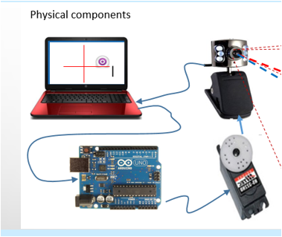
Today’s Goal
Matlab: Generates Signal → Serial USB
Arduino: Rx Serial USB → Moves Servomotor

Slide 4
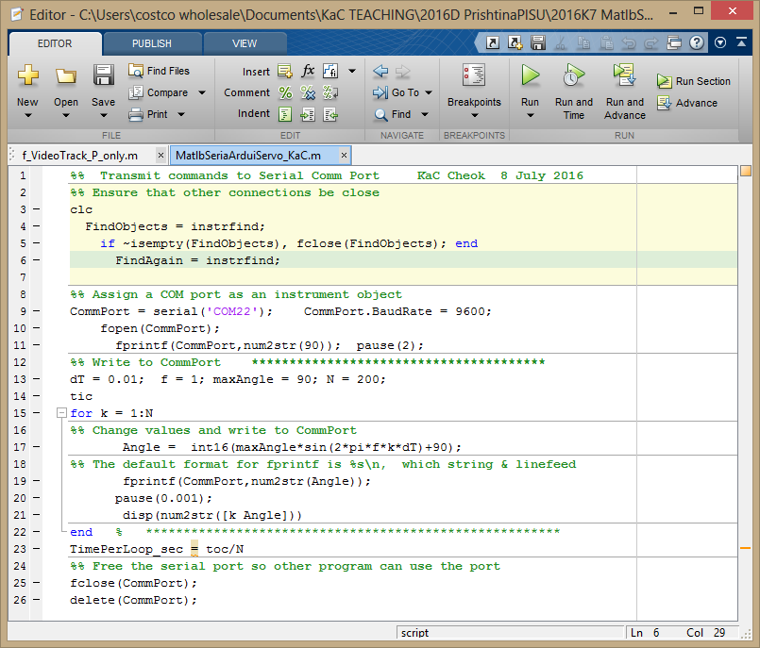
%% Transmit commands to Serial Comm Port KaC Cheok 8 July 2016
%% Ensure that other connections be close
clc
FindObjects = instrfind;
if ~isempty(FindObjects), fclose(FindObjects); end
FindAgain = instrfind;
%% Assign a COM port as an instrument object
CommPort = serial('COM22'); CommPort.BaudRate = 9600;
fopen(CommPort);
fprintf(CommPort,num2str(90)); pause(2);
%% Write to CommPort ***************************************
dT = 0.01; f = 1; maxAngle = 90; N = 200;
tic
for k = 1:N
%% Change values and write to CommPort
Angle = int16(maxAngle*sin(2*pi*f*k*dT)+90);
%% The default format for fprintf is %s\n, which string & linefeed
fprintf(CommPort,num2str(Angle));
pause(0.001);
disp(num2str([k Angle]))
end % *******************************************************
TimePerLoop_sec = toc/N
%% Free the serial port so other program can use the port
fclose(CommPort);
delete(CommPort);

Slide 5
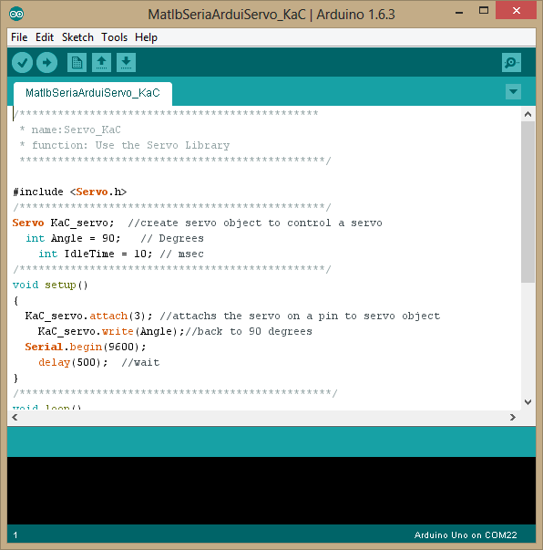
/***********************************************
* name:Servo_KaC
* function: Use the Servo Library
************************************************/
#include <Servo.h>
/************************************************/
Servo KaC_servo; //create servo object to control a servo
int Angle = 90; // Degrees
int IdleTime = 10; // msec
/************************************************/
void setup()
{
KaC_servo.attach(3); //attachs the servo on a pin to servo object
KaC_servo.write(Angle);//back to 90 degrees
Serial.begin(9600);
delay(500); //wait
}
/*************************************************/
void loop()
{
while (Serial.available() > 0)
{
Angle = Serial.parseInt(); // 1st valid integer
if (Serial.read() == '\n'); // Transmission is done
KaC_servo.write(Angle);//go the angle in degrees
delay(IdleTime); //wait
}
}
/**************************************************/

