Slide 1
Auto Target Tracking System Experiment
Insert your info.
Make this PPT more colorful, pleasing or attractive!
Course 8: Mechatronics – Hands-on Approach
Prishtina International Summer University
July 4 – 15, 2016
Engineering Faculty, U of Prishtina
Professor KaC Cheok, Oakland University, Rochester, MI, USA
Professor Arbnor Pajaziti, University of Prishtina, Prishtina, Kosovo
Student 1 Name , major of study, year, email address
Student 2 Name , major of study, year, email address
Student 2 Name , major of study, year, email address, if needed

Slide 2
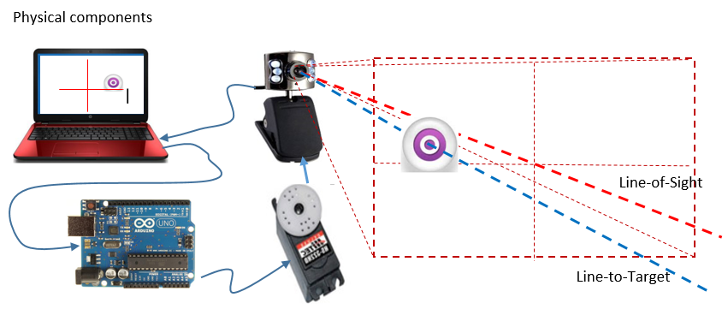
Introduction
Below is an example.
Change it and describe using your own words
In this project, we built and demonstrated a camera-based feedback control servo system that can track a specific colored object. The hardware consists of a USB camera mounted on a servomotor that is controlled by a laptop PC and an Arduino Uno board. A Matlab program finds a target color in the camera images and tells the Uno to drive the motor to track the target. The figure below shows the concept.

Slide 3
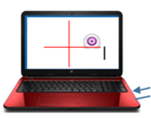
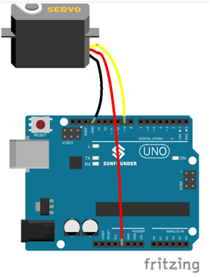
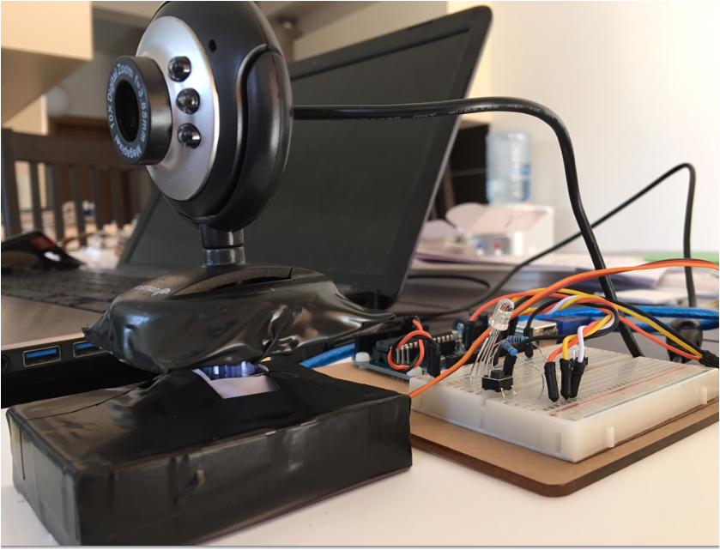
Hardware Setup
Show your own photos. Use Fritzing, if possible.
Describe in your own words what setup and connections you made, including USB.
Describe in your own words what setup and connections you made, including USB.
Show the additional bonus tasks if available

Slide 4
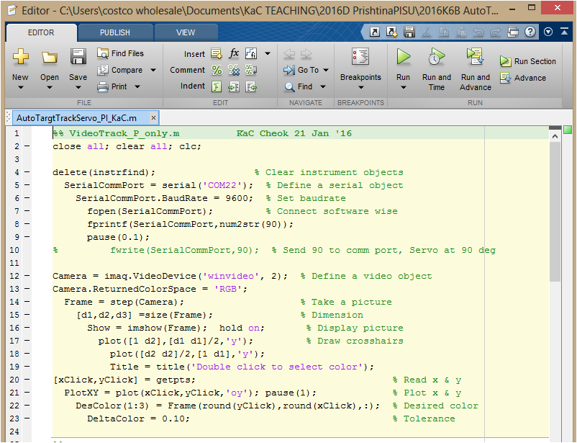
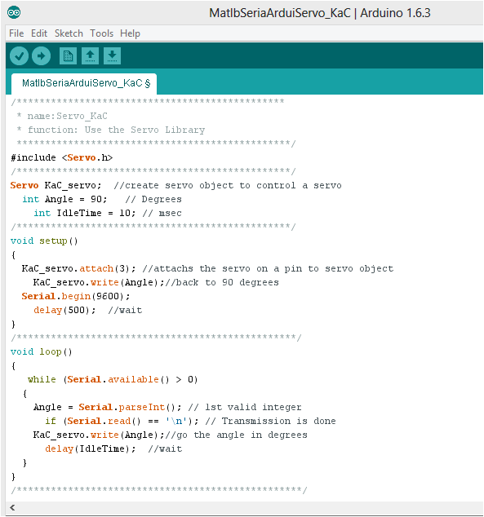
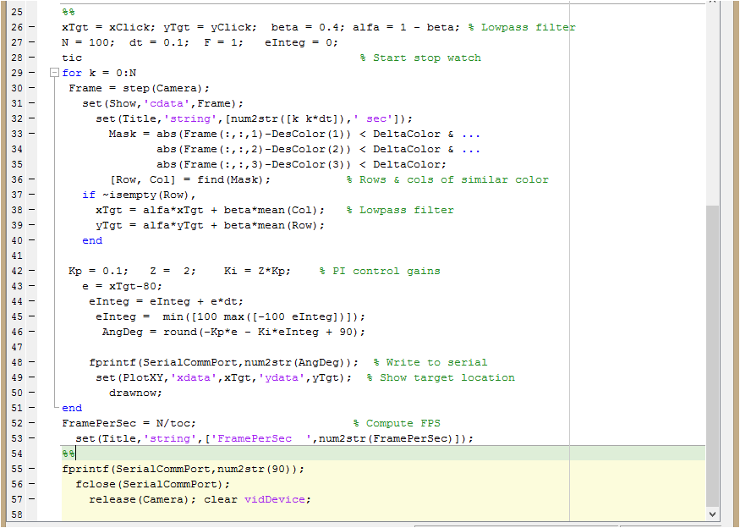
Software Setup
Describe in your own words what software you have to code/provide.
Show the additional bonus task if available

Slide 5
Arduino program
Provide the Arduino code (with your names) here
  Arduino Program
  Arduino: Rx Serial → Servo
Arduino code with your names.
Show the additional bonus task if available

Slide 6
Matlab program
Provide Matlab program with your names here
Matlab code with your names
Show the additional bonus task if available

Slide 7
Matlab program - continued

Slide 8
Experimental runs & results
Describe your experiments & results
Photo & description of your experiment & result (pick a color).
Show the bonus additional LED, if available.
Video (10 sec or so) of your experiment & result (same as the above color) ).
Show the bonus additional LED, if available.

Slide 9
Photo & description of your experiment & result (pick another color).
Show the bonus additional LED, if available.
Photo (10 sec or so) of your experiment & result (same as the above color).
Show the bonus additional LED, if available.

Slide 10
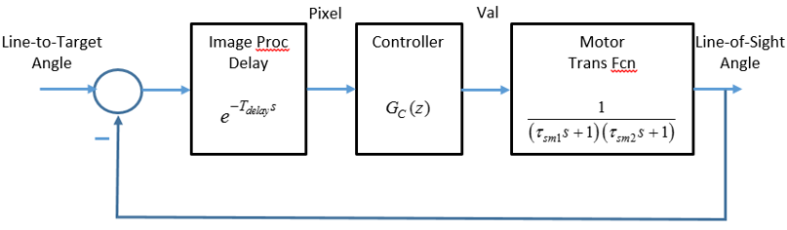
Mechatronics Scheme
Describe in your own words how you relate the experiment to the general scheme & function block. Your interpretation!
Hands-on Mechatronics Experiment
Mechatronics Component Scheme
Human Machine Interface
Environment
Interaction
Feedback Control Function Block
Output
Interface
&
Signal Conditioning
Power Electronics Converter & Actuators
Microcomputers
& Microcontrollers
(Hardware & Software)
Physical Plants
&
Processes
Input Interface
&
Signal Conditioning
Sensors

Slide 11
Survey of Learned Experience
How useful were the Arduino Uno kits and lessons? (Low) 1 2 3 4 5 (High)
How confident are you in using the Arduino Uno on your own? (Low) 1 2 3 4 5 (High)
How useful were the Matlab program for image acquisition & processing? (Low) 1 2 3 4 5 (High)
Do you understand how serial communications works from the lessons? (Low) 1 2 3 4 5 (High)
Do you understand the idea of a closed-loop control system work? (Low) 1 2 3 4 5 (High)
Do you feel like you have a hands-on introduction to a mechatronic system? (Low) 1 2 3 4 5 (High)
Other Learned Experience
Explain what else you learned in this course, if any.

