Slide 1
Mechatronics -
Hands-on Approach
Session 2
Prof Ka C Cheok
Electrical & Computer Engineering Dept
Oakland University, Rochester, MI, USA
Prof Arbnor Pajaziti
Mechanical Engineering
University of Prishtina, Prishtina, Kosovo

Slide 2
Scope of this Course
Tell me and I will forget;
show me and I will remember;
but involve me and I will understand.
Overview of Mechatronics
Microcontrollers – Intro to Arduino & hands-on assignments
Microcomputers & Microcontrollers – Matlab + Arduino combo
Feedback Control System – Simple closed-loop examples
Matlab Video Processing & Simulink Computer Vision – Examples & demos
Auto-Target Tracking Servo-System – Matlab + Arduino experiment
Modeling, Simulation & Visualization of Mechatronics - Matlab Simscape (time permitting)
Other Aspects of Mechatronics

Slide 3
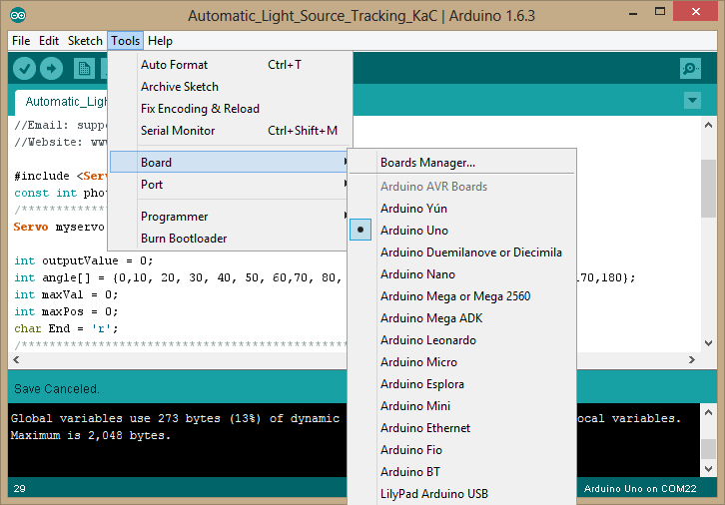
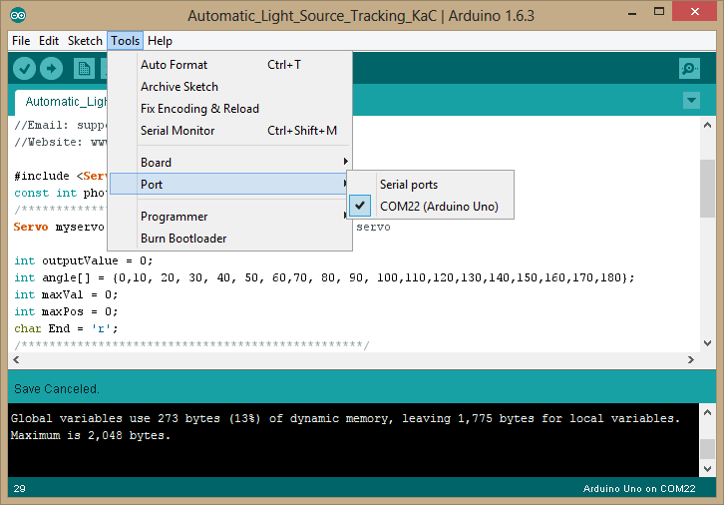
Important detail
The devil is in the detail!
Select the right Ardiono processor
Select the right Serial Port

Slide 4
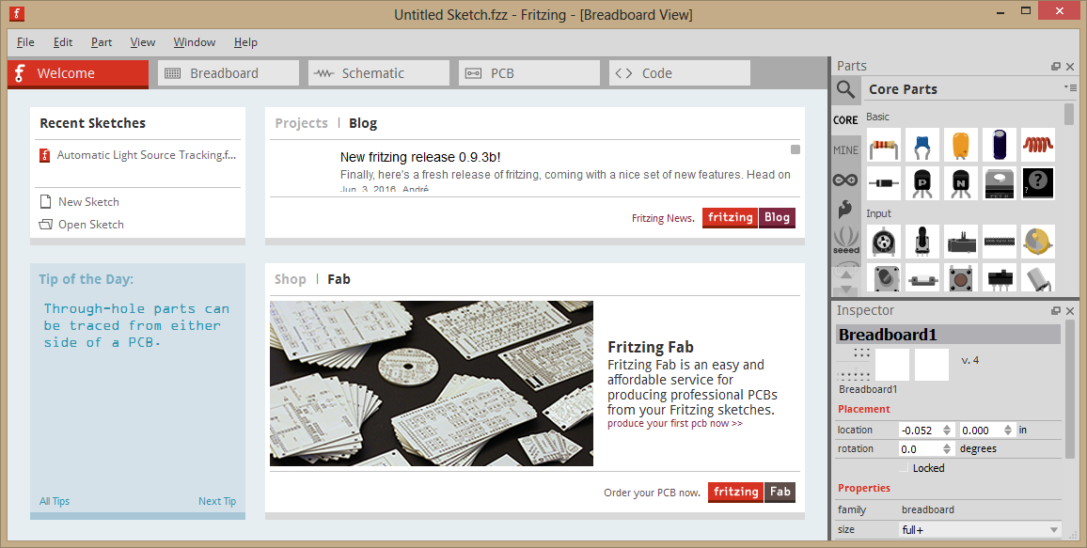
Introducing Fritzing
– tool for creating Arduino circuit connection images
Search, download 7 install Fritzing

Slide 5
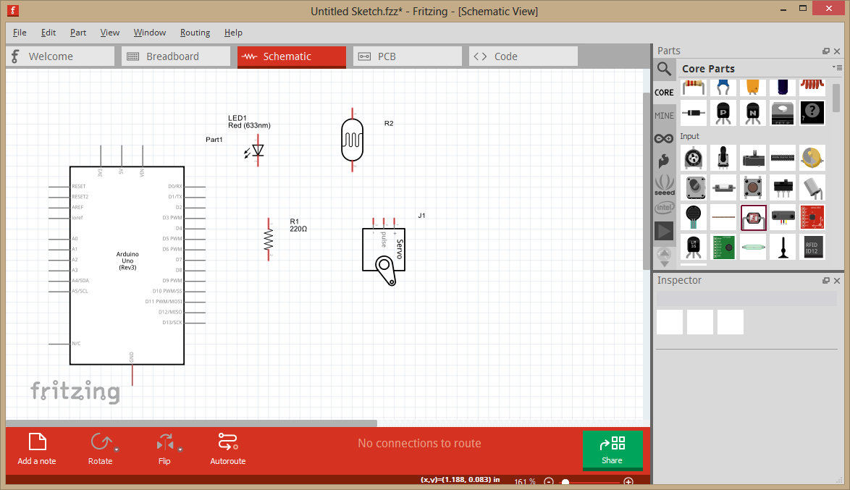
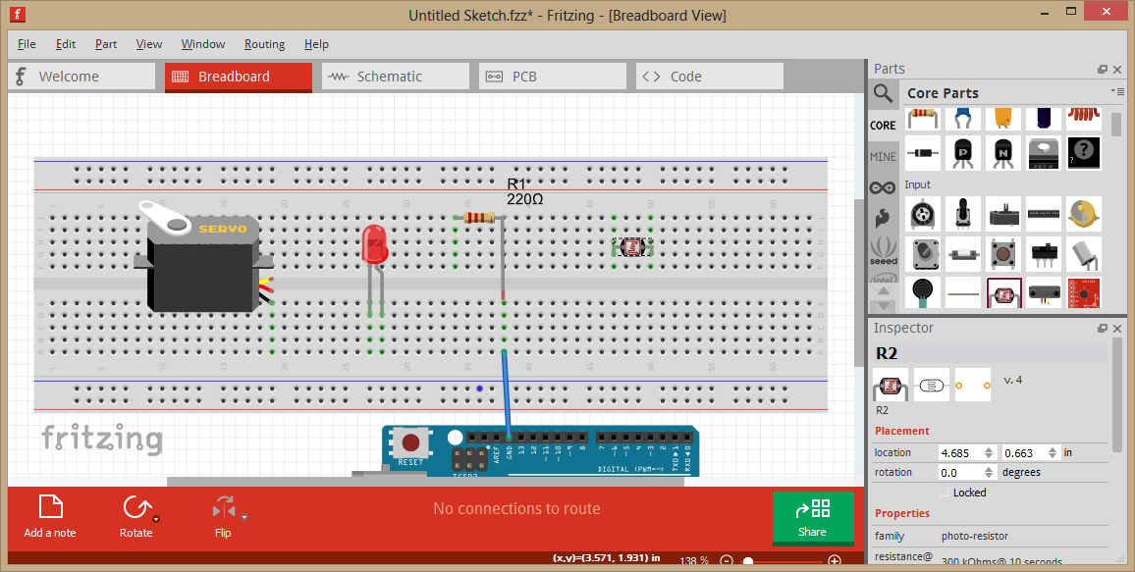

Slide 6
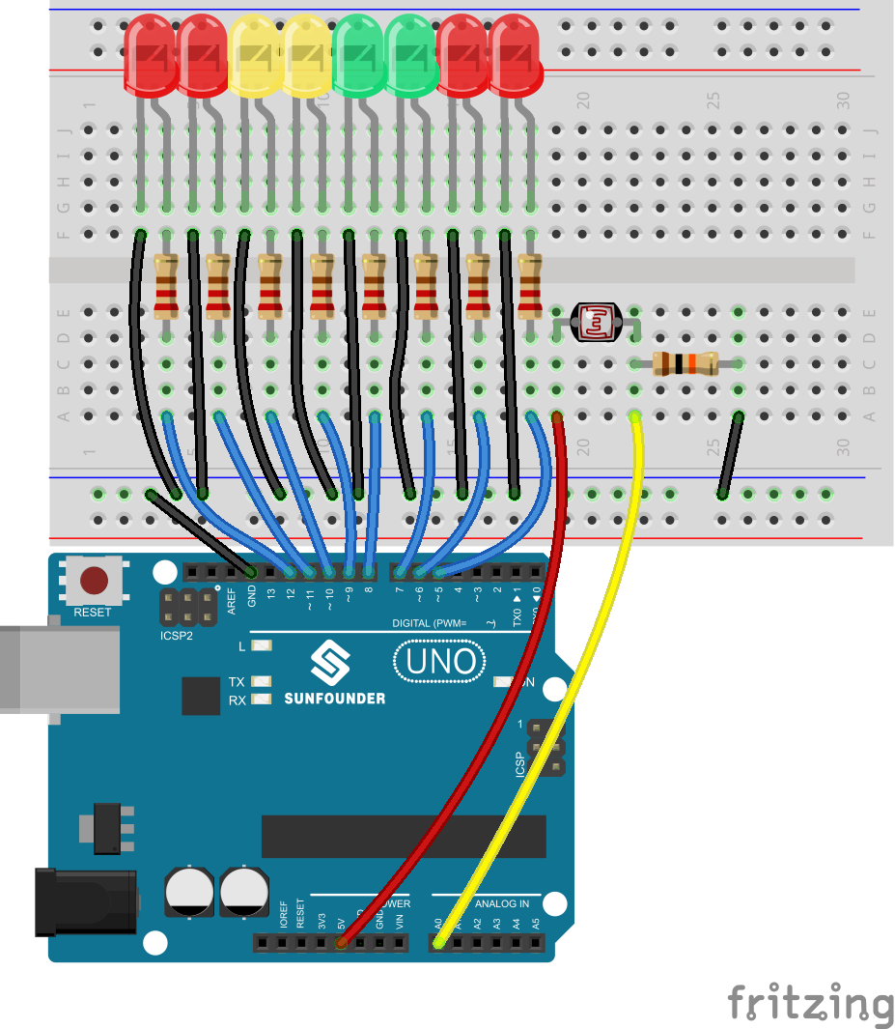
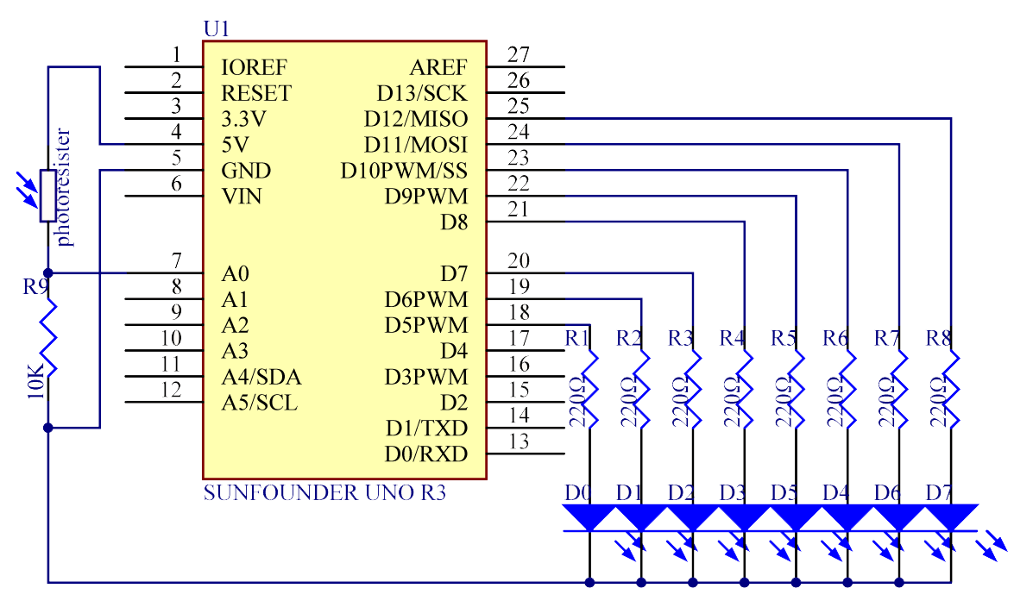
Lesson 5 Photoresistor … SunFounder Website
The resistance of the photoresistor changes with incident light intensity. If the incident light intensity is high, the resistance reduces; if low, increases.
In this experiment, we will use eight LEDs to indicate light intensity. The higher the light intensity is, the more the LED is lit. When the light intensity is high enough, all the LEDs will be lit. When there is no light, all the LEDs will go out.

Slide 7
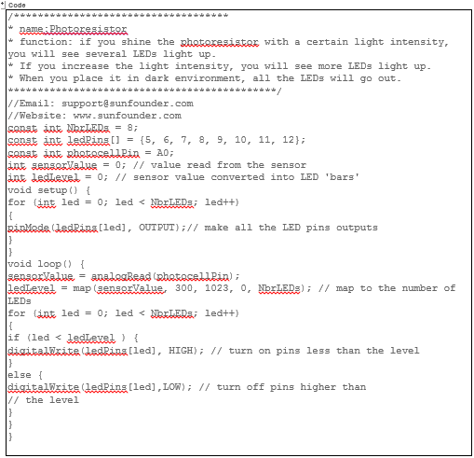
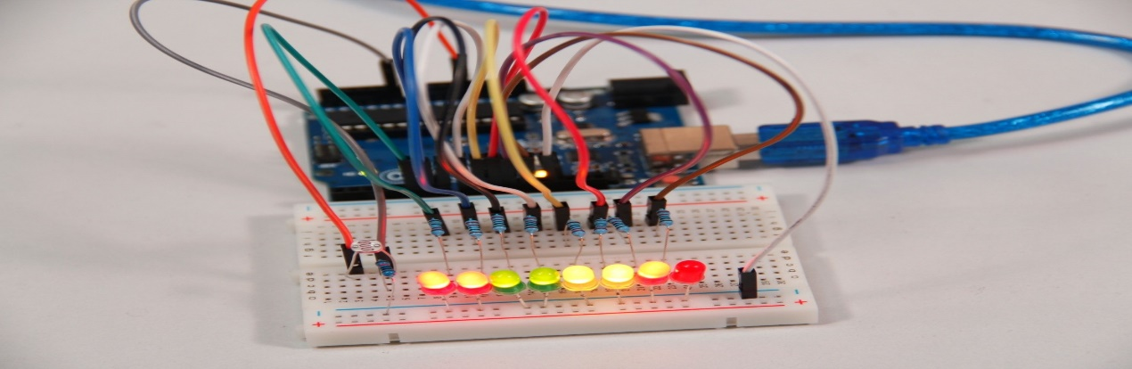
Lesson 5 Photoresistor …cont’d

Slide 8
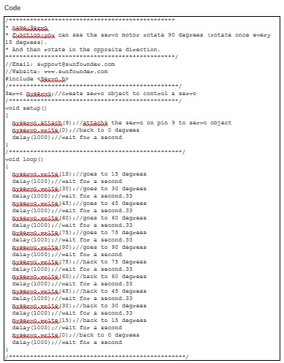
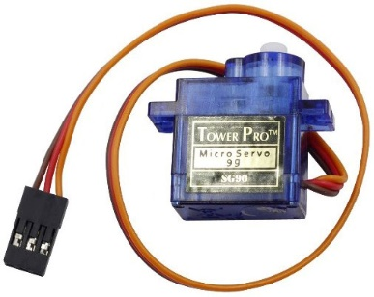
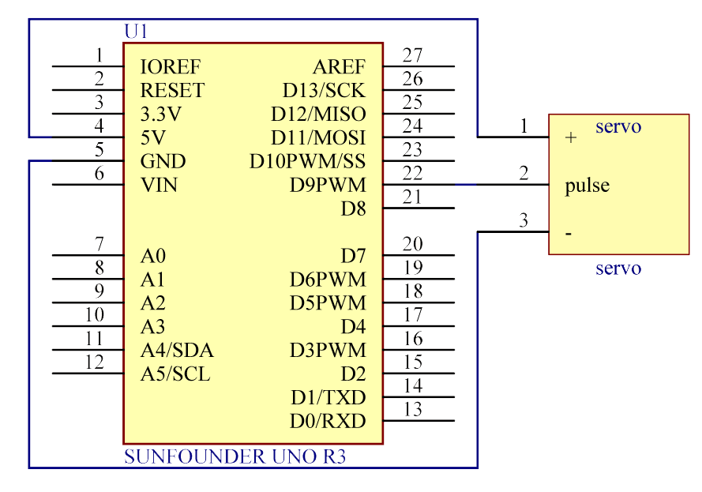
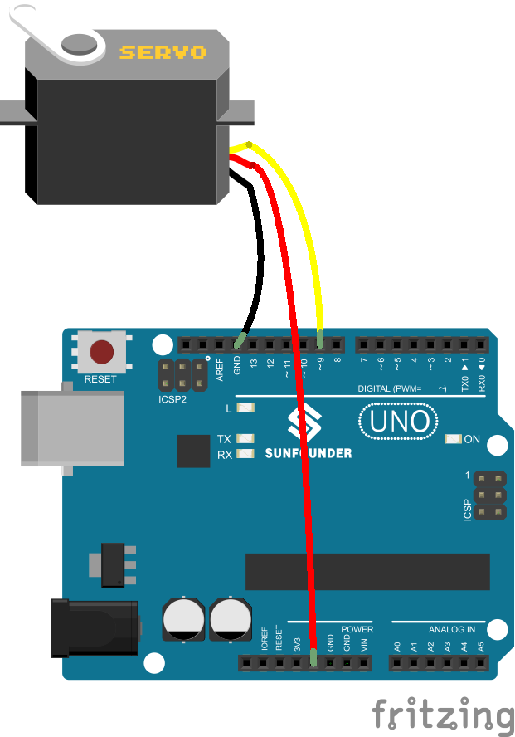
Lesson 7 Servo … SunFounder Website

Slide 9
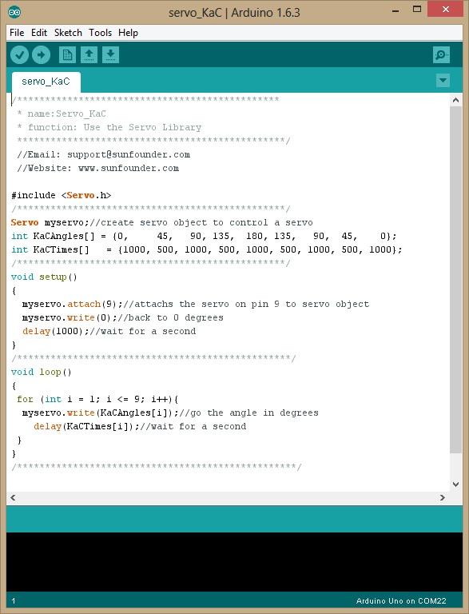
Lesson 7 Servo … add Arrays!
/***********************************************
* name:Servo_KaC
* function: Use the Servo Library
************************************************/
//Email: support@sunfounder.com
//Website: www.sunfounder.com
#include <Servo.h>
/************************************************/
Servo myservo;//create servo object to control a servo
int KaCAngles[] = {0, 45, 90, 135, 180, 135, 90, 45, 0};
int KaCTimes[] = {1000, 500, 1000, 500, 1000, 500, 1000, 500, 1000};
/************************************************/
void setup()
{
myservo.attach(9);//attachs the servo on pin 9 to servo object
myservo.write(0);//back to 0 degrees
delay(1000);//wait for a second
}
/*************************************************/
void loop()
{
for (int i = 1; i <= 9; i++){
myservo.write(KaCAngles[i]);//go the angle in degrees
delay(KaCTimes[i]);//wait for a second
}
}
/**************************************************/

Slide 10
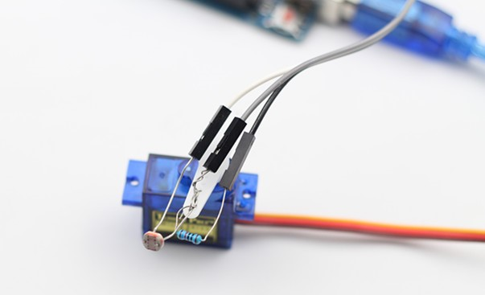
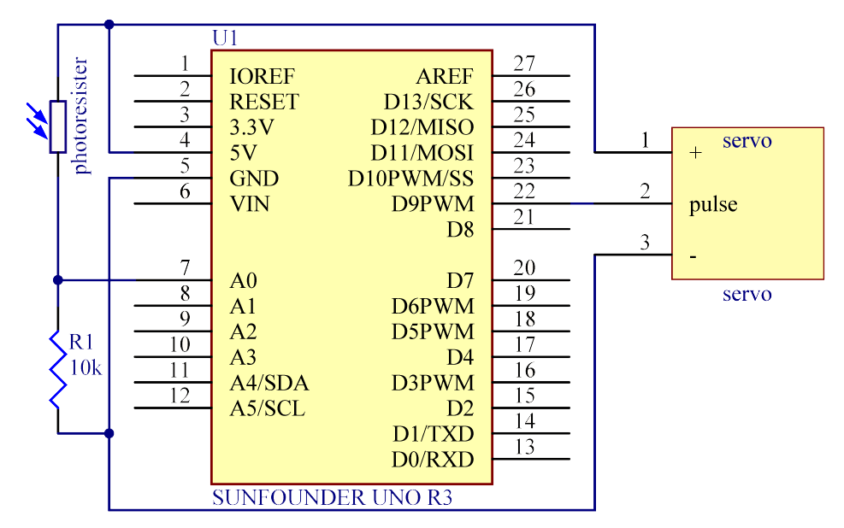
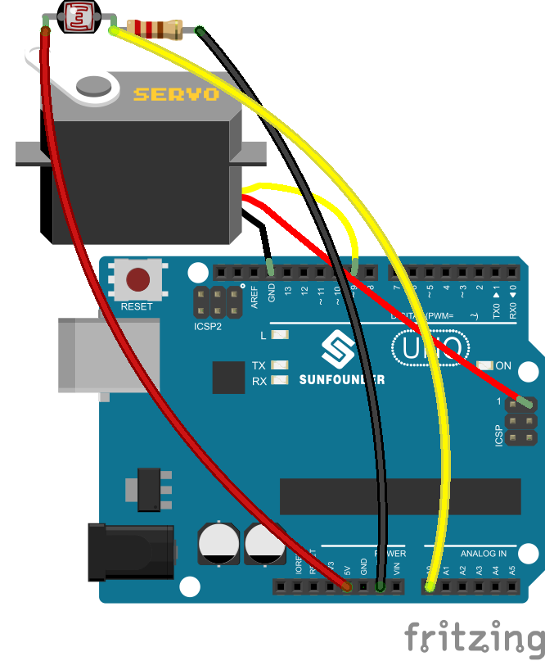
Lesson 11 Light Tracking … SunFounder Website
The servo motor and the photoresistor scan and look for light source in 180 degree and record the location of light source. After finishing scanning, the servo motor and the photoresistor stop at the direction of light source.

Slide 11
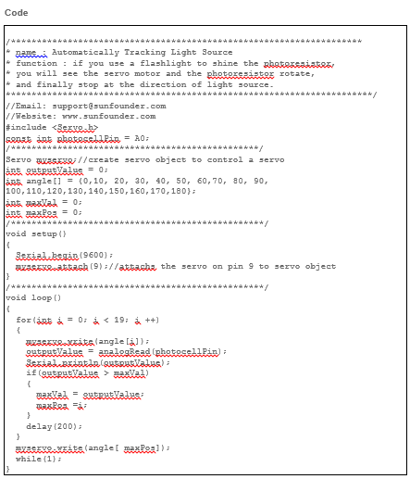
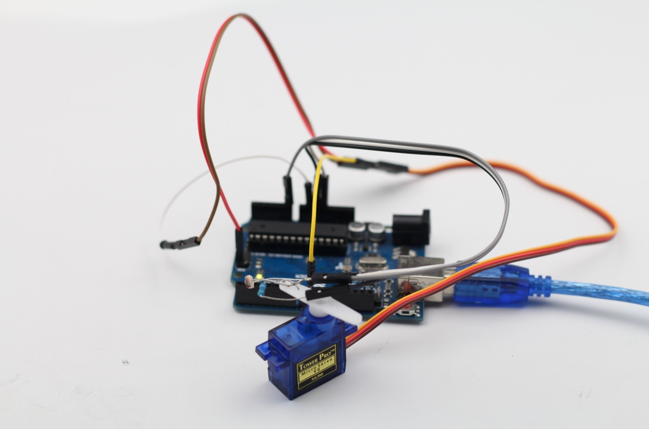
Lesson 11 Servo … contd

