Slide 1
Mechatronics -
Hands-on Approach
Session 7 Things Due for Project Wed 13 July 2016
Prof Ka C Cheok
Electrical & Computer Engineering Dept
Oakland University, Rochester, MI, USA
Prof Arbnor Pajaziti
Mechanical Engineering
University of Prishtina, Prishtina, Kosovo

Slide 2
Scope of this Course
Tell me and I will forget;
show me and I will remember;
but involve me and I will understand.
Overview of Mechatronics
Microcontrollers – Intro to Arduino & hands-on assignments
Microcomputers & Microcontrollers – Matlab + Arduino combo
Feedback Control System – Simple closed-loop examples
Matlab Video Processing & Simulink Computer Vision – Examples & demos
Auto-Target Tracking Servo-System – Matlab + Arduino experiment
Modeling, Simulation & Visualization of Mechatronics - Matlab Simscape (time permitting)
Other Aspects of Mechatronics

Slide 3
BONUS: Additional Thing For Project
Auto-Target Tracking using Matlab
  Control concept, scheme
  Hardware, software components
  Servomotor + Camera mount
  Matlab: Image acquisition
  Image processing
  Feedback control
  If error is small (within 10 pixels), send a signal to turn on Green LED
  (target acquired & locked)! If not, turn on Red LED (target not yet acquired).
  Serial communication
  Arduino: Serial communication
  Turn on Green or Red LED depending on what is received.
  Servomotor
  Note: You can use the Color LED or individual Red & Green LEDs.
  Project ~= 80% grade. Project + Bonus ~= 100% grade

Slide 4
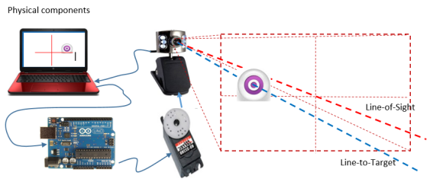
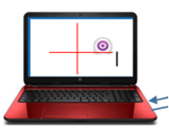
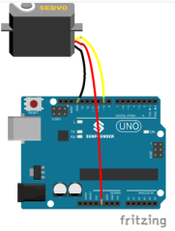
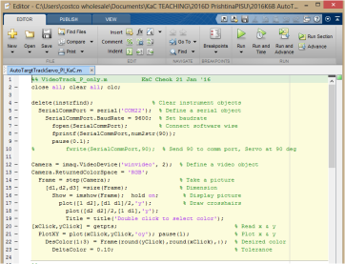
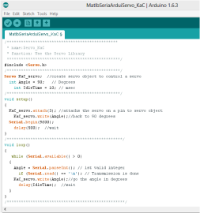
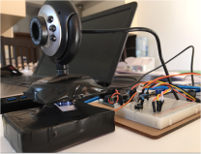
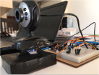
FORMAT OF PRESENTATION & REPORT
Pertinent information
Describe concisely the project.
Auto Target Tracking System Experiment
Course 8: Mechatronics – Hands-on Approach
Prishtina International Summer University
July 4 – 15, 2016
Professor KaC Cheok, Oakland University, Rochester, MI, USA
Professor Arbnor Pajaziti, University of Prishtina, Prishtina, Kosovo
Student 1 Name , major of study, year, email address
Student 2 Name , major of study, year, email address
Summary
In this project, we built and demonstrated a camera-based feedback control servo system that can track a specific colored object. The hardware consists of a USB camera mounted on a servomotor that is controlled by a laptop PC and an Arduino Uno board. A Matlab program finds a target color in the camera images and tells the Uno to drive the motor to track the target.
Examples only.
Use your own words.:
Pictures and description of your hardware setup
Pictures and description of your software setup: Matlab & Sketch
Hardware Setup
Software Setup
Describe in your own words what setup and connections you made, including USB.
Show the additional bonus tasks if available
Show the additional bonus tasks if available

Slide 5


Arduino code with your names.
Show the additional bonus task if available
Matlab code with your names
  Arduino Program
  Arduino: Rx Serial → Servo
Show the additional bonus task if available
  Matlab Program
  Camera → PC → Acquisition → Processing → Control -- > Tx Serial
Photos of your experiment & results
Video of your experiment & results
Experimental runs & results
Photos (2 pics)
Show photo highlights of various colors being tracked.
Report on bonus additional requirement, if available!
Videos (10 secs)
Show video highlight of various colors being tracked.
Show the bonus additional requirement, if available!

Slide 6

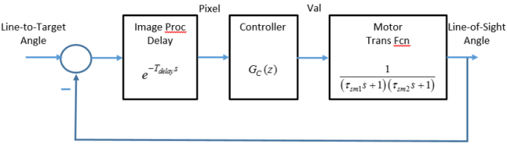
Explain your understanding
Explain what you learned in this course
Feedback Control Scheme
Survey of Learned Experience
…
…
…
…
Survey of Learned Experience
Describe in your own words how the control system you had built work
Describe in your own words what you learned the past two weeks.

