Slide 1
Mechatronics -
Hands-on Approach
Session 4
Prof Ka C Cheok
Electrical & Computer Engineering Dept
Oakland University, Rochester, MI, USA
Prof Arbnor Pajaziti
Mechanical Engineering
University of Prishtina, Prishtina, Kosovo

Slide 2
Scope of this Course
Tell me and I will forget;
show me and I will remember;
but involve me and I will understand.
Overview of Mechatronics
Microcontrollers – Intro to Arduino & hands-on assignments
Microcomputers & Microcontrollers – Matlab + Arduino combo
Feedback Control System – Simple closed-loop examples
Matlab Video Processing & Simulink Computer Vision – Examples & demos
Auto-Target Tracking Servo-System – Matlab + Arduino experiment
Modeling, Simulation & Visualization of Mechatronics - Matlab Simscape (time permitting)
Other Aspects of Mechatronics

Slide 3
Today’s Goal
A) Lesson 6 Color LED… to complete SunFounder version
  Explanation of principle, hardware, software
B) Matlab to Arduino via Serial Comm
  Arduino Rx (receive) serial communication program
  Matlab Tx (transmit) serial communication program
C) Matlab to/from Arduino Communication
  Matlab to Arduino to Matlab?

Slide 4
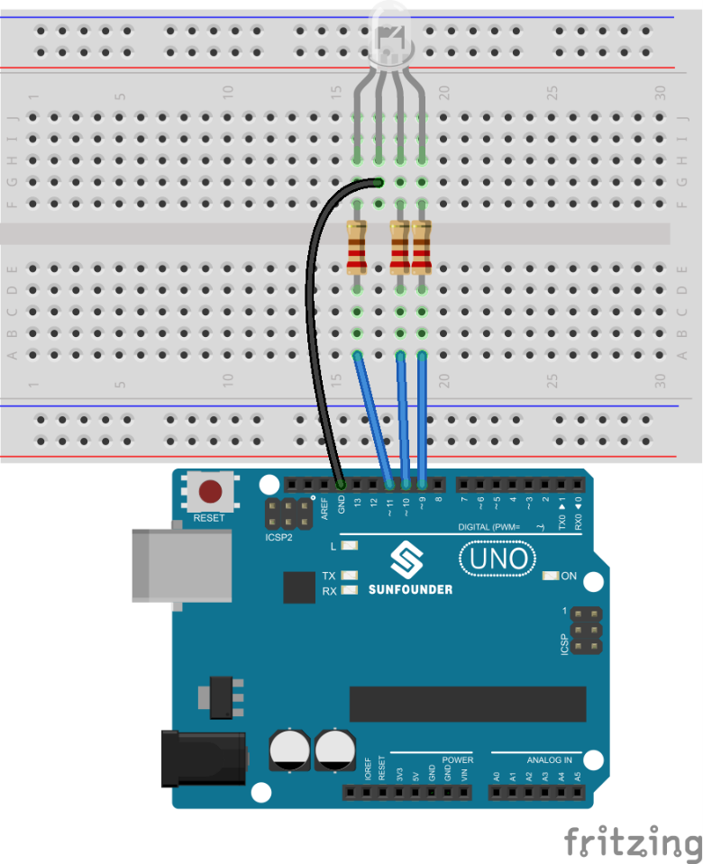
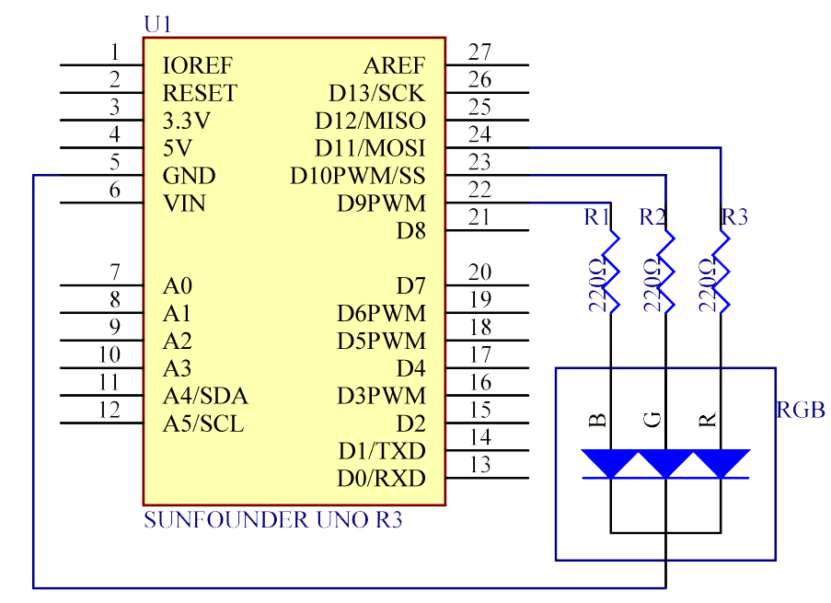
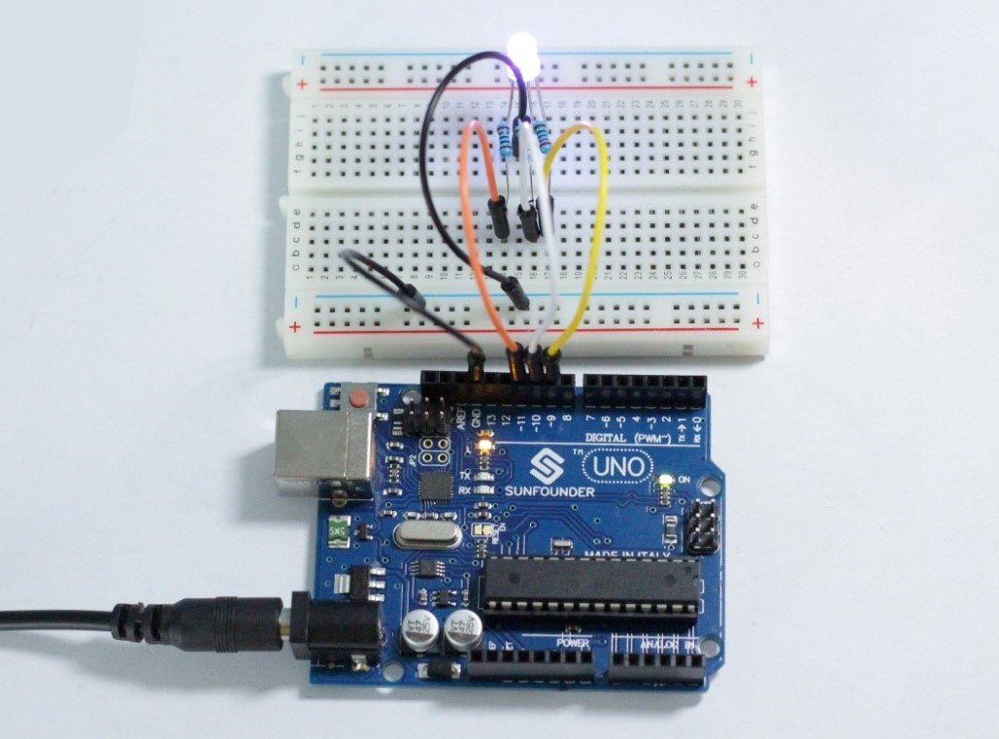
A) Lesson 6 Color LED… complete SunFounder version
In this lesson, you will use PWM to control an RGB LED and cause it to display all kinds of colors.

Slide 5
Lesson 6 Color LED … contd
/***************************************************************************/
void loop() // run over and over again
{
// Basic colors:
color(255, 0, 0); // turn the RGB LED red
delay(1000); // delay for 1 second
color(0,255, 0); // turn the RGB LED green
delay(1000); // delay for 1 second
color(0, 0, 255); // turn the RGB LED blue
delay(1000); // delay for 1 second
// Example blended colors:
color(255,0,252); // turn the RGB LED red
delay(1000); // delay for 1 second
color(237,109,0); // turn the RGB LED orange
delay(1000); // delay for 1 second
color(255,215,0); // turn the RGB LED yellow
delay(1000); // delay for 1 second
color(34,139,34); // turn the RGB LED green
delay(1000); // delay for 1 second
color(0,112,255); // turn the RGB LED blue
delay(1000); // delay for 1 second
color(0,46,90); // turn the RGB LED indigo
delay(1000); // delay for 1 second
color(128,0,128); // turn the RGB LED purple
delay(1000); // delay for 1 second
}
/******************************************************/
void color (unsigned char red, unsigned char green, unsigned char blue) // the color generating function
{
analogWrite(redPin, red);
analogWrite(greenPin, green);
analogWrite(bluePin, blue);
}
/******************************************************/
//RGB LED
//The RGB LED will appear red, green, and blue first, then red, orange, yellow, green, blue, indigo, and purple.
//Email:support@sunfounder.com
//Website:www.sunfounder.com
//2015.5.7
/*************************************************************************/
const int redPin = 11; // R petal on RGB LED module connected to digital pin 11
const int greenPin = 10; // G petal on RGB LED module connected to digital pin 9
const int bluePin = 9; // B petal on RGB LED module connected to digital pin 10
/**************************************************************************/
void setup()
{
pinMode(redPin, OUTPUT); // sets the redPin to be an output
pinMode(greenPin, OUTPUT); // sets the greenPin to be an output
pinMode(bluePin, OUTPUT); // sets the bluePin to be an output
}

Slide 6
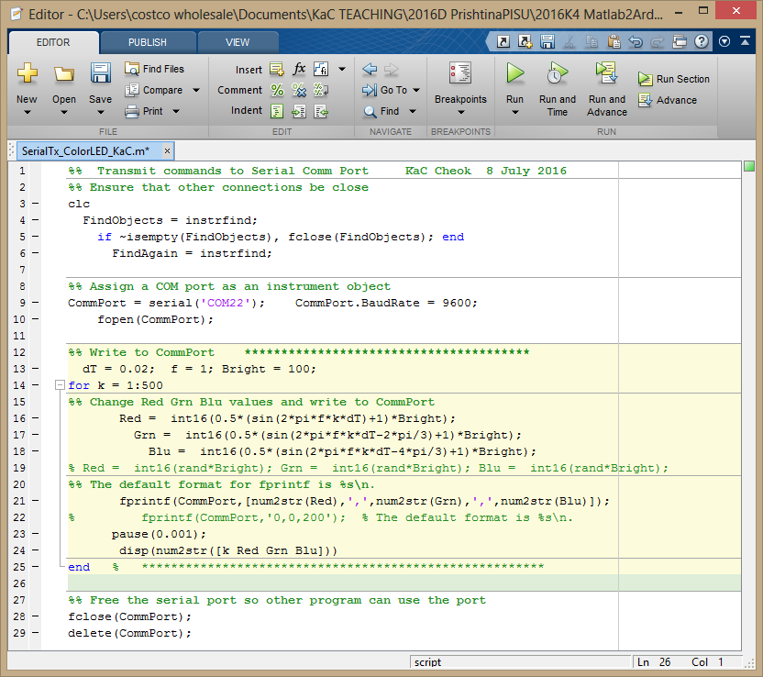
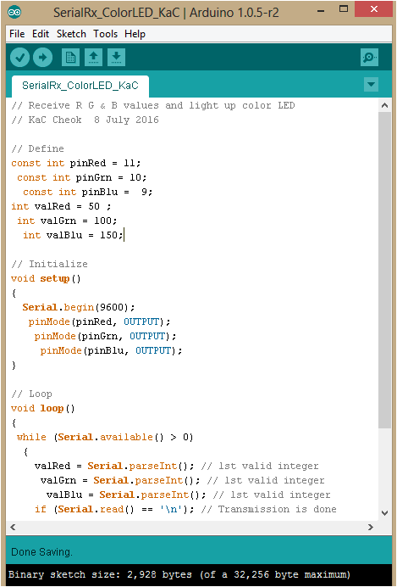

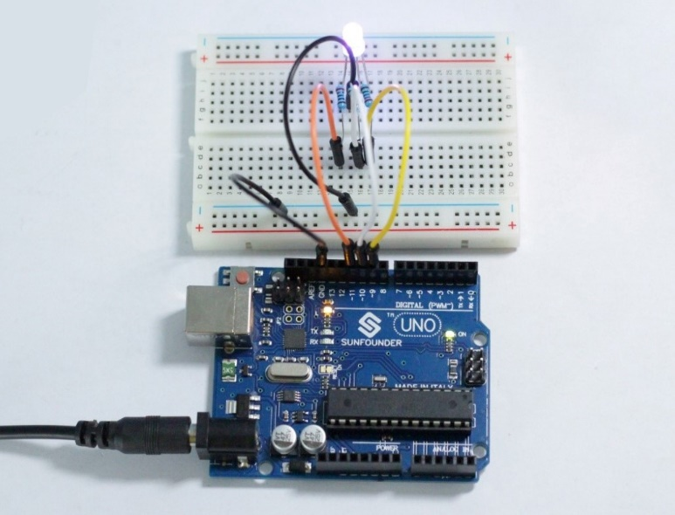
B) Matlab to Arduino via Serial Comm
USB

Slide 7
  Serial Rx communication program – Arduino side
// Loop
void loop()
{
while (Serial.available() > 0)
{
valRed = Serial.parseInt(); // 1st valid integer
valGrn = Serial.parseInt(); // 1st valid integer
valBlu = Serial.parseInt(); // 1st valid integer
if (Serial.read() == '\n'); // Transmission is done
{
analogWrite(pinRed, valRed);
analogWrite(pinGrn, valGrn);
analogWrite(pinBlu, valBlu);
}
}
}
// Receive R G & B values and light up color LED
// SerialRx_ColorLED_KaC.ino KaC Cheok 8 July 2016
// Define
const int pinRed = 11;
const int pinGrn = 10;
const int pinBlu = 9;
int valRed = 50 ;
int valGrn = 100;
int valBlu = 150;
// Initialize
void setup()
{
Serial.begin(9600);
pinMode(pinRed, OUTPUT);
pinMode(pinGrn, OUTPUT);
pinMode(pinBlu, OUTPUT);
}

Slide 8
  Serial Tx communication program – Matlab side
%% Transmit commands to Serial Comm Port KaC Cheok 8 July 2016
%% Ensure that other connections be close
clc
FindObjects = instrfind;
if ~isempty(FindObjects), fclose(FindObjects); end
FindAgain = instrfind;
%% Assign a COM port as an instrument object
CommPort = serial('COM22'); CommPort.BaudRate = 9600;
fopen(CommPort);
%% Write to CommPort ***************************************
dT = 0.02; f = 1; Bright = 100;
for k = 1:500
%% Change Red Grn Blu values and write to CommPort
Red = int16(0.5*(sin(2*pi*f*k*dT)+1)*Bright);
Grn = int16(0.5*(sin(2*pi*f*k*dT-2*pi/3)+1)*Bright);
Blu = int16(0.5*(sin(2*pi*f*k*dT-4*pi/3)+1)*Bright);
% Red = int16(rand*Bright); Grn = int16(rand*Bright); Blu = int16(rand*Bright);
%% The default format for fprintf is %s\n.
fprintf(CommPort,[num2str(Red),',',num2str(Grn),',',num2str(Blu)]);
% fprintf(CommPort,'0,0,200'); % The default format is %s\n.
pause(0.001);
disp(num2str([k Red Grn Blu]))
end % *******************************************************
%% Free the serial port so other program can use the port
fclose(CommPort);
delete(CommPort);

Slide 9
C) Matlab-Arduino-Matlab Serial Comm
Your task is to figure and test how to perform a w two-way communication!

